Slide 1
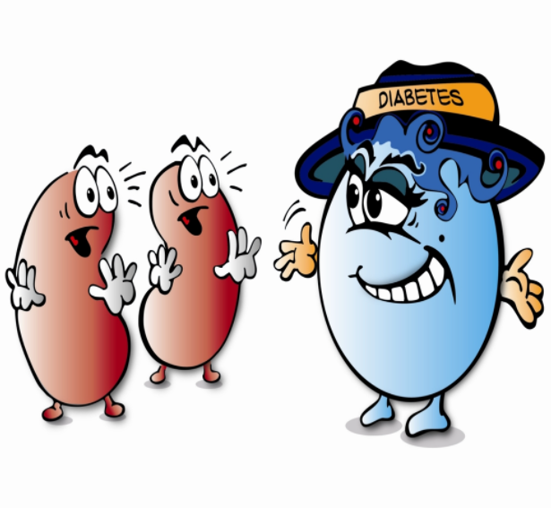
Diabetes prediction
Using Machine Learning
-Python
-Support Vector Machine

Slide 2
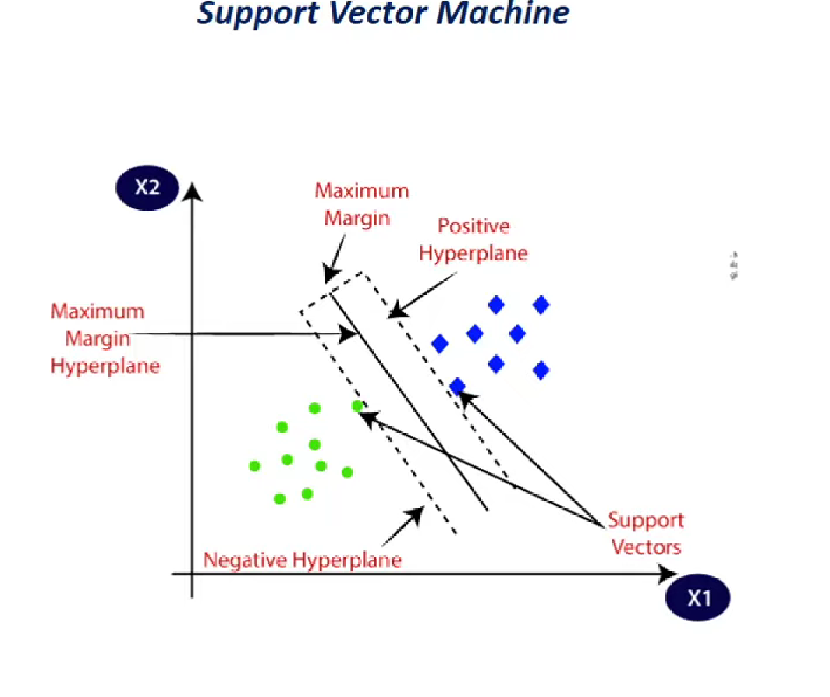

Slide 3
