Slide 1
Algorithms for Assignment and Transportation problem
Team 12
Akshith N M | 181IT104 | 8217618871
Akashdeep S | 181IT203 | 9591884616
Sujan Reddy | 181IT147 | 6362575844
Harshvardhan R | 181IT217 | 9741691395

Slide 2
Assignment Problem Example
You are a sales manager and your salespeople are in Jaipur, Pune and Bangalore, and you want them to fly to three other cities: Delhi, Mumbai and Chennai. The table below shows the cost of airline tickets in INR between the cities: We have to find the minimal cost of assignment
From/to | Delhi | Chennai | Mumbai
Jaipur | 2500 | 4000 | 3500
Pune | 4000 | 6000 | 3500
Bangalore | 2000 | 4000 | 2500

Slide 3
Assignment Problem Example
The following assignment has the minimum cost = 9500 INR
From/to | Delhi | Chennai | Mumbai
Jaipur | 2500 | 4000 | 3500
Pune | 4000 | 6000 | 3500
Bangalore | 2000 | 4000 | 2500

Slide 4
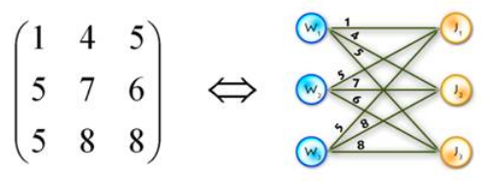
Assignment Problem
Assignment problem is to find the maximum-weight matchings also called perfect matching in bipartite graphs.
Total number of perfect matchings = n!

Slide 5
Problem definition
Input - A n x n matrix representing the costs
Output - A perfect matching such that the costs are minimized
The Hungarian matching algorithm, also called the Kuhn-Munkres algorithm, is a O(n^3) algorithm that can be used to solve this problem

Slide 6
The Hungarian Method
Subtract the smallest entry in each row from all the other entries in the row. This will make the smallest entry in the row now equal to 0.
Subtract the smallest entry in each column from all the other entries in the column. This will make the smallest entry in the column now equal to 0.
Draw lines through the row and columns that have the 0 entries such that the fewest lines possible are drawn.
If there are n lines drawn, an optimal assignment of zeros is possible and the algorithm is finished. If the number of lines is less than n, then the optimal number of zeroes is not yet reached. Go to the next step.
Find the smallest entry not covered by any line. Subtract this entry from each row that isn’t crossed out, and then add it to each column that is crossed out. Then, go back to Step 3.

Slide 7
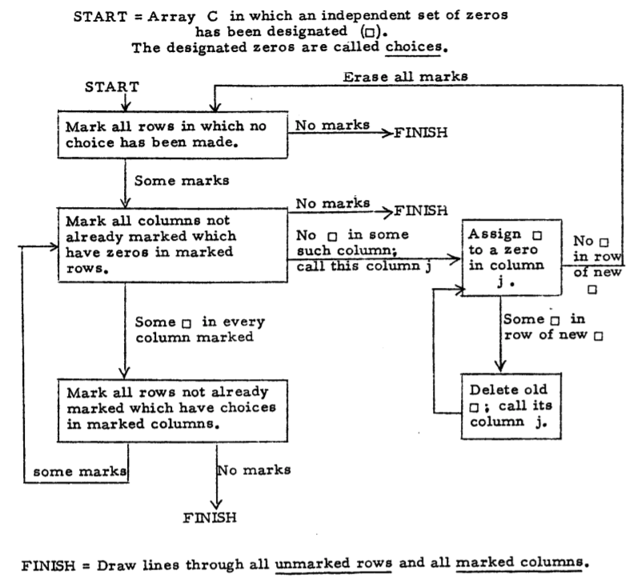
Hungarian Sub-algorithm

Slide 8
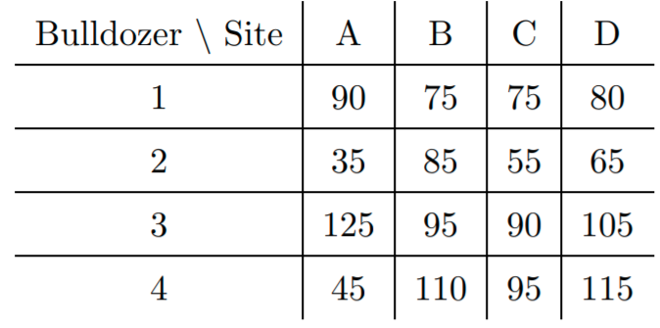
Hungarian Algorithm Example
Cost matrix -

Slide 9
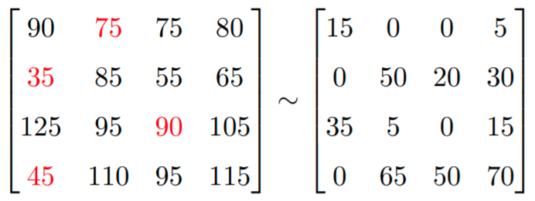
Step 1 - Subtract 75 from Row 1, 35 from Row 2, 90 from Row 3, and 45 from Row 4.

Slide 10
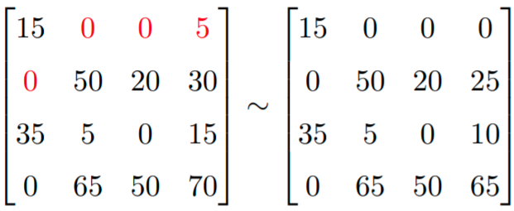
Step 2. Subtract 0 from Column 1, 0 from Column 2, 0 19 from Column 3, and 5 from Column 4.

Slide 11
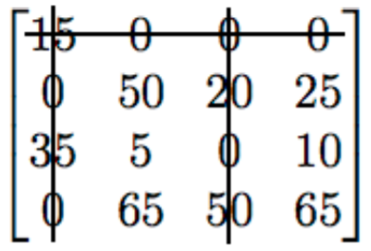
Step 3. Cover all the zeros of the matrix with the minimum number of horizontal or vertical lines.
Step 4. Since the minimal number of lines is less than 4, we have to proceed to Step 5

Slide 12
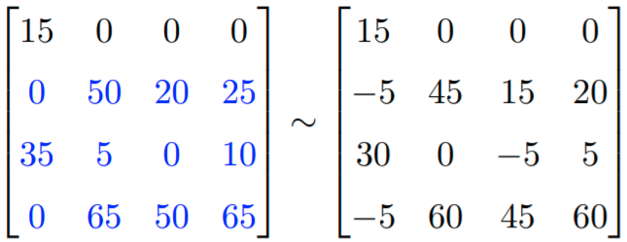
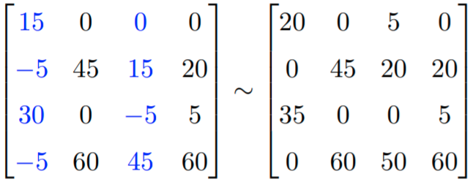
Step 5. Note that 5 is the smallest entry not covered by any line. Subtract 5 from each uncovered row.
Now add 5 to each covered column

Slide 13
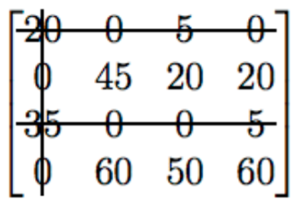
Step 3. Cover all the zeros of the matrix with the minimum number of horizontal or vertical lines.
Step 4. Since the minimal number of lines is less than 4, we have to return to Step 5.

Slide 14
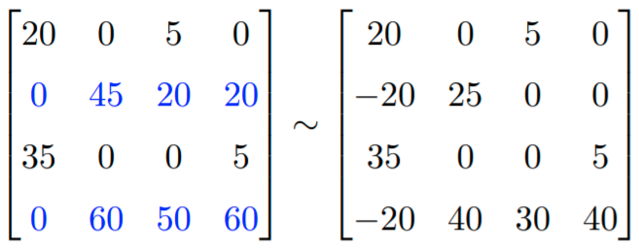
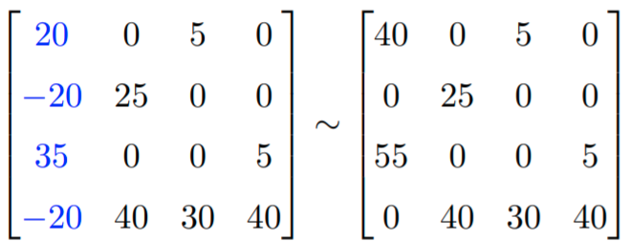
Step 5. Note that 20 is the smallest entry not covered by a line. Subtract 20 from each uncovered row.
Then add 20 to each covered column.

Slide 15
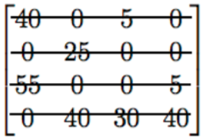
Step 3. Cover all the zeros of the matrix with the minimum number of horizontal or vertical lines.
Step 4. Since the minimal number of lines is 4, an optimal assignment of zeros is possible and we are finished.

Slide 16
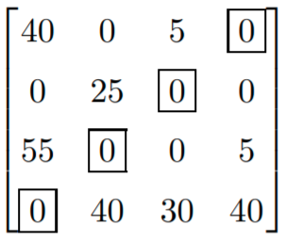
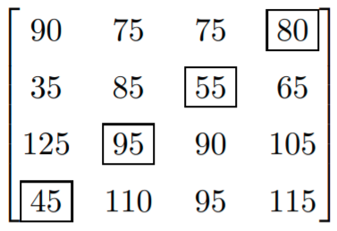
The final cost = 275

Slide 17

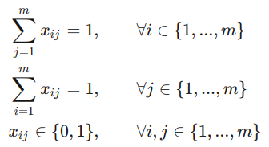
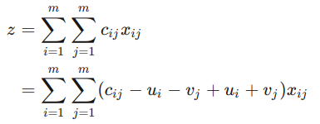




Correctness
Mathematical formulation of assignment problem -
where

Slide 18

Correctness
min
The dual solution is always feasible.
The algorithm reaches an ending - the dual problem is bounded, and so the dual solution value can’t increase forever and the algorithm must terminate

Slide 19
Complexity Analysis
Step 1 - O(n^2)
Step 2 - O(n^2)
Step 3 - O(n^2)
Step 4 and 5 - In the worst case just 1 line can be used to cover all zeroes and this can continue n times which results in the repeating steps 1, 2 and 3 n times.
Hence the overall running time in the worst case is O(n^3)
Space required is O(n^2)

Slide 20
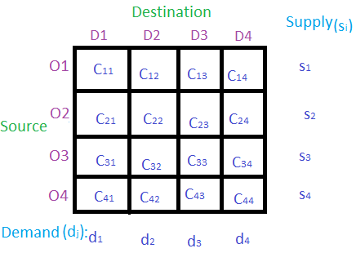
Transportation Problem Example

Slide 21
Vogel Approximation Algorithms
It is an O(n^2.logn) solution to the transportation problem. It gives only a near-optimal solution. It uses the concepts of penalty- cost to identify which cell has to be assigned first.

Slide 22
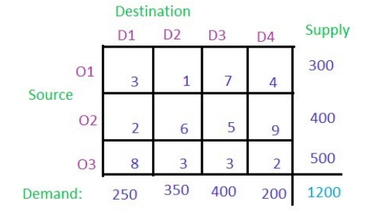

Slide 23
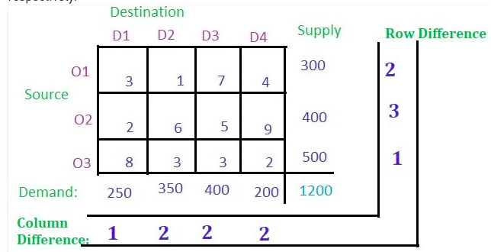
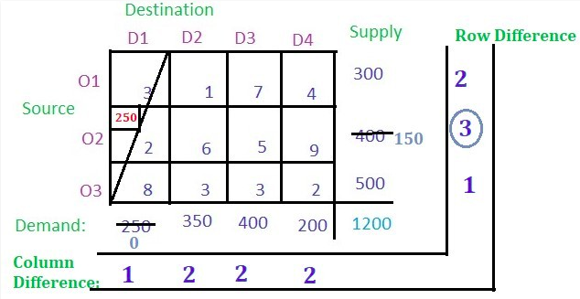
The row and column penalties are calculated.
Choose the cell with the least cost in the row or column with maximum penalty.
Allocate as demand/supply as possible in this cell and ignore the row or column which is left with a supply/demand of 0.

Slide 24
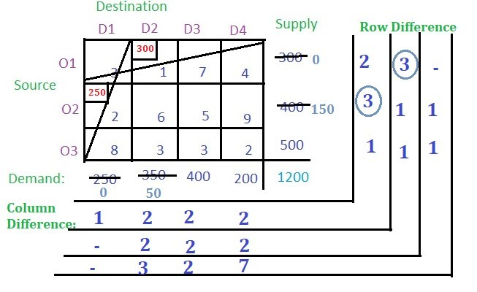
Continue the above steps till a single cell is left.

Slide 25
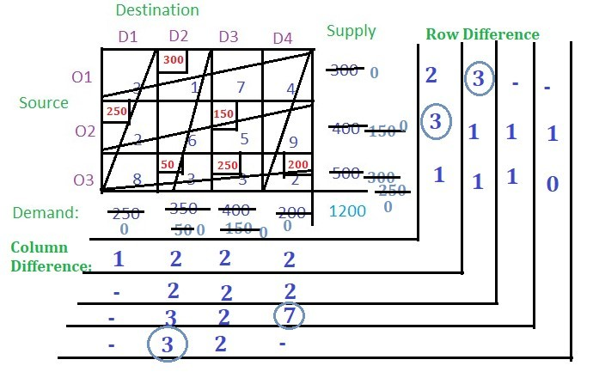
Allocate the remaining demand or supply to the cell.
The final cost can be calculated as:
=(300 * 1) + (250 * 2) + (50 * 3) +
(250 * 3) + (200 * 2) + (150 * 5)
= 2850

Slide 26
Vogel Approximation Algorithm time complexity analysis
Step 1: Determine a penalty cost for each row (column) by subtracting the lowest unit cell cost in the row (column) from the next lowest unit cell cost in the same row (column). - O(n^2.logn)
Step 2: Identify the row or column with the greatest penalty cost. Break the ties arbitrarily (if there are any). Allocate as much as possible to the variable with the lowest unit cost in the selected row or column. Adjust the supply and demand and cross out the row or column that is already satisfied. If a row and column are satisfied simultaneously, only cross out one of the two and allocate a supply or demand of zero to the one that remains. -O(n)
Step 3:If there is exactly one row or column left with a supply or demand of zero, stop. If there is one row (column) left with a positive supply (demand), determine the basic variables in the row (column) using the Minimum Cell Cost Method. Stop. O(1)
If all of the rows and columns that were not crossed out have zero supply and demand (remaining), determine the basic zero variables using the Minimum Cell Cost Method. Stop.
In any other case, continue with Step 2.

Slide 27
Russel Approximation Method - O(n^3) algorithm
D1 D2 D3 D4 Supply
S1 19 30 50 10 7
S2 70 30 40 60 9
S3 40 8 70 20 18
Demand 5 8 7 14

Slide 28
Step 1 and 2 - calculate Ui and Vj(maximum cost)
D1 D2 D3 D4 Supply Ui
S1 19 30 50 10 7 50
S2 70 30 40 60 9 70
S3 40 8 70 20 18 70
Demand 5 8 7 14
ˉVj 70 30 70 60

Slide 29
Step 3 - calculate Δij=cij-(Ui+Vj)
D1 D2 D3 D4 Supply Ui
S1 19 [-101] 30 [-50] 50 [-70] 10 [-100] 7 50
S2 70 [-70] 30 [-70] 40 [-100] 60 [-70] 9 70
S3 40 [-100] 8 [-92] 70 [-70] 20 [-110] 18 70
Demand 5 8 7 14
ˉVj 70 30 70 60

Slide 30
Step 4 - Allocate as much as possible
D1 D2 D3 D4 Supply Ui
S1 19 30 50 10 7 50
S2 70 30 40 60 9 70
S3 40 8 70 20(14) 4 70
Demand 5 8 7 0
ˉVj 70 30 70 --

Slide 31
Step 5 - Eliminate unnecessary cells
D1 D2 D3 D4 Supply Ui
S1 19 30 50 10 7 50
S2 70 30 40 60 9 70
S3 40 8 70 20(14) 4 70
Demand 5 8 7 0
ˉVj 70 30 70 --

Slide 32
Russel Approximation Method - O(n^3) algorithm
Step 1 : For each source row still under consideration, determine its ˉUi (largest cost in row i).
Step 2: For each destination column still under consideration, determine its ˉVj (largest cost in column j).
Step 3: For each variable, calculate Δij=cij-(Ui+Vj). - O(n^2)
Step 4: Select the variable having the most negative Δ value, break ties arbitrarily.
Step 5: Allocate as much as possible. Eliminate unecessary cells from consideration. Return to Step-1.

Slide 33
TOCM - variant-Amaliah et al. [4]
The TOC matrix is obtained by adding the "row opportunity cost matrix" (row opportunity cost matrix: for each row, the smallest cost of that row is subtracted from each element of the same row) and the "column opportunity cost-matrix" (column opportunity cost matrix: for each column of the original transportation cost matrix the smallest cost of that column is subtracted from each element of the same column).

Slide 34
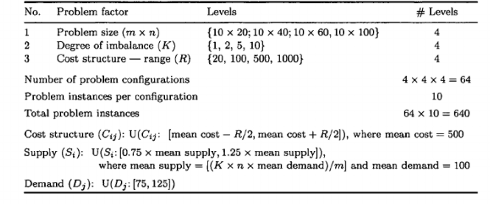
Experimental Design-M.Mathirajan & B.meenakshi[4]

Slide 35
Integrated ranks - Kaur, Lakhveer et al.[4]
Algorithm | 1st Rank | 2nd Rank | 3rd Rank | 4th Rank | Integrated Ranks
VAM | 86 | 163 | 227 | 164 | 2.73
VAM-TOCM | 211 | 47 | 348 | 34 | 2.32
RAM | 148 | 242 | 116 | 134 | 2.36
RAM- TOCM | 235 | 154 | 150 | 101 | 2.18

Slide 36
References
Logical Development Of Vogel’s ApproximationMethod (LD-VAM): An Approach To Find Basic
Feasible Solution Of Transportation Problem - Utpal Kanti Das , Md. Ashraful Babu
Bruff, D. The Assignment Problem and the Hungarian Method. Retrieved June 26, 2016
Harold W. Kuhn, "The Hungarian Method for the assignment problem", Naval Research Logistics Quarterly, 2: 83–97, 1955. Kuhn's original publication - https://web.eecs.umich.edu/~pettie/matching/Kuhn-hungarian-assignment.pdf
Amaliah, Bilqis & Fatichah, Chastine & Suryani, Erma. (2019). Total opportunity cost matrix – Minimal total: A new approach to determine initial basic feasible solution of a transportation problem. Egyptian Informatics Journal. 20. 10.1016/j.eij.2019.01.002.
M, Mathirajan & B.meenakshi,. (2012). EXPERIMENTAL ANALYSIS OF SOME VARIANTS OF VOGEL'S APPROXIMATION METHOD. Asia-Pacific Journal of Operational Research. 21. 10.1142/S0217595904000333.
Kaur, Lakhveer & Chahal, Sandeep & Paul Rakshit, Madhuchanda. (2018). An Improvement in Maximum Difference Method to Find Initial Basic Feasible Solution for Transportation Problem.

