Slide 1
CL-716 Modelling Chemical and Biological Patterns BIFURCATION ANALYSIS OF NONLINEAR REACTION-DIFFUSION EQUATIONS
Project Presentation
Group 11
Date: 16th Apr 2015
Akash Deep Singhal (11D020024)
Amit Agarwal (11D020014)

Slide 2
Abstract
The theoretical expressions are limited to the neighborhood of the marginal stability point. Computer simulations allow not only the verification of their predictions but also the investigation of the behavior of the system for larger deviations from the instability point.

Slide 3
Introduction
Chemical Reaction
Rate Equation
Boundary Conditions

Slide 4
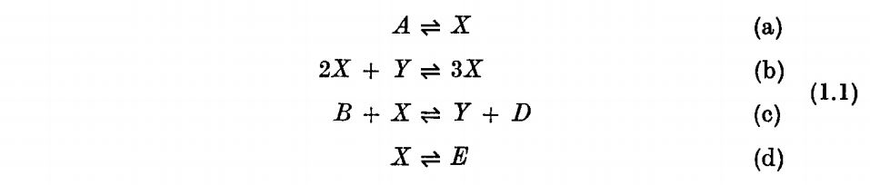
Chemical Reaction
The theory of dissipative structures have been illustrated on a simple model system involving the following set of coupled chemical reactions:
The system is open to the initial and final chemicals A, B, D and E, whose concentrations are imposed throughout the system
Nonlinearity is introduced by the auto- and cross-catalytic steps (b) and (c);

Slide 5
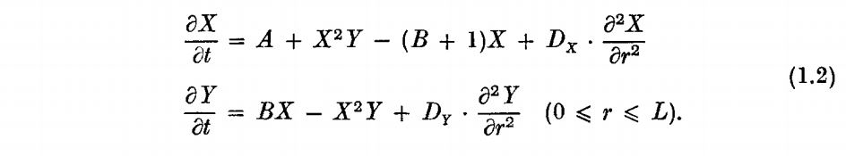
Rate Equations
The rate equations of our nonlinear reaction-diffusion system are given by:
Where, D_{x} and D_{y} are the diffusion coefficients of X and Y
Assumption: Fick’s law is valid

Slide 6
Boundary Conditions
Two types of boundary conditions will be considered:
Zero flux boundary conditions (Neumann conditions):
Fixed boundary conditions (Dirichlet conditions):

Slide 7
Matlab Code
The main script
PDE Solver
Initial Condition
Boundary Conditions

Slide 8
Matlab Code
The main script file

Slide 9
Matlab Code
PDE solver

Slide 10
Matlab Code
Initial Conditions

Slide 11
Matlab Code
Boundary Conditions

Slide 12
Numerical Analysis
Simulation using Matlab
Space-time Plots

Slide 13
Numerical Analysis
We use the simulation using MATLAB to verify the numerical results with the analytical ones.
Following are the major numerical simulations:-

Slide 14
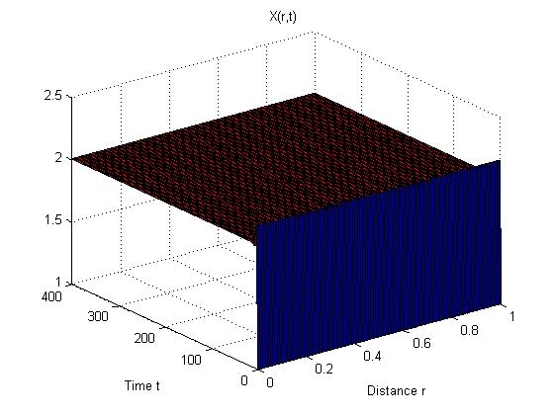
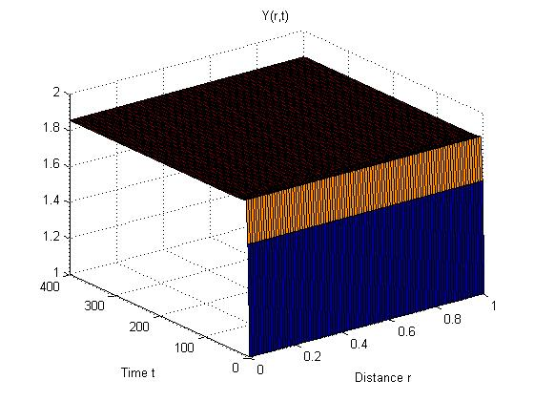
Numerical Analysis
Case 1
All the equations are restricted to the constraint 0 ≤ r ≤ L and L is taken to be 1.
Also diffusion coefficients are taken to be:-
Dx = 1.6 x 10⁻³
Dy = 8.0 x 10⁻³
A = 2 and B = 3.7 for zero flux boundary condition
X vs distance ‘r’ and time ‘t’
Y vs distance ‘r’ and time ‘t’

Slide 15
Numerical Analysis
Case 2
All the equations are restricted to the constraint 0 ≤ r ≤ L and L is taken to be 1.
Also diffusion coefficients are taken to be:-
Dx = 8.0 x 10⁻³
Dy = 1.6 x 10⁻³
A = 2 and B = 3.7 for zero flux boundary condition
X vs distance ‘r’ and time ‘t’
Y vs distance ‘r’ and time ‘t’

Slide 16
Analytical Solution
General solution
Linear Stability Diagrams
Comparison
Critical Wavenumber

Slide 17
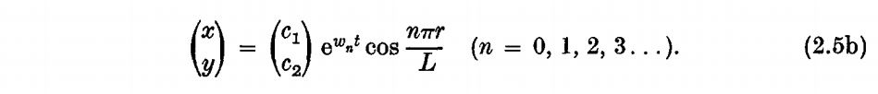
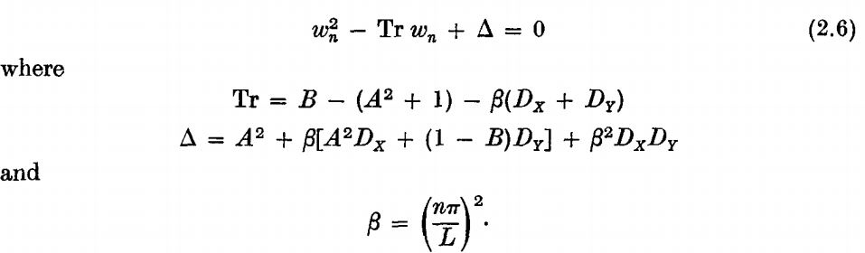
Analytical Solution
For zero – flux boundary conditions,
Inserting this into the rate equations, we get secular equation relating w_{n} to the wavenumber n and the system's parameters:

Slide 18
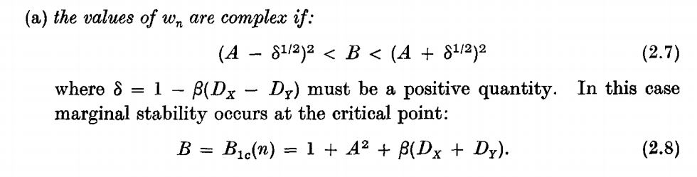
Analytical Solution
Instability of the thermodynamic branch will occur for some value of n, if at least one of the roots of (2.6) has a positive Re w_{n} part. The main point is thus to establish the conditions for marginal stability, Re w_{n} = 0, corresponding either to 'exchange of stability', Im w_{n} = 0, or to 'overstability' Im w_{n} ≠ 0. A close analysis of (2.6) shows that:

Slide 19
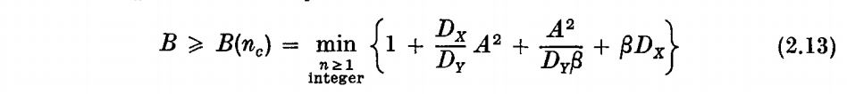
Analytical Solution
For real w_{n}’s the instability conditions reads:-

Slide 20
Linear stability diagram
Case I
A=2
B=3.7
L=1
Dx = 8.0 x 10⁻³
Dy = 1.6 x 10⁻³

Slide 21
Linear stability diagram
Case II
A=2
B=3.7
L=1
Dx = 1.6 x 10⁻³
Dy = 8.0 x 10⁻³

Slide 22
Linear stability diagram: Comparison
Case I
Case II

Slide 23
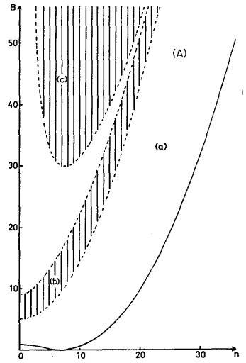
Linear stability diagram: Validity Verification (Case I)
Numerical
Analytical

Slide 24
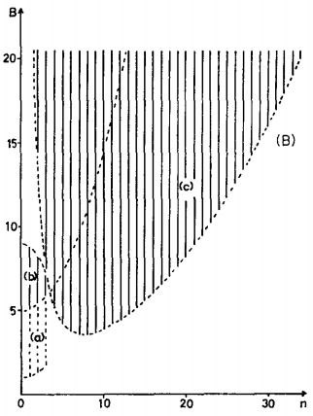
Linear stability diagram: Validity Verification (Case II)
Numerical
Analytical

Slide 25
Critical Wave Number
The critical wave number corresponding to the onset of stability is given by n_{min} if it is an integer or by one of the two closest integers.
Case I: A=2, B=3.7, L=1, Dx = 8.0 x 10⁻³, Dy = 1.6 x 10⁻³
Critical Wave number = [1/∏ * 2^{1/2}/(8*10⁻³*1.6*10⁻³)^{1/4} ] = 8
Case II: A=2, B=3.7, L=1, Dx = 1.6 x 10⁻³, Dy = 8.0 x 10⁻³
Critical Wave number = [1/∏ * 2^{1/2}/(1.6*10⁻³*8*10⁻³)^{1/4} ] = 8 (same)

Slide 26
Extended Analysis
Analytical steady state dissipative structure
Properties of the Dissipative Structure
Matlab code

Slide 27
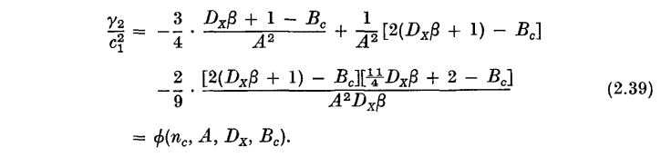
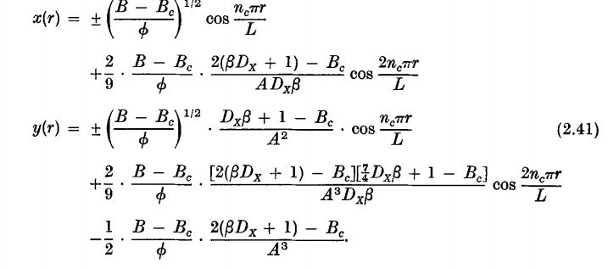
Analytical steady state dissipative structure
We have,
The bifurcating non uniform steady state solution near B = B_{c} is thus approximated by:

Slide 28
Matlab Code

Slide 29
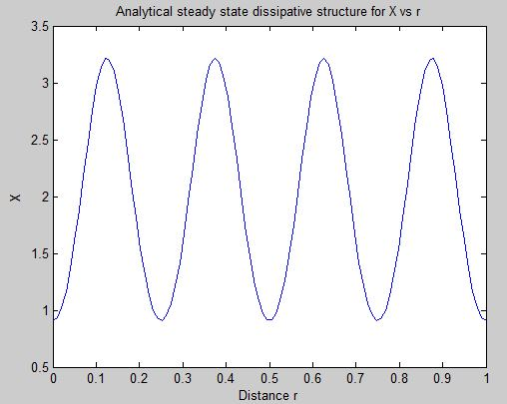
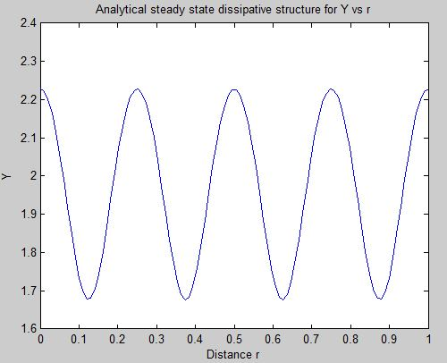
Dissipative structure pattern
X v/s r
Y v/s r
Results obtained from the simulation of the above MATLAB code; Matched with the original solution given in figure 5a and 5b in the paper.

Slide 30
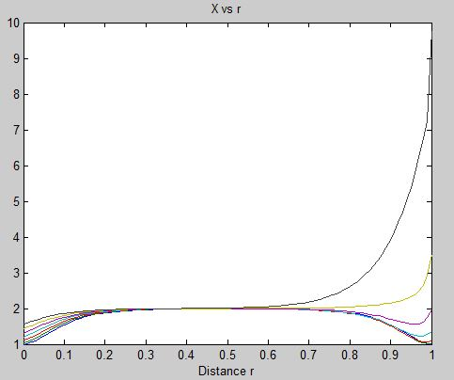
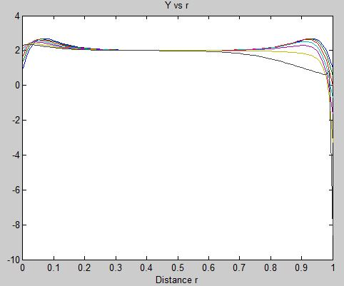
Pattern from numerical integration of steady state rate equation
And the pattern obtained from numerical integration of equation 1.2,
comes out to be as follows:-

Slide 31
References
J. F. G. Auchmuty and Nicholis G. Bifurcation analysis of Nonlinear Reaction-Diffusion Equations - I [Journal]. - [s.l.] : Bull. Math. Biology, 1974. - Vol. 37.
Kaufman M. Herschkowitz Bifurcation analysis of non-linear reaction-diffusion equations - II [Journal]. - Belgium : [s.n.], 1975. - Vol. 37.
Murray J. D. Mathematical Biology [Book]. - Vol. II.
Solving Initial-Boundary value problems for parabolic-elliptic PDEs in 1-D [Online] // Mathworks India. - http://in.mathworks.com/help/matlab/ref/pdepe.html.

Slide 32
Thank You

