Slide 1

NEXTHIKE IT SOLUTIONS LTD. Akash appasaheb Deshmukh
Creating a GUI Python Calculator

Slide 2
Objective:
Need to create a Graphical User Interface (GUI), in Python by using any GUI python library.
It is must to perform well defined mathematical Functions and show respective results on screen display.
Here, this project can also motivate us to learn core python, Python IDE (VS Code), GitHub etc.

Slide 3
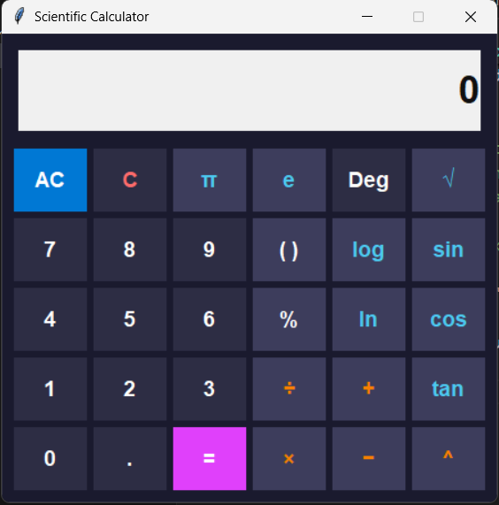
GUI Calculator Design

Slide 4
Learning & Challenges:
During this Project I had no any idea about Graphical User Interface (GUI), but during this Project I have research, learn about Tkinter Library and how to use it.
Also, Learn core Python like OPP programming, Functions etc.
[ Refer “Codewithharry” & “CampusX” Youtube channels and their respective content]
[Also refer website like Geeksforgeeks.org, Python Documentation, also take help from CloudeAI

Slide 5

Thank You

