Slide 1
Enhancing Thermal Stability of 8-Cell Lithium-Ion Batteries Using PCMs
Developed a thermal management system using n-octadecane as PCM to regulate the temperature of an 8-cell lithium-ion battery pack.
Designed and tested a PCM enclosure to absorb excess heat during operation, ensuring stable performance and safety.
Conducted experimental validation and thermal simulations to evaluate heat transfer efficiency and optimize battery lifespan and reliability.

Slide 2
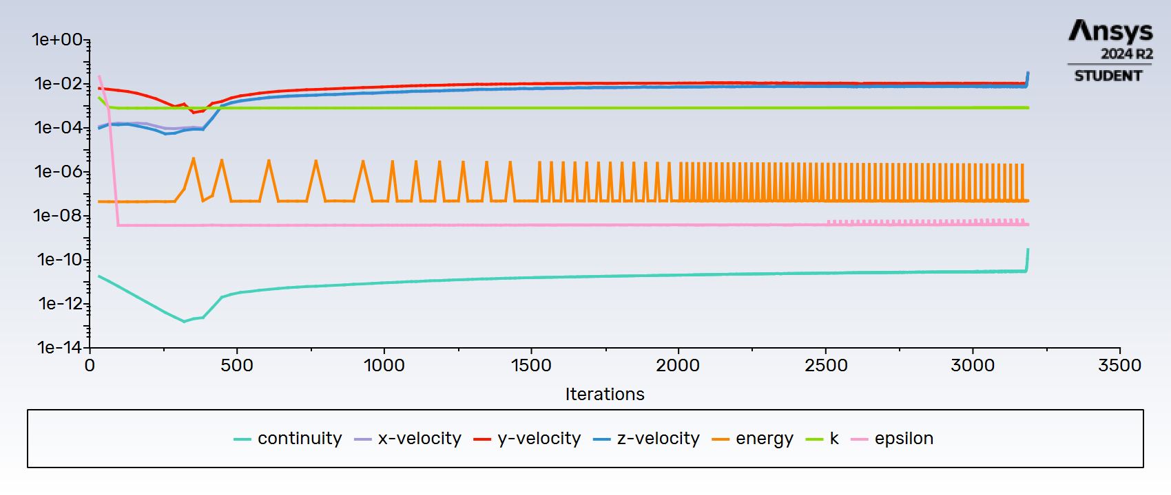

Slide 3
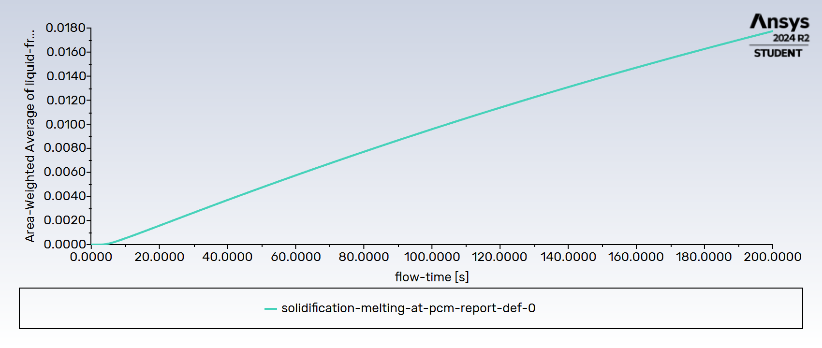

Slide 4
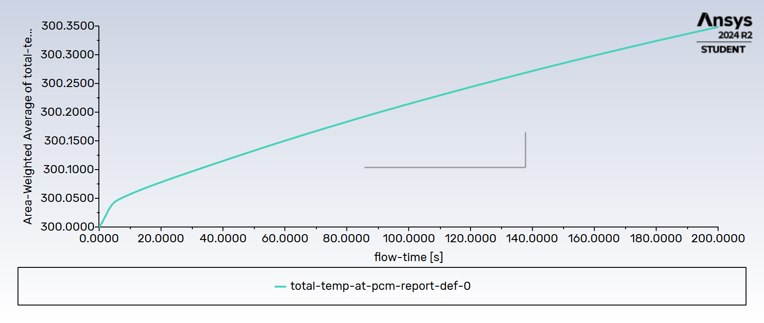

Slide 5
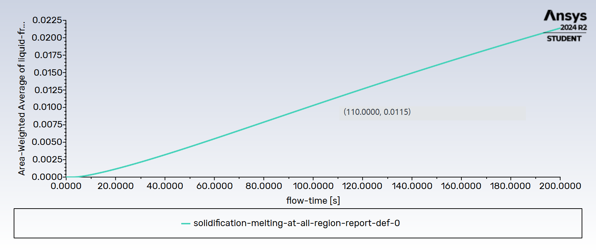

Slide 6
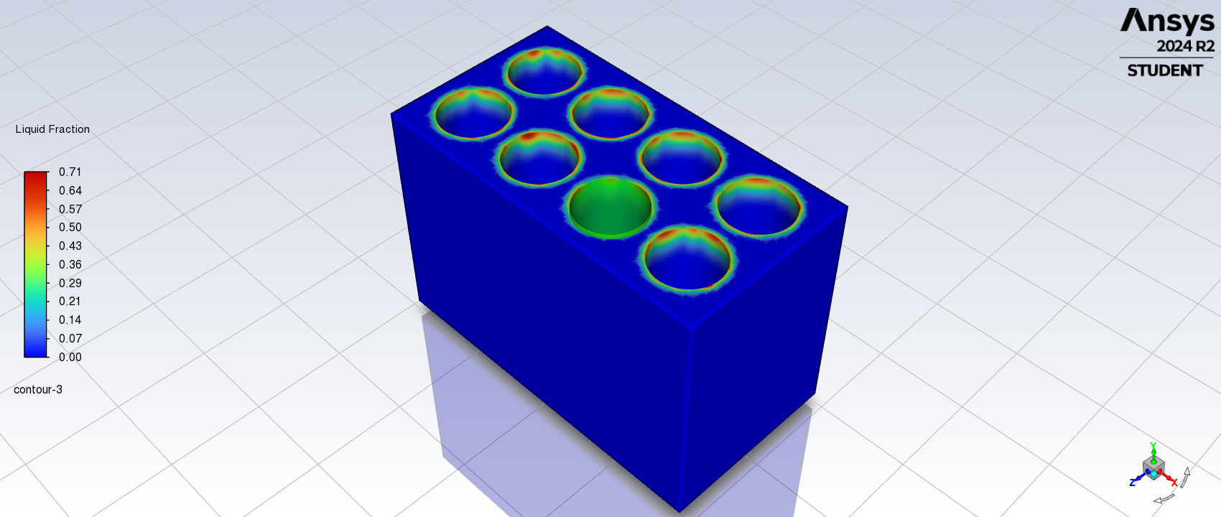

Slide 7
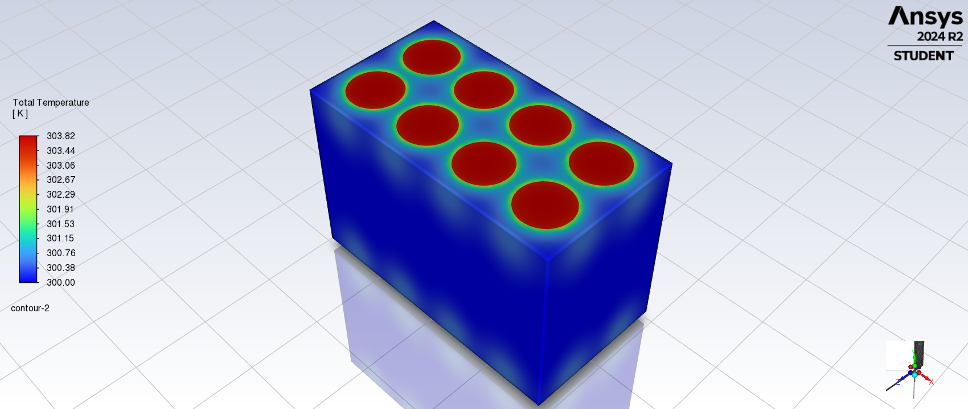

Slide 8


