Slide 1






System Design Through
Verilog
UNIT - I
Shaik Riyazuddien Assoc Prof., VVIT

Slide 2
Unit - I
INTRODUCTION TO VERILOG:
 Verilog as HDL
 Levels of design Description








Concurrency
Simulation and Synthesis
Functional Verification
System Tasks
Programming Language Interface (PLI)
Module
Simulation and Synthesis Tools
Test Benches.
LANGUAGE CONSTRUCTS AND CONVENTIONS:
 Introduction, Keywords, Identifiers, White Space Characters, Comments,
 Numbers
 Strings
 Logic Values
 Strengths
 Data Types
 Scalars and Vectors
 Parameters
 Operators.

Slide 3
Objectives and Outcomes
Objective: To make the student learn and understand
 Acquire a basic knowledge of the Verilog HDL
 Language constructs and conventions in Verilog
 Basic Concepts of Verilog HDL like Data Types, System Tasks and
Compiler Directives.
Outcomes: The student will be able to
 Define basic terms in HDL
 Knows Syntax and lexical conventions
 Remembers Data types, operators
 Remember testbenches for simulation and verification

Slide 4
VERILOG AS AN HDL
 Verilog aimed at providing a functionally tested and a verified
design description for the target FPGA or ASIC.

Slide 5
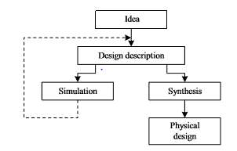

Slide 6
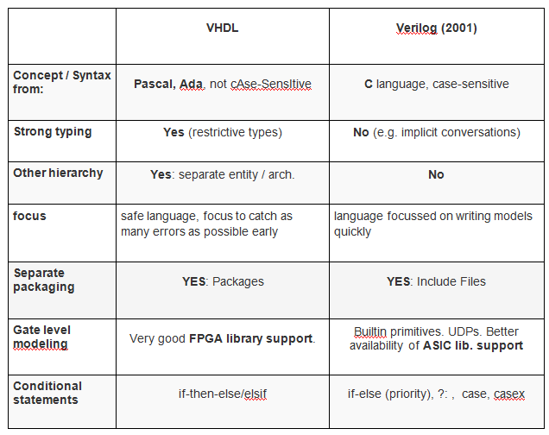
Comparison Between VHDL & Verilog

Slide 7
Summary -Verilog as HDL
Verilog is based on C, while VHDL is based on Pascal and Ada.
Unlike Verilog, VHDL is strongly typed.
Unlike VHDL, Verilog is case sensitive.
Verilog is easier to learn compared to VHDL.
Verilog has very simple data types, while VHDL allows users to create more complex data types.
Verilog lacks the library management, like that of VHDL.

Slide 8
LEVELS OF DESIGN DESCRIPTION
Gate Level
Data Flow
Behavioral Level
Circuit
Level or
switch level

Slide 9
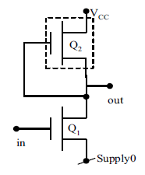
Circuit Level or switch level
 At the circuit level, a switch is the basic element
with which digital circuits are built.
 Switches can be combined to form inverters and other gates at the next higher level of abstraction.

Slide 10
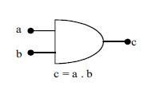
Gate Level
 At the next higher level of abstraction,
design is carried out in terms of basic gates.
 All the basic gates are available as ready modules
called “Primitives”.

Slide 11
Data Flow
 Data flow is the next higher level of abstraction.
 All possible operations on signals and variables are represented here in terms of assignments
y = (ab+cd)

Slide 12
Behavioral Level
 Behavioral level constitutes the highest level of design description; it is essentially at the system level itself.
 With the assignment possibilities, looping constructs and conditional branching possible, the design description essentially looks like a “C” program.

Slide 13
Verilog Language Concepts
 Concurrency
 Simulation and Synthesis
 Functional Verification
 System Tasks
 Programming Language Interface (PLI)

Slide 14
Concurrency
 In an electronic circuit all the units are to be active and functioning concurrently. The voltages and currents in the different elements in the circuit can change simultaneously. In turn the logic levels too can change.
 Simulation of such a circuit in an HDL calls for concurrency of operation.
 A number of activities – may be spread over different modules – are to be run concurrently here.
 Verilog simulators are built to simulate concurrency.
Concurrency is achieved by proceeding with simulation in equal time steps.

Slide 15
Simulation and Synthesis
 The design that is specified and entered as described earlier is
simulated for functionality and fully debugged.
 Translation of the debugged design into the corresponding hardware circuit (using an FPGA or an ASIC) is called “synthesis.”
 The circuits realized from them are essentially direct translations of functions into circuit elements.

Slide 16
Functional Verification
 Testing is an essential ingredient of the VLSI design process as
with any hardware circuit.
 It has two dimensions to it – functional tests and timing tests.
 Testing or functional verification is carried out by setting up a “test bench” for the design.
The test benches are mostly done at the behavioral level. The constructs there are flexible enough to allow all types of test signals to be generated.

Slide 17
System Tasks
 A number of system tasks are available in Verilog.
 Though used in a design description, they are not part of it.
 Some tasks facilitate control and flow of the testing process.
 A set of system functions add to the flexibility of test benches:
They are of three categories:
Functions that keep track of the progress of simulation time
Functions to convert data or values of variables from one
format to another
Functions to generate random numbers with specific distributions.

Slide 18
Programming Language Interface (PLI)
 Programming Language Interface (PLI) is a way to provide
Application Program Interface (API) to Verilog HDL.
 The interface adds a new dimension to working with Verilog routines from a C platform.
Essentially it is a mechanism to invoke a C function from a Verilog code.
 PLI is primarily used for doing the things which would not have been possible otherwise using Verilog syntax.
Delay values, logic values, etc., within a module can be accessed and altered.
Blocks written in C language can be linked to Verilog modules

Slide 19
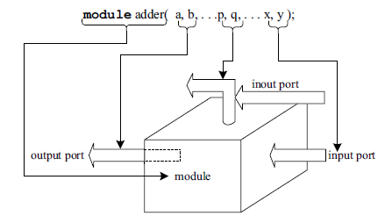
MODULE
 Any Verilog program begins with a keyword – called a
“module.”
 A module is the name given to any system considering it as a black box with input and output terminals as shown in Figure
 The terminals of the module are referred to as ‘ports’.

Slide 20
Cont…
 The ports attached to a module can be of three types:
input ports through which one gets entry into the module
output ports through which one exits the module.
inout ports: These represent ports through which one gets entry into the module or exits the module
 All the constructs in Verilog are centred on the module.

Slide 21
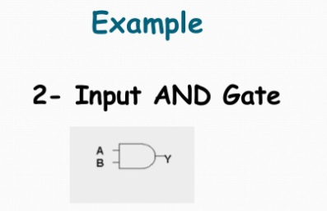
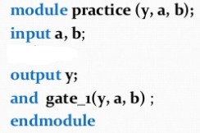
MODULE SYNTAX
 module module_name (port_list);
Input, output, inout declaration Intermediate variable declarations
Functional Description
(gate / switch / data flow / Behv.)
endmodule

Slide 22
SIMULATION AND SYNTHESIS TOOLS
 A variety of Software tools related to VLSI design is available.
 Few of them are
Xilinx
Modelsim and
Leonardo Spectrum of MentorGraphics.
 Modelsim and Xilinx are been used to simulate the designs.
 Leonardo Spectrum has been used to obtain the synthesized circuits

Slide 23
TEST BENCH SYNTAX
 A test bench is HDL code that allows you to provide a
documented, repeatable set of stimuli.
 module tb_module_name ;
Input, output, inout declaration Intermediate variable declarations
Stimulus (initial / always) endmodule

Slide 24
LANGUAGE CONSTRUCTS AND CONVENTIONS IN VERILOG
 CASE SENSITIVITY
Verilog is a case-sensitive language like C
Ex: sense, Sense, SENSE, sENse…etc., are all treated as different entities/quantities in verilog
 KEYWORDS
 The keywords define the language constructs. A keyword signifies an activity to be carried out, initiated, or terminated
 All keywords in Verilog are in small letters
Ex: module, endmodule, begin, end, if, while

Slide 25
IDENTIFIERS
 IDENTIFIERS
 Any program requires blocks of statements, signals, etc., to be identified with an attached nametag. Such nametags are identifiers
 All characters of the alphabet or an underscore can be used as the first character. Subsequent characters can be of alphanumeric type, or the underscore (_), or the dollar ($) sign
Valid Identifiers | Invalid Identifiers
name, _name, name1, name_$, \abc ( escaped identifier) | name aa, $name, 1_name, @name, a+b

Slide 26
WHITE SPACE CHARACTERS , COMMENTS
 WHITE SPACE CHARACTERS
Blanks (\b), tabs (\t), newlines (\n), and form feed form the white space characters in Verilog
Functionally, they separate legal tokens.
They are introduced between keywords, keyword and an identifier, between two identifiers, between identifiers and operator symbols, and so on.
White space characters have significance only when they appear inside strings
 COMMENTS
 A single line comment begins with “//” and ends with a new line
 multiline comments “/*” signifies the beginning of a comment and “*/” its end.

Slide 27
NUMBERS,
STRINGS
 NUMBERS
Integer Numbers : the number is taken as 32 bits wide.
 25, 253, –253
 - 8 'h f 4
Real Numbers: Real numbers can be specified in decimal or scientific notation
4.3, 4.3e2
 STRINGS : A string is a sequence of characters enclosed within double quotes
 “This is a string”

Slide 28
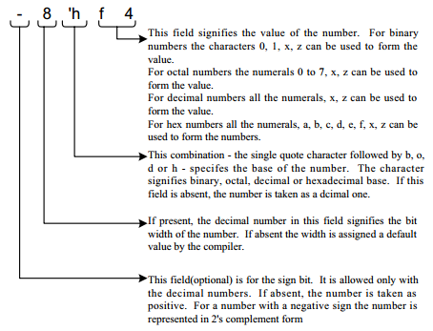

Slide 29
Examples
Representation | Remarks
33 ‘d33 | 0000 0000 0000 0000 0000 0000 0010 0001
9’d439 9’D439 9’D4_3 | Underscore is ignored and D,d both specify decimal numbers only
9’b1_1011_1x01 9’b11011x01 9’B11011x01 | 11011x01 Here x represents as unknown value
9’o123 | 001 010 011
9’o1x3 | 001 xxx 011
9’o12z | 001 010 zzz(z represents to be in high impedance state)
11’hb0 | 000 1011 0000
9’hza | zzzzz 1010
5’hza, 5’h?a | Z1010(? Is another representation of z)
-4’d7 | -9

Slide 30
LOGIC VALUES
 1 signifies the 1 or high or true level
 0 signifies the 0 or low or false level.
 Two additional levels are also possible designated as x and z.
 x represents an unknown or an uninitialized value. This corresponds to the don’t care case in logic circuits.
 z represents or signifies a high impedance state
The logic levels are also associated with strengths.
In many digital circuits, multiple assignments are often combined to reduce silicon area or to reduce pin- outs.
To facilitate this, one can assign strengths to logic levels.
Verilog has eight strength levels i.e., four of these are of the driving type, three are of capacitive type and one of the hi-Z type.

Slide 31
STRENGTHS
 | Strength Name | Strength Level | Element Modelled | Declaration Abbreviation
 | Supply Drive | 7 | Power supply connections. | supply
 | Strong Drive | 6 | Default gate & assign output strength. | strong
 | Pull Drive | 5 | Gate & assign output strength. | pull
 | Large Capacitor | 4 | Size of trireg net capacitor. | large
 | Weak Drive | 3 | Gate & assign output strength. | weak
 | Medium Capacitor | 2 | Size of trireg net capacitor. | medium
 | Small Capacitor | 1 | Size of trireg net capacitor. | small
 | High Impedence | 0 | Not Applicable. | highz

Slide 32
Data Types
 The data handled in Verilog fall into two categories:
Net data type
Variable data type
 The two types differ in the way they are used as well as with regard to their respective hardware structures.
Data type of each variable or signal has to be declared prior to its use.
The same is valid within the concerned block or module.

Slide 33
Net data type
 A net signifies a connection from one circuit unit to another, which carries the value of the signal it is connected to and transmits to the circuit blocks connected to it.
 If the driving end of a net is left floating, the net goes to the high impedance state.
 Various nets supported in Verilog
WIRE / TRI WOR / TRIOR
TRI0
SUPPLY1 -- For Vdd
WAND / TRIAND TRI1
TRIREG -- Infers a capacitance
SUPPLY0 -- For Vss

Slide 34
DIFFERENCES BETWEEN WIRE AND TRI
 wire: It represents a simple wire doing an interconnection.
Only one output is connected to a wire and is driven by that.
 tri: It represents a simple signal line as a wire. Unlike the wire, a tri can be driven by more than one signal outputs.

Slide 35
Variable Data Type
A variable is an abstraction for a storage device
It can be declared through the keyword reg and stores the value of a logic level: 0, 1, x, or z.
A net or wire connected to a reg takes on the value stored in the reg and can be used as input to other circuit elements. But the output of a circuit cannot be connected to a reg.
The value stored in a reg is changed through a fresh assignment in the program.
time, integer, real, and realtime are the other variable types of data

Slide 36
MEMORY
Different types and sizes of memory, register file, stack, etc., can be formed by extending the vector concept.
Thus the declaration Reg [15:0] memory[511:0];
declares an array called “memory”; it has 512 locations. Each location is 16 bits wide. The value of any chosen location can be assigned to a selected register or vice versa;.
As an example, consider the assignment statement
B = mem[(p-q)/2];
The simulator first evaluates (p - q)/2 (which should be an integer) Then the data stored at mem is assigned to B.
Different types of memory addressing like indirect, indexed, etc., can also be accommodated.

Slide 37
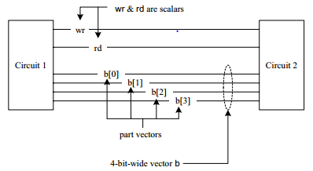
Scalars and Vectors
 Entities representing single bits — whether the bit is stored,
changed, or transferred — are called “scalars.”
 Multiple lines carry signals in a cluster treated as a “vector.”
reg[2:0] b;
reg[4:2] c;
wire[-2:2] d ;
 All the above declarations are vectors.
 If range is not specifies it is treated as scalars

Slide 38
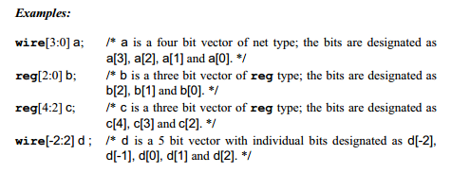

Slide 39
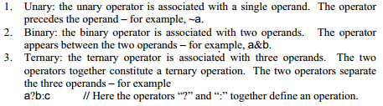
Parameters, Operators.
PARAMETERS
All constants can be declared as parameters at the outset in a Verilog module
 parameter word_size = 16;
 parameter word_size = 16, mem_size = 256;
OPERATORS

Slide 40
System Tasks
During the simulation of any design, a number of activities are to be carried out to monitor and control simulation.
A number of such tasks are provided / available in Verilog.
The “$” symbol identifies a system task. A task has the format $<keyword>
$display
When the system encounters this task, the specified items are displayed in the formats specified and the system advances to a new line.
Example: $display (“The value of a is : a = , %d”, a);
$monitor
The $monitor task monitors the variables specified whenever any one of those specified changes.
A monitor statement need appear only once in a simulation program.
Example: $monitor (“The value of a is : a = , %d”, a);

Slide 41
System Tasks
Tasks for Control of Simulation
Two system tasks are available for control of simulation:
$finish task, when encountered, exits simulation. Control is reverted to the Operating System. Normally the simulation time and location are also printed out by default as part of the exit operation.
$stop task, suspends simulation; if necessary the simulation can be resumed by user intervention. Thus with the stop task, the simulator is in an interactive mode. In contrast with $finish, simulation has to be started afresh.

Slide 42
Thank you
&
Any Queries?

