Slide 1






System Design Through Verilog
UNIT - II
Prepared BY
Shaik Riyazuddien Assoc Prof., VVIT

Slide 2

Unit - II GATE LEVEL MODELING
 Introduction
 AND Gate Primitive
 Module Structure
 Other Gate Primitives
 Illustrative Examples
 Tri-State Gates
 Array of Instances of Primitives
 Design of Flip – Flops with gate primitives
 Delays
 Strengths and Contention Resolution,
 Net Types
 Design of Basic Circuits.

Slide 3

AND GATE PRIMITIVE
U n i t - II
 All the basic gates are available as “Primitives” in Verilog.
The AND gate primitive in Verilog is instantiated with the following statement:
and g1 (O, I1, I2, . . ., In);
Here ‘and’ is the keyword signifying an AND gate.
g1 is the name assigned to the specific instantiation.
O is the gate output.
I1, I2, etc., are the gate inputs.

Slide 4
AND GATE PRIMITIVE
U n i t - II
 All the basic gates are available as “Primitives” in Verilog.
The AND gate primitive in Verilog is instantiated with the following statement:
and g1 (O, I1, I2, . . ., In);
Here ‘and’ is the keyword signifying an AND gate.
g1 is the name assigned to the specific instantiation.
O is the gate output.
I1, I2, etc., are the gate inputs.

Slide 5
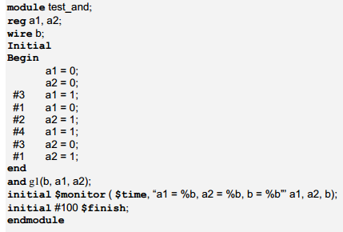
Stimulus program for Testing AND GATE
The module test and has no port. It instantiates the AND module once.
The test input sequence is specified within the initial block – the sequence of statements between the begin and end statements together form this block.
The keyword “initial” signifies the settings done initially — that is, only once for the whole routine.
The first set of statements within the initial block
a1 = 0;
a2 = 0;
make
a1 = a2 = 0
at zero simulation time.
After 3 time steps, a1 is set to one but a2 remains at 0. The expression “#3” means “after 3 time steps”. Subsequent changes in a1 and a2 also can be explained in the same manner.

Slide 6
MODULE STRUCTURE
The first statement of a module starts with the keyword module; it may be followed by the name of the module and the port list if any
All the variables in the ports-list are to be identified as inputs, outputs, or inouts.
The corresponding declarations have the form shown below:
Input a1, a2;
Output b1, b2;
Inout c1, c2;
The ports and the other variables used within the body of the module are to be identified as nets or registers with specific types in each case.
The respective declaration statements follow the port-type declaration statements.
Examples:
wire a1, a2, c;
reg b1, b2;
The executable body of the module follows the declaration indicated above.
The last statement in any module definition is the keyword “endmodule”.
Comments can appear anywhere in the module definition.

Slide 7
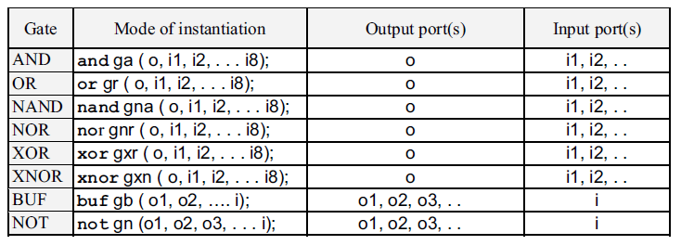
Other GATE Primitives
U n i t - II
 All the basic gates are available as “Primitives” in Verilog.

Slide 8
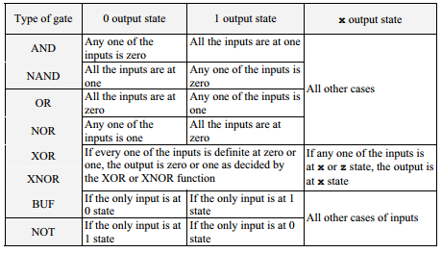
Rules for deciding the output values of gate primitives for different input combinations

Slide 9
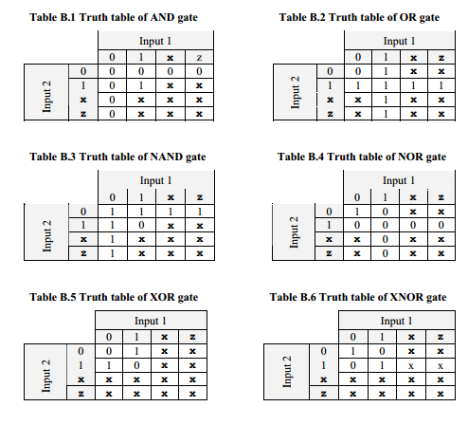

Slide 10
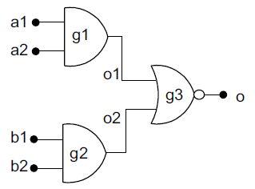

ILLUSTRATIVE EXAMPLES Verilog module for AOI logic
U n i t - II
 module aoi_gate(o,a1,a2,b1,b2); input a1,a2,b1,b2; output o; wire o1,o2;
and g1(o1,a1,a2);
and g2(o2,b1,b2);
nor g3(o,o1,o2); endmodule
 module aoi_st;
reg a1,a2,b1,b2; wire o;
initial begin
a1 = 0;
#3 a1 = 1;
a2 = 0; b1 = 0; b2 = 0;
a2 = 1; b1 = 1; b2 = 0;
end
initial
$monitor($time , " o = %b , a1 = %b , a2 = %b , b1 = %b ,b2 = %b ",o,a1,a2,b1,b2);
aoi_gate gg(o,a1,a2,b1,b2); initial #100 $stop;
endmodule

Slide 11
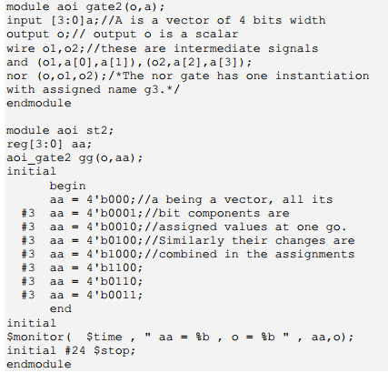
Vector version of AOI GATE
U n i t - II

Slide 12
A
0
A
1
A
D
D
D
D
0
0
1
2
3
A
1
0
0
1
0
0
0
D
=
A
A
0
1
0
1
0
0
0
1
0
1
0
0
0
1
0
1
1
0
0
0
1
D
1
=
A
A
1
0
(a)
Verilog Program
Module decoder24 (D0,D1,D2,D3, A0,A1);
input A0,A1;
output D0,D1,D2,D3;
and g1 (D0, (~A1),(~A0));
and g2 (D1, (~A1),A0);
and g3 (D2, A1,(~A0));
and g4 (D3, A1,A0);
endmodule
D
=
A
A
2
1
0
D
=
A
A
3
1
0
(b)

Slide 13
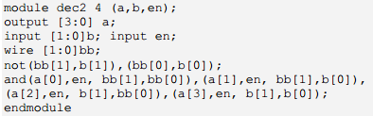

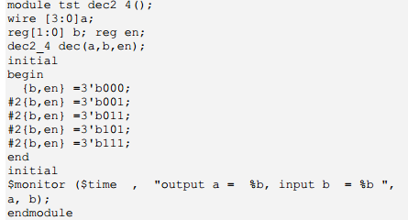
VERILOG PROGRAM FOR 2 TO 4 DECODER
Testbench Program for
2 to 4 Decoder

Slide 14
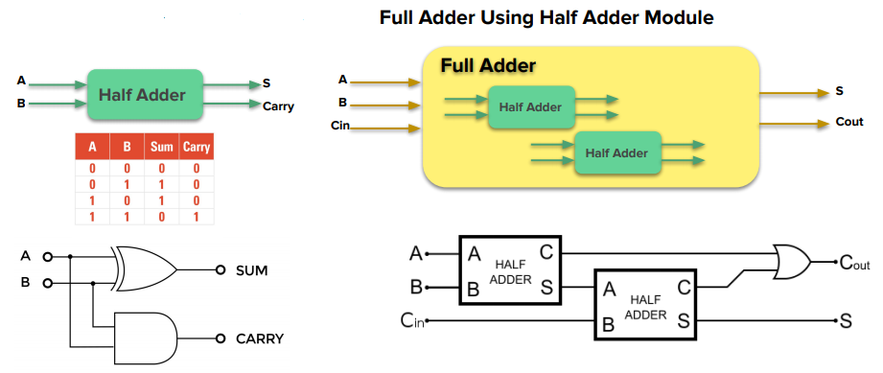

Slide 15
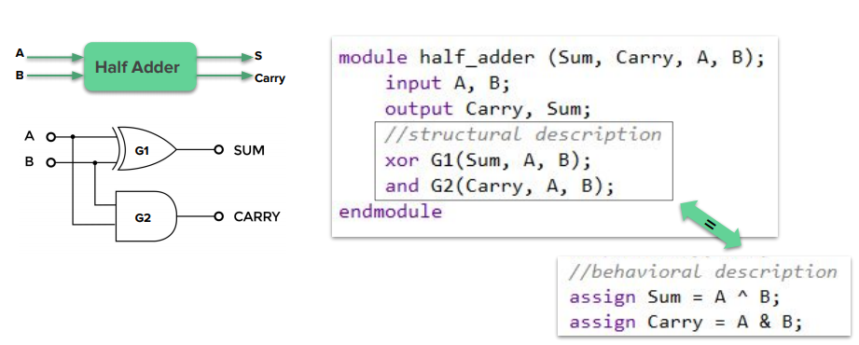

Slide 16
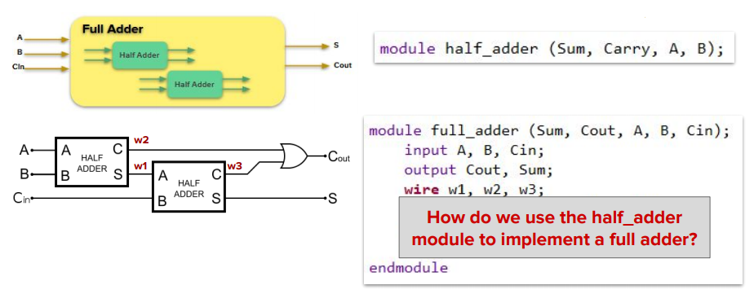

Slide 17
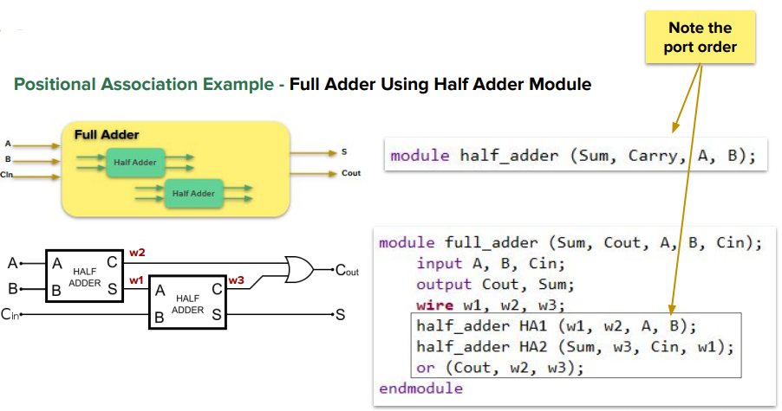

Slide 18
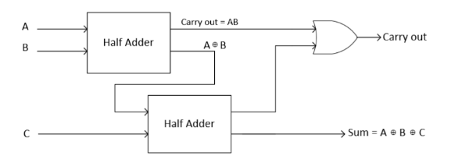
Full adder using two Half adders
module full_adder_join(fsum, fcarry_out, a, b, c);
input a, b, c;
output fsum, fcarry_out;
wire half_sum_1, half_carry_1, half_carry_2;
half_adder HA1(half_sum_1, half_carry_1, a, b); //instance 1 of Half Adder half_adder HA2(fsum, half_carry_2, half_sum_1, c); //instance 2 of Half Adder
or or1(fcarry_out, half_carry_2, half_carry_1); endmodule

Slide 19
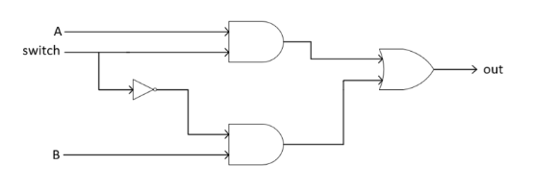
2 X 1 multiplexer
Input |  |  | Output
A | B | S | Out
0 | 0 | 0 | 0
0 | 0 | 1 | 0
0 | 1 | 0 | 1
0 | 1 | 1 | 0
1 | 0 | 0 | 0
1 | 0 | 1 | 1
1 | 1 | 0 | 1
1 | 1 | 1 | 1
module mux2x1(out,a,b,s);
input a,b,s;
wire and_1,and_2,s_c;
output out;
not (s_c,s);
and (and_1,a,s_c);
and (and_2,b,s);
or (out,and_1,and_2);
endmodule
Boolean Expression is Out =AS+BS′

Slide 20
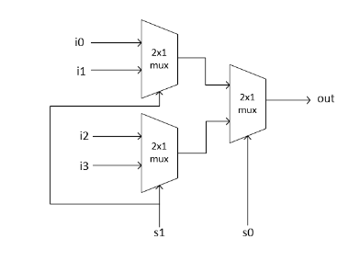
4 X 1 Mux using 2 X 1 Mux
When S1 is set to HIGH it will select i1 and i3;
now if s0 is LOW output will have i1 otherwise i3 and similar for i0 and i2.
Verilog code of 4×1 mux by just instantiating three 2×1 muxes
module mux4x1(out,i0,i1,i2,i3,s1,s0);
input i0,i1,i2,i3,s1,s0;
output out;
wire mux1,mux2;
mux2x1 mux_1(mux1,i0,i1,s1);
mux2x1 mux_2(mux2,i2,i3,s1);
mux2x1 mux_3(out,mux1,mux2,s0); endmodule
S0 | S1 | Out
0 | 0 | i0
0 | 1 | i1
1 | 0 | i2
1 | 1 | i3

Slide 21
i0 | i1 | i2 | i3 | s0 | s1 | out
1 | 0 | 1 | 1 | 0 | 1 | 0
0 | 1 | 0 | 0 | 0 | 1 | 1
0 | 0 | 1 | 0 | 1 | 0 | 1
0 | 0 | 0 | 1 | 1 | 1 | 1
1 | 0 | 0 | 0 | 0 | 0 | 1

Slide 22

TRI-STATE GATES
U n i t - II
 Four types of tri-state buffers are available in Verilog as
Primitives
Their outputs can be turned ON or OFF by a control signal. The direct buffer is instantiated as
bufif1 nn (out, in, control);
out as the single output variable
in as the single input variable and
control as the single control signal variable.
When control = 1, out = in.
When control = 0, out is cut off from the input and tri-stated.

Slide 23
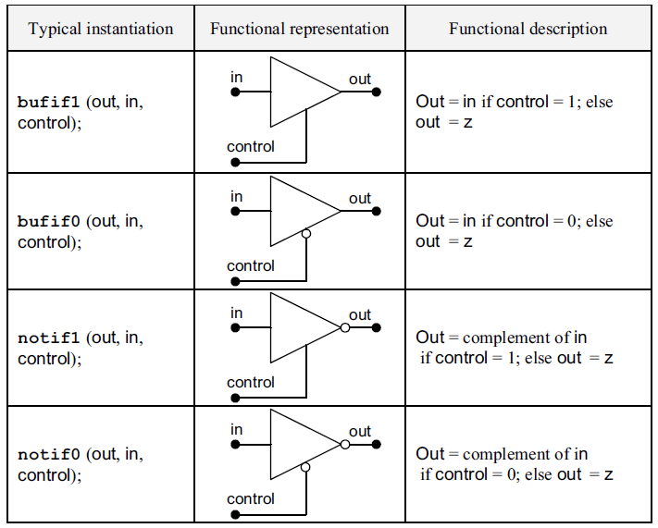
TRI-STATE GATES
U n i t - II

Slide 24
ARRAY OF INSTANCES OF PRIMITIVES
U n i t - II
 The primitives available in Verilog can also be instantiated as arrays.
A typical array instantiation has the form
and gate [7 : 4 ] (a, b, c);
where a, b, and c are to be 4 bit vectors. The above instantiation is equivalent to combining the following 4 instantiations:
 and gate [7] (a[3], b[3], c[3]),
gate [6] (a[2], b[2], c[2]),
gate [5] (a[1], b[1], c[1]),
gate [4] (a[0], b[0], c[0]);
Syntax: and gate[mm : nn](a, b, c);

Slide 25
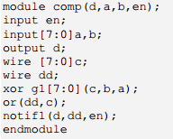
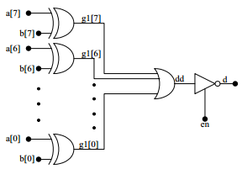
ARRAY OF INSTANCES OF PRIMITIVES
U n i t - II
A Byte Comparator
A circuit to compare two variables each of one byte.
The circuit outputs a flag d; d is 1 if the two bytes are equal; else it is 0.
The output is activated only if the enable signal en = 1. If en = 0, the circuit output is tri-stated.

Slide 26
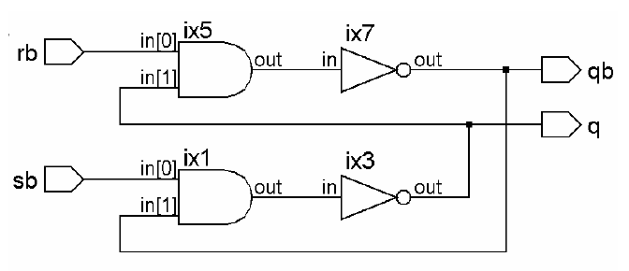
DESIGN OF FLIP-FLOPS WITH GATE PRIMITIVES
U n i t - II
 Simple Latch
module sbrbff(sb,rb,q,qb); input sb,rb;
output q,qb;
nand(q,sb,qb);
nand(qb,rb,q);
endmodule

Slide 27
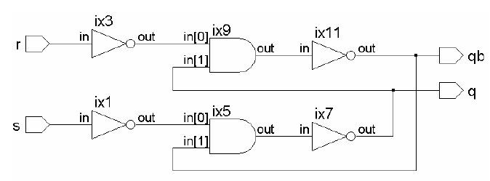
RS Flip-Flop module
U n i t - II
 module srff(s,r,q,qb);
input s,r; output q,qb; wire ss,rr;
not(ss,s),(rr,r);
nand(q,ss,qb);
nand(qb,rr,q);
endmodule

Slide 28
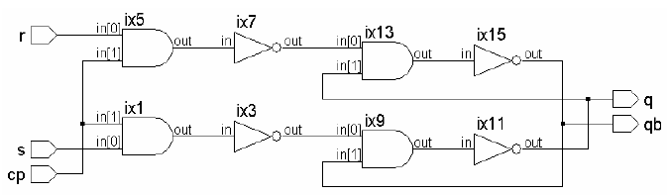
A Clocked RS Flip-Flop module
U n i t - II
 module srffcplev(cp,s,r,q,qb);
input cp,s,r; output q,qb; wire ss,rr;
nand
(ss,s,cp),
(rr,r,cp),
(q,ss,qb),
(qb,rr,q);
endmodule

Slide 29
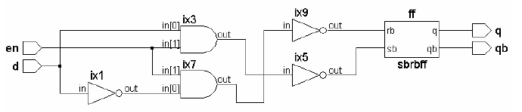
D-Latch module
U n i t - II
 module dlatch(en,d,q,qb);
input d,en; output q,qb; wire dd; wire s,r;
not n1(dd,d);
nand (sb,d,en); nand g2(rb,dd,en);
sbrbff ff(sb,rb,q,qb);
endmodule

Slide 30
DELAYS
U n i t - II
Verilog has the facility to account for different types of propagation delays of circuit elements.
Any connection can cause a delay due to the distributed nature of its resistance and capacitance.
These manifest as propagation delays in the 0 to 1 transitions and 1 to 0 transitions from input to the output. Such propagation delays can differ for the two types of transitions.

Slide 31
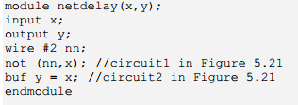
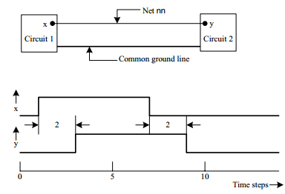
DELAYS
U n i t - II
 Net Delay
wire #2 nn;
// nn is declared as a net with a propagation delay of 2 time steps

Slide 32
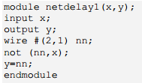
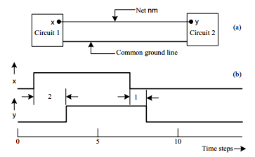
Delays
U n i t - II
wire # (2, 1) nm;
//the positive (0 to 1) transition has a delay of 2 time steps
//The negative (1 to 0) transition has a delay of 1 time step

Slide 33
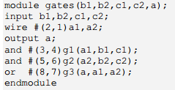
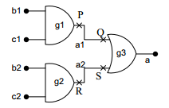
Delays
U n i t - II
Gate Delay
and #3 g( a, b, c);
The above represents an AND gate description with a uniform delay of 3 ns for all transitions from input to output.
and #(2, 1) g(a, b, c);
With the above statement the positive (0 to 1) transition at the output has a delay of 2 time steps while the negative (1 to 0) transition has a delay of 1 time step.

Slide 34
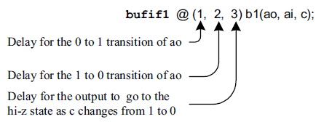
Delays with Tri-state Gates
U n i t - II
The instantiation inclusive for a tri-state buffer of the bufif1 type. Three time delay values are specified:
The first number represents the delay associated with the positive (0 to 1) transition of the output.
The second number represents the delay associated with the negative (1 to 0) transition of the output.
The third number represents the delay for the output to go to the hi-Z state as the control signal changes from 1 to 0 (i.e., ON to OFF command).
Delays for the other tri-state buffers – namely bufif0, notif1 and notif0 – may be specified in a similar manner.

Slide 35
min, typical, max delays
U n i t - II
It is customary for manufacturers to specify delays and their range in the following manner:
Each of the delays in a gate primitive or for a net can be specified in terms of these three values. For example
and #(2:3:4) g1(a0, a1, a2);
can instantiate an AND gate with the following time delay specifications:
The 0 to 1 rise time and the 1 to 0 fall time are equal.
The minimum value of either is 2 time steps. Typical value is 3 time steps and the maximum value is 4 time steps.
Note that the colon that separates the numbers signifies that the timings specified are the minimum, typical, and maximum values.
At the time of simulation, one can specify the simulation to be carried out with any of these three delay values. If the same is not specified, the simulation is carried out with the typical delay value.

Slide 36
min, typical, max delays
U n i t - II
The group of minimum, typical, and maximum delay values for the propagation delays can be specified separately for any gate primitive.
Thus an AND gate primitive can be specified as
and #(1:2:3, 2:4:6) g2(b0, b1, b2);
Here for the 0 to 1 transition of the output (rise time) the gate has a minimum delay value of 1 ns, a typical value of 2 ns, and a maximum value of 3 ns.
Similarly, for the 1 to 0 transition (fall time) the gate has a minimum delay value of 2 ns, a typical delay value of 4 ns, and a maximum delay value of 6 ns.
Such delay specifications can be associated with nets as well as tri-state type gates also.

Slide 37
min, typical, max delays
U n i t - II
wire #(1:2:3) a;
/* The net a has a propagation delay whose minimum, typical and maximum values are 1 ns, 2 ns, and 3 ns, respectively*/
bufif1 #(1:2:3, 2:4:6, 3:6:9) g3 (a0, b0, c0);
The different delay values for the buffer are as follows:
The output rise time (0 to 1 transition) has a minimum value of 1 ns, a typical value of 2 ns and a maximum value of 3 ns.
The output fall time (1 to 0 transition) has a minimum value of 2 ns, a typical value of 4 ns and a maximum value of 6 ns.
The output turn-off time (1 to 0) has a minimum value of 3 ns, a typical value of 6 ns, and a maximum value of 9 ns. */

Slide 38
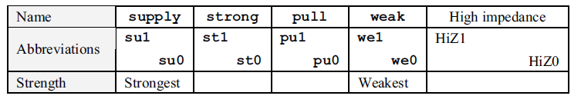
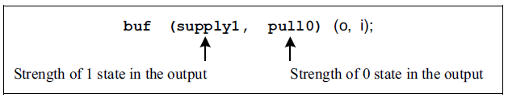
STRENGTHS AND CONTENTION RESOLUTION
U n i t - II
When the outputs of two gates are joined together, the signal level is decided by the relative magnitudes of the source impedances.
Sometimes a disparity between the impedances is intentionally introduced to minimize circuit hardware.
Effects of such differences in the impedances are indirectly introduced in design descriptions by assigning “strengths” to specific signals.

Slide 39
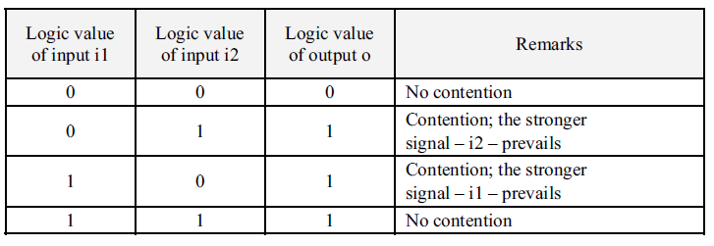

STRENGTH CONTENTION in GATE PRIMITIVES
U n i t - II
When two signals of opposite polarity and differing strengths drive a line, the output status is decided by the stronger signal.
However, if the signals are of equal strength, the output is indeterminate.

Slide 40

Net Charges
U n i t - II
Whenever a net is driven by a signal, it takes the logic value of the signal.
When the signal source is tri-stated, the net too gets tri-stated.
In practice the net can have a capacitor associated with it, which can store the signal level even after the signal source dries up (i.e., tri-stated).
Such nets are declared with the keyword trireg.

Slide 41
Net Charges
U n i t - II
A trireg net can be driven with possibilities of contention from two or more sources
A trireg net can be in one of two possible states only:
Driven state: When driven by a source or multiple sources, the net assumes the strength of the source.
Capacitive state: When the driven source (sources) is (are) tri-stated, the net retains the last value it was in – by virtue of the capacitance associated with it. The value can be 0, 1 or x (but not the high impedance value).
When in the capacitive state, a net can have a storage strength associated with it. Three such storage strengths are possible – namely large, medium, and small.
When a storage strength is not specified, it is assigned the default value – medium.
For a trireg net one cannot assign storage strength capacity separately for the 0 and the 1 states.

Slide 42
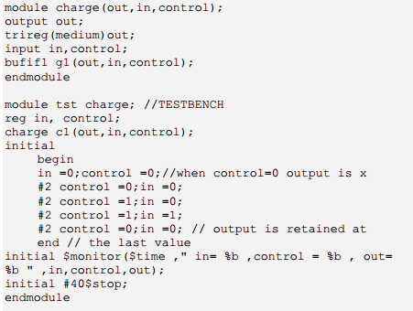
Net Charges
U n i t - II
Net Storage
Exercise: As long as the signal control = 1, the signal out follows the signal in. When control goes to 0, out is disconnected from the input and it '‘floats.'’ It retains the last value due to the capacitance storage capacity. The storage strength is medium, signifying a medium value of capacitance.

Slide 43
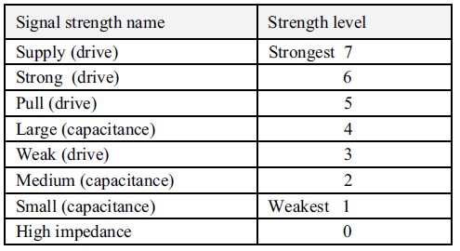
Signal strength names and weights
U n i t - II

Slide 44
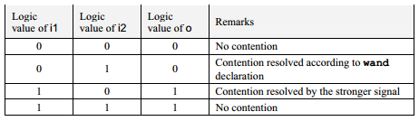
NET Types
U n i t - II
wire is possibly the simplest type of net declaration.
wand and wor
Strengths on nets can be decided in ways other than a direct declaration also.
‘wand’ and ‘wor’ are two types of net declarations for such contention resolution.
wand is a wire declaration, which resolves to AND logic in case of contention.
wor is a wire declaration, which resolves to OR logic in case of a contention.
All synthesizers support wire. Triand, trior, tri0, and tri1 may not be supported by some synthesizers.

Slide 45
NET Types
U n i t - II
TRI
The keyword tri has a function identical to that of wire.
When a net is driven by more than one tri-state gate, it is declared as tri rather than as wire. The distinction is for better clarity. Similarly, Triand and trior are the counterparts of wand and wor, respectively.
If the output of a tri-state buffer is to be pulled up to the 1 state when tri-stated, it is declared as net tri1. Similarly, it is declared as tri0 if it is to be pulled down to 0 state when tri-stated.
Reset, Chip Enable and similar signals can be pulled up or down as required with tri0 or tri1; this signifies the normal status –that is, the chip is disabled or the reset is disabled.
Similarly, the reset can be activated for a specified period to reset the chip; subsequently, the reset can be deactivated to restore normal operation of the chip.
All synthesizers support wire. Triand, trior, tri0, and tri1 may not be supported by some synthesizers.

Slide 46
U n i t - II
supply0 and supply1
supply0 and supply1 are the keywords signifying the high- and low-side supplies.
Nets to be connected to the Vcc supply are declared as supply1, and those to be grounded are declared as supply0.
DESIGN OF BASIC CIRCUITS
Elementary gates are the basic building blocks of all digital circuits – whether combinational, sequential, or involved versions combining both.
Any digital circuit however involved it may be, can be realized in terms of gate primitives. The step-by-step procedure to be adopted may be summarized as follows:
Draw the circuit in terms of the gates.
Name gates and signals.
Using the same nomenclature as above, do the design description.
As the functional blocks like encoder, decoder, half-adder, full-adder, etc., get more and more involved, treat each as a building block with corresponding inputs and outputs.
Make more involved circuits in terms of the building blocks – as far as possible. Each block within another block manifests as an instantiation of one module within another.

Slide 47
Thank you
&
Any Queries?

