Slide 1
UNIT-3
BEHAVIORAL MODELING:
Introduction
Operations and Assignments
Functional Bifurcation
Initial Construct, Always Construct
Assignments with Delays Wait Construct
Multiple Always Blocks
Designs at Behavioral Level
Blocking and Non-Blocking Assignments
The case statement
Simulation Flow
if and if-else constructs
assign–deassign construct, repeat construct, for loop, the disable construct,
while loop, forever loop, parallel blocks, force-release construct, Event.

Slide 2
BEHAVIORAL MODELING
 Behavioral level modeling constitutes design description at an abstract level.
 One can visualize the circuit in terms of its key modular functions and their behavior; it can be described at a functional level itself instead of getting bogged down with implementation details.

Slide 3
Operations and Assignments
 The design description at the behavioral level is done through a sequence of assignments.
 These are called ‘procedural assignments’ – in contrast to the continuous assignments at the data flow level.
 All the procedural assignments are executed sequentially in the same order as they appear in the design description.

Slide 4
Operations and Assignments
The procedure assignment is characterized by the following:
The assignment is done through the “=” symbol
An operation is carried out and the result assigned through the “=” operator to an operand specified on the left side of the “=”
for example, N = ~N;
Here the content of reg N is complemented and assigned to the reg N itself. The assignment is essentially an updating activity.
3. The operation on the right can involve operands and operators. The operands can be of different types – logical variables, numbers – real or integer and so on.
4. The operands on the right side can be of the net or variable type. They can be scalars or vectors.
5. It is necessary to maintain consistency of the operands in the operation expression – e.g.,
N = m / l;
Here m and l have to be same types of quantities – specifically a reg, integer, time, real, realtime, or memory type of data.
6. The operand to the left of the “=” operator has to be of the variable (e.g., reg) type. It has to be specifically declared accordingly. It can be a scalar, a vector, a part vector, or a concatenated vector.

Slide 5
Functional Bifurcation
Design description at the behavioural level is done in terms of procedures of two types;
one involves functional description and interlinks of functional units. It is carried out through a series of blocks under an “always”.
The second concerns simulation – its starting point, steering the simulation flow, observing the process variables, and stopping of the simulation process
all these can be carried out under the “always” banner, an “initial” banner, or their combinations.

Slide 6
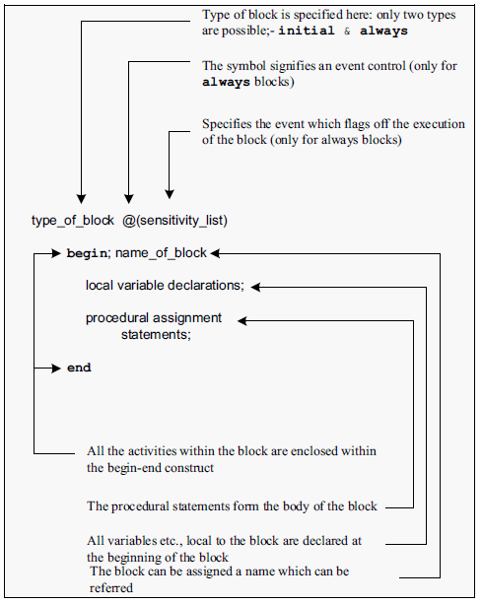
Procedure- Block Structure
 A procedure-block of either type – initial or always

Slide 7
Begin-End Construct
 If a procedural block has only one assignment to be carried out, it can be specified
as initial #2 a=0;
 More often more than one procedural assignment is to be carried out in an initial block.
 All such assignments are grouped together between “begin” and “end” declarations.
 Every begin declaration must have its associated end
declaration.
 begin – end constructs can be nested as many times as desired.

Slide 8
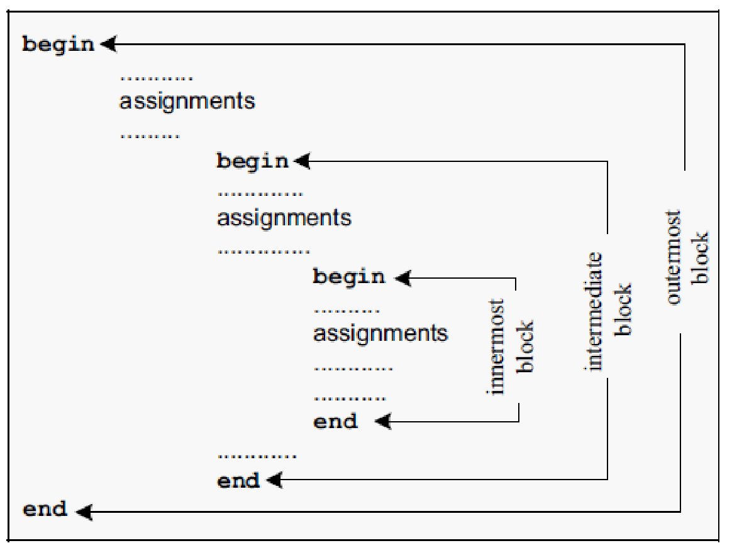
NESTED BEGIN – END BLOCKS
outermost block
Assigning names to blocks serves different purposes:
Registers declared within a block are local to it and are not available outside. However, during simulation they can be accessed for simulation, etc., by proper dereferencing
Named blocks can be disabled selectively when desired

Slide 9

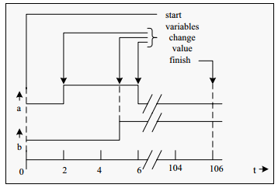
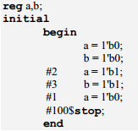
INITIAL CONSTRUCT
A set of procedural assignments within an initial construct are
executed only Once
In any assignment statement the left-hand side has to be a storage type of element (and not a net). It can be a reg, integer, or real type of variable. The right-hand side can be a storage type of variable or a net.
BEHAVIORAL MODELING

Slide 10
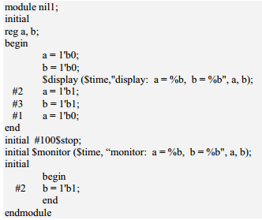
Multiple Initial Blocks
A module can have as many initial blocks as desired. All of them are activated at the start of simulation. The time delays specified in one initial block are exclusive of those in any other block.

Slide 11
ALWAYS CONSTRUCT
 The always process signifies activities to be executed on an “always basis.”
 Its essential characteristics are:
Any behavioral level design description is done using an always block.
The process has to be flagged off by an event or a change in a net or a reg. Otherwise it ends in a stalemate.
The process can have one assignment statement or
multiple assignment statements.
Normally the statements are executed sequentially in the order they appear.
BEHAVIORAL MODELING

Slide 12
EVENT CONTROL
 The always block is executed repeatedly and endlessly. It is necessary to specify a condition or a set of conditions, which will steer the system to the execution of the block. Alternately such a flagging-off can be done by specifying an event preceded by the symbol “@”.
 @(negedge clk) :executes the following block at the negative edge of clk.
 @(posedge clk) : executes the following block at the positive edge of the clk.
BEHAVIORAL MODELING
 @clk :
executes the following block at both the edges of clk.
 @(prt or clr) :
 @(posedge clk1 or negedge clk2) :
 @ (a or b or c) can also write as @ (a or b or c)
@ (a, b, c)
@ (a, b or c)
@ (a or b, c)

Slide 13
EXAMPLE COUNTER
 module counterup(a,clk,N);
input clk; input[3:0]N;
output[3:0]a;
reg[3:0]a;
initial a=4'b0000;
always@(negedge clk) a=(a==N)?4'b0000:a+1'b1;
 endmodule
BEHAVIORAL MODELING

Slide 14
Examples
Design verilog module of a down counter and its test bench
Design verilog module of a updown counter and its test bench
Design verilog module of a 8 bit shift register and its test bench
Design verilog module of clocked flip flop and its test bench
Design verilog module of D Latchand its test bench

Slide 15
Down counter
module counterdn(a,clk,N);
input clk;
input[3:0]N;
output[3:0]a;
reg[3:0]a;
initial a =4'b0000;
always@(negedge clk) a=(a==4'b0000)?N:a-1'b1;
endmodule
module tst_counterdn();//TEST_BENCH reg clk;
reg[3:0]N; wire[3:0]a;
counterdn cc(a,clk,N);
initial
begin
N= 4'b1010;
Clk = 0;
end
always #2 clk=~clk;
initial $monitor($time,"a=%b,clk=%b,N=%b",a,clk,N); initial #55 $stop;
endmodule

Slide 16
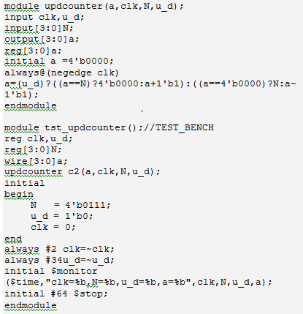
Design module of an up down counter and a test bench

Slide 17
Design module of a shift register with facility for right or left shift and a test bench
module shifrlter(a,clk,r_l); input clk,r_l;
output [7:0]a;
reg[7:0]a; initial a= 8'h01;
always@(negedge clk)
begin
a=(r_l)?(a>>1'b1):(a<<1'b1);
end endmodule
module tst_shifrlter;//test-bench reg clk,r_l;
wire [7:0]a;
shifrlter shrr(a,clk,r_l); initial
begin
clk =1'b1; r_l = 0;
end
always #2 clk =~clk; initial #16 r_l =~r_l; initial
$monitor($time,"clk=%b,r_l = %b,a =%b ",clk,r_l,a); initial #30 $stop;
endmodule

Slide 18
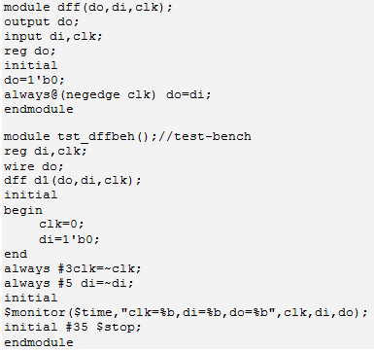
Design module of a D-flip-flop and a test bench

Slide 19
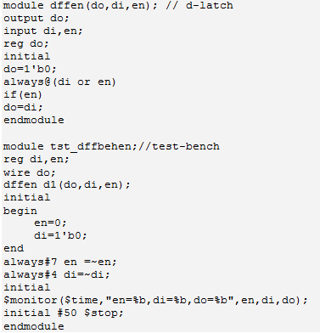
Design module of a D-latch and a test bench

Slide 20
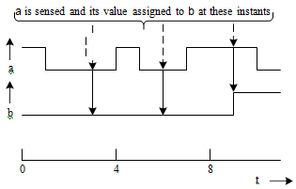
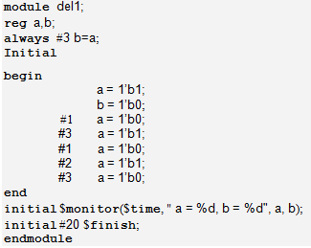
ASSIGNMENT WITH DELAYS
Specific delays can be associated with procedural assignments.
Consider the assignment always #3 b = a;
simulator encounters this at zero time and posts the entire activity to be done 3 ns later.
The always nature of the activity, the assignment is scheduled to be repeated every 3 ns, irrespective of whether a changes in the meantime. Values of a at the 3rd, 6th, 9th, etc., ns are sampled and assigned to b.

Slide 21
INTRA ASSIGNMENT DELAYS
The “intra-assignment” delay carries out the assignment in two parts.
An assignment with an intra- assignment has the form
A = # dl expression;
Here the expression is scheduled to be evaluated as soon as it is encountered. However, the result of the evaluation is assigned to the right-hand side quantity after a delay specified by dl.
In case it is an expression, it is evaluated and execution delayed by the number of time steps. If the number evaluates to a negative quantity, the same is interpreted as a 2’s complement value. In the statement
always #b a = a + 1;
a and b are variables. The execution incrementing a is scheduled at b ns. If b changes, the execution time also changes accordingly.

Slide 22
INTRA ASSIGNMENT DELAYS
As another example consider the procedural assignment
always #(b + c) a = a + 1;
Here a, b, and c are variables. The algebraic addition of variables b and c is to be done. The scheduler schedules the incrementing of a and reassigning the incremented values back to a with a time delay of (b + c) ns.
As an additional example consider the assignment below with an intra-assignment delay.
always #(a + b) a = #(b + c) a +1;
Here the simulator evaluates (a + b) during simulation. After a lapse of (a + b) ns, execution of the statement is taken up; (a + 1) is evaluated and assigned as the new value of a – but the assignment is delayed by (b + c) ns.
Zero Delay: A delay of 0 ns does not really cause any delay. However, it ensures that the assignment following is executed last in the concerned time slot.
always
begin a = 1;
#0 a = 0;
end

Slide 23
Wait CONSTRUCT
The wait construct makes the simulator wait for the specified expression to be true before proceeding with the following assignment or group of assignments.
Its syntax has the form wait (alpha) assignment1;
alpha can be a variable, the value on a net, or an expression involving them.
If alpha is an expression, it is evaluated; if true, assignment1 is carried out. One can also have a group of assignments within a block in place of assignment1.
The activity is level-sensitive in nature, in contrast to the edge-sensitive nature of event specified through @. Specifically the procedural assignment
@clk a = b;
assigns the value of b to a when clk changes;
if the value of b changes when clk is steady, the value of a remains unaltered.
In contrast, with wait(clk) #2 a = b;
the simulator waits for the clock to be high and then assigns b to a with a delay of 2 ns. The assignment will be refreshed as long as the clk remains high.

Slide 24
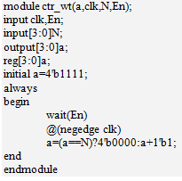
Example: The counter module uses a wait construct. It has an enable input En. The counter is active and counts only when En = 1

Slide 25

MULTIPLE ALWAYS BLOCKS
All the activities within an always block are scheduled for sequential execution.
The activities can be of a combinational nature, a clocked sequential nature, or a combination of these two. (A design description involving such combinations is conventionally called the ‘Register Transfer Level’ description.)
Basically, any circuit block whose end-to-end operation can be described as a continuous sequence can be described within an always block.
A typical circuit block conforming to the above description has three activities termed A1, A2, and A3. These three are to be done in that order. Activity A1 accepts x as input, and it generates output B and p. p and y form inputs to activity A2.
Similarly activity A2 generates outputs c and q after activity A1 is completed. q and z form outputs of A2. After activity A2 is completed, activity A3 is scheduled. It accepts z and q as inputs and generates D as output.
Here if A1, A2, and A3 are logical activities, the whole block can be synthesized as a combinational logic unit. If one or more of these are clocked events, execution may be sequential.

Slide 26
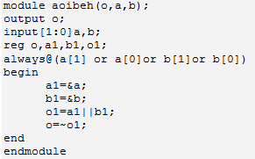
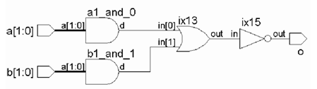

Designs at Behavioral level

Slide 27
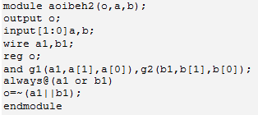
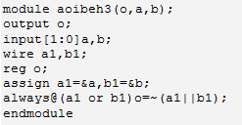

Slide 28
BLOCKING AND NONBLOCKING ASSIGNMENTS
 All assignment within an initial or an always block done through an equality (“=”) operator. These are executed sequentially. Such assignments block the execution of the following lot of assignments at any time step. Hence they are called “blocking assignments”.
 If the assignments are to be effected concurrently A facility called the “nonblocking assignment” is available for such situations. The symbol “<=” signifies a non-blocking assignment. The main characteristic of a nonblocking assignment is that its execution is concurrent
BEHAVIORAL MODELING

Slide 29
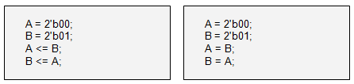
Swapping variable values through nonblocking assignments.
Another group of blocking assignments.
First A is assigned the binary value 00, and then B is assigned the value 01. These two assignments are sequential. The subsequent two assignments are concurrent. The assignment A <= B “reads” the value of B, stores it separately, and then assigns it to A. The new value of a is 01. The assignment B <= A ; takes the value of A– i.e., 00 – stores it separately and assigns it to B. Thus the new value of B is 00. After the block is executed, A has the value 01 while B has the value 00.
All four assignments here are sequential in nature. The third one, namely A = B; assigns the value 01 to a; subsequently the fourth and following assignment B = A ; assigns the present value of A (i.e., 01) to b; The value of b remains at 01 itself.

Slide 30
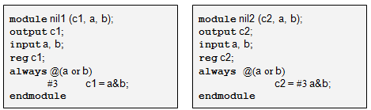
Blocking Assignments and Delays
Program1: A time delay in an evaluation
Program2: An intra-assignment delay
In Program 1, which has a delay of 3 ns for the blocking assignment to c1. If a or b changes, the always block is activated. Three ns later, (a&b) is evaluated and assigned to c1. The event “(a or b)” will be checked for change or trigger again. If a or b changes, all the activities are frozen for 3 ns. If a or b changes in the interim period, the block is not activated. Hence the module does not depict the desired output.
In Program2, with an intra-assignment delay of 3 ns to the assignment to c2. The always block is activated if a or b changes. (a & b) is evaluated immediately but assigned to c2 only after 3 ns. However, the behavior is not acceptable on two counts: a)The output assignment has to wait for 3 ns after the change. b)Only after the delayed assignment to c2, the event (a or b) checked for change. If a or b changes in the interim period, the block is not activated.

Slide 31
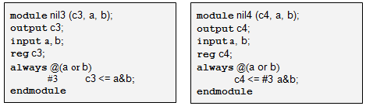
Non Blocking Assignments and Delays
Program 3: A time delay in a non- blocking assignment
Program 4: An intra-assignment delay in a non
blocking assignment.
In Program 3, has a blocking delay of 3 ns; but the assignment is of the non blocking type. The block is entered if the value of a or b changes but the evaluation of a&b and the assignment to c3 take place with a time delay of 3 ns. If a or b changes in the interim period, the block is not activated.
In Program 4, possibly represents the best alternative with time delay. The always block is activated if a or b changes. (a&b) is evaluated immediately and scheduled for assignment to c4 with a delay of 3 ns. Without waiting for the assignment to take effect (i.e., at the same time step as the entry to the block), control is returned to the event control operator. Further changes to a or b – if any are again taken cognizance of. The assignment is essentially a delay operation.

Slide 32
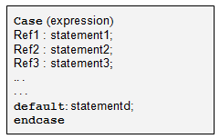
The CASE statement
The case statement is an elegant and simple construct for multiple branching in a module.
The keywords case, endcase, and default are associated with the case construct.
First expression is evaluated. If the evaluated value matches ref1, statement1 is executed; and the simulator exits the block;
else expression is compared with ref2 and in case of a match, statement2 is executed, and so on.
If none of the ref1, ref2, etc., matches the value of expression, the default statement is executed.

Slide 33
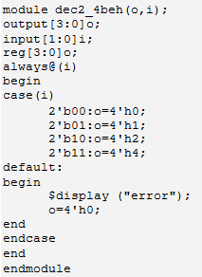
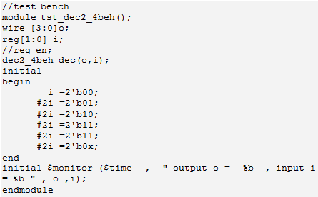
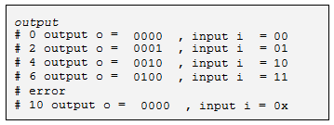
Example 1: Consider the module for a 2-to-4 decoder. The test bench is also included in the figure. One of the 4 output bits goes high, depending on the binary value of {i1, i2}. If i1, i2, or both take x or z values, there is no match and the default block is executed.

Slide 34
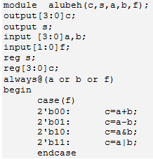
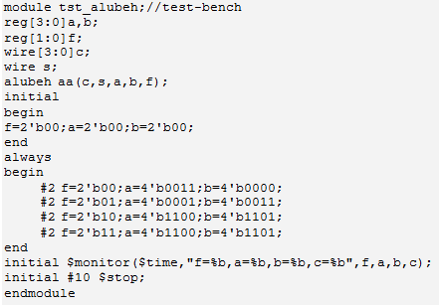
Example 2: An ALU module along with a test bench. The ALU function has been realized through a block with a case construct. Additional functions can be added to the ALU by a direct expansion of the case block.

Slide 35
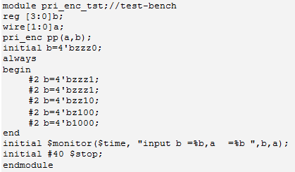
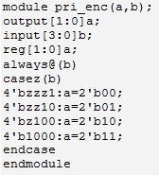
Casex and Casez
The case statement executes a multiway branching where every bit of the case expression contributes to the branching decision.
The statement has two variants where some of the bits of the case expression can be selectively treated as don’t cares – that is, ignored.
Casez allows z to be treated as a don’t care. “?” character also can be used in place of z.
Casex treats x or z as a don’t care.

Slide 36
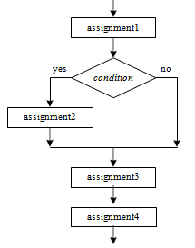

IF construct
The if construct checks a specific condition and decides execution based on the result. The following figure shows the structure of a segment of a module with an if statement.
After execution of assignment1, the condition specified is checked. If it is satisfied, assignment 2 is executed; if not, it is skipped. In either case the execution continues through assignment3, assignment4, etc. Execution of assignment2 alone is dependent on the condition. The rest of the sequence remains.

Slide 37
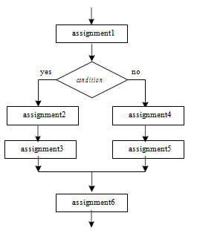
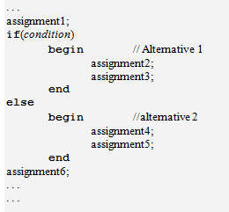
IF-ELSE construct
The if- else construct is more common and turns out to be more useful than the if construct taken alone.
The design description has two branches; the alternative taken is decided by the condition:
After the execution of assignment1, if the condition is satisfied, alternative1 is followed and assignment2 and assignment3 are executed. Assignment4 and assignment 5 are skipped and execution proceeds with assignment6.
If the condition is not satisfied, assignment2 and assignment3 are skipped and assignment4 and assignment5 are executed. Then execution continues with assignment6.

Slide 38
ASSIGN–DEASSIGN CONSTRUCT
The assign – deassign constructs allow continuous assignments
within a behavioral block.
always@(posedge clk) a = b;
BEHAVIORAL MODELING
At the positive edge of clk the value of b is assigned to a, and a remains frozen at that value until the next positive edge of clk.
Changes in b in the interval are ignored.
As an alternative, consider the block
always@(posedge clk) assign c = d;
Here at the positive edge of clk, c is assigned the value of d in a continuous manner; subsequent changes in d are directly reflected as changes in variable c:

Slide 39
always
begin
BEHAVIORAL MODELING
@(posedge clk) assign c = d; @(negedge clk) deassign c;
end
The above block signifies two activities:
1. At the positive edge of clk, c is assigned the value of d in a continuous manner.
2. At the following negative edge of clk, the continuous assignment to c is removed; subsequent changes to d are not passed on to c; it is as though c is electrically disconnected from d.

Slide 40
REPEAT CONSTRUCT
The repeat construct is used to repeat a specified block a specified
number of times.
…
repeat (a)
begin
assignment1;
assignment2;
…
End
…
The quantity a can be a number or an expression evaluated to a number.
The following block is executed “a” times. If “a” evaluates to 0 or x or z, the block is not executed.
BEHAVIORAL MODELING

Slide 41
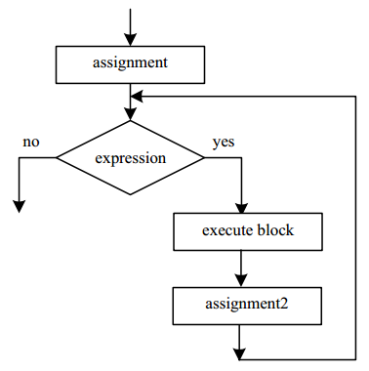
FOR LOOP
The for loop in Verilog is quite similar to the for loop in C
It has four parts; the sequence of execution is as follows:
1. Execute assignment1.
2. Evaluate expression.
3. If the expression evaluates to the true state (1), carry out statement. Go to step 5.
4. If expression evaluates to the false state (0), exit the loop.
5. Execute assignment2. Go to step 2
Structure:
. . . .
for(assignment1; expression; assignment 2)
statement;
. . .

Slide 42
THE DISABLE CONSTRUCT
To break out of a block or loop. The disable statement terminates a named block or task.
Control is transferred to the statement immediately following the block
The disable construct is functionally similar to the break in C
BEHAVIORAL MODELING
always@(posedge en)
begin:OR_gate
b=1'b0;
for(i=0; i<=3; i=i+1) if(a[i]==1'b1)
begin
b=1'b1;
disable OR_gate;
end
end

Slide 43

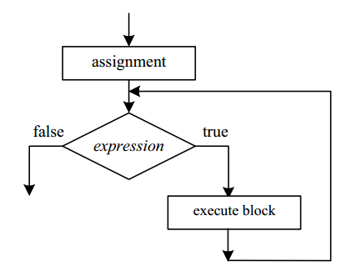
WHILE LOOP
The Boolean expression is evaluated. If it is true, the statements are executed and expression evaluated and checked.
If the expression evaluates to false, the loop is terminated and the following statement is taken for execution.
BEHAVIORAL MODELING

Slide 44
FOREVER LOOP
 Repeated execution of a block in an endless manner is best done with the forever loop (compare with repeat where the repetition is for a fixed number of times).
BEHAVIORAL MODELING
always @(posedge en)
forever#2 clk=~clk;

Slide 45
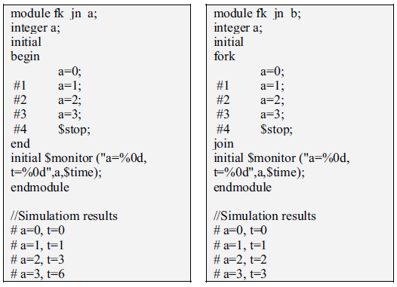
PARALLEL BLOCKS
 All the procedural assignments within a begin–end block are executed sequentially. The fork–join block is an alternate one where all the assignments are carried out concurrently (The non-blocking assignments too can be used for the purpose.). One can use a fork- join block within a begin–end block or vice versa.
BEHAVIORAL MODELING

Slide 46
FORCE–RELEASE CONSTRUCT
When debugging a design with a number of instantiations, one may be stuck with an unexpected behavior in a localized area. Tracing the paths of individual signals and debugging the design may prove to be too tedious or difficult.
In such cases suspect blocks may be isolated, tested, and debugged and status quo ante established. The force–release construct is for such a localized isolation for a limited period.
force a = 1'b0;
forces the variable a to take the value 0.
force b = c&d;
BEHAVIORAL MODELING
forces the variable b to the value obtained by evaluating the expression c&d.

Slide 47
EVENT
The keyword event allows an abstract event to be declared. The event is not a data type with any specific values; it is not a variable (reg) or a net.
It signifies a change that can be used as a trigger to communicate between modules or to synchronize events in different modules.
The operator “→” signifies the triggering. Subsequently, another
BEHAVIORAL MODELING
activity can be started in the module by the event change.
. . .
event change;
. . .
always
. . .
. . . → change;
. . .
always@change

Slide 48
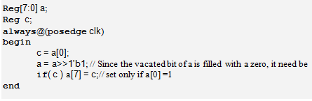
Example: A segment of a design using the if construct. It is a ring counter, which shifts one bit right at every clock pulse. The shift operation shifts the a byte right by one bit and fills the vacated bit – a[7] – with a zero. It is set to 1 if the bit shifted out last
– a[0] – was a 1. The same is carried out through the if statement.
A Ring counter description using the if construct

Slide 49
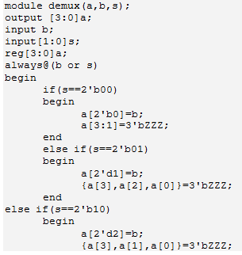
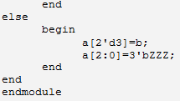
The use of case statement to realize mux, demux, direct encoders, and decoders makes the design description simple and direct – in contrast to the use of if-else-if construct.
Example: 2 to 4 demux module

Slide 50
SIMULATION FLOW
In Verilog the parallel processing is structured through the following [IEEE]
Simulation time: Simulation is carried out in simulation time.
At every simulation step a number of active events are sequentially carried out.
The simulator maintains an event queue – called the “Stratified Event Queue” – with an active segment at its top. The top most event in the active segment of the queue is taken up for execution next.
The active event can be of an update type or evaluation type. The evaluation event can be for evaluation of variables, values on nets, expressions, etc. Refreshing the queue and rearranging it constitutes the update event.
Any updating can call for a subsequent evaluation and vice versa.
Only after all the active events in a time step are executed, the simulation advances to the next time step.
Completion of the sequence of operations above at any time step signifies the parallel nature of the HDL.

Slide 51
Stratified Event Queue
The events being carried out at any instant give rise to other events – inherent in the execution process. All such events can be grouped into the following 5 types:
Active events –
Inactive events – The inactive events are the events lined up for execution immediately after the execution of the active events. Events specified with zero delay are all inactive events.
Blocking Assignment Events – Operations and processes carried out at previous time steps with results to be updated at the current time step are of this category.
Monitor Events – The Monitor events at the current time step –$monitor and $strobe – are to be processed after the processing of the active events, inactive events, and non blocking assignment events.
Future events – Events scheduled to occur at some future simulation time are the future events.

Slide 52
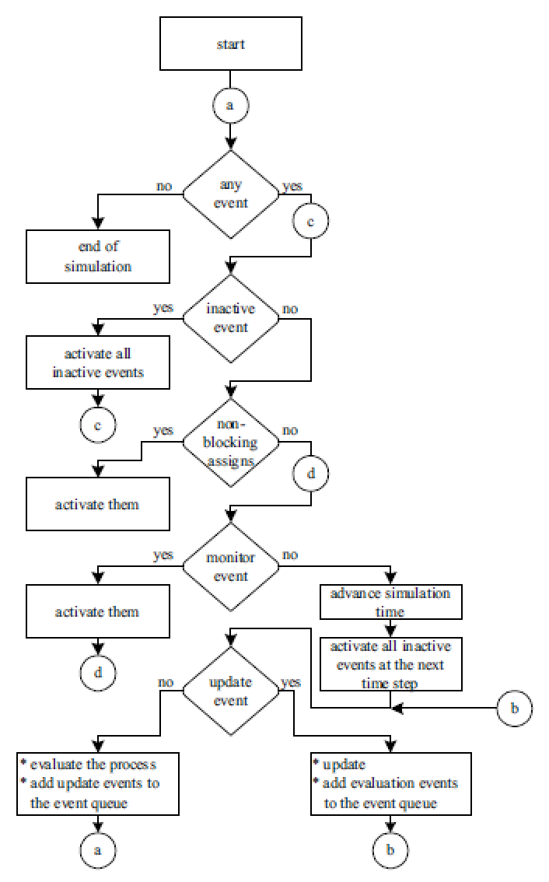
FLOW CHART for SIMULATION FLOW

