Slide 1
UNIT-4
DATAFLOW LEVEL AND SWITCH LEVEL MODELLING
Introduction
continuous assignment structures
delays and continuous assignments
assignment to vectors,
basic transistor switches,
CMOS switch
Bidirectional gates and time delays with switch primitives
instantiations with strengths and delays
strength contention with trireg nets.

Slide 2
INTRODUCTION
Gate level design description makes use of the gate primitives available in Verilog. These are repeatedly and judiciously instantiated to achieve the full design description.
Behavioral level modeling constitutes design description at an abstract level. it can be described at a functional level itself instead of getting bogged down with implementation details.
Data flow level description of a digital circuit is at a higher level. It makes the circuit description more compact as compared to design through gate primitives.
The operations are carried out on the operand(s) in singles or in combinations [IEEE]. The results are assigned to nets. The operand- operation-assignments representing data flow are carried out repeatedly to complete the design description

Slide 3

CONTINUOUS ASSIGNMENT STRUCTURES
A simple two input AND gate in data flow format has the form
assign c = a && b;
Here “assign” is the keyword carrying out the assignment operation. This type of assignment is called a continuous assignment.
a and b are operands – typically single-bit logic variables.
“&&” is a logic operator. It does the bit-wise AND operation on the two operands a and b.
“=” is an assignment activity carried out.
c is a net representing the signal which is the result of the assignment.
A module with an AND gate at the data flow level

Slide 4

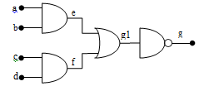

An A-O-I gate circuit

Slide 5
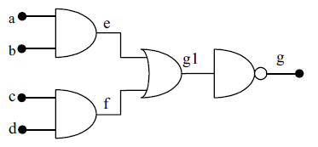
Combining Assignment and Net Declarations
The assignment statement can be combined with the net declaration itself making the assignment implicit in the net declaration itself.
Thus the two statements
wire c;
assign c = a & b; can be combined as wire c = a & b;
Example1:
module aoi1(g,a,b,c,d);
output g;
input a,b,c,d;
wire e,f,g1,g;
assign e = a && b,f = c && d, g1 = e||f, g=~g1;
endmodule
Example2:
module aoi2(g,a,b,c,d);
output g;
input a,b,c,d;
wire g;
wire e= a && b;
wire f= c && d;
wire g1 = e||f;
assign g = ~g1;
endmodule

Slide 6
Continuous Assignments and Strengths
A net to which a continuous assignment is being made can be assigned strengths for its logic levels.
The procedure is akin to the strength allocation to the outputs of primitives.
The assignment to g can be combined with the wire declaration into a single statement as wire (pull1, strong0)g = ~g1;
module aoi3 (g, a, b, c, d);
output g;
input a, b, c, d;
wire g;
wire e = a &&b;
wire f = c & &d;
wire g1 = e || f;
assign (pull1, strong0)g = ~g1;
endmodule

Slide 7
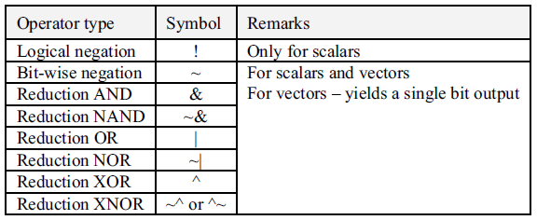
OPERATORS
Unary Operators

Slide 8
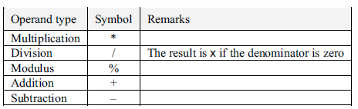

Binary Operators
 Arithmetic operators and their symbols
 Binary logical operators and their symbols

Slide 9
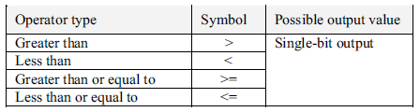
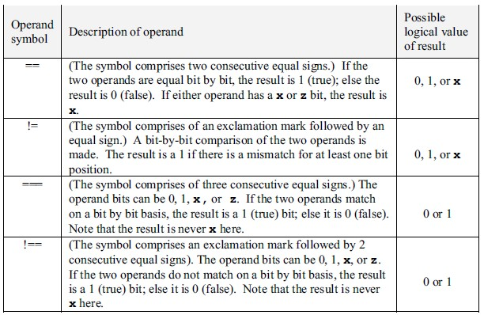
Relational operators and their symbols
Equality operators and their symbols

Slide 10
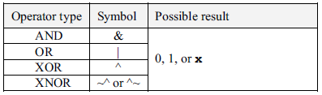
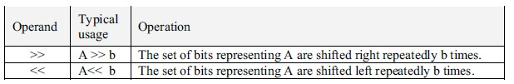
Bit-wise logical operators and their symbols
Shift type operators and their symbols
Ternary operator: Verilog has only one ternary operator – the conditional operator. It checks a condition and does a branching. It is a versatile and powerful operator. It enhances the potential of design description substantially
The general form is A?b:c
The conditional operation is made up of two operators – “?” and “:” – and three operands. The two operators separate the three operands in the order shown
“A” is evaluated first.
If A is true, b is evaluated.
If A is false, c is evaluated.

Slide 11
As an example1, consider the assignment statement
assign y = w ? x : z;
where w, x, y and z are binary bits. If the bit w is true (1), y is assigned the value of x: otherwise – that is, if w is false (0) – y is assigned the value of z. The assignment statement here multiplexes x and z onto y; w is the control signal here
As an example2, ALU can be defined in a compact manner using the ternary operator. assign d = (f==add)?(a+b): ((f==subtract)?(a-b): ((f==compl)?~a: ~b));
In the example here, f is taken as a control word. If it is equal to the number add, d is to be equal to the sum of a and b. If f is equal to the number subtract, d is to be equal to the difference between a and b. If it is equal to the number compl, d is to be the complement of a.
Verilog Program for ALU in Data flow modeling
module alu_df1 (d, co, a, b, f,cci);
output [3:0] d;
output co;
wire[3:0]d;
wire co;
input cci;
input [3 : 0 ] a, b;
input [1 : 0] f;
assign {co,d}=(f==2'b00)?(a+b+cci):((f==2'b01)?(a-b):((f==2'b10)? {1'bz,a^b}:{1'bz,~a}));
endmodule

Slide 12


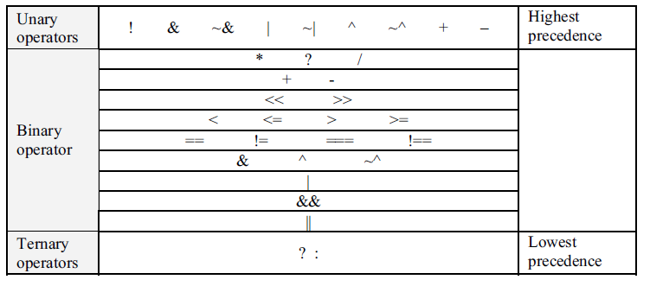
Operator Priority
U n i t - II
 The table brings out the order of precedence. The order of precedence decides the priority for sequence of execution and circuit realization in any assignment
 statement.

Slide 13
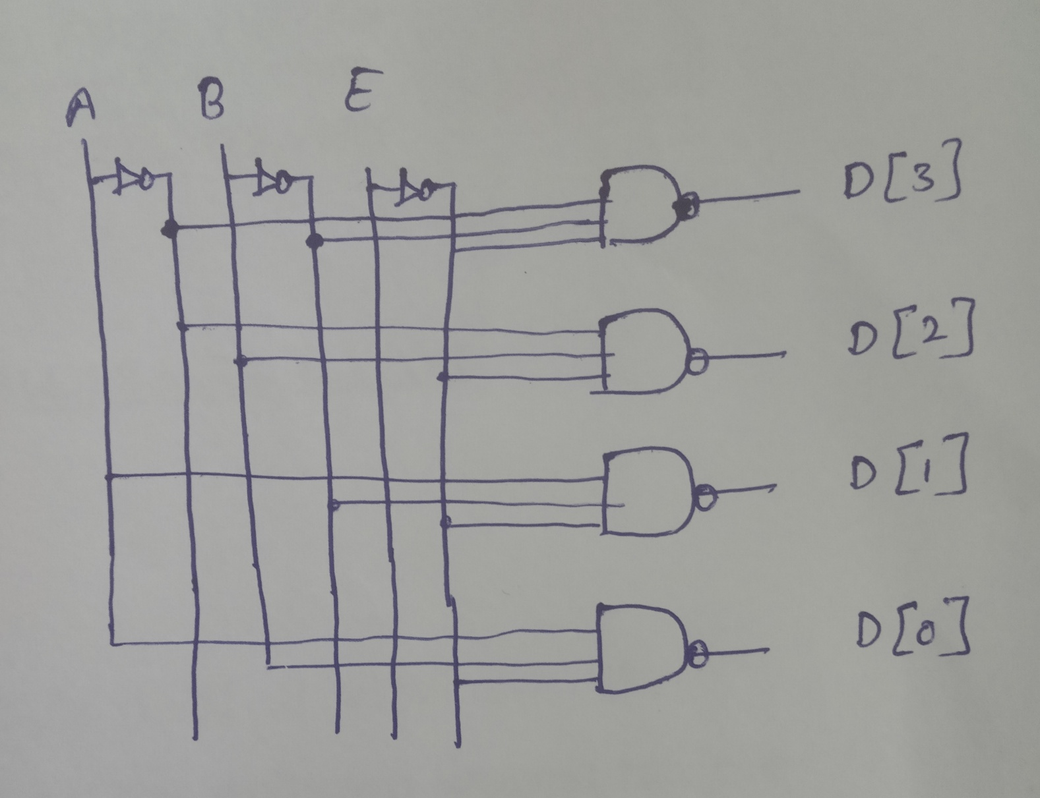
Dataflow description of 2-to-4 line decoder with enable input (E)

Slide 14
Dataflow description of 2-to-4 line decoder with enable input (E) module decoder_df (A,B,E,D);
input A,B,E;
output [3:0] D;
assign D[3] =~(~A & ~B & ~E);
assign D[2] =~(~A & B & ~E);
assign D[1] =~( A & ~B & ~E);
assign D[0] =~( A & B & ~E);
Or
assign D[3] =~(~A & ~B & ~E),
D[2] =~(~A & B & ~E),
D[1] =~( A & ~B & ~E),
D[0] =~( A & B & ~E);
endmodule

Slide 15
Decoders
3-to-8 Line Decoder
Binary Decoder
Y₇
Y₆
Y₅
Y₄ Y₃
Y₂
Y₁
Y₀
I₂
I₁
I₀

Slide 16
Encoders
Octal-to-Binary Encoder (8-to-3)
Binary Encoder
I₇
I₆
I₅
I₄ I₃
I₂
I₁
I₀
I₇ I₆ I₅ I₄ I₃ I₂ I₁ I₀ | Y₂ Y₁ Y₀
0 0 0 0 0 0 0 1 | 0 0 0
0 0 0 0 0 0 1 0 | 0 0 1
0 0 0 0 0 1 0 0 | 0 1 0
0 0 0 0 1 0 0 0 | 0 1 1
0 0 0 1 0 0 0 0 | 1 0 0
0 0 1 0 0 0 0 0 | 1 0 1
0 1 0 0 0 0 0 0 | 1 1 0
1 0 0 0 0 0 0 0 | 1 1 1
Y₂
Y₁
Y₀

Slide 17
Multiplexers
S₁ S₀ | Y
0 0 | I₀
0 1 | I₁
1 0 | I₂
1 1 | I₃
MUX
I₀
I₁
I₂
I₃
Y
S₁ S₀

Slide 18
Multiplexers
2-to-1 MUX
4-to-1 MUX
MUX
I₀
I₁
Y
S
MUX
I₀
I₁
I₂
I₃
Y
S₁ S₀

Slide 19
BCD-to-Seven-Segment Decoder
Specification
Digital readouts on many digital products often use LED seven-segment displays.
Each digit is created by lighting the appropriate segments. The segments are labeled a,b,c,d,e,f,g
The decoder takes a BCD input and outputs the correct code for the seven-segment display.

Slide 20
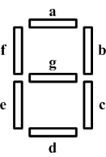
Specification
Input: A 4-bit binary value that is a BCD coded input.
Outputs: 7 bits, a through g for each of the segments of the display.
Operation: Decode the input to activate the correct segments.

Slide 21
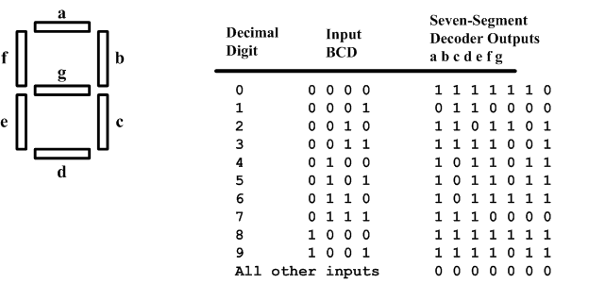
Formulation
Construct a truth table

Slide 22
Optimization
Create a K-map for each output and get
A = A’C+A’BD+B’C’D’+AB’C’
B = A’B’+A’C’D’+A’CD+AB’C’
C = A’B+A’D+B’C’D’+AB’C’
D = A’CD’+A’B’C+B’C’D’+AB’C’+A’BC’D
E = A’CD’+B’C’D’
F = A’BC’+A’C’D’+A’BD’+AB’C’
G = A’CD’+A’B’C+A’BC’+AB’C’

Slide 23
DELAYS AND CONTINUOUS ASSIGNMENTS
Delays can be incorporated at the data flow level in different ways
Example1:
wire c, a, b;
assign #2 c = a & b;
Example2:
wire a, b;
wire #2 c = a & b;
The assignment takes effect with a time delay of 2 time steps. If a or b changes in value, the program waits for 2 time steps, computes the value of c based on the values of a and b at the time of computation, and assigns it to c.
In the interim period, a or b may change further, but c changes and takes the new value only 2 time steps after the change in a or b initiates it.

Slide 24
ASSIGNMENT TO VECTORS
The continuous assignments are equally applicable to vectors. A single statement can describe operations involving vectors wherever possible.
Concatenation of Vectors: One can concatenate vectors, scalars, and part vectors to form other vectors. The concatenated vector is enclosed within braces. Commas separate the components –scalars, vectors, and part vectors.
{2{p}} = {p, p}
{2{p}, q} = {p, p, q}
{a, 3 {2{b , c}, d}} = {a, b, c, b, c, d, b, c, b, c, d, b, c, b, c, d }
Example: Eight Bit adder
module add_8(a,b,c);
input[7:0]a,b;
output[7:0]c;
assign c = a + b ;
endmodule

Slide 25

SWITCH LEVEL MODELING
INTRODUCTION
The MOS transistor is the basic element around which a VLSI is built. Designers familiar with logic gates and their configurations at the circuit level may choose to do their designs using MOS transistors.
Verilog has the provision to do the design description at the switch level using such MOS transistors, which is the theme of the present chapter.
Switch level modeling forms the basic level of modeling digital circuits. The switches are available as primitives in Verilog

Slide 26


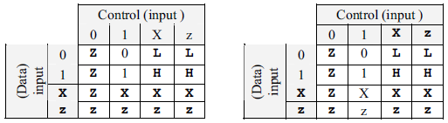
BASIC SWITCH PRIMITIVES
Different switch primitives are available in Verilog
nmos switch primitives
nmos (out, in, control);
pmos switch primitives
pmos (out, in, control);

Slide 27
Resistive Switches
 nmos and pmos represent switches of low impedance in the
on-state. rnmos and rpmos represent counterparts of these respectively.
rnmos (output1, input1, control1);
rpmos (output2, input2, control2);
the resistive
 It inserts a definite resistance between the input and the output signals but retains the signal value
 The rpmos and rnmos switches function as unidirectional switches; the signal flow is from the input to the output side.

Slide 28
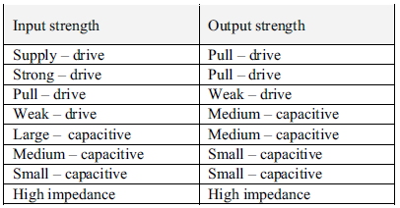
strength levels
 Output-side strength levels for different input-side
strength values of rnmos, rpmos, and rcmos switches

Slide 29
pullup and pulldown
 A MOS transistor functions as a resistive element when in the active state. Realization of resistance in this form takes less silicon area in the IC as compared to a resistance realized directly. pullup and pulldown represent such resistive elements.
 pullup (x);
Here net x is pulled up to the supply1 through a resistance.
 pulldown(y);
pulls y down to the supply0 level through a resistance.
The pullup and pulldown primitives can be used as loads for switches or to connect the unused input ports to VCC or GND, respectively.

Slide 30
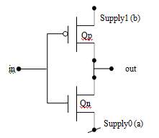
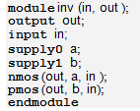
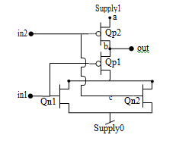
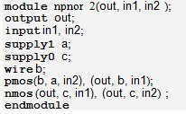
CMOS INVERTER
CMOS NOR

Slide 31
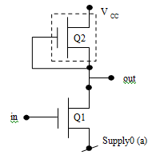
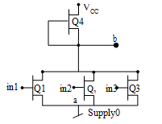
NMOS Inverter with Pull up Load
module NMOSinv(out,in);
output out;
input in;
supply0 a;
pullup (out);
nmos(out,a,in);
endmodule
An NMOS Three Input NOR Gate
module nor3NMOS(in1,in2,in3,b);
output b;
input in1,in2,in3;
supply0 a;
pullup(b);
wire b;
nmos(b,a,in1),(b,a,in2),(b,a,in3);
endmodule

Slide 32

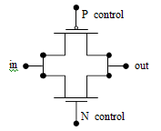
CMOS SWITCH
 A CMOS switch is formed by connecting a PMOS and an NMOS switch in parallel – the input leads are connected together on the one side and the output leads are connected together on the other side.
 The CMOS switch is instantiated as shown below.
cmos csw (out, in, N_control, P_control );

Slide 33
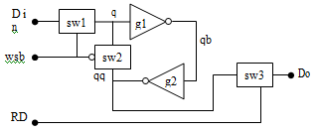
A RAM Cell or SRAM
A basic RAM cell with facilities for writing data, storing data, and reading data.
When switch sw2 is ON, qb – the output of inverter g1 – forms the input to the inverter g2 and vice versa.
The g1-g2 combination functions as a latch and freezes the last state entry before sw2 turns on. The step-by-step function of the cell is as
When wsb (write/store) is high, switch sw1 is ON, and switch sw2 OFF. With sw1 on, input Din is connected to the input of gate g1 and remains so connected.
When wsb goes low, din is isolated, since sw1 is OFF. But sw2 is ON and the data remains latched in the latch formed by g1-g2. In other words the data Din is stored in the RAM cell formed by g1-g2.
When RD (Read) goes active (=1), the latched state is available as output Do.
Reading is normally done when the latch is in the stored state.

Slide 34
module ram_cell(do,din,wsb,rd);
output do;
input din,wsb,rd;
wire sb;
wire q,qq;
tri do;
csw sw1(q,din,wsb),sw2(q,qq,sb),sw3(do,q,rd);
not n1(sb,wsb),n2(qb,q),n3(qq,qb);
endmodule
module csw(out,in,n_ctr);
output out;
input in,n_ctr;
wire p_ctr;
assign p_ctr =~n_ctr;
cmos csw(out,in,n_ctr,p_ctr);
endmodule

Slide 35
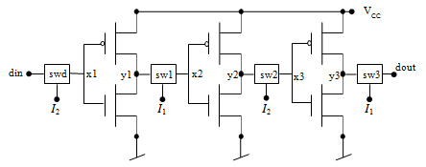
A Dynamic Shift Register
Three successive stages of a dynamic shift register. It is operated through a two-phase clock system – I1 and I2. Each stage has a CMOS inverter. Successive stages are given input through CMOS switches (sw1, sw2, etc.). I1 and I2 are symmetric clock waveforms in anti-phase. Two successive stages together form one storage element.
When I2 is ON AND I1 is OFF. Din is input to stage 1 through switch swd. sw1 and sw3 are OFF and sw2 is ON. State of stage 2 (attained when I1 was high last) is coupled as input to stage 3 through switch sw2, and stage 3 takes up the new state.
In the next half cycle, I1 is ON and I2 is OFF. sw1 and sw3 are ON and sw2 is OFF. State of stage 1 (attained when I2 was high last) is coupled as input to stage 2 through switch sw1 and Do takes up the new state from stage3 through sw3.

Slide 36
BI-DIRECTIONAL GATES
 Verilog has a set of primitives for bi-directional switches as well. They connect the nets on either side when ON and isolate them when OFF. The signal flow can be in either direction
 tran and rtran
The tran gate is a bi-directional gate of two ports. When instantiated, it connects the two ports directly.
tran (s1, s2); connects the signal lines s1 and s2.
Either line can be input, inout or output.
rtran is the resistive counterpart of tran.

Slide 37
Cont…
tranif1 and rtranif1
 tranif1 is a bi-directional switch turned ON/OFF through a control line(c). It is in the ON-state when the control signal is at 1 (high) state
tranif1 (s1, s2, c );
tranif0 and rtranif0
 tranif0 and rtranif0 are again bi-directional switches. The switch is OFF if the control line is in the 1 state, and it is ON when the control line is in the 0 state.
tranif0 (s1, s2, c);

Slide 38
TIME DELAYS WITH SWITCH PRIMITIVES
 nmos g1 (out, in, ctrl );
has no delay associated with it.
 nmos (delay1) g2 (out, in, ctrl );
has delay1 as the delay for the output to rise, fall, and turn OFF.
 nmos (delay_r, delay_f) g3 (out, in, ctrl );
has delay_r as the rise-time for the output. delay_f is the fall-time for the
output. The turn-off time is zero.
 nmos (delay_r, delay_f, delay_o) g4 (out, in, ctrl );
has delay_r as the rise-time for the output. delay_f is the fall-time for the output delay_o is the time to turn OFF when the control signal ctrl goes from 0 to 1.

Slide 39
Cont…
 Delays can be assigned to the other uni-directional gates in a
similar manner.
 Bi-directional switches do not delay transmission – their rise- and fall-times are zero. They can have only turn-on and turn-off delays associated with them.
 tran has no delay associated with it.
 tranif1 (delay_r, delay_f) g5 (out, in, ctrl );
When control changes from 0 to 1, the switch turns on with a delay of delay_r. When control changes from 1 to 0, the switch turns off with a delay of delay_f.
 transif1 (delay0) g2 (out, in, ctrl );
represents an instantiation with delay0 as the delay for the switch to turn on when control changes from 0 to 1, with the same delay for it to turn off when control changes from 1 to 0

Slide 40
INSTANTIATIONS WITH STRENGTHS AND DELAYS
nmos (strong1, strong0) (delay_r, delay_f, delay_o ) gg (s1,
s2, ctrl) ;
rnmos, pmos, and rpmos switches too can be instantiated in the general form in the same manner. The general instantiation for the bi-directional gates too can be done similarly.
STRENGTH CONTENTION WITH TRIREG NETS
 nets declared as trireg can have capacitive storage. Such storage can be assigned one of three strengths – large, medium, or small.
 Driving such a net from different sources can lead to contention

