Slide 1
UNIT-5 & 6
SYNTHSIS OF COMBINATIONAL AND SEQUENTIAL LOGIC USING VERILOG
VERILOG MODULES
Synthesis of combinational logic:
Net list of structured primitives
A set of continuous assignment statements and
level sensitive cyclic behavior with examples,
Synthesis of priority structures
Exploiting logic don’t care conditions.
Synthesis of sequential logic with latches
Accidental synthesis of latches and Intentional synthesis of latches
Synthesis of sequential logic with flip-flops
Synthesis of explicit state machines
Verilog Modules

Slide 2
Design and synthesis
Given an overall system architecture and partitioning is stable one can capture the design
Work at many level typically at the register transfer level.
Synthesis tools convert RTL to gate level circuits.
Large designs require working at high level automation to minimize time to market -> RTL should be synthesizable
Typically design at the RTL level of abstraction as lowest level of abstraction
is used for functional simulation
Synthesized to gate level for use by the CAD tools

Slide 3
LOGIC SYNTHESIS
Verilog is used to
Model hardware for discrete-event simulation
Input to logic synthesis
Construct test benches
Only a subset of Verilog constructs can be synthesized into an efficient circuit
Exactly what can synthesize depends on tools and technologies
Logic synthesis involves
Translating Verilog source to a net list
Optimization for speed and circuit size
Detect and eliminate redundant logic
Detect combinatorial feedback loops
Exploit don’t cares
Collapse equivalent states
Optimize for a particular technology

Slide 4
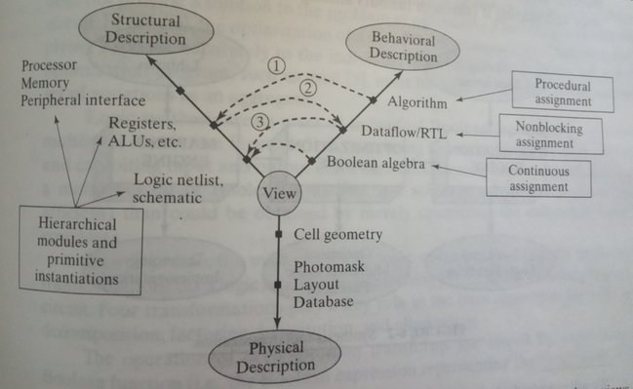
A Y-chart representation of verilog constructs supporting synthesis activity in three domains

Slide 5
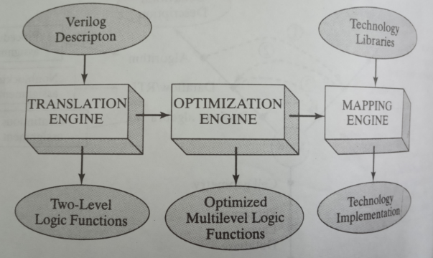
Synthesis Tool Organization

Slide 6
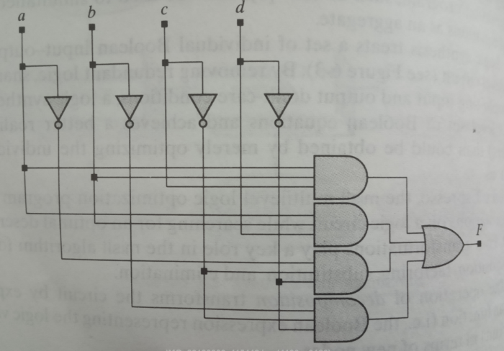
Circuit Before Decomposition
The following figure is to be decomposed in terms of new nodes X and Y.
The original form F = abc + abd + a’c’d’ + b’c’d’

Slide 7
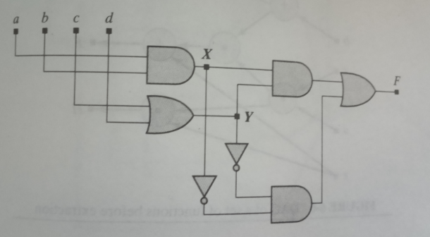
Circuit After Decomposition
F = XY + X’Y’
X= ab
Y= c+d

Slide 8
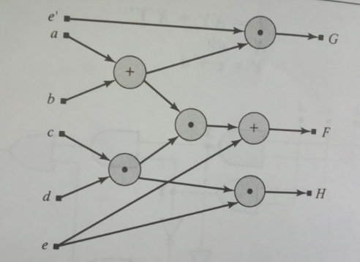
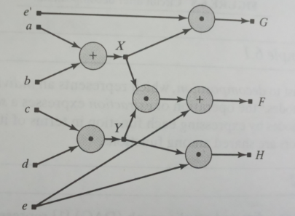
Circuit Before Decomposition
Circuit After Decomposition

Slide 9
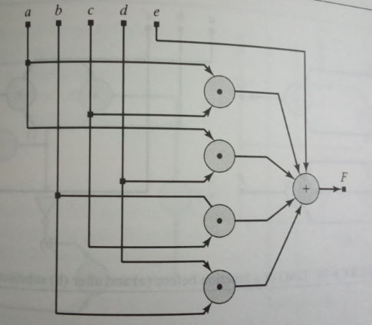
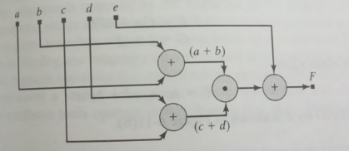
Circuit Before Decomposition
Circuit After Decomposition

Slide 10
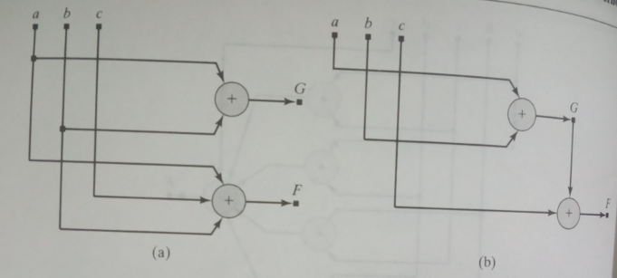

Slide 11
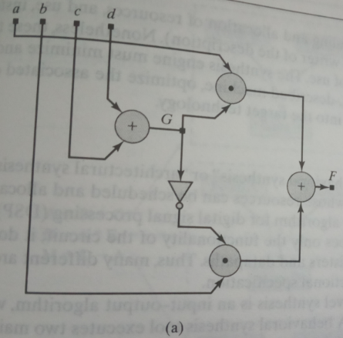
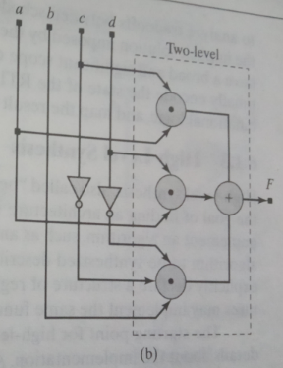

Slide 12
Synthesis of Combinational Logic
Synthesizable combinational logic can be described by
A net list of structural primitives or combinatorial modules
Continuous assignment statements
Level sensitive cyclic behaviors

Slide 13
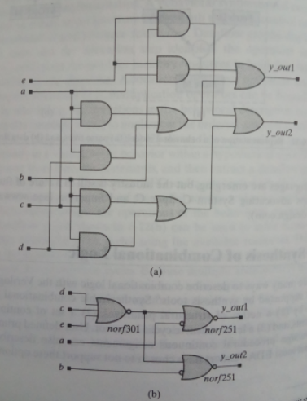
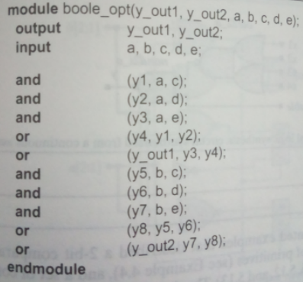
A net list of structural primitives or combinatorial modules

Slide 14
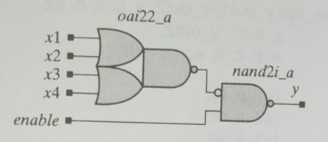
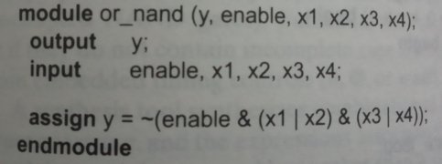
Continuous assignment statements
For combinational logic, behavioral descriptions take the form of Boolean equations
Verilog equivalent is continuous assignment statement.
Assigns net (wire) to output of multilevel comb. circuit

Slide 15
Level sensitive cyclic behaviors
Level sensitive cyclic behavior will synthesis to combinational logic if there is an output for every possible input combination (to inputs in sensitivity list)
Sensitivity list must be sensitive to every input
Every path through behavior must assign value to every output
Defines functionality in device independent way but doesn’t define realization, timing
module comparator (AltB, AgtB, AeqB, A1, A0, B1, B0);
input A1, A0, B1, B0;
output AltB, AgtB, AeqB;
reg AltB, AgtB, AeqB;
always @ (A0 or A1 or B0 or B1)
begin
AltB =({A1,A0} < {B1,B0});
AgtB =({A1,A0} > {B1,B0});
AeqB =({A1,A0} == {B1,B0});
end
endmodule

Slide 16
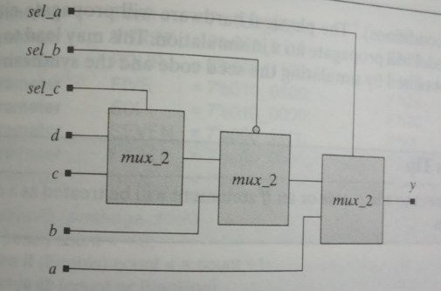
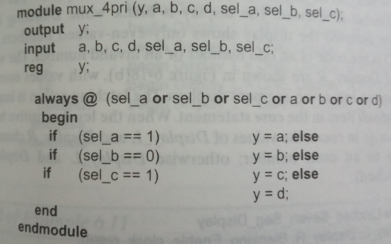
Synthesis of priority structures

Slide 17
EXPLOITING LOGICAL DON’T CARE CONDITIONS
When case, conditional branch(if), or conditional assignment (?... :) statements are used in verilog behavioral description of combinational logic then the synthesized net list should produce the same simulation results if the code has default assignments that are purely 0 or 1.
Simulation results will differ if the default or branch statements makes an explicit assignment of an X or a Z.
A synthesis tool will treat casex and casez statements as case statements.
Those case items that decode to explicit assignment of X or Z will be treated as don’t care conditions for the purpose of logical minimization of the equivalent Boolean expressions

Slide 18
Synthesis of sequential Logic with latches
Latches are synthesized in two ways as intentionally and accidentally
A feedback free net list of combinational primitives or continuous assignments will synthesize into latch-free combinational logic
If the assign statement or level sensitive always @ has feedback a latch is synthesized assign Q = s ? D:Q;
Feedback free net list of combinational logic will form latch free combinatorial logic – REG variables do not always mean flip-flops
Accidental synthesis of latches can occur in procedural combinational logic blocks
If an output is not specified for some combination of inputs in the sensitivity list Verilog assumes current values of variables set in procedural assignments is maintained and latch will be inferred. • Likewise all RHS operands of procedural assignments should be in sensitivity list • Also RHS operand of procedural assignment must not be on LHS of the expression (explicit feedback)

Slide 19
Accidental synthesis of latches
module mux_latch (yout, sela, selb, datax, datay);
output yout;
input sela, selb, datax, datay;
reg yout;
always @ (sela or selb or datax or datay)
case ({ sela, selb })
2’b10:yout=datax;
2’b01:yout=datay;
endcase
endmodule
Intentional synthesis of latches
module latch_if (datout, datain, latchenable);
output [3:0] dataout;
input [3:0] datain;
input latchenable;
reg [3:0] dataout;
always @ (latchenable or datain)
if (latchenable) dataout=datain;
else dataout=dataout;
endmodule

Slide 20
A continuous assignment that uses the conditional operator (? :) with feedback will synthesize to a latch. Ex: SRAM
assign data_out= (CS==0) ? (WE==0) ? Data_in : data_out : 1’bz;
Here the signals CS and WE are active low chip select and write enable functions of the cell
If the chip is selected and WE==0, data_out follows data_in (Transparent mode) but when WE switches to 1 then data_out=data_out (Latched mode).
Synthesis tool infer the behavior of latch because the output of device is not effected by data_in while WE=1 and data_out holds the remaining value.
If CS==1 then the cell is in three state high impedance condition

Slide 21
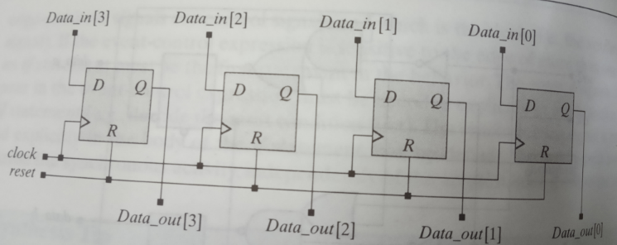
Synthesis of sequential logic with flip flops
FOUR BIT PARALLEL IN PARALLEL OUT DATA REGISTER
module d_reg(dataout, clock, reset, datain);
output [3:0] dataout;
input [3:0] datain;
input clock, reset;
reg [3:0] dataout;
always @ (posedge clock or posedge reset)
begin
if (reset==1’b1) dataout<=4’b0;
else dataout<=datain;
end
endmodule

Slide 22
The behavior in emptycircuit assigns value to the register variable dout. But in the below verilog program dout is not referenced outside the scope of the behavior. Consequently, a synthesis tool will eliminate dout.
module emptycircuit (din, clk);
input din;
input clk;
reg dout;
always @ (posedge clk)
begin
dout<=din;
end
endmodule
If emptycircuit is modified to declare dout as an output port then dout will be synthesized as the output of a flip flop

Slide 23
Sensitivity list of an always block can be sensitive to clock edges (posedge or negedge)
Clock, clk etc are not keywords and need to be defined and assigned.
Synthesis tool must infer the synchronising signal and whether a flip flop is required.
// D Flipflop
module my_dff (q, qbar,d, clk,clr); input d, clk, clr; output q, qbar; assign qbar = ~q; always @ (posedge clk)
begin if (clr == 0) q <= 0; else q <=d; end endmodule
// asynchronous clear D flipflop module my_dff (q, qbar,d, clk,clr); input d, clk, clr; output q, qbar; assign qbar = ~q; always @ (posedge clk or negedge clr) begin if (clr == 0) q <= 0; else q <=d; end endmodule

Slide 24
SHIFT REGISTERS
Registers can be modeled as vectored flipflops
module shiftreg (A, E, clk, rst);
output A;
input E;
input clk,rst;
reg A,B,C,D;
always @ (posedge clk or posedge rst)
begin if (rst)
begin A <= 0; B <= 0; C <= 0; D <= 0; end else
begin
A <= B; //D <= E;
B <= C; //C <= D;
C <= D; //B <= C;
D <= E; //A <= B;
end end endmodule

Slide 25
Synthesis of explicit state machines
For state machine implementation – State based on control operations (counting up,down, idle) rather than count itself. Can often be simplified to counting/idle. – More flexible – Generalizes to other word lengths – Count maintained in separate register than the state
Explicit state machines have explicit storage of state variables and explicit logic to generate next state. Typically at least two (or three) always blocks
Level sensitive, next state (and output) generator Use = for combinations logic
Decode all possible states
Edge sensitive, synchronous state transitions Use <= for synchronous transitions
Usually restrictions on state machine implementation for synthesis – Can assign a variable in state assignments – Must set entire state register at once • Avoid having one variable assigned in more than one always block.

