Slide 1
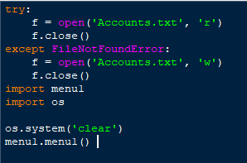
MAIN ATM module
This is the main module of this project.
To run this ATM simulator project we have to execute this python code (program).
This code uses an exception handling mechanism .
If the file Account.txt already exist it read from that file else a FileNotFoundError exception occurs
The Account.txt file is created in the forth coming section of ‘creating account function’.
This code contains a module named ‘menu1’ which will be called once we run the code.
Exception handling: When an error occurs, or exception as we call it, Python will normally stop and generate an error message. These exceptions can be handled using the try statement
The try block lets you test a block of code for errors.
The except block lets you handle the error.

Slide 2
Description Of The Above Module
# create Accounts.txt if not exist
The try block defines :
# read the 'Accounts.txt' file
# if you try to open non existing file in read mode, this will throw an error
The except block defines :
# if 'Accounts.txt' file is not found, create it
Import modules
import menu1
import os
menu1.menu1() # start the program - call menu1() function

Slide 3
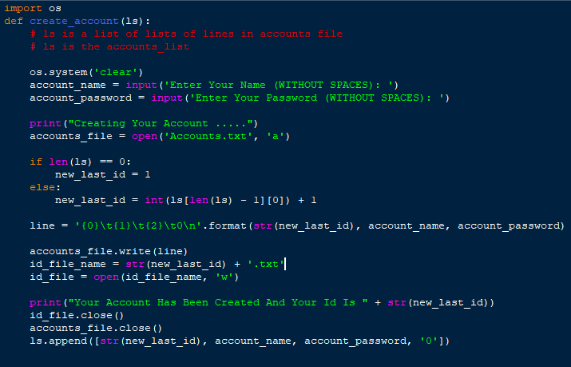
CREATE ACCOUNT
import os The OS module in python provides functions for interacting with the operating system. OS, comes under Python’s standard utility module
In this module we are creating an account. A text file name Accounts.txt is created that is we are appending (creating a file if it does not exist) the file with account : name, id, password and balance
Every time a new account is created the id get appended by 1.
ls- ls is the account list i.e. the lists of lines in account file
Id_file is maintained to keep record of the process that takes place through the account

Slide 4
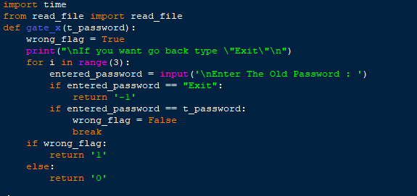
CHANGE PASSWORD part 1
This python file change_password.py intend to change the password of the user account.
This python code can be divided into 2 paths:
get old password or exit (if you want to go back)
Change the password
The process:
Get the old password
Enter a new password
Append the new password corresponding to the matched id in the ‘Account.txt’ file

Slide 5
Description Of The Above Module
import time #handle time-related tasks
from read_file import read_file #import the read_file module
def gate_x(t_password): #t_password = true password
# Enter old password to confirm the new password
wrong_flag = True # True if end all tries wrong
print("\nIf you want go back type \"Exit\"\n")
for i in range(3): # Limit the try to enter the old password
entered_password = input('\nEnter The Old Password : ')
if entered_password == "Exit": # Return the Exit flag i.e. it revert back to the menu1
return '-1'
if entered_password == t_password: # Compere if the Entered password = the True password
wrong_flag = False # Set to false mean the entered password confirmed
break
if wrong_flag: # Return the wrong flag
return '1'
else: # Return the true flag
return '0'

Slide 6
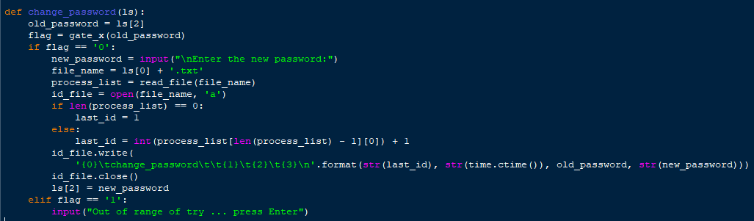
CHANGE PASSWORD part 2

Slide 7
Description Of The Above Module
def change_password(ls): #a function to change the password
# It is used Get the old password
old_password = ls[2]
# Ask to old password to enter new one
flag = gate_x(old_password)
# Security flag get the output flag
if flag == '0':
new_password = input("\nEnter the new password: ")
file_name = ls[0] + '.txt'
process_list = read_file(file_name)
id_file = open(file_name, 'a')
if len(process_list) == 0: # if there are no processes in the file
last_id = 1
else:
last_id = int(process_list[len(process_list) - 1][0]) + 1 # get last id and increment it
id_file.write('{0}\tchange_password\t\t{1}\t{2}\t{3}\n'.format(str(last_id), str(time.ctime()), old_password, str(new_password)))
# write process id type before after
id_file.close()
# Check if Different is negative value
ls[2] = new_password
# Write the new password
elif flag == '1':
input("Out of range of try ... press Enter")
Note: a process_list (id_file) is maintained to keep records/count on the number of times the password is changed .

