Slide 1

KAKATIYA INSTITUTE OF TECHNOLOGY& SCIENCE (An Autonomous Institute under Kakatiya University, Warangal) Opp: Yerragattu Gutta, Hasanparthy (M), Warangal-506015, Telangana (INDIA)
DEPARTMENT OF ELECTRONICS & COMMUNICATION ENGINEERING
U18EC510: SEMINAR
“ARTIFICIAL INTELLEGENCE FOR SPEECH RECOGNATION”
Presented by
Name: Gajjala Akash Reddy
Roll Number: B19EC080
SeminarSupervisor Seminar Coordinator Seminar Convener Head, Dept.of ECE
Dr.Umamaheswar Sri A.Srinivas Dr.M.Raju Dr. B.RamaDevi
Asst.professer Asst. Professor Assoc. Professor Professor
Dept. of ECE Dept. of ECE Dept. of ECE

Slide 2
CONTENTS
* ABSTRACT
* OVERVIEW & BACKGROUND
* KEY TERMS
* OBJECTIVES
* BLOCK DIAGRAM
* APPLICATIONS
* ADVANTAGES & DISADVANTAGES
* CONCLUSION

Slide 3
ABSTRACT
Speech Recognisation the most important application of Artificial Intelligence in which people interact with Roberts and computer as they are humans. Speech and gestures are the most natural ways for humans to communicate with other.
It entails recording and digitalize sound waves and converts spoken speech into alphanumeric text and navigation instruction it may be stated that speech recognisation benefits its user and assists them in performance their everyday regular duties in a more convenient and productive manner.

Slide 4
OVERVIEW & BACKGROUND
Artificial intelligence for speech recognisation is to convert speech into a sequence of words by a computer program . Some of these applications include voice dialing ,call routing.
As the most naturally communication modality for humans, the ultimate dream of speech recognisation is to enable people to communicate more naturally and effectively.
The first speech recognisation system was focused on numbers, not words.In 1952, Bell Laboratories designed ‘Audrey’ system which would recognize a single voice speaking digits aloud.

Slide 5
KEY TERMS
AUTOMATIC SPEECH RECOGNISATION : It is the technology that allows human beings to use their voices to speak with computer.
HUMAN COMPUTER INTERACTION : It focuses on the interface between humans and computers.
ARTIFICIAL INTELLEGENCE : It is the stimulation of human Intelligence processes by machines, especially computer systems.

Slide 6
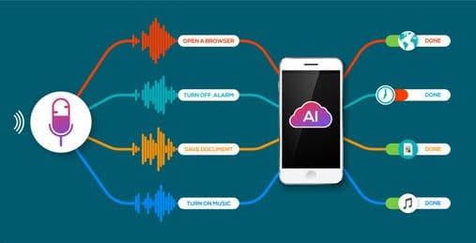
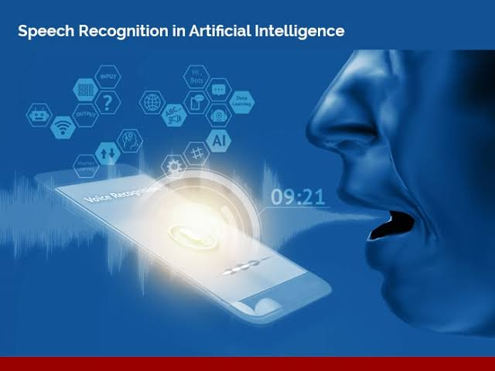
OBJECTIVE
Speech recognition, the ability of devices to respond to spoken commands. Speech recognition enables hands-free control of various devices and equipment (a particular boon to many disabled persons), provides input to automatic translation, and creates print-ready dictation.

Slide 7
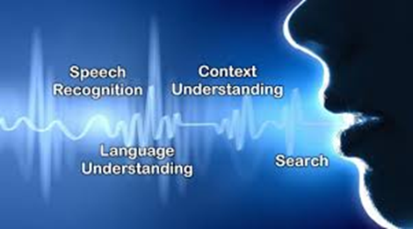
BLOCK DIAGRAM
Speech signal
Recognized signal
PREPROCESSING
FEATURE
EXTRACTION
PATTERN
CLASSIFICATION
PATTERN
TRANING
DECISION
RULES
TEMPLATE/
MODEL

Slide 8
APPLICATIONS
Searching for reports or documents on your computer.
Self driving cars (to adjust volume, change stations, improve driving safety)
Popular Digital Assistance
- Amazon Alexa.
-Apple’s Siri.
-Google’s Goggle Assistant.
-Microsoft’s Cortana.

Slide 9
ADVANTAGES AND DISADVANTAGES
ADVANTAGES | DISADVANTAGES
1. Voice commands are a far more efficient tools than typing a message . | 1.Difficult to build a perfect system.
2.In business it provides better customer service experience increase customer satisfaction ,decrease operational cost. | 2.It doesn’t keep privacy it does not suit a crowned environment.
3.It catches speech much faster then we type. | 3.The software can struggle with vocabulary, particularly if there are specialist terms .
4.Hand free capability. | 4.Filtering noise is a task and it is too much that can even be difficult for humans to accomplish.

Slide 10
CONCLUSION
Speech is a primary and most convenient way for people to communicate.
We’re at a turning point where voice and natural language understanding are suddenly at the forefront.
The main goal of the speech recognition area is to develop techniques and systems for speech input to the machine.

Slide 11
REFERENCES
[1] Laszlo, T. (2018). Deep Neural Networks with Linearly Augmented Rectifier Layers for Speech Recognition, SAMI 2018 IEEE16th World Symposium on Applied Machine Intelligence and Informatics February 7-10 Košice, Herl’any, Slovakia.
[2] Lilia, L., Mohamed, T. L., Rachid, B. (2017). Discriminant Learning for Hybrid HMM/MLP Speech Recognition System using a Fuzzy Genetic Clustering, Intelligent Systems Conference 20177-8 | London, UK.

Slide 12
THANK YOU

