Slide 1

VISVODAYA ENGINEERING COLLEGE::KAVALI (Affiliated to JNTUA, Anantapuram & Approved by AICTE) SPSR Nellore Dist., Kavali , Andhra Pradesh-524201
AUTOMATIC MOVABLE ROAD DIVIDER USING IOT
Presented by:
P.DIVYA 204N1A3535
Guided by: P.POOJITHA 204N1A3532
D.NAGA AKASH 204N1A3509
Mr.P.VENKATESWARA REDDY P.KISHAN KUMAR 204N1A3534
Assistant Professor V. UDAY CHANDRA 204N1A3554

Slide 2
ABSTRACT...
The street dividers are commonly utilized for separating the street for continuous and approaching traffic. This is useful in keeping the progression of traffic. For this situation, there is equal number of lanes for both approaching and continuous traffic. Be that as it may, in certain zones, such as in industrial or shopping zones the traffic for the most part streams a one way in the first part of the morning or night. The other roadside is unfilled or unused. It leads to time loss for public and congested driving conditions. We mean to assemble a shrewd street divider as far as a mechanized street divider which moves or move the path coordinating the surge in rush hour gridlock. Such kind of component of traffic framework spares time as well as fuel. It can include 1 more path based the traffic in the specific bearing. With the more intelligent application planned underneath, manual reliance and manual traffic relation is decreased. Like this a proposition of savvy traffic is worked in less, medium and more density in the rush hour gridlock. The sensors and Arduino boards are utilized. An array of IR sensors are placed on the dividers which sense the progression of traffic. It gives a superior answer to traffic issue.
Keywords: Mechanized street divider, traffic framework, IR Sensors

Slide 3
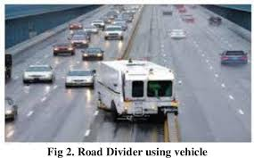
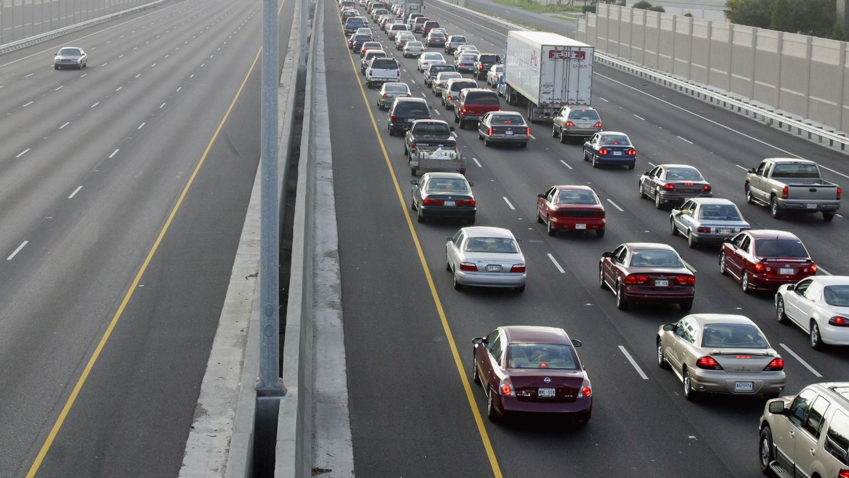
EXISTING SYSTEM...
In a country with the third largest road network in the world, the total number of vehicles in fiscal year 2019 stood at 295.8 million.
All over India there are only fixed dividers which cant be moved.
The existing system needs a vehicle to move the dividers.
We have introduced movable dividers which moves depending on the traffic.

Slide 4
PROPOSED SYSTEM...
The proposed system “AUTOMATIC MOVABLE ROAD DIVIDER” moves the divider without any human interference
This system uses an array of IR sensors which are programmed to detect the traffic flow.
If the traffic in a way is higher than the other side then the divider switch to the other side slowly with a buzzer sound and indicators.
This helps to control the traffic with ease and also helps the people reach the destination faster.

Slide 5
SYSTEM ARCHITECTURE...
Arduino
Motor
Power Supply
Buzzer
Traffic Lights
IR Sensors
Indiactors

Slide 6
WORKING...
This project uses aurdino uno, ir sensor, buzzer, led , servo motor and indicators.
This project utilizes servo motors and move the divider based on the ir sensors function which indicates manageable system for traffic or waiting queue .

Slide 7
COMPONENTS REQUIRED...
Hardware Requirements
Arduino UNO Board
IR Sensors
Servo Motor
Traffic Lights
Indicators
Buzzer
Connecting Wires
Software Requirements
Arduino IDE
Blynk
Embedded C language

Slide 8
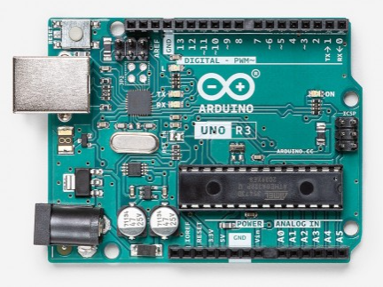
Arduino uno
Arduino Uno is a microcontroller board based on the ATmega328P .
It has 14 digital input/output pins (of which 6 can be used as PWM outputs), 6 analog inputs, a 16 MHz ceramic resonator, a USB connection, a power jack, an ICSP header and a reset button.
It contains everything needed to support the microcontroller; simply connect it to a computer with a USB cable or power it with a AC-to-DC adapter or battery to get started.

Slide 9
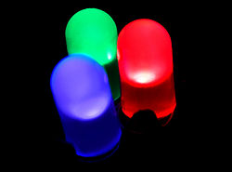
LED
A light-emitting diode (LED) is a semiconductor light source that emits light when current flows through it. Electrons in the semiconductor recombine with electron holes, releasing energy in the form of photons.
The color of the light (corresponding to the energy of the photons) is determined by the energy required for electrons to cross the band gap of the semiconductor. White light is obtained by using multiple semiconductors or a layer of light-emitting phosphor on the semiconductor device

Slide 10
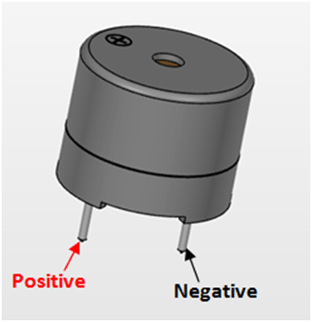
BUZZER
A buzzer or beeper is an audio signalling device, which may be mechanical, electromechanical, or piezoelectric (piezo for short).
Typical uses of buzzers and beepers include alarm devices, timers, and confirmation of user input such as a mouse click or keystroke.

Slide 11
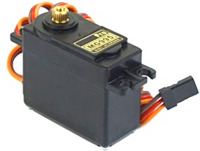
SERVO MOTOR
It is a closed-loop system where it uses a positive feedback system to control motion and the final position of the shaft. Here the device is controlled by a feedback signal generated by comparing output signal and reference input signal.
Here reference input signal is compared to the reference output signal and the third signal is produced by the feedback system. And this third signal acts as an input signal to the control the device. This signal is present as long as the feedback signal is generated or there is a difference between the reference input signal and reference output signal
We can get desired angle.

Slide 12
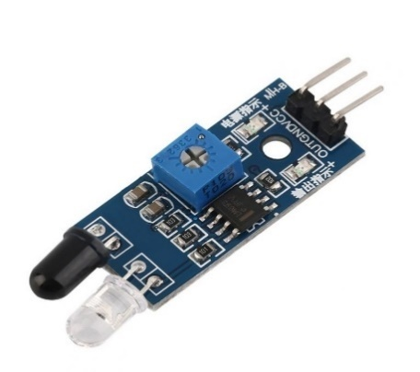
IR SENSOR
IR sensor is an electronic device that emits the light in order to sense some object of the surroundings. An IR sensor can measure the heat of an object as well as detects the motion. Usually, in the infrared spectrum, all the objects radiate some form of thermal radiation.
These types of radiations are invisible to our eyes, but infrared sensor can detect these radiations.

Slide 13

Blynk IoT
Blynk is a platform that enables developers to create IoT (Internet of Things) applications for controlling hardware remotely. With Blynk, users can build custom dashboards to monitor and control connected devices using a smartphone app. It supports a wide range of hardware platforms and communication protocols, making it popular among hobbyists and professionals alike for creating IoT projects.

Slide 14
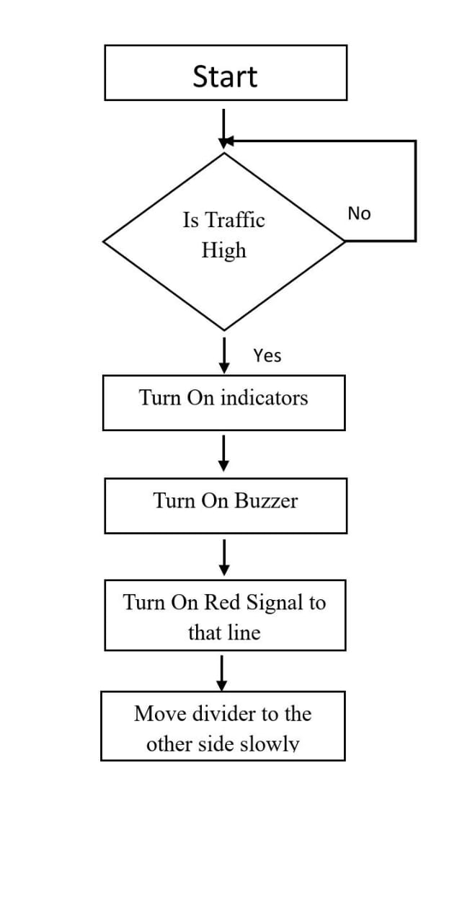
DATA FLOW DIAGRAM...

Slide 15
ADVANTAGES ....
Advantages:
Fully Automated
24 Hour Operation
No Manual Errors
Contactless Working

Slide 16
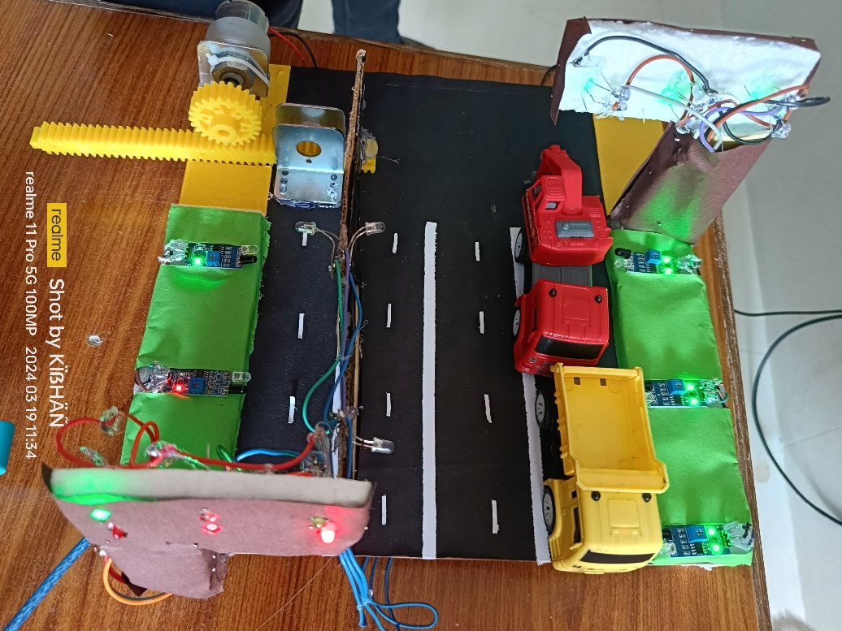



RESULT:

Slide 17
CONCLUSION...
An automatic movable road divider equipped with IR sensors detects traffic flow and adjusts accordingly. Servo motors enable the divider to divert traffic as needed, effectively managing road movement.

Slide 18


