Slide 1
LAB 9 PSIS · ACTIVITY 1 · RAG-BASED DOMAIN ASSISTANT
FinSight-RAG
Answers from company financial filings, every one with its document and page
Akash Goyal · I025
Karan Lokhande · I039
Meer Magia · I040
Data & Retrieval & Demo
Application & Chain
Evaluation, Report

Slide 2
The problem
A 10-K runs past 100 pages of narrative and tables. Finding one figure means searching the whole document, and a general LLM answers from memory, not from the filing.
107 pages
No source
Answer + page
NIKE FY2023 10-K: risk factors, MD&A and financial tables
A plain LLM can state figures that the filing does not contain
FinSight-RAG answers only from retrieved passages and cites the page, or says the filing does not contain it

Slide 3
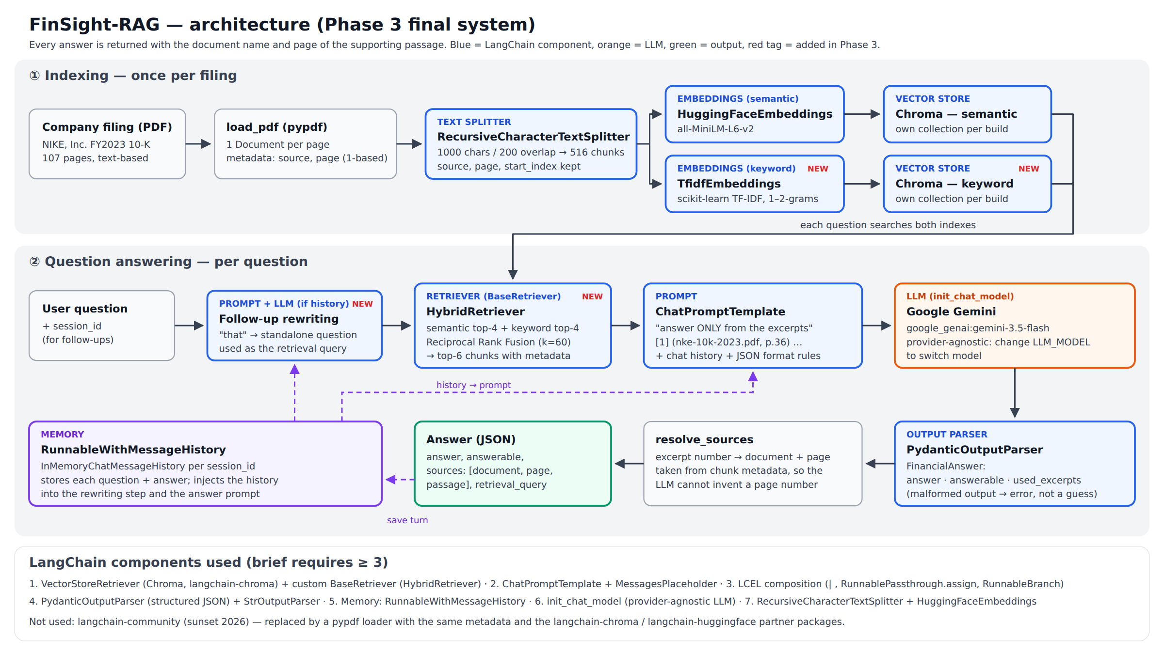

Slide 4
LangChain components
Component | What it does in FinSight-RAG
VectorStoreRetriever + HybridRetriever | Chroma semantic + TF-IDF keyword search, fused with Reciprocal Rank Fusion into the top-6 chunks
ChatPromptTemplate | Numbered excerpts labelled [n] (document, p. N); answer only from them; slot for chat history
LCEL chain | Rewrite follow-up → retrieve → prompt → Gemini → parse → attach sources
PydanticOutputParser | JSON {answer, answerable, used_excerpts}; page numbers come from chunk metadata
RunnableWithMessageHistory | Memory per session, so follow-up questions work
Also: RecursiveCharacterTextSplitter · HuggingFaceEmbeddings · init_chat_model (Gemini 3.5 Flash; one variable switches provider)

Slide 5
Live demo: four test cases
Q2 · FACT LOOKUP
Q1 + FOLLOW-UP · MEMORY
How many employees did NIKE have as of May 31, 2023?
Total revenues in fiscal 2023? Then: how much did that grow on a currency-neutral basis?
Expected: about 83,700 (p. 9)
Expected: $51.2 billion, then 16%
Q6 · DESIGNED WEAK CASE
Q7 · NOT IN THE FILING
Which geographic segment had the highest EBIT margin in fiscal 2023?
What were NIKE's total revenues in fiscal 2025?
Expected: Greater China, 31.5% (must be computed, p. 39)
Expected: answerable = false, no guess

Slide 6
Challenge: search missed an exact fact
BEFORE (PHASE 2 RETRIEVER)
AFTER (HYBRID RETRIEVAL)
"How many employees did NIKE have?" retrieved pp. 4, 86, 6, 36. The answer is one sentence on p. 9, so the system replied:
Combine both rankings with Reciprocal Rank Fusion. Evidence retrieved:
4/6 → 6/6
"the excerpts do not contain information about the number of employees"
"approximately 83,700 employees worldwide" (p. 9)
Keyword search found it, but failed on Q1 and Q6.
Also hit: the Gemini free tier (5 requests/min, 20/day), so we paced calls, retried on 429 errors and made the evaluation resumable. And a bug where Chroma doubled the index to 1,032 chunks.

Slide 7
Evaluation: 7 questions checked by hand
RETRIEVAL HIT-RATE
CORRECT ANSWERS
GROUNDED
4/6 → 6/6
6/7 → 7/7
6/6
Semantic only (Phase 2) → hybrid retrieval (Phase 3)
Same prompt and Gemini 3.5 Flash; only the retriever changed
Every figure found in the cited page; Q7 (not in the filing) correctly declined
Poor case: the Phase 2 retriever missed p. 9, so the employee question was answered "not in the excerpts". Surprise: the designed weak case Q6 passed; Gemini computed all four segment margins correctly.

Slide 8
Limitations and next improvement
Limitations
Proposed improvements
pypdf flattens tables, so calculations across table columns (Q6) are fragile
One filing and 7 questions: results are indicative only
k and the fusion constant were fixed in advance, not tuned
Memory lives in the Python process; the API is deprecated in LangChain 1.6
Table-aware parsing plus a calculator tool for ratios
Several companies and years, with metadata filters
A cross-encoder re-ranker after hybrid retrieval
Larger test set with an automatic faithfulness score

Slide 9
Thank you
Code, notebook, results and report:
github.com/akashgoyalll/finsight-rag-I025-39-40

