Slide 1
CREDIT SCORE CLASSIFICATION
G.AKASH REDDY

Slide 2
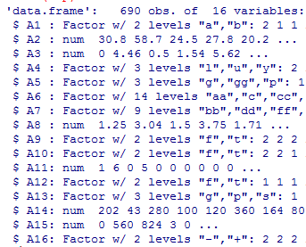
DATA SET DESCRIPTION
CHARACTERISTIC | COUNT
ROWS /OBSERVATIONS | 690
ATTRIBUTES | 16
CLASS ATTRIBUTE | 16th
NUMBER OF CLASSES | 2(+,-)
NUMBER OF MISSING VALUES | 67
Str(dataframe_name)
Summary(dataframe_name)
sum(is.na(dataframe_name))

Slide 3
OBJECTIVE
The aim of this project is to classify the credit card applications dataset samples into Positive Credit(+) or Negative Credit(-).
Algorithm used: C5.0 decision trees.
All attribute names and values have been changed by the provider to meaningless symbols, to protect confidentiality of the data.

Slide 4
PRE PROCESSING
Converting attributes to their appropriate types.
Syntax:dataframe$attribute=as.factor(dataframe$attribute)
dataframe$attribute=as.numeric(dataframe$attribute)
Replacing Missing Values of numeric attributes by their mean
Syntax: D$A=replace(D$A, is.na(D$A), mean(D$A, na.rm=T))
Replacing Missing Values of Nominal attributes by their mode
Example:temp<-table(as.vector(D$A))
mod<-names(temp)[temp==max(temp)]
D$A=replace(D$A, is.na(D$A), mod)

Slide 5
CLASSIFICATION AND PREDICTION
shuffle<-credit[order(random),]
random<-runif(nrow(credit))
Data Frame : credit
Sno Row no
Sno Row no
1
R35
35
1
R1
2
R101
Training
50%
101
2
R2
3
.
345
R7
.
R297
7
3
R3
After Shuffling
690
Random
numbers
.
.
.
.
306
.
.
.
.
690
.
.
.
.
R690
346
.
.
690
R100
.
.
R306
Testing
50%
TRAINING
trained<-C5.0(shuffle[1:345,-16],shuffle[1:345,16])
TESTING
test<-predict(trained,shuffle[346:690,])

Slide 6
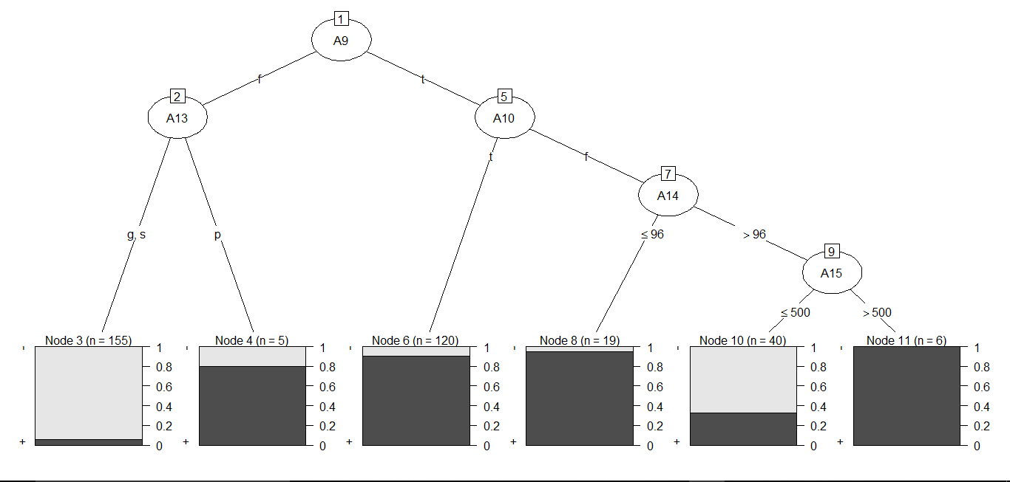
CLASSIFICATION AND PREDICTION plot(trained)

Slide 7
CONFUSION MATRIX
confusionMatrix(shuffle[346:690,16],test)
Confusion Matrix and Statistics
Reference
Prediction - +
- 177 19
+ 32 117
Accuracy : 0.8522
95% CI : (0.8103, 0.8879)
No Information Rate : 0.6058
P-Value [Acc > NIR] : < 2e-16
Kappa : 0.6956
Mcnemar's Test P-Value : 0.09289
Sensitivity : 0.8469
Specificity : 0.8603
Pos Pred Value : 0.9031
Neg Pred Value : 0.7852
Prevalence : 0.6058
Detection Rate : 0.5130
Detection Prevalence : 0.5681
Balanced Accuracy : 0.8536
'Positive' Class : -

Slide 8
CONCLUSION
The dataset is preprocessed by replacing the missing values
With the mean or mode of the respective attributes.
50% of the data samples are trained and classified using C5.0 algorithm.
Rest of the 50% samples are tested and their respective classes are predicted with an accuracy of 85.22%.

Slide 9
THANK YOU

