Slide 1
Accessing eBooks using the R2 Digital Library

Slide 2
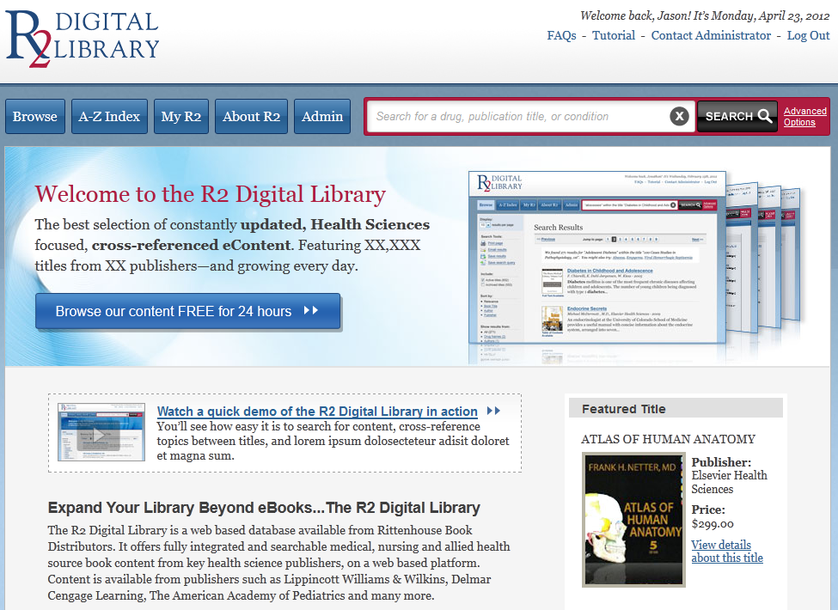
eBooks via the R2 Digital Library
The R2 Library is an electronic database that enables access to eBooks from multiple health science publishers
Browse and search a single title or the entire collection, it’s up to you

Slide 3
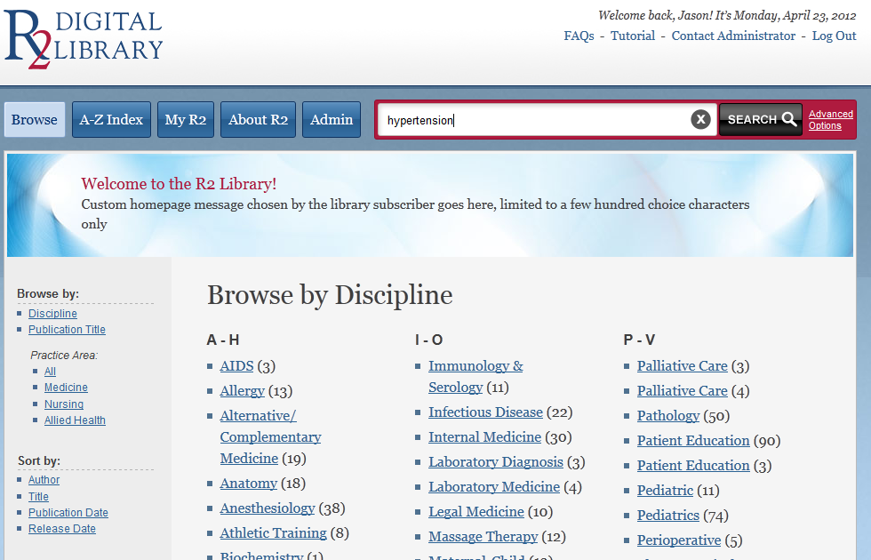
Searching eBooks
Search the entire collection by entering a key topic, term, drug name, author or title in the Search box

Slide 4
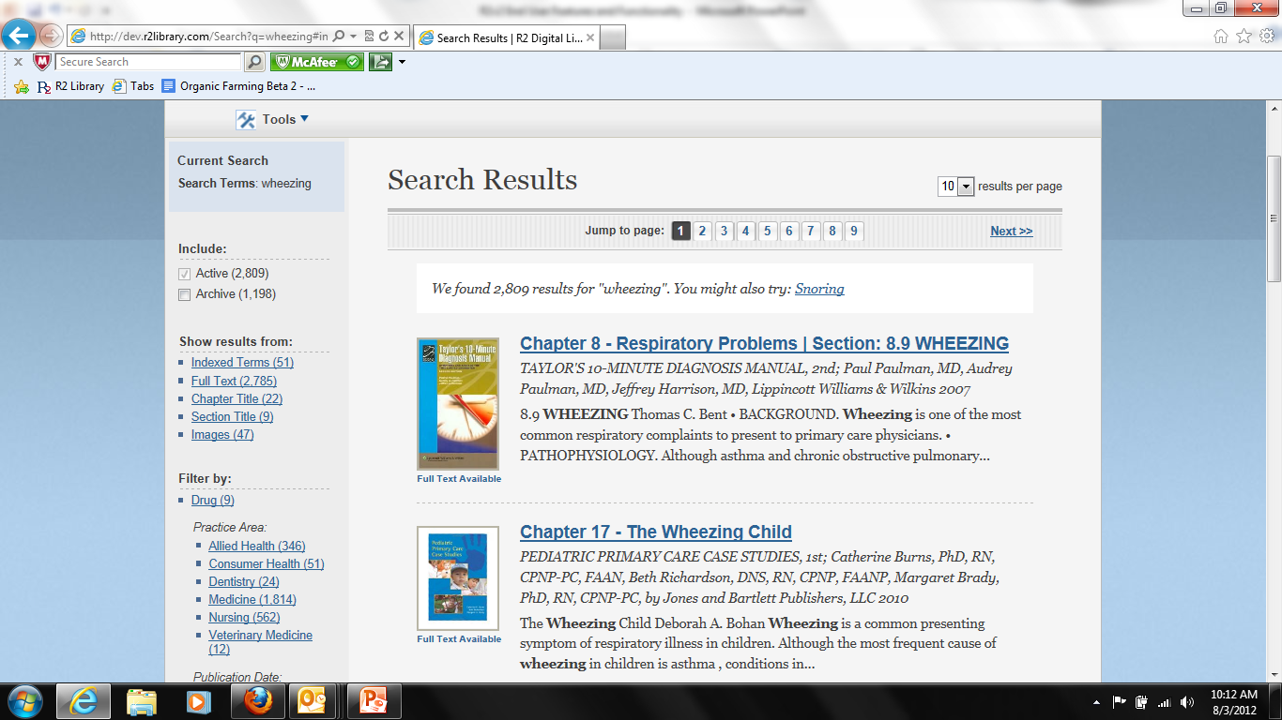
Searching eBooks
You will see results from all available eBooks, simply select the result you would like to view
You can use the tools in the left navigation pane to sort and filter your results

Slide 5
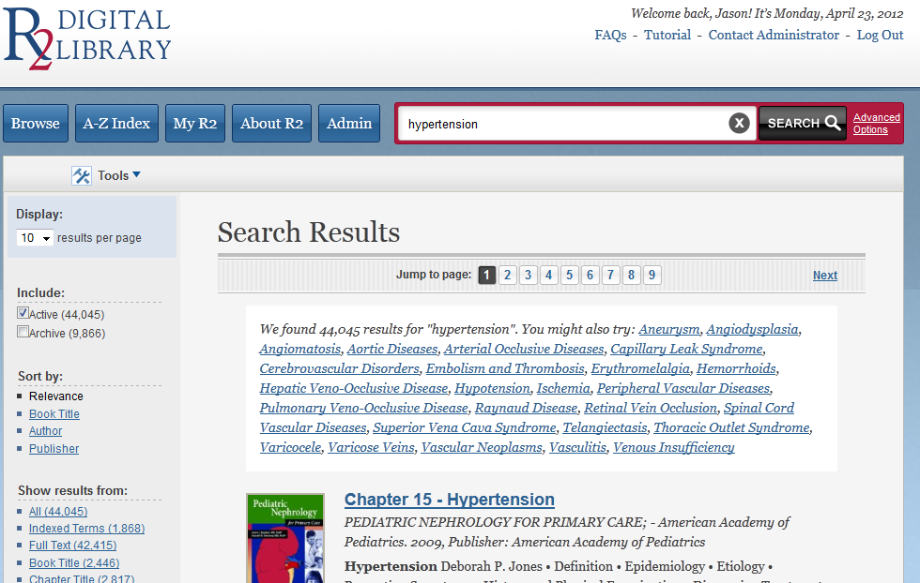
Searching eBooks
You can also use the Advanced Options option to create a more specific search

Slide 6
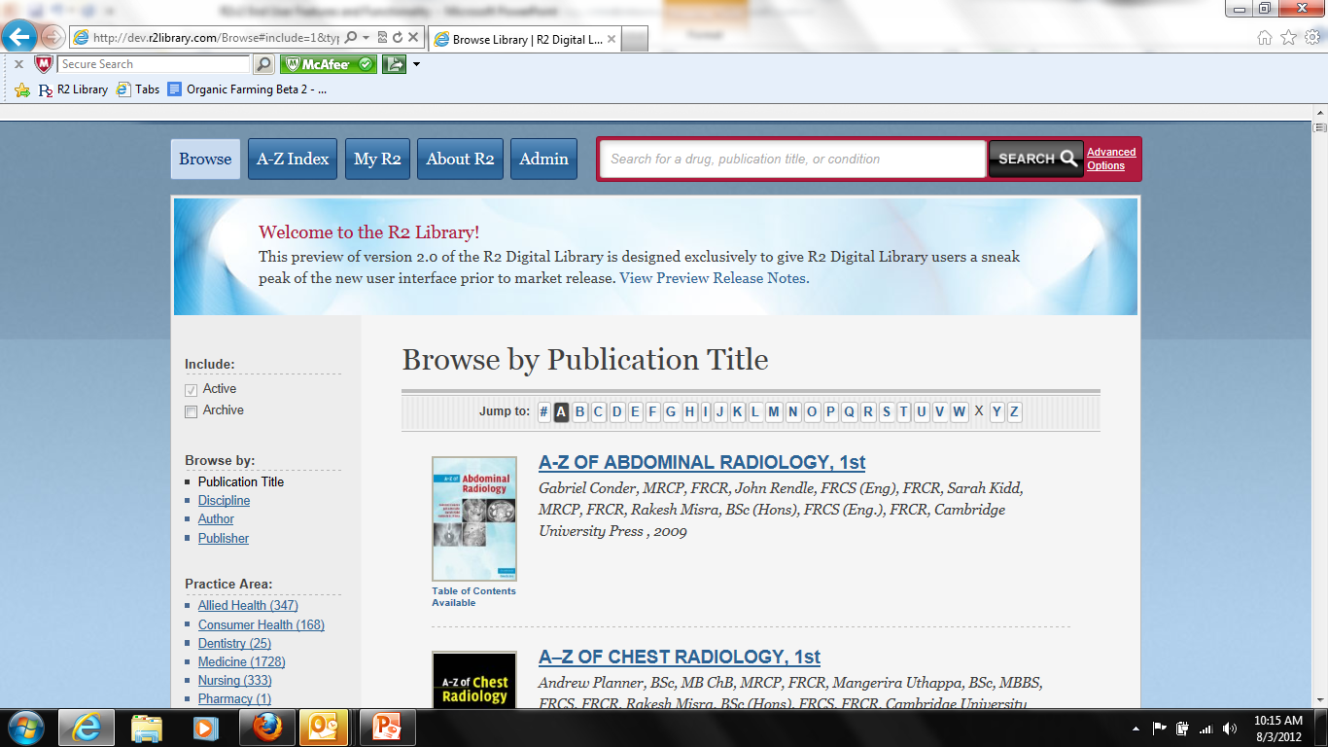
Browsing eBooks
Browse by Discipline, eBook Title, Publisher or Author
Use Filter options to narrow your selections.

Slide 7
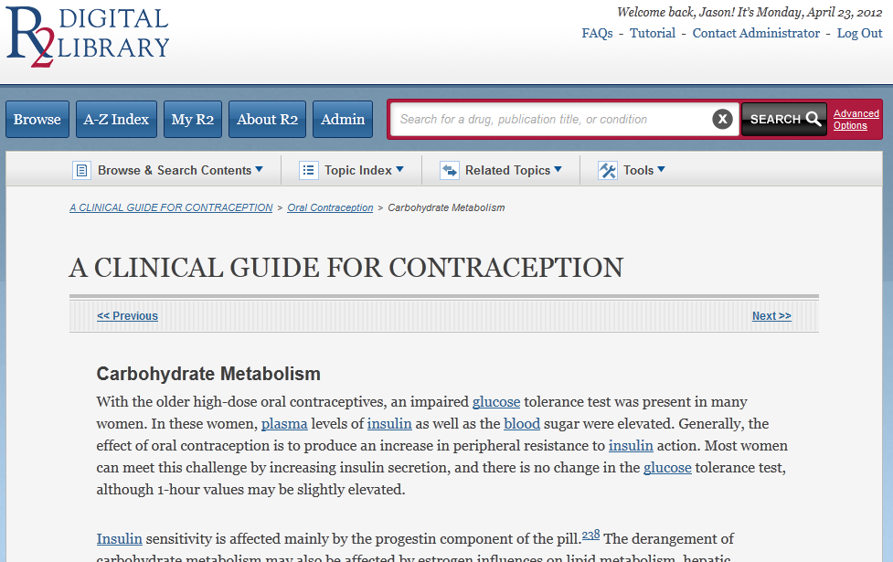
Browsing eBooks
You can browse each eBook using the Table of Contents or Related Topics
Use the Breadcrumbs to identify which chapter or section you are viewing

Slide 8
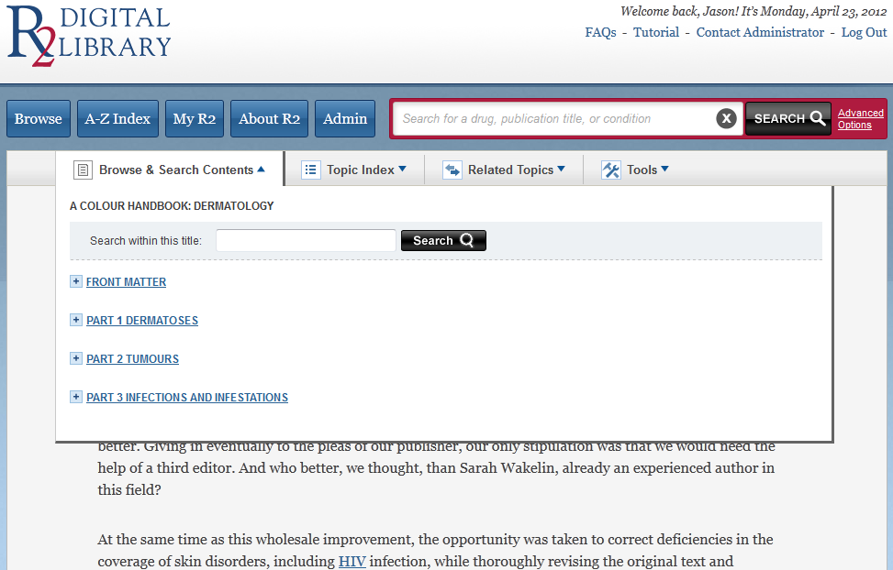
Browsing eBooks
To Search for a key topic, term or drug name in a specific title, select “Browse and Search Content” when that eBook is open

Slide 9
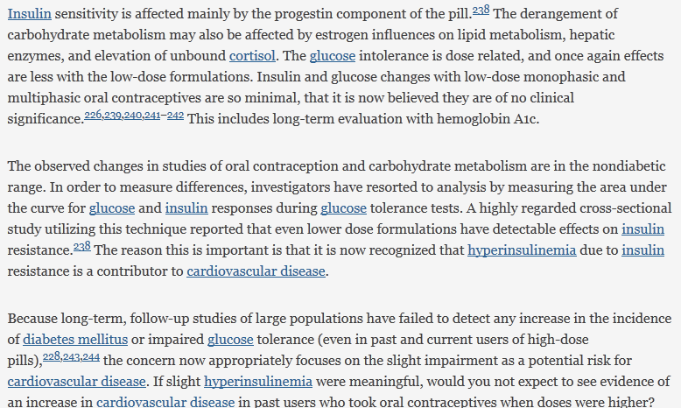
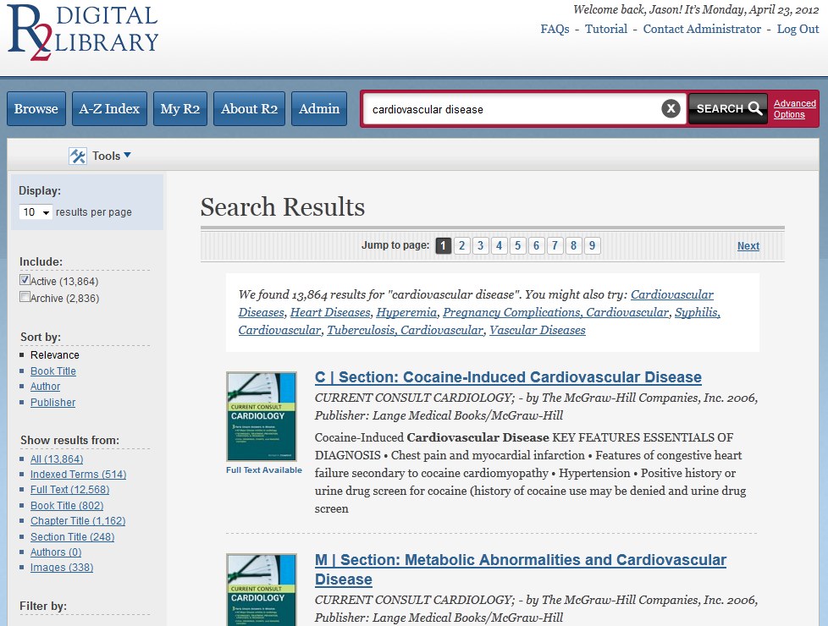
Linking to eBooks
Key topics, terms, and drug names are hyperlinked within each eBook. To view additional information, simply select the hyperlink to view available resources on that topic, term or drug name

Slide 10
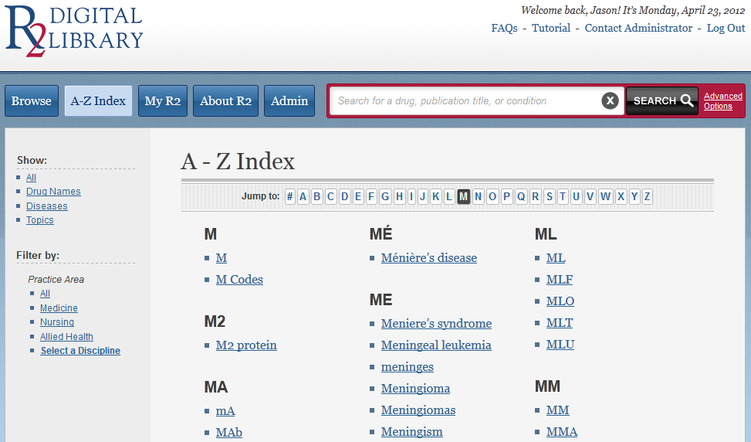
Linking to eBooks
You can also link to key topics and drug names in eBooks using the A-Z index
Simply click on a key topic or drug name to see all available information

Slide 11
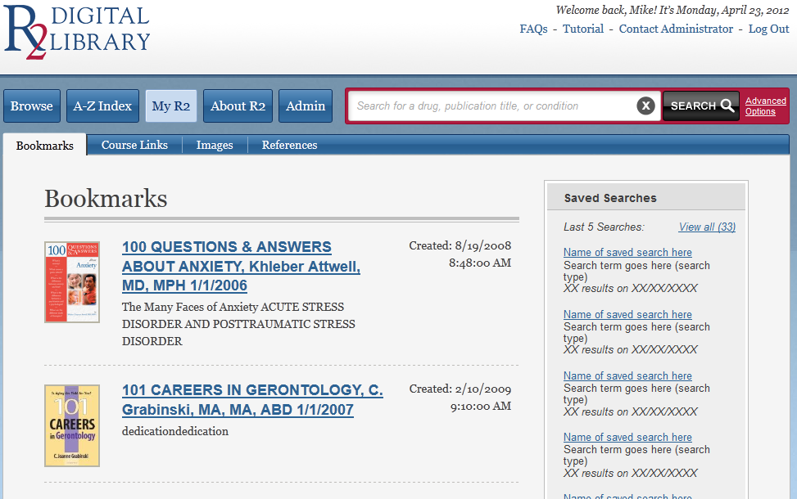
My eBooks
You can save links to eBooks, images, citations, searches and more using the “MyR2” tab
If you have a unique R2 user name and password, you can save this information and view it each time you are accessing R2 eBooks

Slide 12
What can I do with R2 eBook content?
Use the “Tools” tab to
Print sections
Email sections
Export images
Create and export links to sections
Create and export links to eBooks
Export citations
Build and export reference lists

Slide 13
More Questions?
Contact your librarian for more information or see the Frequently Asked Questions link on the R2 home page!
Thank you for using the R2 Library!

