Slide 1
School Management System
Files:
Main.java
Sample.fxml
Controller.java
Dashboard.fxml
Student.fxml
Style.css

Slide 2
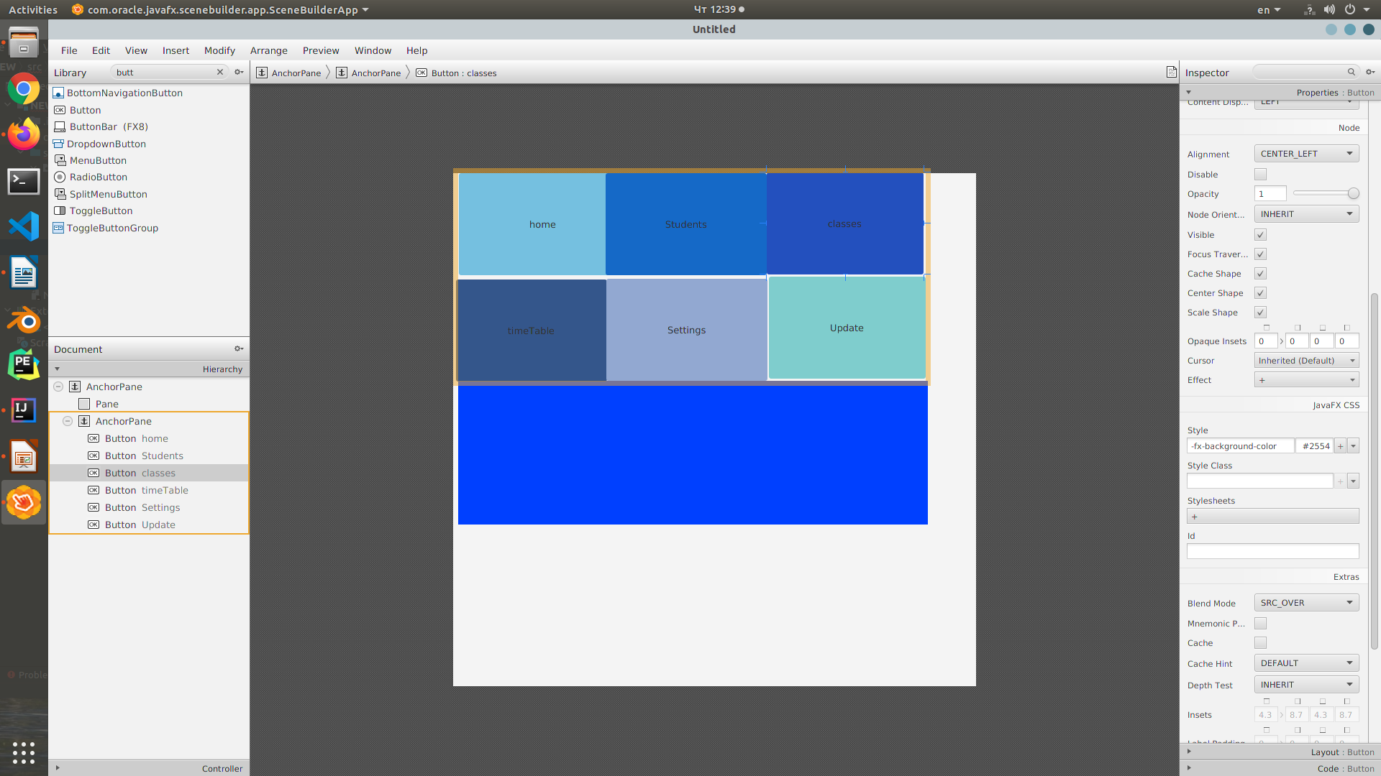
School Management System
Information management system to manage all student’s data.

Slide 3
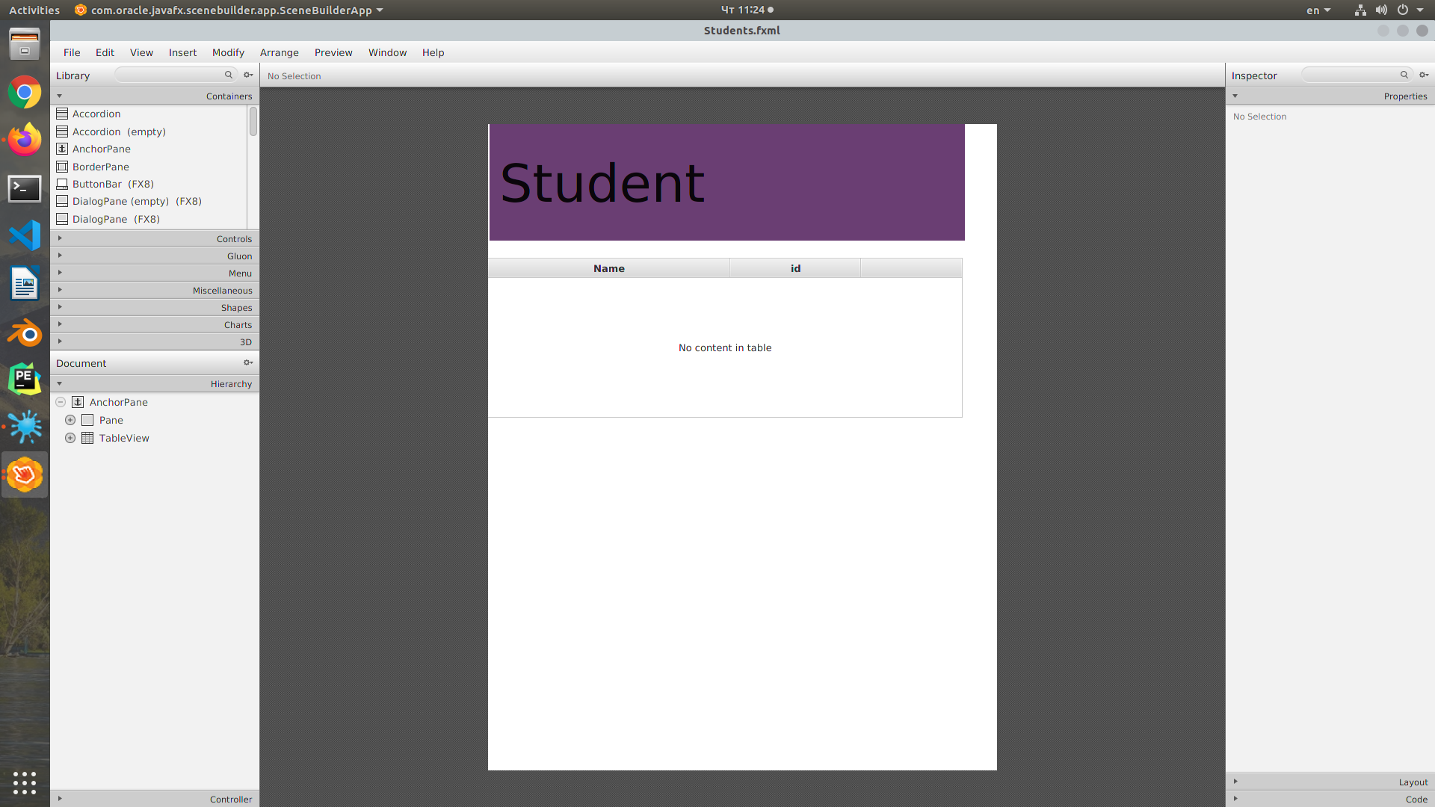
School Management System
Name, id! Information that is related to students can be easily accessed using a school management system.

Slide 4
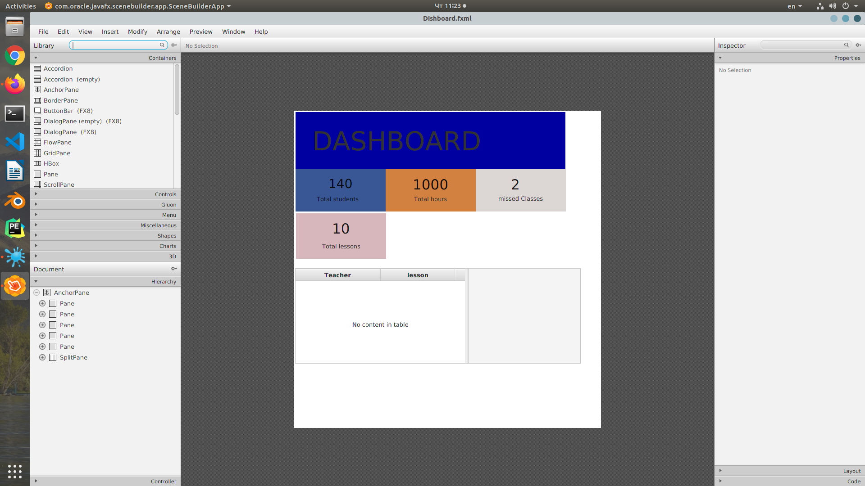
School Management System
A school management system not only gives information about students. It can provide information about teachers also.

