Slide 1
QUIZ APP
QUIZ APP USING JAVASCRIPT

Slide 2
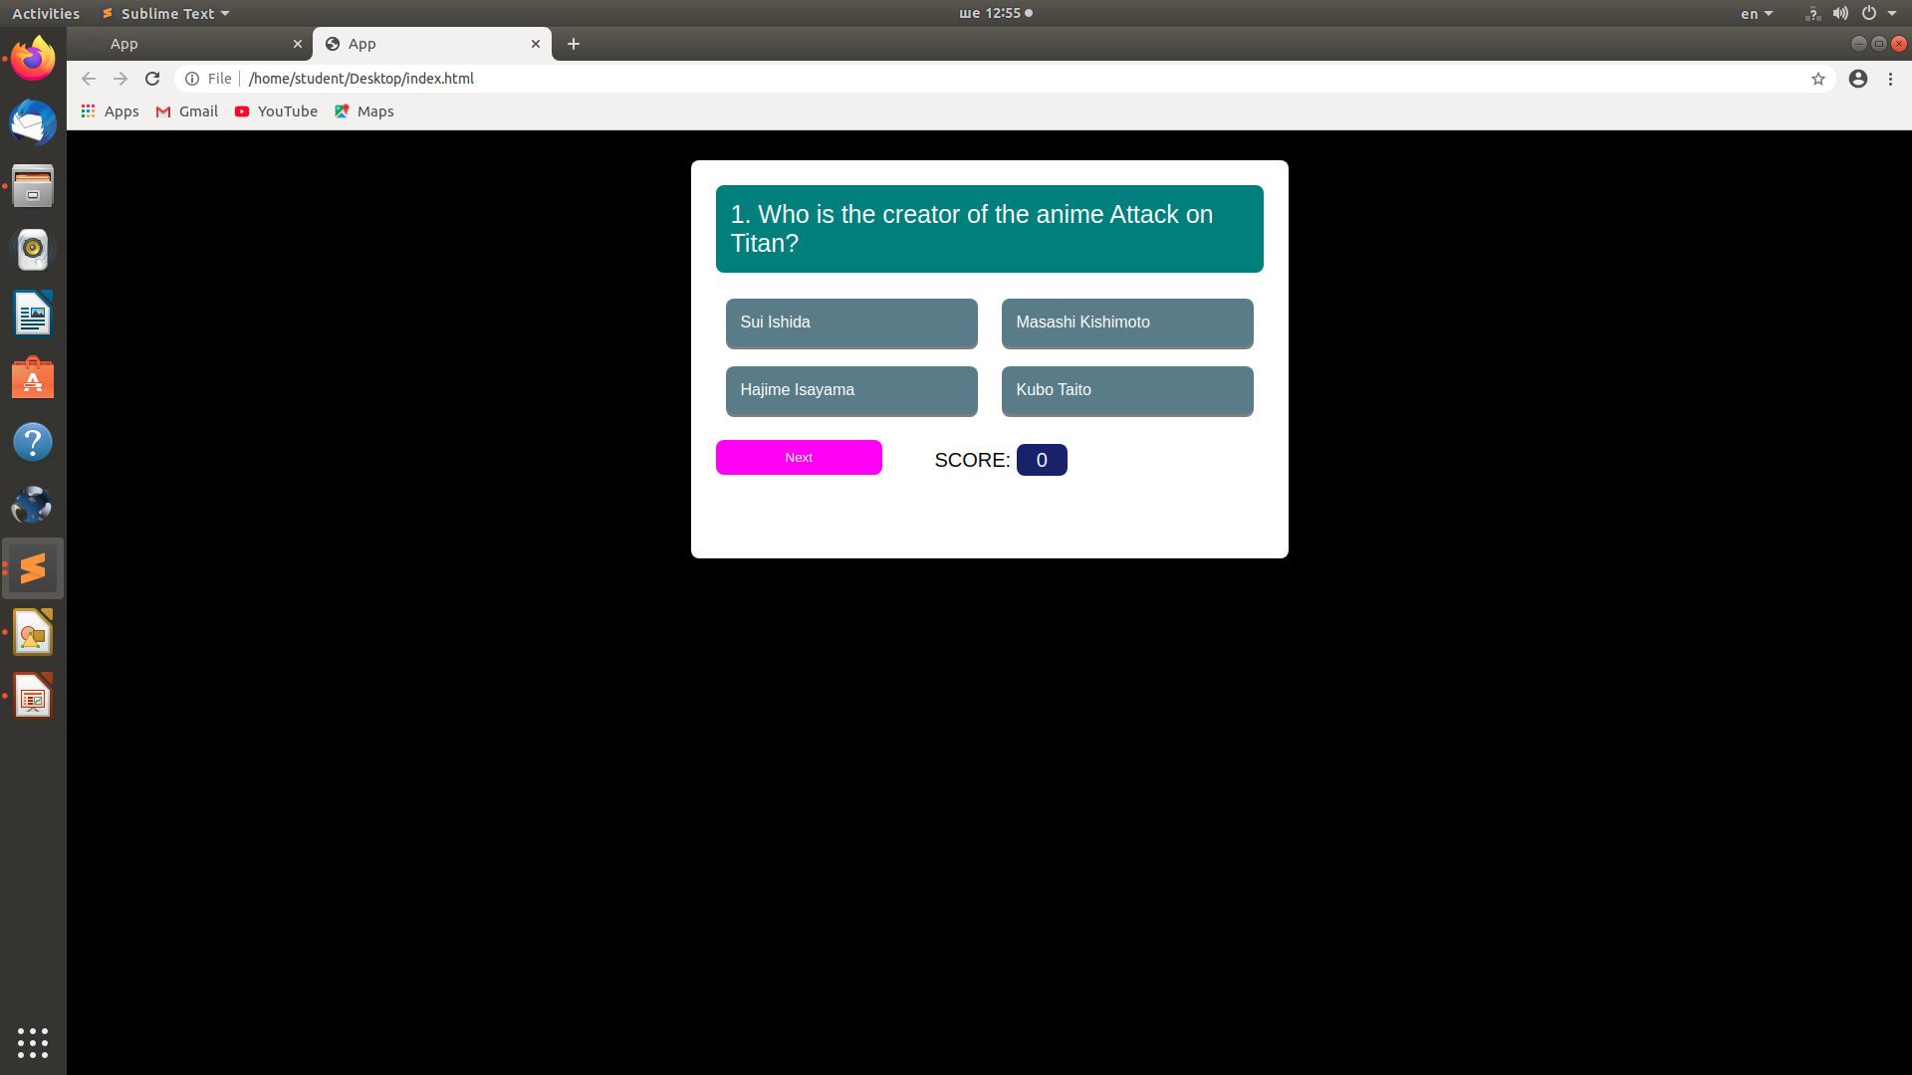
QUIZ APP

Slide 3
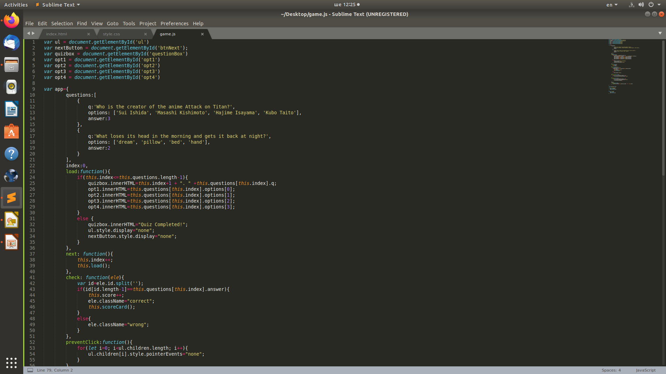
QUIZ APP
Used Javascript practices to create this app

Slide 4
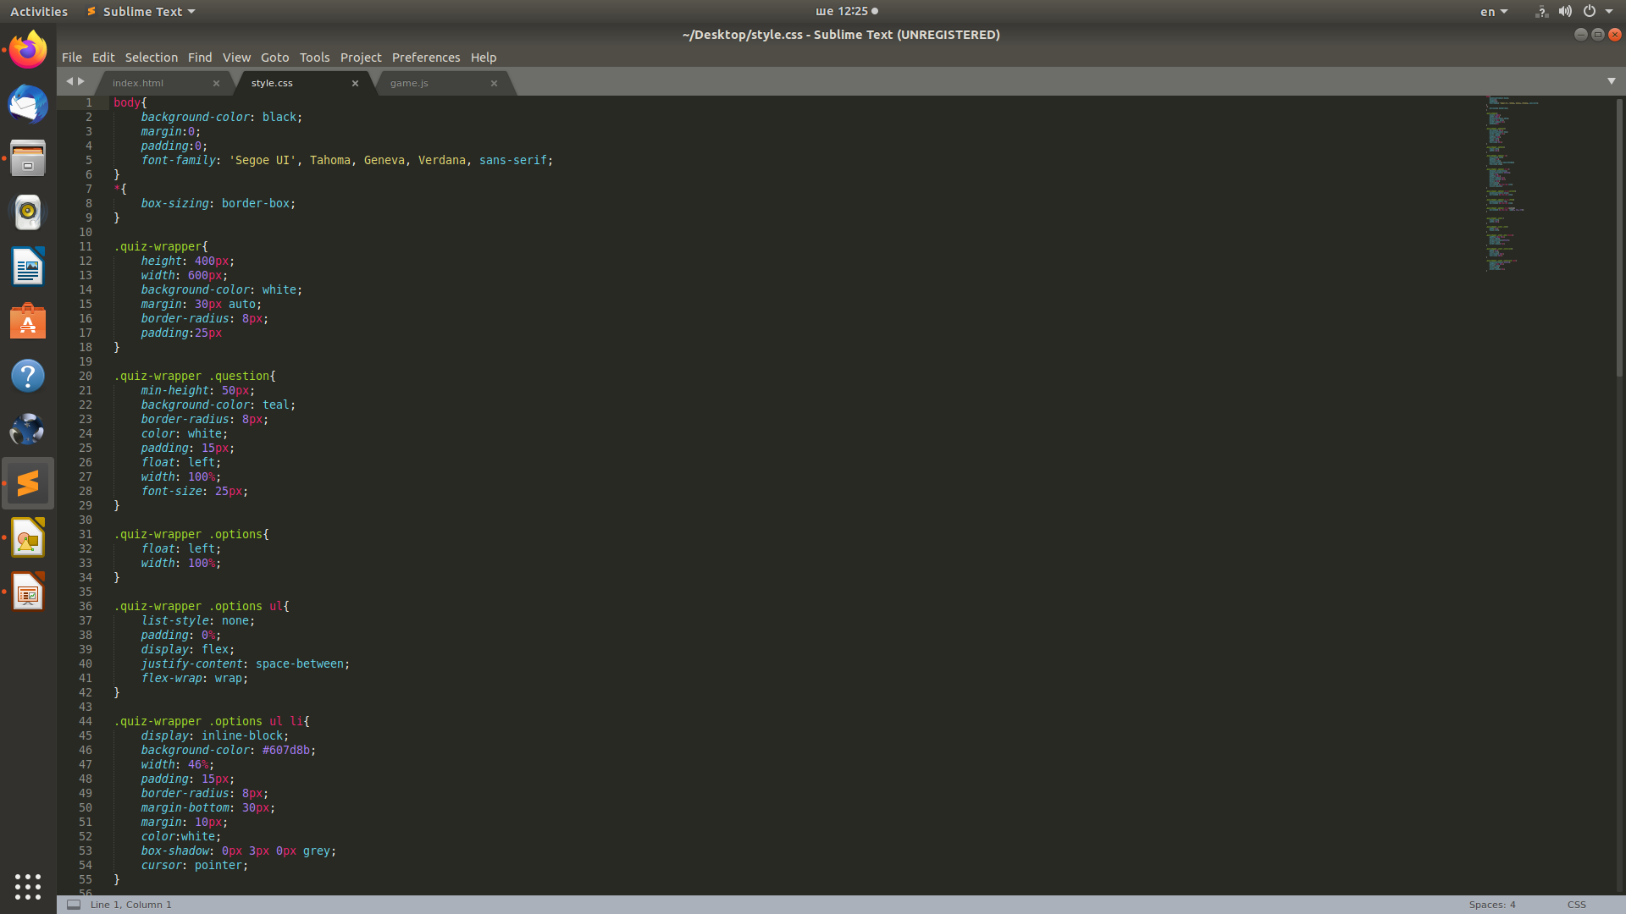
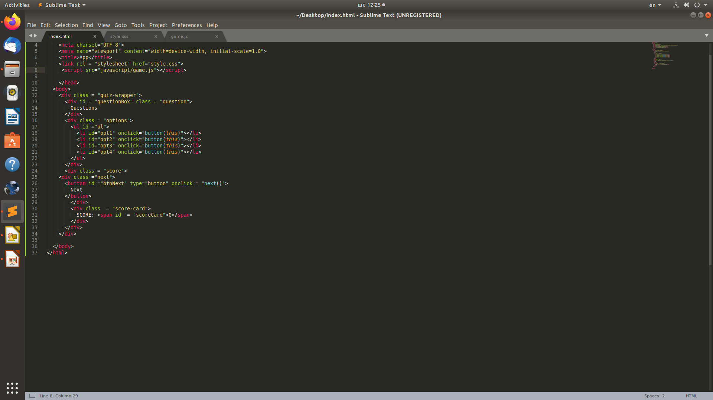
QUIZ APP
Code included CSS variables

