Slide 1
Client Valuation Automation
Architecture diagrams · October 2026
Interactive versions: https://akashic.github.io/Diagrams/
Notes:
Client Valuation Automation finds the publicly traded companies most comparable to a private Client, scores the match with AI, and emails an Excel report. Every diagram in this deck is also published as an interactive page at https://akashic.github.io/Diagrams/

Slide 2




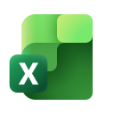

How it works
From a Client description to an emailed Valuation Report, with no manual comparison work
~40,000
≤ 50
1
Listed Companies to search
companies in each Shortlist
AI Match Score per company
1
Describe and search
2
Score
3
Report
The User describes the Client and narrows Search Criteria; options and counts update live, and search returns the top 50 by Market Cap.
Each Shortlist Entry is compared with the Client description by Azure OpenAI, giving a Match Score and rationale.
Scores fill an Excel workbook, sorted by Match Score, which is emailed to the User as the Valuation Report.
Built with
Power Apps
Dataverse
Power Automate
Azure OpenAI
Excel
Outlook
Notes:
Three numbers frame the system: about 40,000 Listed Companies, Shortlists of at most 50, and one AI Match Score per Shortlist Entry. The flow is describe and search, then score, then report. It is built entirely on Power Platform, Azure OpenAI and Microsoft 365.

Slide 3
Architecture
The logical design, and how it was built on Power Platform

Slide 4
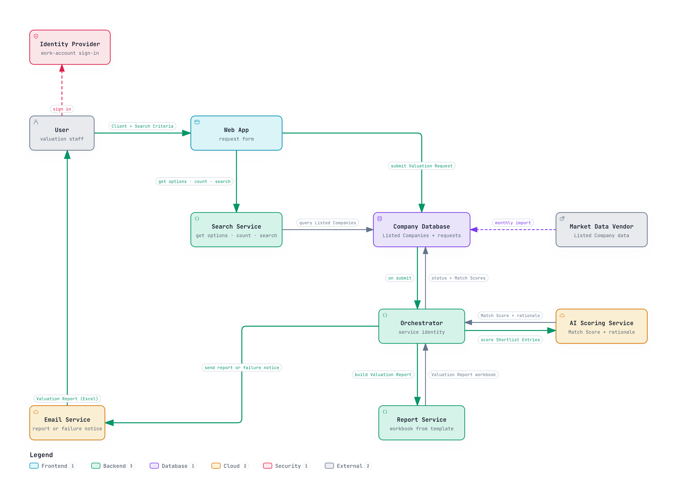
Logical architecture
Technology-neutral components and how a request moves through them
1
Search Service
Gets narrowed options and live counts for the Search Criteria, then returns the top 50 by Market Cap.
2
Asynchronous orchestration
Submitting a Shortlist creates a Valuation Request. The Orchestrator handles it, so the User never waits.
3
Score, build, deliver
The AI Scoring Service gives each entry a Match Score, the Report Service builds the workbook, and Email delivers it.
Notes:
The logical view is product-neutral. The User signs in through the Identity Provider and uses the Web App, which calls the Search Service against the Company Database. On submit, the Orchestrator scores each Shortlist Entry, builds the Valuation Report and emails it. Listed Companies are imported monthly from the Market Data Vendor.

Slide 5
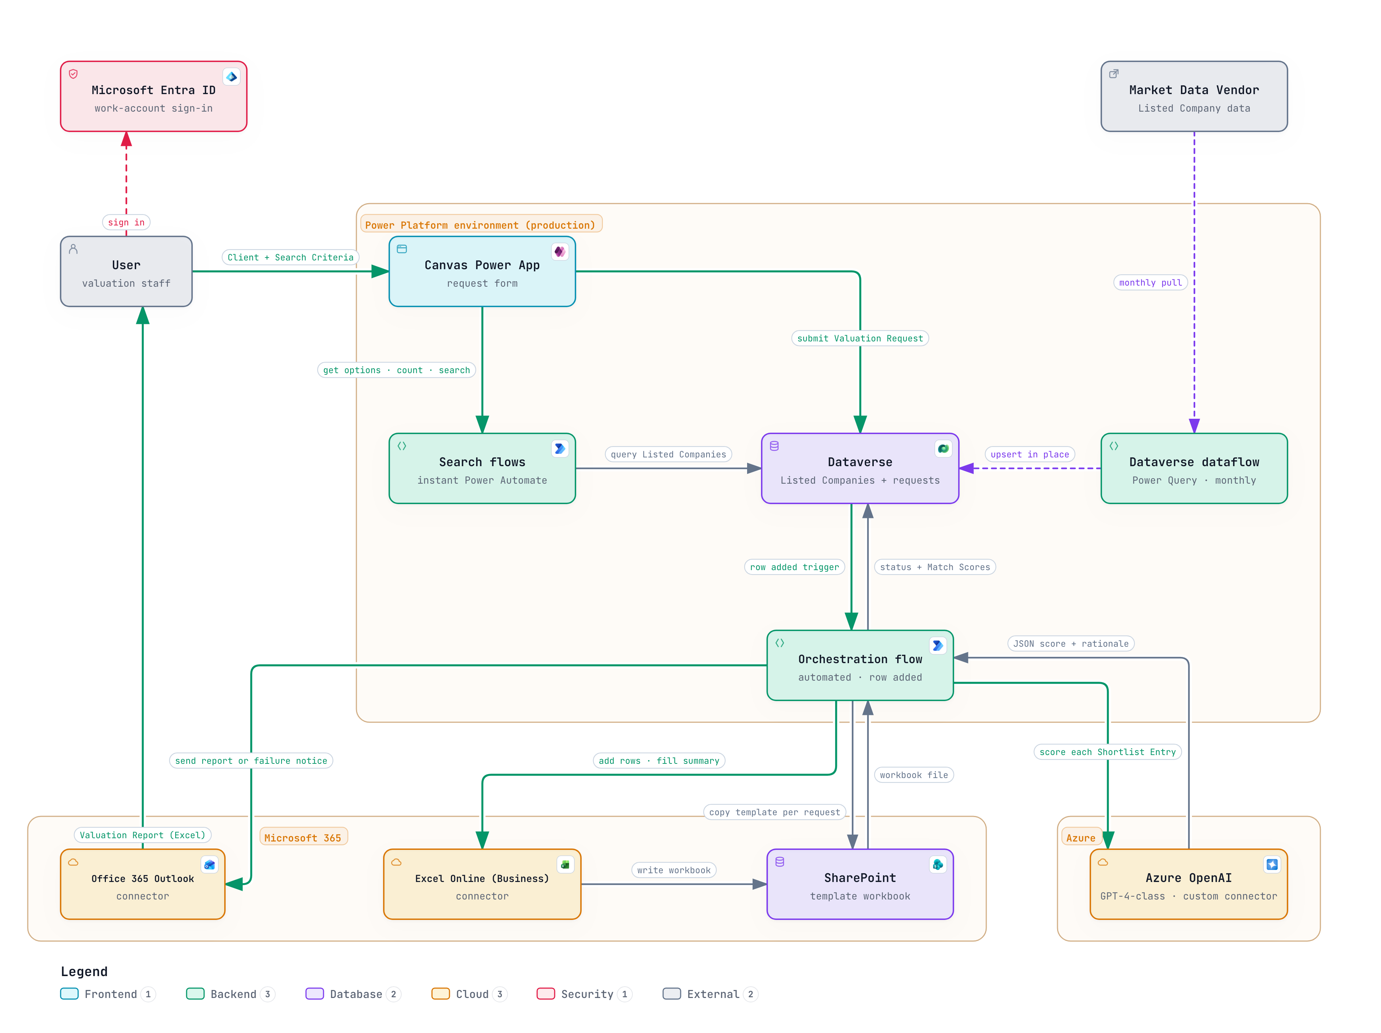
As built on Power Platform
The same design realised with Power Platform, Microsoft 365 and Azure
1
Form only in the app
The Canvas Power App calls instant Power Automate flows for search, which avoids delegation limits over 40,000 rows.
2
Triggered, not called
A Dataverse row-added trigger on the Valuation Request starts the orchestration flow.
3
Native Microsoft 365
Azure OpenAI via a custom connector, a SharePoint template filled by Excel Online, delivered by Outlook.
Notes:
Each logical component maps to one product: Canvas Power App, Power Automate search flows, Dataverse, an automated orchestration flow, Azure OpenAI through a custom connector, SharePoint plus Excel Online for the report, Outlook for email, and Entra ID for sign-in. A Dataverse dataflow imports company data monthly. See ADR 0001 for why Power Platform was chosen.

Slide 6
Behaviour
Searching, scoring and reporting, and the Valuation Request lifecycle

Slide 7
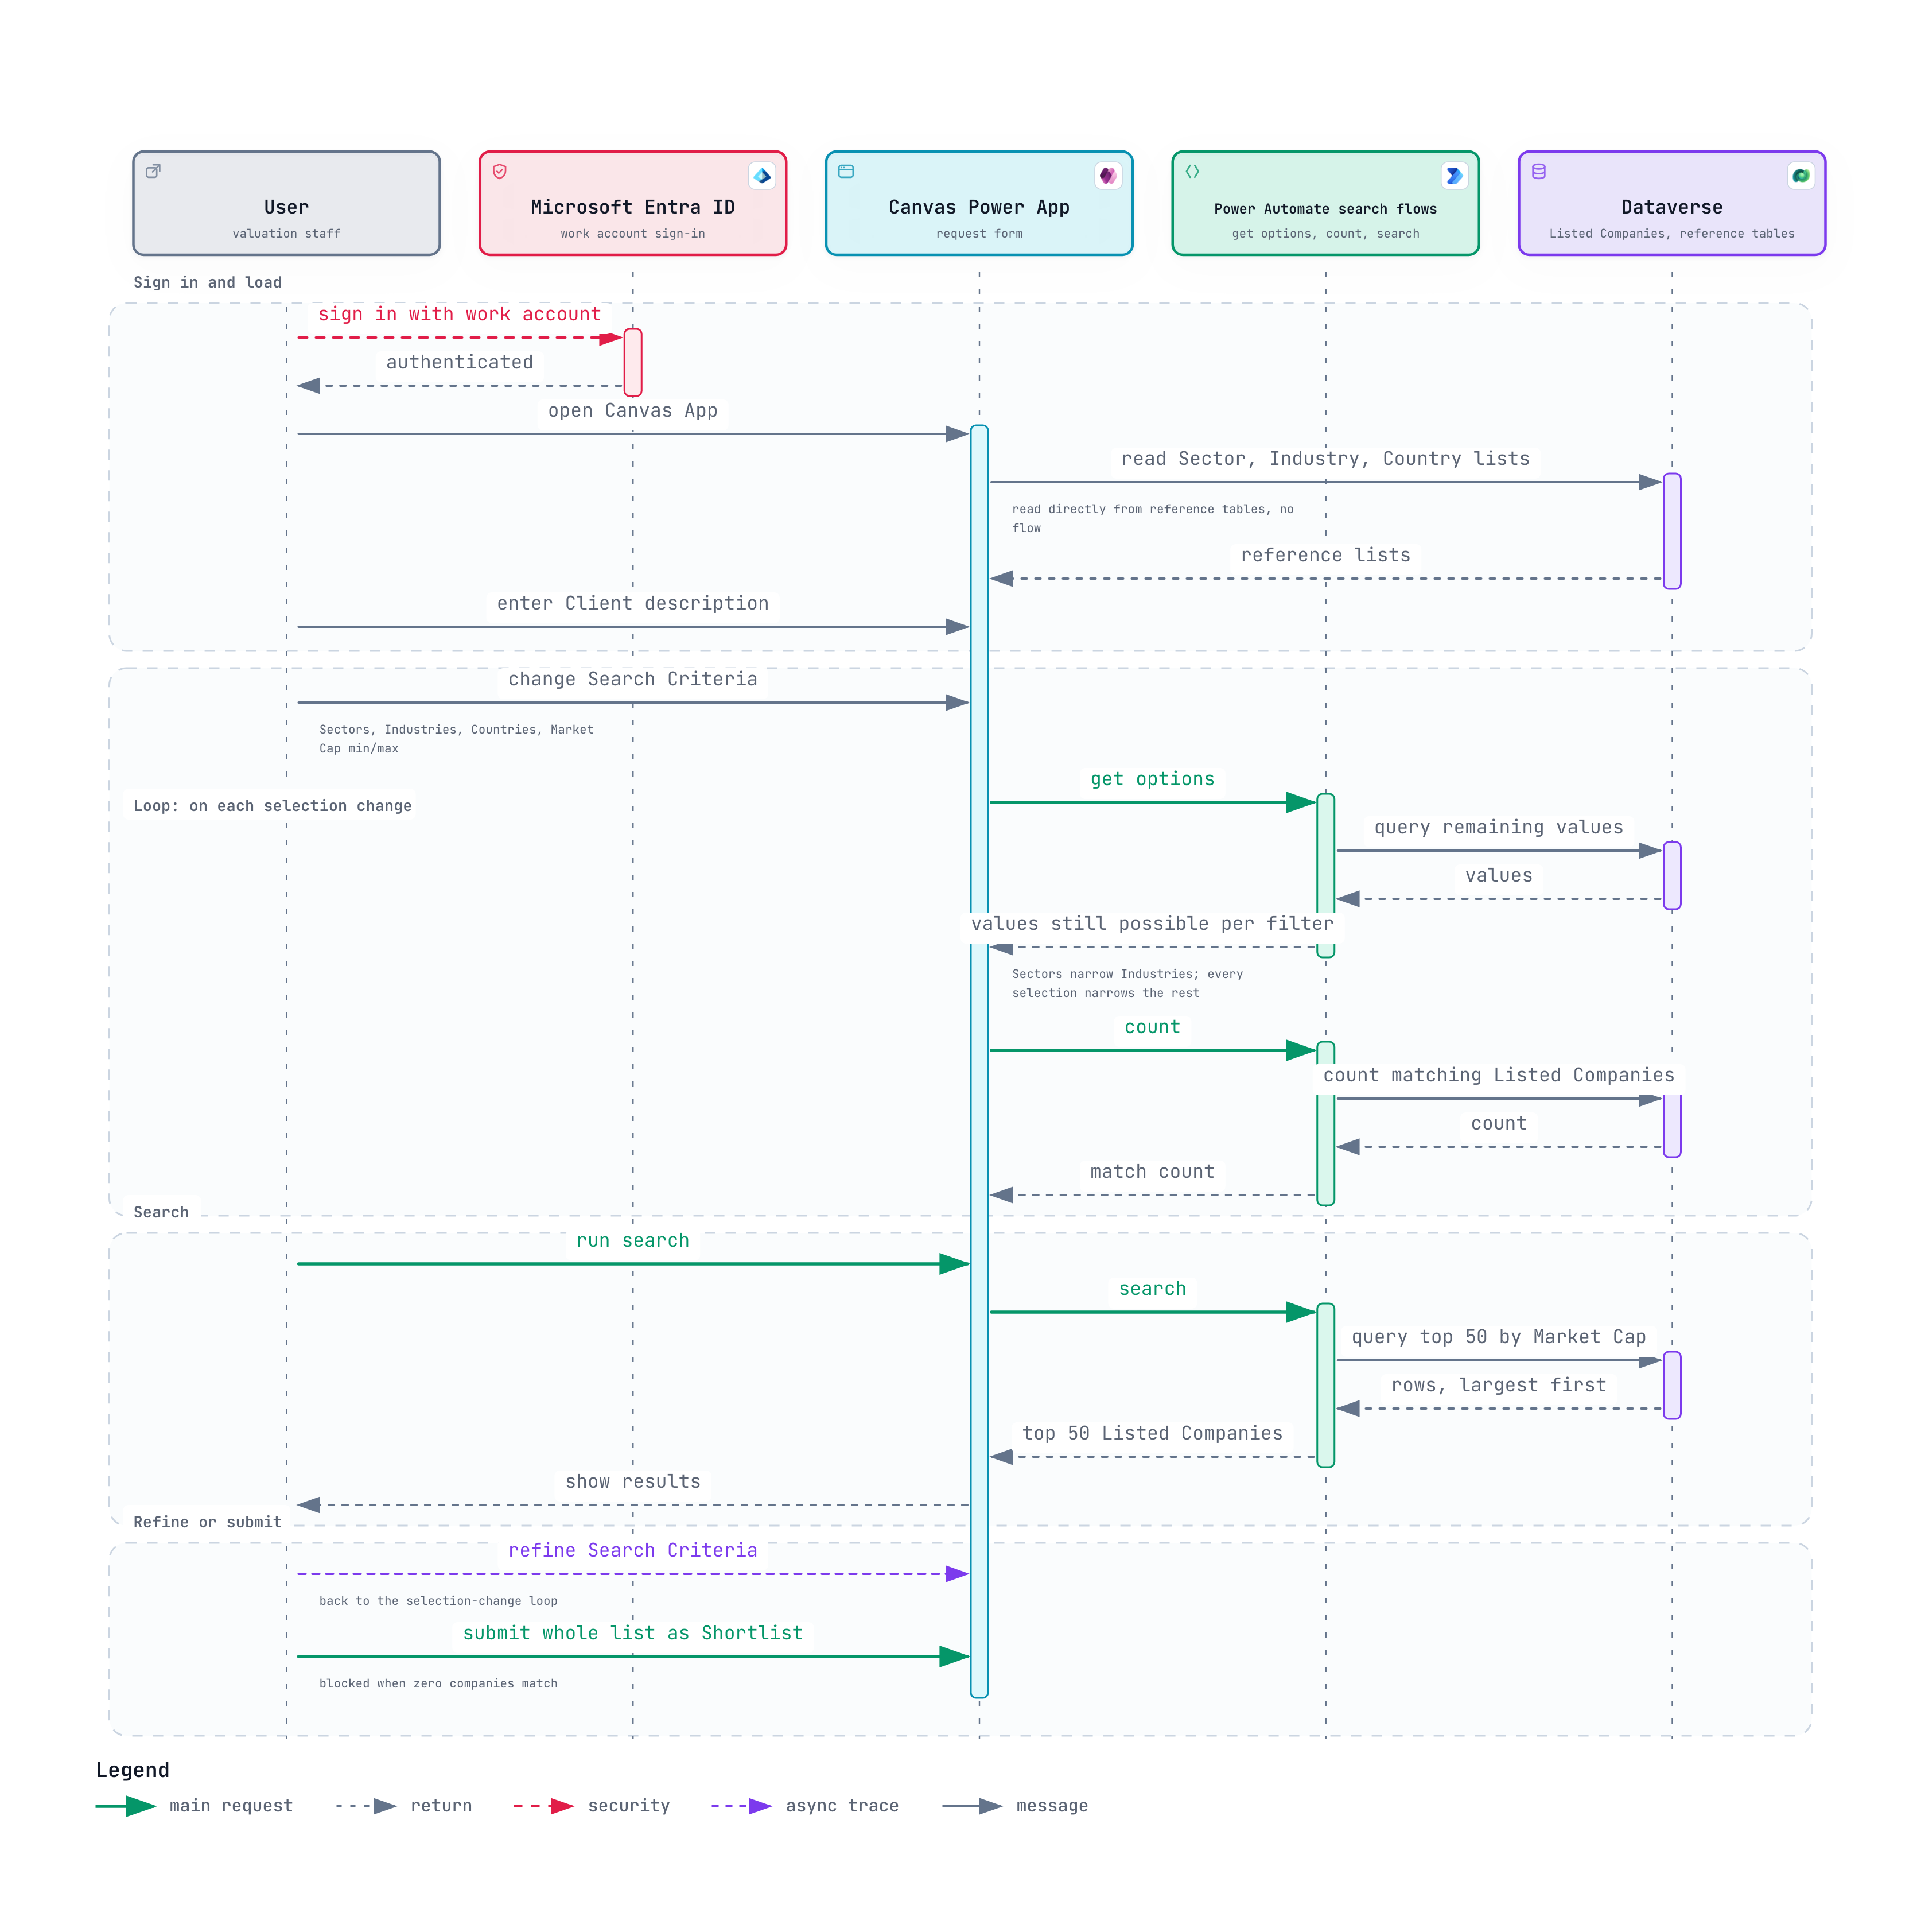
Search sequence
Filter options that narrow with each selection, live counts and the top-50 search
1
Reference lists load directly
Sector, Industry and Country lists come straight from Dataverse reference tables.
2
Every selection narrows the rest
Each change calls the get-options and count flows, so the form narrows itself and shows a live count.
3
Top 50, all or nothing
Search returns the top 50 by Market Cap. The User refines or submits the whole list; zero matches blocks submit.
Notes:
After signing in with Entra ID, the app loads the reference lists from Dataverse. Each selection change calls two flows: get options, which returns the values still possible in each filter, and count. Search returns the top 50 by Market Cap, largest first. The User either refines or submits the whole list as the Shortlist.

Slide 8
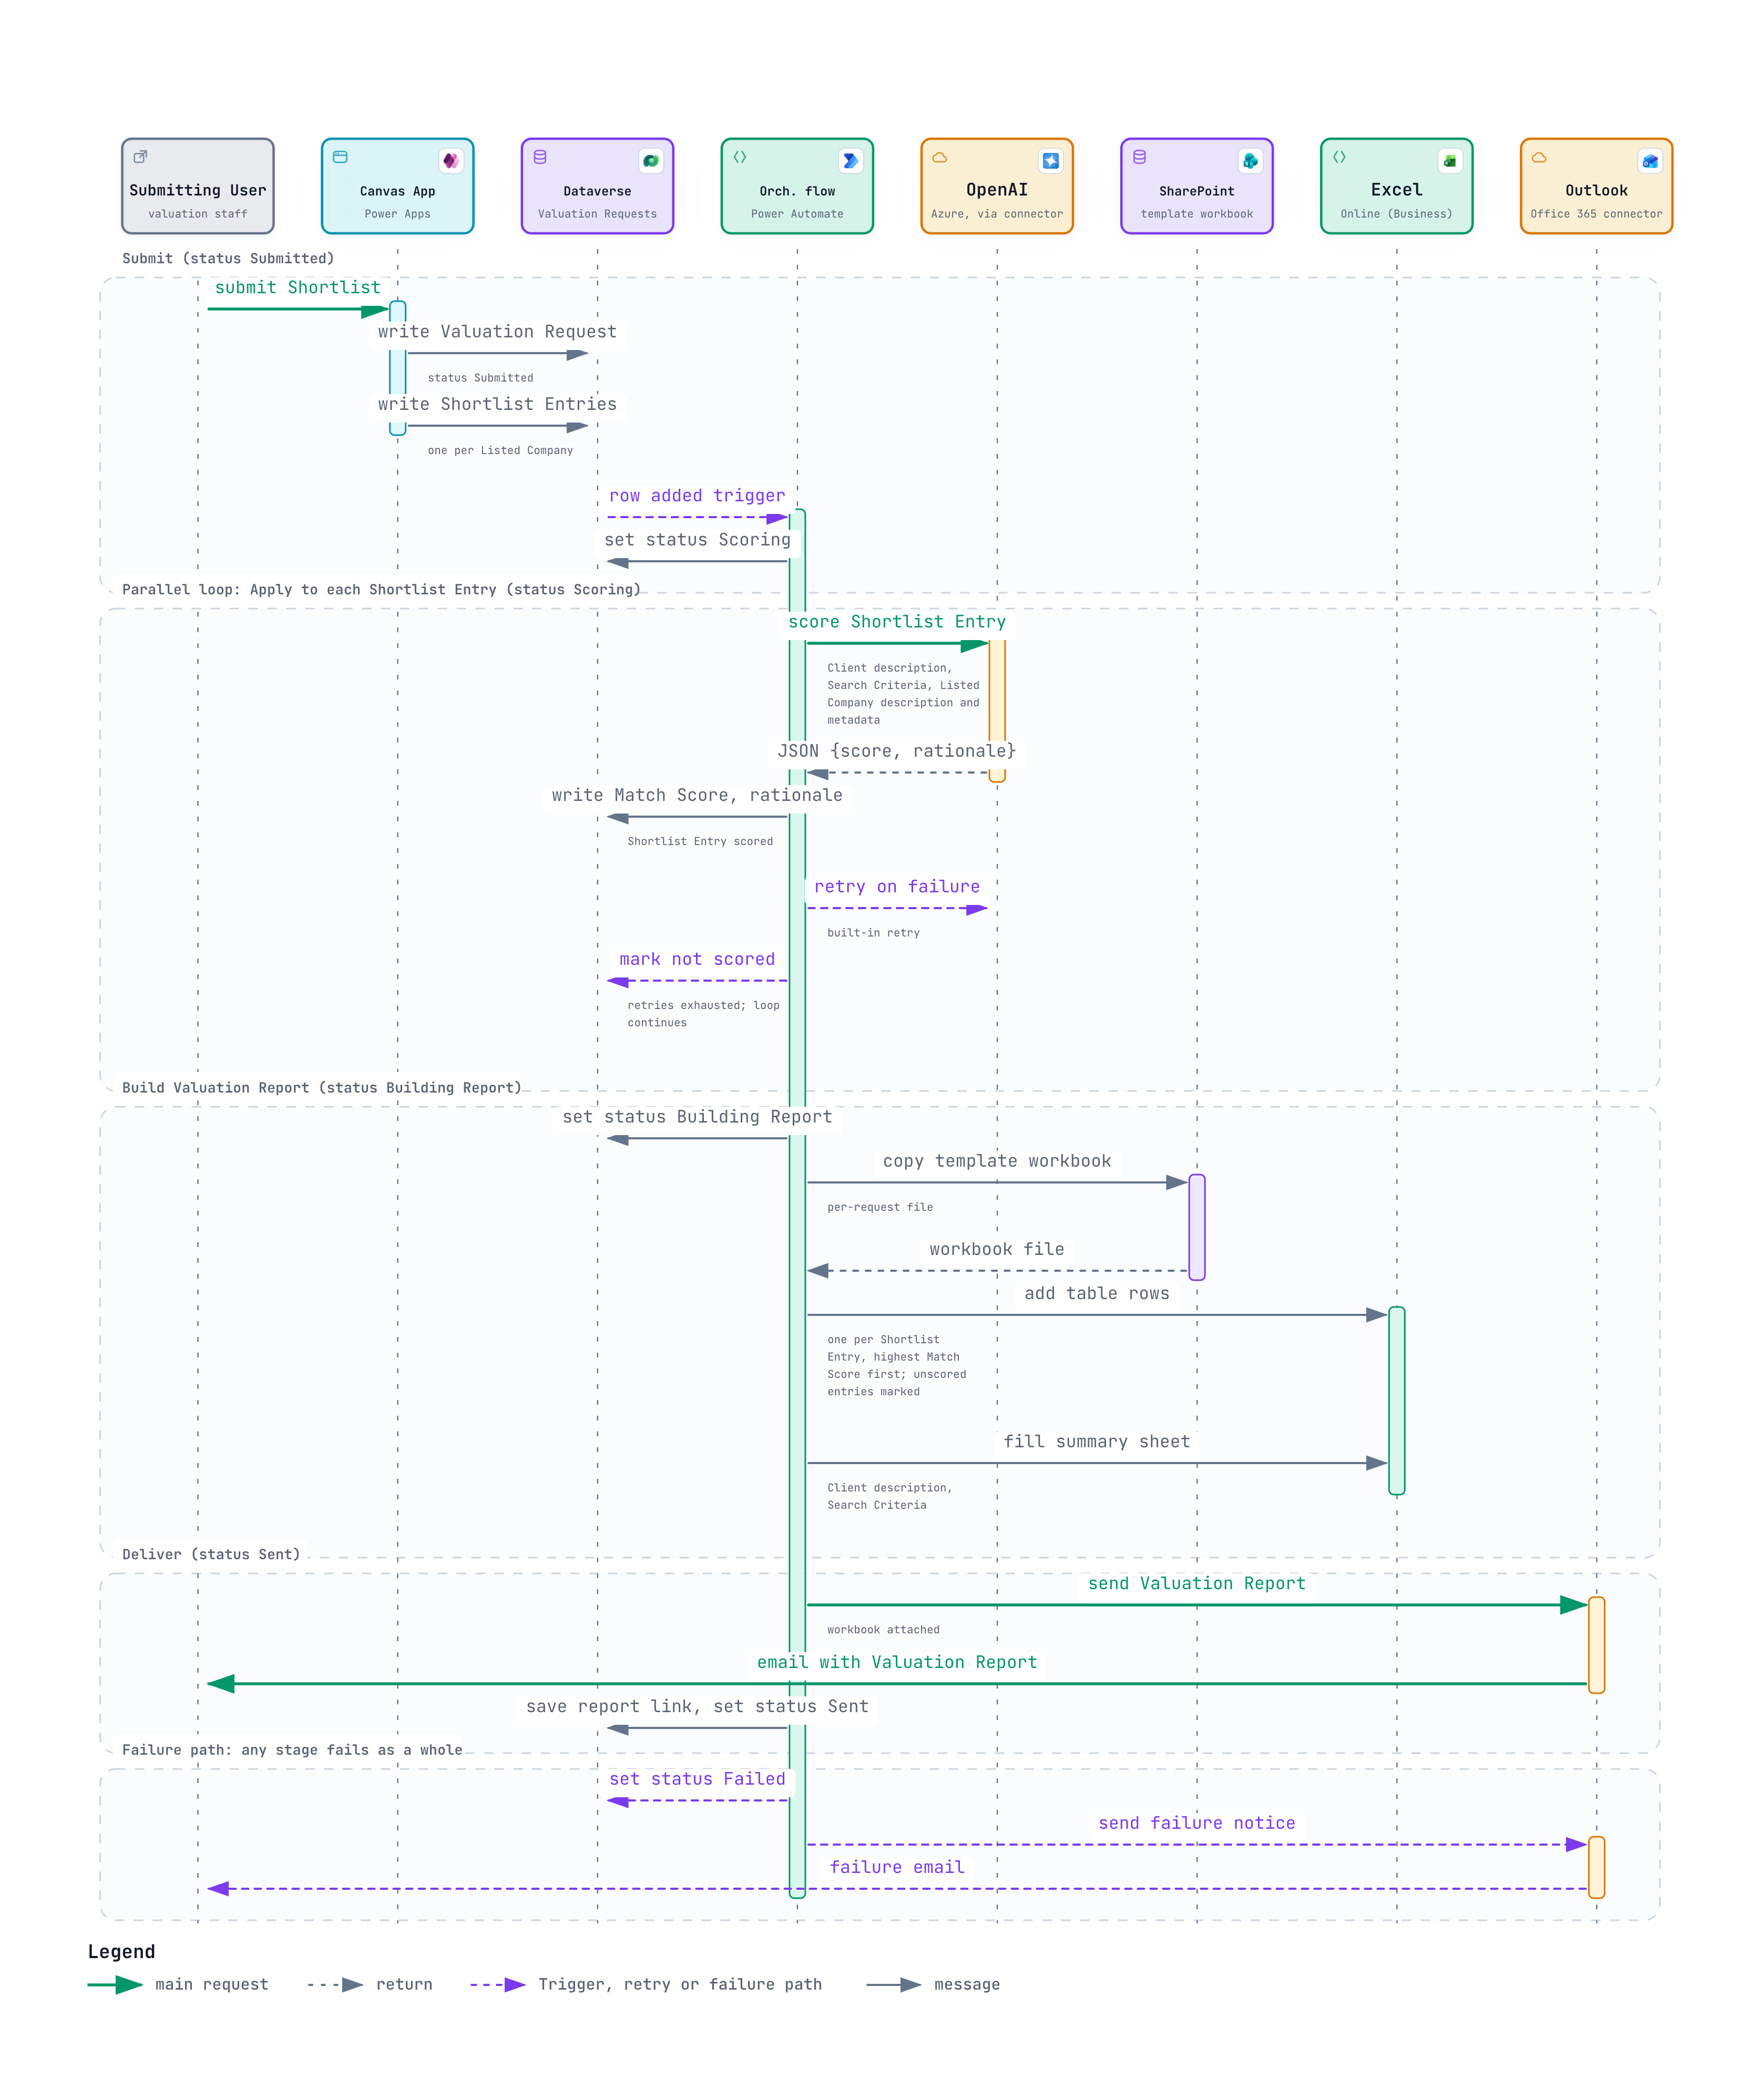
Scoring and report sequence
From Shortlist submission to the emailed Valuation Report
1
Write, then trigger
The app writes the Valuation Request and its Shortlist Entries. A Dataverse trigger starts orchestration.
2
Parallel scoring
Apply to each scores every entry with Azure OpenAI. Once retries run out, the entry is marked not scored and the loop continues.
3
Report and failure path
Rows are sorted by Match Score and emailed as an attachment. If a whole stage fails, the request becomes Failed and the User gets a failure email.
Notes:
Statuses move Submitted, Scoring, Building Report, Sent. Each Azure OpenAI call receives the Client description, Search Criteria and the Listed Company's description and metadata, and returns JSON with a score and rationale. The report is a copied SharePoint template filled with Excel Online, plus a summary sheet, sent by Outlook.

Slide 9
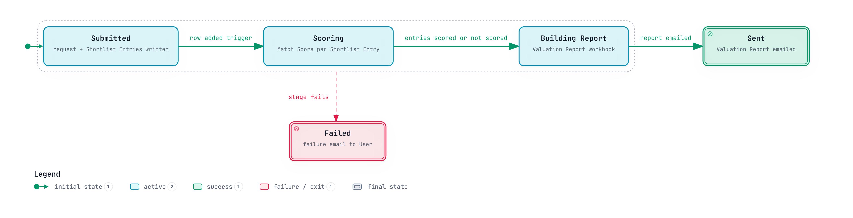
Valuation Request lifecycle
Every request ends in Sent or Failed
Happy path
Submitted → Scoring → Building Report → Sent. Each step is driven by the orchestration flow.
Partial scoring is not failure
An entry that can't be scored is marked not scored and shown in the report. It never fails the request.
No Draft state
Searches before submission aren't saved. A request exists only once the Shortlist is submitted.
Notes:
Failed can be reached from Submitted, Scoring or Building Report, and sends the User a failure email. A single unscored Shortlist Entry does not fail the request.

Slide 10
Data
Six Dataverse tables behind search, requests and scoring

Slide 11
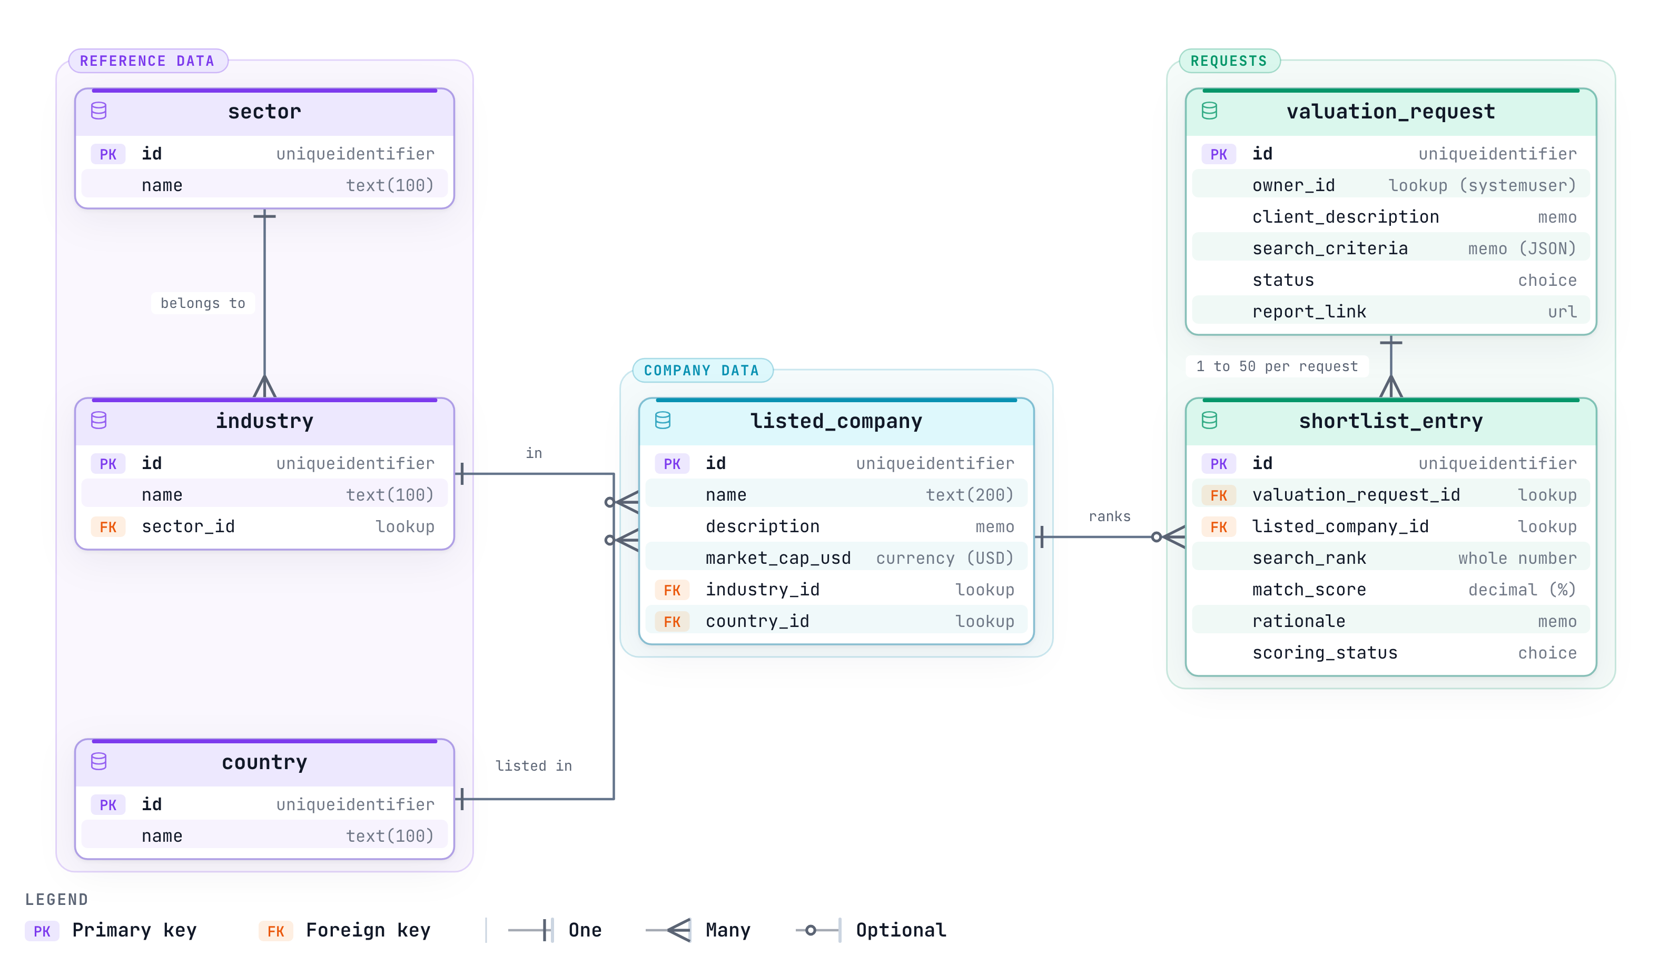
Data model
Reference data, Listed Companies, and Valuation Requests with their Shortlist Entries
1
Reference data
Every Industry belongs to one Sector. Sector, Industry and Country feed the Search Criteria options.
2
Listed Company
Name, description and Market Cap in USD, with lookups to Industry and Country.
3
Requests and entries
Each Valuation Request has 1 to 50 Shortlist Entries, holding the search rank, Match Score, rationale and scoring status.
Notes:
Search Criteria are saved on the Valuation Request as a JSON snapshot. Statuses: Submitted, Scoring, Building Report, Sent, Failed. Scoring status: pending, scored, not scored. The owner is a lookup to the Dataverse system user table, which is outside this model.

Slide 12
Explore the diagrams
https://akashic.github.io/Diagrams/
Architecture description
Glossary
ADR 0001: Build on Power Platform
Notes:
Every diagram is interactive on the site, with light and dark themes and export options. The architecture description, glossary and ADR are the sources the diagrams were drawn from.

