Slide 1
Data Structure & Algorithm
14 – Dynamic Programming
JJCAO

Slide 2
Overview
What is DP?
Characteristics of DP
Formulation
Examples
Disadvantages of DP
References

Slide 3
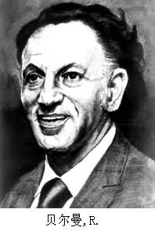
WHAT IS DP?
Dynamic Programming (DP) is a commonly used method of optimally solving complex problems by breaking them down into simpler subproblems in a recursive manner.
Dynamic programming is both a mathematical optimization method and a computer programming method. It is applicable to both discrete and continuous domains.
Floyd’s all-pairs shortest-path algorithm was an example of dynamic programming.
Richard Bellman pioneered the systematic study of dynamic programming in the 1950s.

Slide 4
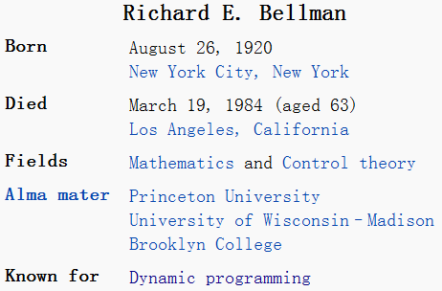


Applied_Dynamic_Programming_1962
2010
Also known for:
Hamilton–Jacobi–Bellman equation
Discrete: Bellman equation in optimal control
Continuous: Hamilton–Jacobi equation in classical physics
Curse of dimensionality
E.G. Evenly-spaced sample points of 1d interval, 2d image, 10d hypercube, …
Bellman–Ford algorithm
Dijkstra’s algorithm is faster with non-negative weights
http://bellmanequation.com 2010
Notes:
The Bellman–Ford algorithm sometimes referred to as the Label Correcting Algorithm, computes single-source shortest paths in a weighted digraph (where some of the edge weights may be negative). Dijkstra's algorithm accomplishes the same problem with a lower running time, but requires edge weights to be non-negative. Thus, Bellman–Ford is usually used only when there are negative edge weights.

Slide 5
Greedy vs. Exhaustive Search
Greedy algorithms focus on making the best local choice at each decision point. In the absence of a correctness proof such greedy algorithms are very likely to fail.
Dynamic programming gives us a way to design custom algorithms which systematically search all possibilities (thus guaranteeing correctness) while storing results to avoid recomputing (thus providing efficiency).
Once understood it is relatively easy to apply, it looks like magic until you have seen enough examples.

Slide 6
Applications
Once you understand dynamic programming, it is usually easier to reinvent certain algorithms than try to look them up!
Steven Skiena had found dynamic programming to be one of the most useful algorithmic techniques in practice:
Shortest path on a DAG
Morphing in computer graphics.
Data compression for high density bar codes.
Designing genes to avoid or contain specified patterns.
Knapsack (0/1, integer)
Matrix Chain multiplication problem
Longest common subsequence
VLSI CAD problems, e.g., Gate sizing, Placement, Routing etc.
Queuing theory, Control theory, Bioinformatics, Information theory, Operations Research etc.
Multiple-class Mean Value Analysis (MVA) etc.

Slide 7
CHARACTERISTICS OF DP
DP is applicable to problems that exhibit the properties of overlapping subproblems which are only slightly smaller and optimal substructure.
Overlapping subproblems
If overlapping problems are much smaller than the original problem, the strategy is called “divide and conquer”, such as mergesort, quicksort.
Optimal substructure
the solution to a given optimization problem can be obtained by the combination of optimal solutions to its subproblems
usually described by means of recursion
Notes:
Overlapping Subproblem重叠子问题: 对于子问题的重复调用
optimal structure最优子结构

Slide 8
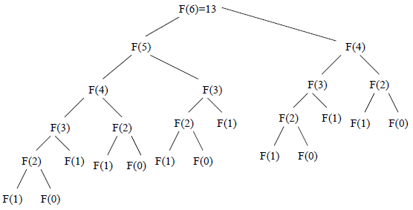
Overlapping subproblems
A naive implementation of finding nth Fibonacci number is :
But this involves repeated calculations –for higher numbers it leads to exponential time!!!
Function fib(n)
if n =0 return 0
else if n =1 return 1
else return fib(n-1) + fib (n-2)

Slide 9
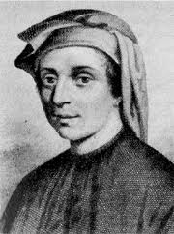
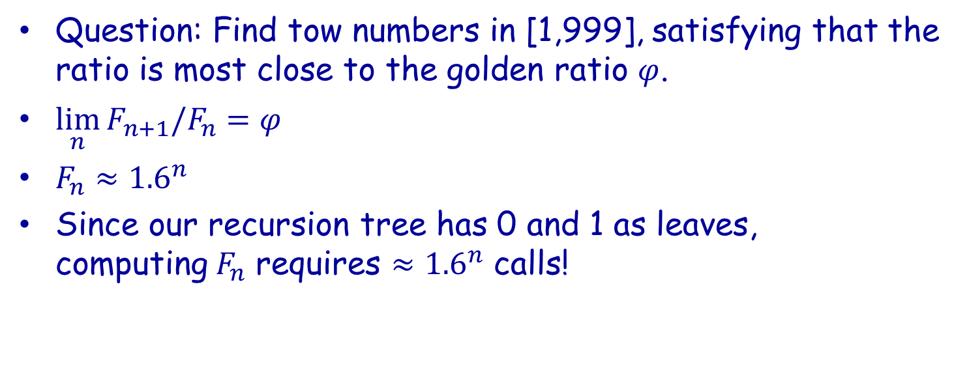
How slow?
Question: Find tow numbers in [1,999], satisfying that the ratio is most close to the golden ratio $φ$.
$\lim_{n}{F_{n+1}/F_{n}}=φ$
$F_{n}≈{1.6}^{n}$
Since our recursion tree has 0 and 1 as leaves, computing$F_{n}$ requires $≈{1.6}^{n}$ calls!

Slide 10
Overlapping subproblems
Top-down approach of DP: Memorize and use solutions of previously solved subproblems
Moral: we traded space for time. O(n) is the time complexity and O(n) is space complexity, compared to exponential complexity of naïve method.
Function fib(n)
if n =0 return 0
else if n =1 return 1
else return fib(n-1) + fib (n-2)
FIB = -ones(n,1);
FIB[0]=0; FIB[1]=1;
Function fib(n)
if FIB(n) < 0 return fib(n-1) + fib (n-2)
else return FIB(n);

Slide 11
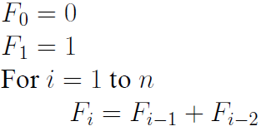
Overlapping subproblems
Bottom-up approach of DP: Memorize by solving the subproblems first and use their solutions to build-on and arrive at solutions to bigger subproblems
O(n) is the time complexity and O(1) is space complexity, compared to exponential complexity of naïve method.
Function fib(n)
Var previousFib:= 0, currentFib:= 1
if n =0 return 0
else if n = 1 return 1
repeat n-1 times
Var newFib:= previousFib+ currentFib
previousFib:= currentFib
currentFib:= newFib
return currentFib
Moral: we traded space for time.

Slide 12
Overlapping subproblems
Dynamic programming is a technique for avoiding recomputation by storing partial results
The trick to dynamic program is to see that the naive recursive algorithm repeatedly computes the same subproblems over and over and over again. If so, storing the answers to them in a table instead of recomputing can lead to an efficient algorithm.
Top-down approach: memorize or store the solutions to the subproblems in a table. Whenever we attempt to solve a new subproblem, we first check the table to see if it is already solved. If a solution has been recorded, we can use it directly, otherwise we solve the subproblem and add its solution to the table.
Bottom-up approach: Once we formulate the solution to a problem recursively as in terms of its subproblems, we can try reformulating the problem in a bottom-up fashion: try solving the subproblems first and use their solutions to build-on and arrive at solutions to bigger subproblems. This is also usually done in a tabular form by iteratively generating solutions to bigger and bigger subproblems by using the solutions to small subproblems. For example, if we already know the values of F₄₁ and F₄₀, we can directly calculate the value of F₄₂.
Thus we must first hunt for a correct recursive algorithm – later we can worry about speeding it up by using a results matrix.

Slide 13
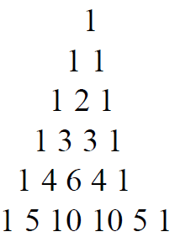
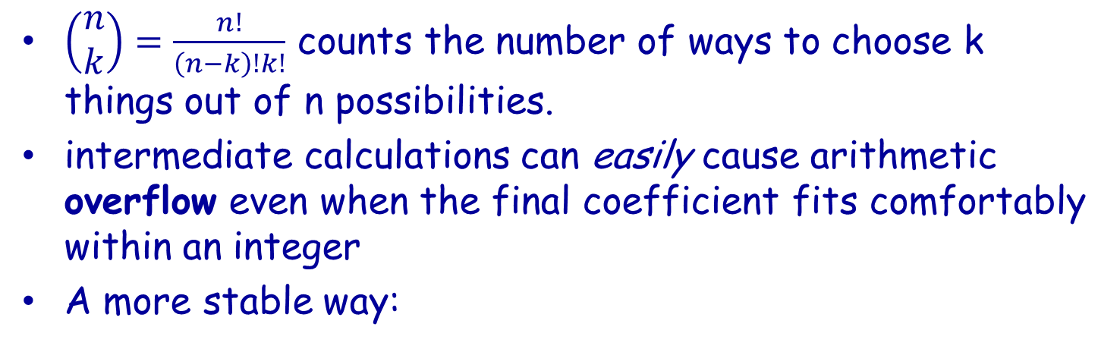
Binomial Coefficients
$\left(\begin{matrix}n \\ k\end{matrix}\right)=\frac{n!}{\left(n−k\right)!k!}$ counts the number of ways to choose k things out of n possibilities.
intermediate calculations can easily cause arithmetic overflow even when the final coefficient fits comfortably within an integer
A more stable way:
$\left(\begin{matrix}n \\ k\end{matrix}\right)=\left(\begin{matrix}n−1 \\ k\end{matrix}\right)$+$\left(\begin{matrix}n−1 \\ k−1\end{matrix}\right)$=$\left(\begin{matrix}n−2 \\ k\end{matrix}\right)$+$\left(\begin{matrix}n−2 \\ k−1\end{matrix}\right)$+$\left(\begin{matrix}n−2 \\ k−1\end{matrix}\right)$+$\left(\begin{matrix}n−2 \\ k−2\end{matrix}\right)$=...
Pascal’s Triangle

Slide 14
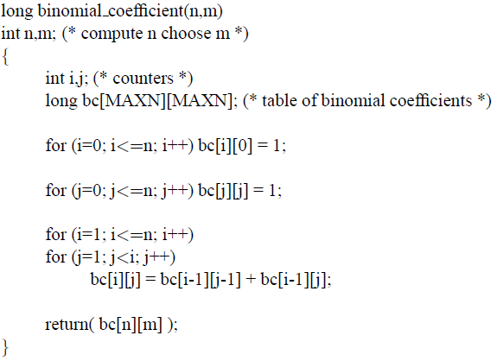
Binomial Coefficients Implementation

Slide 15
Three Steps to Dynamic Programming
Formulate the answer as a recurrence relation or recursive algorithm.
Show that the number of different instances of your recurrence is bounded by a polynomial.
Specify an order of evaluation for the recurrence so you always have what you need.

Slide 16
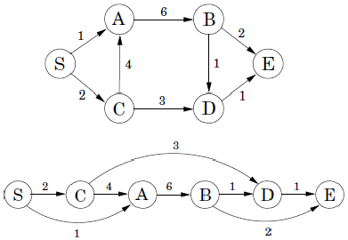


Optimal Substructure - Shortest path example
To find the shortest path to D:
If the shortest path involves to D involves the path from S to D has the node C, then the shortest path from S to C and shortest path from C to D are the optimal subsolutions of the actual problem.

Slide 17


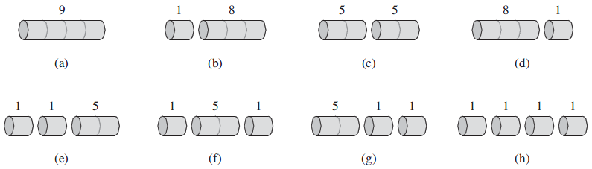
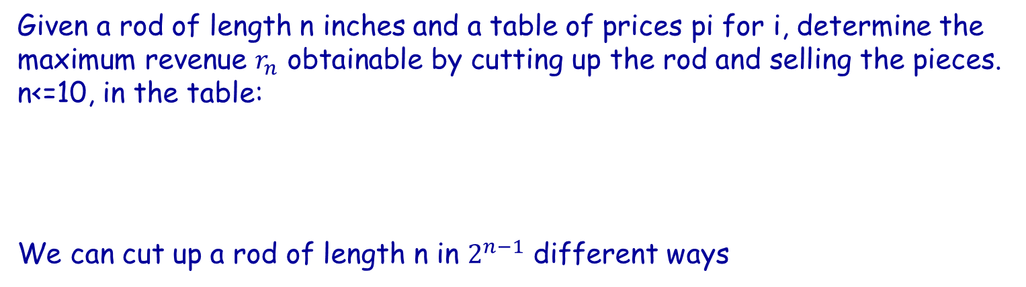
Example 0: Rod cutting
Given a rod of length n inches and a table of prices pi for i, determine the maximum revenue $r_{n}$ obtainable by cutting up the rod and selling the pieces. n<=10, in the table:
We can cut up a rod of length n in $2^{n−1}$ different ways
The 8 possible ways of cutting up a rod of length 4. Above each piece is the value of that piece, according to the sample price chart. The optimal strategy is part (c)—cutting the rod into two pieces of length 2—which has total value 10

Slide 18

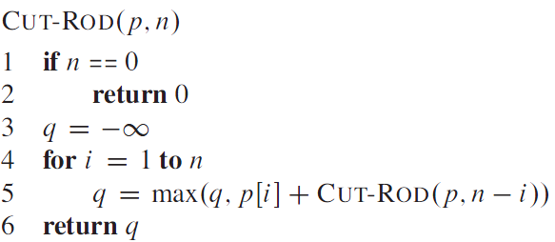
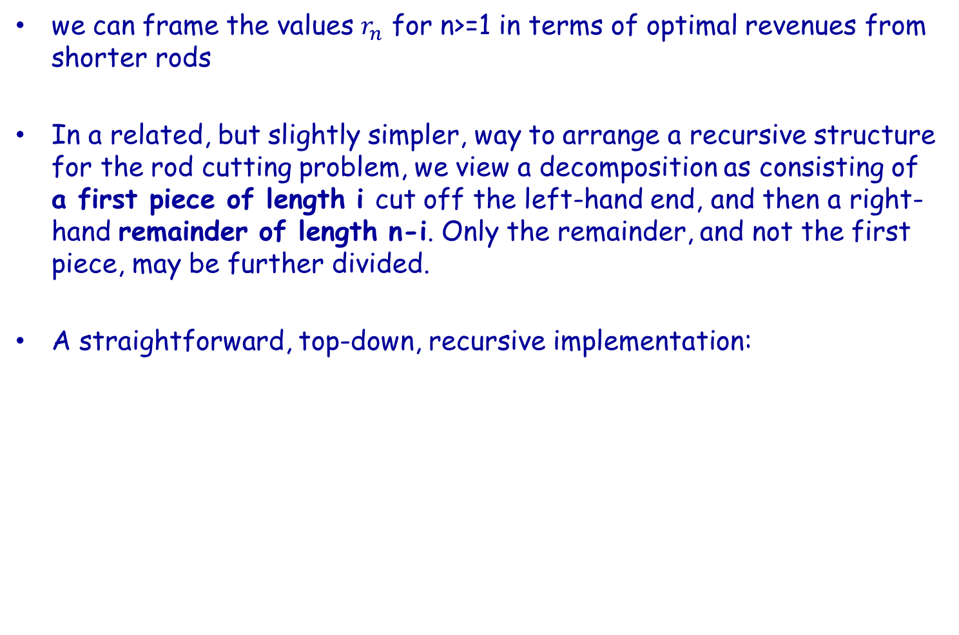
Rod cutting
we can frame the values $r_{n}$ for n>=1 in terms of optimal revenues from shorter rods
In a related, but slightly simpler, way to arrange a recursive structure for the rod cutting problem, we view a decomposition as consisting of a first piece of length i cut off the left-hand end, and then a right-hand remainder of length n-i. Only the remainder, and not the first piece, may be further divided.
A straightforward, top-down, recursive implementation:

Slide 19
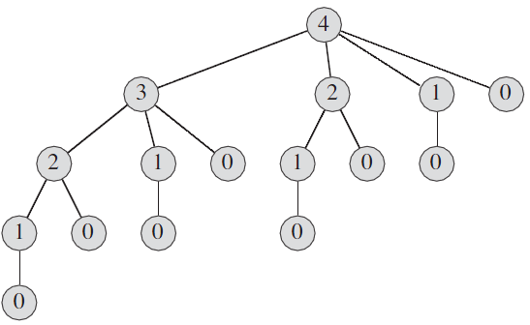
CUT-ROD(p,n)
The recursion tree showing recursive calls resulting from a call CUT-ROD(p,n) for n=4.
In general, this recursion tree has 2^n nodes and 2^(n-1) leaves.
the running time of CUT-ROD is exponential in n.

Slide 20
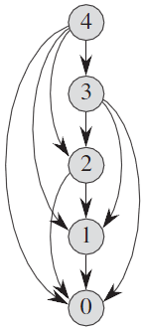
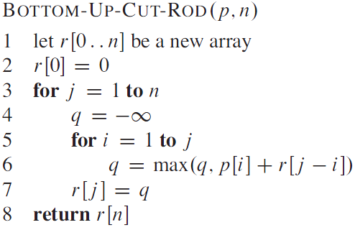
Dynamic programming for optimal rod cutting
The subproblem graph for the rod-cutting problem with n
The running time of BOTTOM-UP-CUT-ROD is O(n^2)

Slide 21
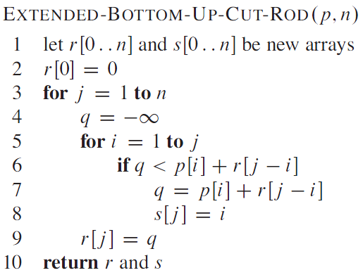
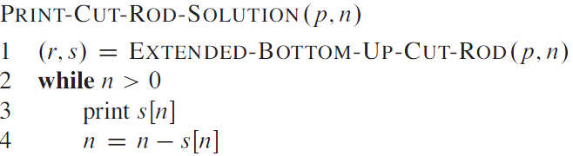
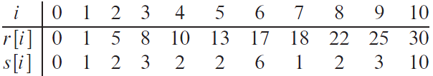
Reconstructing a solution
s[1..n]: optimal first-piece sizes
prints out the complete list of piece sizes in an optimal decomposition of a rod of length n:
A call to PRINT-CUT-ROD-SOLUTION(p,10) would print just 10, but a call with n=7 would print the cuts 1 and 6, corresponding to the optimal decomposition for r_7

Slide 22
Example 1: The Partition Problem
Suppose the job scanning through a shelf of books is to be
split between k workers.
To avoid the need to rearrange the books or separate them into piles, we can divide the shelf into k regions and assign each region to one worker.
What is the fairest way to divide the shelf up?
If each book is the same length, partition the books into equalized regions,
100 100 100 | 100 100 100 | 100 100 100
But what if the books are not the same length? This partition would yield
400 500 600 | 100 200 300 | 700 800 900
No sort is permitted here!

Slide 23
The Linear Partition Problem
Input: A given arrangement S of nonnegative numbers {s1, . . . , sn} and an integer k.
Problem: Partition S into k ranges, so as to minimize the maximum sum over all the ranges.
E.g. n=9,k=3, the maximum sum is 1700: 100 200 300 400 500 | 600 700 | 800 900
Try to find an algorithm which always gives the optimal solution.

Slide 24
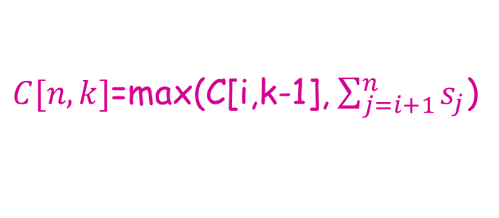
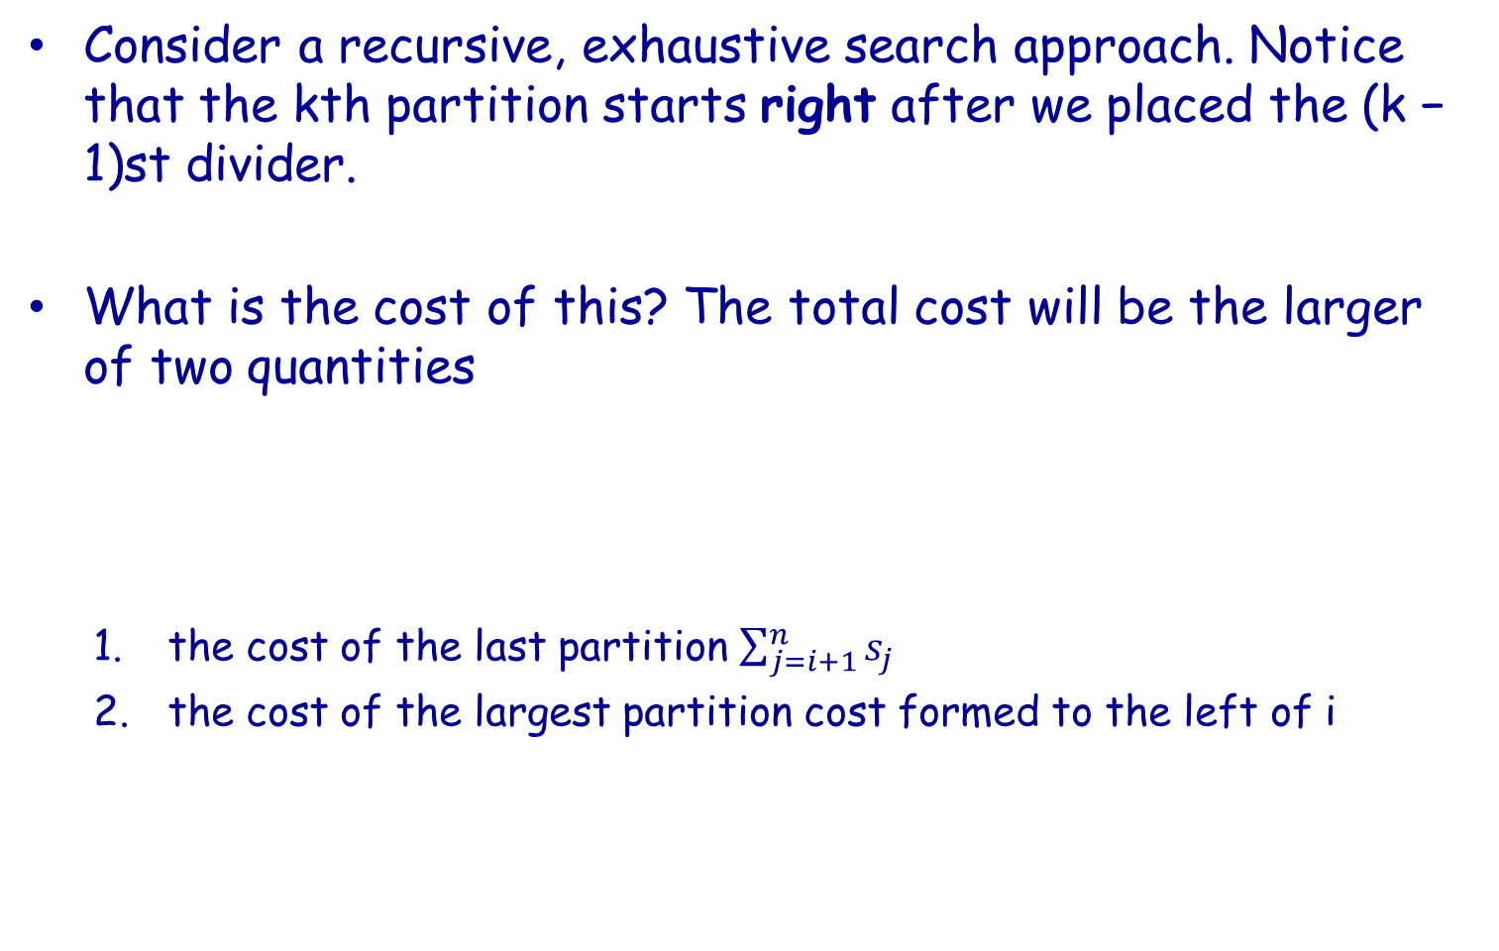
Recursive Idea
Consider a recursive, exhaustive search approach. Notice that the kth partition starts right after we placed the (k − 1)st divider.
What is the cost of this? The total cost will be the larger of two quantities
the cost of the last partition $\sum_{j=i+1}^{n}{s_{j}}$
the cost of the largest partition cost formed to the left of i
$C[n,k]$=max(C[i,k-1], $\sum_{j=i+1}^{n}{s_{j}}$)

Slide 25

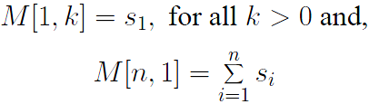

Dynamic Programming Recurrence
Define M[n, k] to be the minimum possible cost over all partitionings of {s1, . . . , sn} into k ranges, where the cost of a partition is the largest sum of elements in one of its parts. Thus defined, this function can be evaluated:
with the natural basis cases of
For computing M[n,k], you need to memorize a n*(k-1) table
Running time (a total of kn cells, each cell depends on n others): O(kn^2)
$\begin{matrix}M[1,1] \\ M[2,1] \\ \begin{matrix} \\ \\ M[n,1]\end{matrix}\end{matrix}$ $\begin{matrix}M[1,2] \\ M[2,2] \\ \begin{matrix} \\ \\ \end{matrix}\end{matrix}$ $\begin{matrix} \\ M[2,3] \\ \begin{matrix} \\ \\ \end{matrix}\end{matrix}$ $\begin{matrix}M[1,k−1] \\ M[2,k−1] \\ \begin{matrix} \\ \\ M[n,k−1]\end{matrix}\end{matrix}$

Slide 26
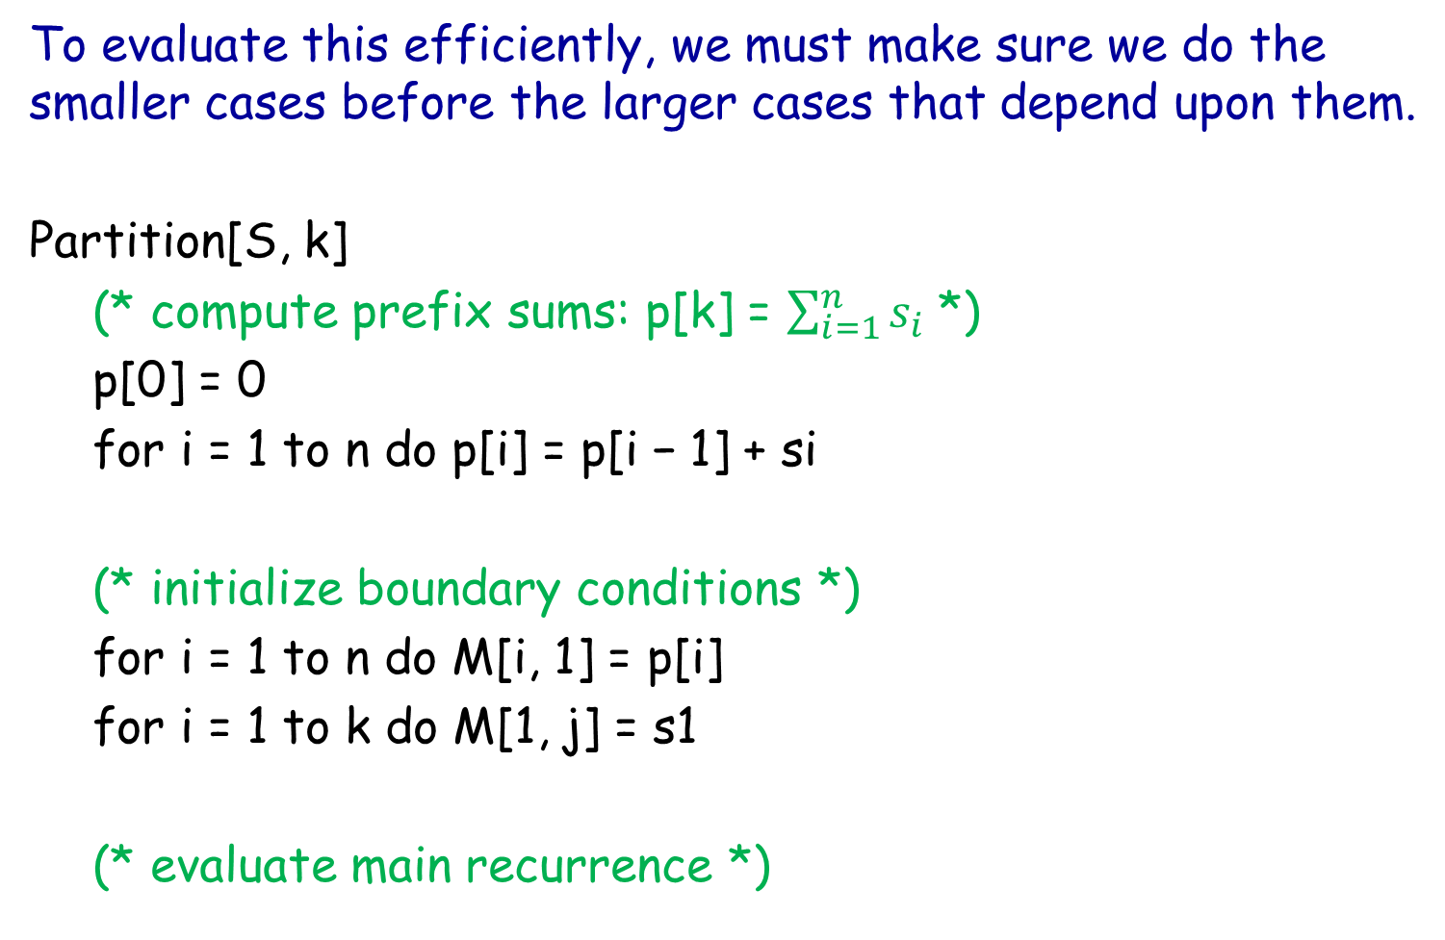
Implementation
To evaluate this efficiently, we must make sure we do the smaller cases before the larger cases that depend upon them.
Partition[S, k]
(* compute prefix sums: p[k] = $\sum_{i=1}^{n}{s_{i}}$ *)
p[0] = 0
for i = 1 to n do p[i] = p[i − 1] + si
(* initialize boundary conditions *)
for i = 1 to n do M[i, 1] = p[i]
for i = 1 to k do M[1, j] = s1
(* evaluate main recurrence *)

Slide 27
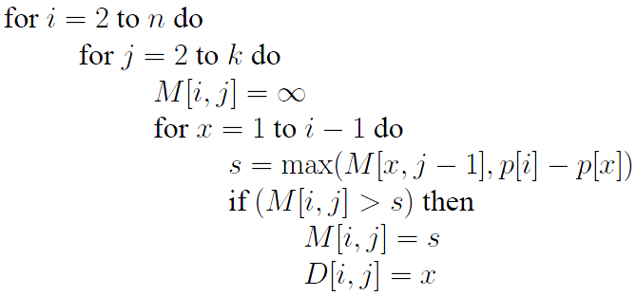

Slide 28
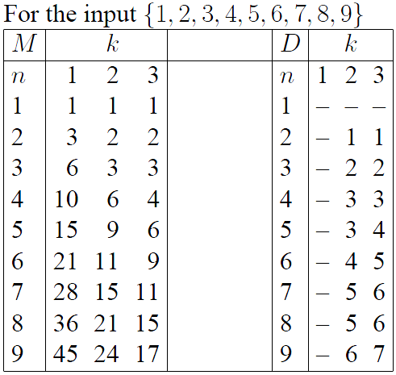
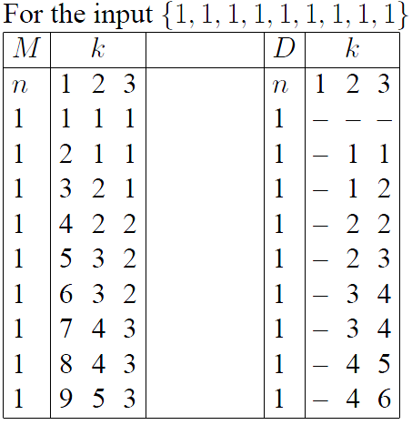
DP Matrices

Slide 29
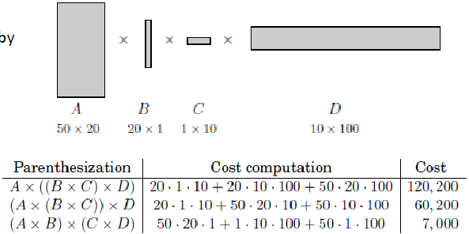
Example 2: OPTIMAL MATRIX MULTIPLICATION ORDER
General problem: Determine the optimal order of A1xA2xA3x… xAn
Subproblems : AixAi+1x… Aj, 1<= i <= j <= n
Define C(i,j) = minimum cost of multiplying Ai xAi+1x… Aj
The cost of the subproblemis the cost of these two pieces and the cost of combining them

Slide 30
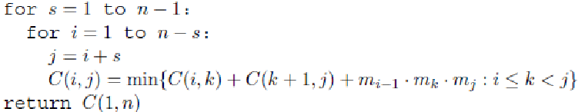
The pseudo code
The complexity of O(n^3).

Slide 31
Example 3: KNAPSACK PROBLEM
《在云端》背包理论.mp4

Slide 32
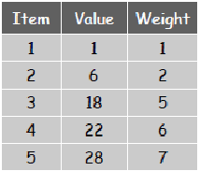
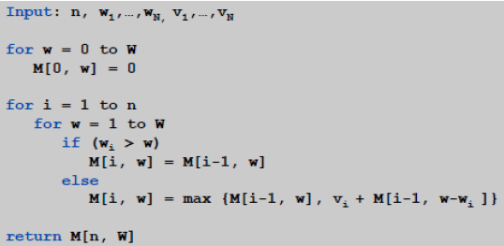
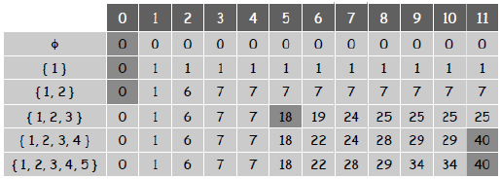




0/1 KNAPSACK PROBLEM
Given n objects and a “knapsack”.
Item I weights wi> 0 Kgs & has value vi> 0.
Knapsack has capacity of W Kgs.
Goal: fill knapsack so as to maximize its total value.
OPT(i,w) = max profit subset of items 1…i with weight limit w
OPT(i,w) =
$$max⁡\{OPT\left(i−1,w\right), v_{i}+OPT(i−1, w−w_{i}\}$$
if $w_{i}$<=w
$$OPT\left(i−1,w\right)$$
if $w_{i}$>w
0
if i=0
Running time: O(n*W)

Slide 33
What is DP?
Recurrent/recursive formula
Starting states
DP solutions have a polynomial complexity with assures a much faster running time than backtracking, brute-force etc.

Slide 34
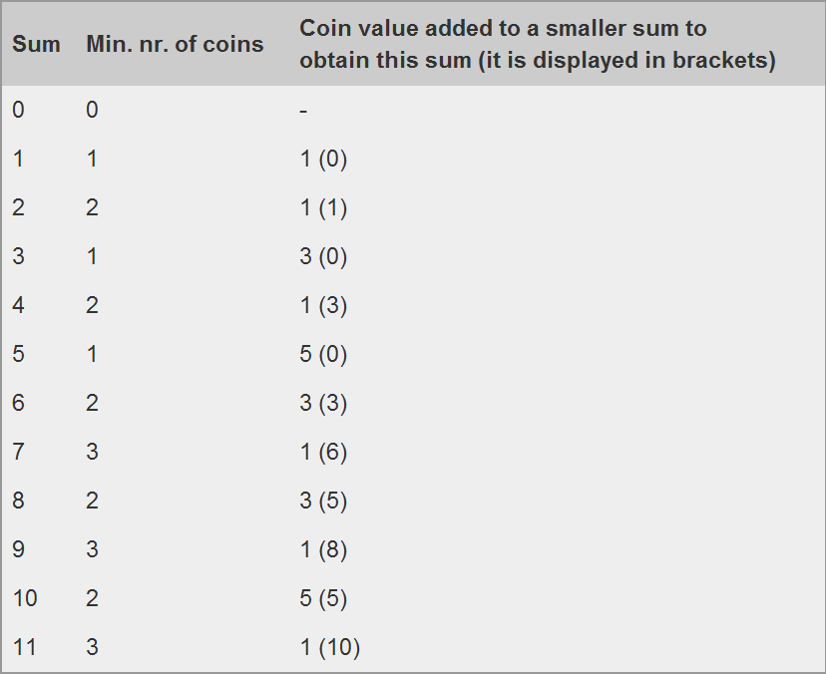
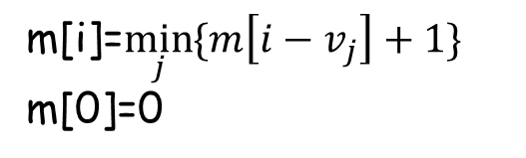
Example 4
Given a list of N coins, their values (V₁, V₂, ... , V_{N}), and the total sum S.
Find the minimum number of coins the sum of which is S: m[s] (we can use as many coins of one type as we want),
or report that it's not possible to select coins in such a way that they sum up to S.
m[i]=$\min_{j}{\{m\left[i−v_{j}\right]+1\}}$
m[0]=0
Set Min[i] equal to Infinity
for all of i Min[0]=0
For i = 1 to S
For j = 0 to N - 1
If (V_{j}<=i AND Min[i-V_{j}]+1<Min[i])
Then Min[i]=Min[i-V_{j}]+1
Output Min[S]
Example: Given coins with values 1, 3, and 5. And S=11.

Slide 35
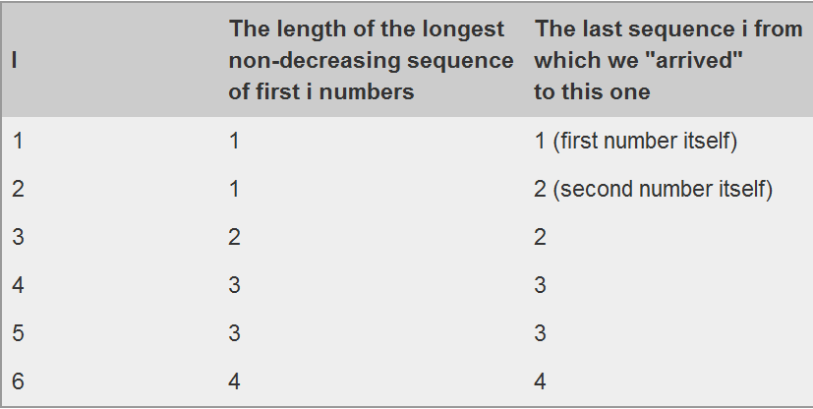
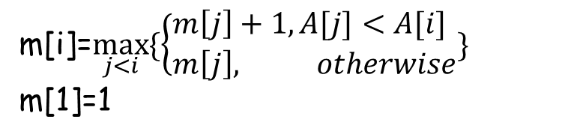
Example 5
Given a sequence of N numbers - A[1] , A[2] , ..., A[N] . Find the length of the longest non-decreasing sequence m[N].
m[i]: len of longest non-decreasing sequence which has its last number A[i]
Example: 5, 3, 4, 8, 6, 7
m[i]=$\max_{j<i}{\{\left\{\begin{matrix}m\left[j\right]+1,A[j]<A[i] \\ m\left[j\right], otherwise\end{matrix}\right.\}}$
m[1]=1

Slide 36
More 1D DP examples
TopCoder competitions
ZigZag - 2003 TCCC Semifinals 3
BadNeighbors - 2004 TCCC Round 4
FlowerGarden - 2004 TCCC Round 1

Slide 37
Example 6
Problem: A table composed of N x M cells, each having a certain quantity of apples, is given. You start from the upper-left corner. At each step you can go down or right one cell. Find the maximum number of apples you can collect.
S[i][j] is max number collected when you arrived [i,j]
 |  | *
S[i][j]=A[i][j] + max(S[i-1][j], if i>0 ; S[i][j-1], if j>0)
S[0][0]=0;
S[0][j]=A[0][j]+S[0][j-1]
S[i][0]=A[i,0]+S[i-1][0]
For i = 0 to N - 1
For j = 0 to M - 1
S[i][j] = A[i][j] + max(S[i][j-1], if j>0 ; S[i-1][j], if i>0 ; 0)
Output S[n-1][m-1]
Notes:
First of all we have to find a state. The first thing that must be observed is that there are at most 2 ways we can come to a cell - from the left (if it's not situated on the first column) and from the top (if it's not situated on the most upper row). Thus to find the best solution for that cell, we have to have already found the best solutions for all of the cells from which we can arrive to the current cell.

Slide 38
More 2D DP examples
TopCoder competitions
AvoidRoads - 2003 TCO Semifinals 4
ChessMetric - 2003 TCCC Round 4

Slide 39
Example 7
Given an undirected graph G having positive weights and N vertices. You start with having a sum of M money. For passing through a vertex i, you must pay S[i] money. If you don't have enough money - you can't pass through that vertex. Find the shortest path from vertex 1 to vertex N, respecting the above conditions; or state that such path doesn't exist.
Restrictions: 1<N<=100 ; 0<=M<=100 ; for each i, 0<=S[i]<=100

Slide 40
Pseudocode
Set dist[i][j] to Infinity for all (i,j)
dist[0][M]=0
While(TRUE)
(d,k,l)=min{dist[i][j]}
If (d== Infinity) break;
For All Neighbors p of Vertex k.
If (l-S[p]>=0 && dist[p][l-S[p]]>dist[k][l]+weight[k][p])
Then dist[p][l-S[p]]=dist[k][l]+weight[k][p]
End For
End While
Find the smallest number among dist[N-1][j] (for all j, 0<=j<=M); if there are more than one such states, then take the one with greater j.
If there are no states(N-1,j) with value less than Infinity - then such a path doesn't exist.

Slide 41
More TC problems for practicing
Jewelry - 2003 TCO Online Round 4
StripePainter - SRM 150 Div 1
QuickSums - SRM 197 Div 2
ShortPalindromes - SRM 165 Div 2

Slide 42
DISADVANTAGES OF DP
“Curse of dimensionality” –Richard Bellman:
Runtime is strongly dependent on the range of state variable ( example the weight capacity W of the knapsack), so we cannot guarantee bounds on the runtime.
Problems involving fractional state variable values can lead exponential increase in the iterations (time complexity).
The storage space (space complexity) is strongly dependent on the state variable and can also be .
Is only applicable to problems with identified overlapping subproblems and optimal substructures. Many problems use using dynamic programming locally to solve the larger problem.
Establishing/identifying the optimal substructure and the DP recursion is not a trivial task for large problems.

Slide 43
References
Thomas H. Cormen, Charles E. Leiserson, Ronald L. Rivest, Clifford SteinIntroduction to Algorithms_3rd.
http://en.wikipedia.org/wiki/Dynamic_programming
R. Bellman, Dynamic Programming. Dover Publications, N.Y, 1957.
Bellman, R. and S. Dreyfus (1962) Applied Dynamic Programming Princeton University Press Princeton, New Jersey.
Blackwell, D. (1962) Discrete Dynamic Programming. Annals of Mathematical Statistics 33, 719-726.
Chow, C.S. and Tsitsiklis, J.N. (1989) The Complexity of Dynamic Programming. Journal of Complexity 5 466.488.
Eric V. Denardo Dynamic programming: models and applications, 2003.
www.cs.berkeley.edu/~vazirani/algorithms/chap6.pdf
http://www2.fiu.edu/~thompsop/modeling/modeling_chapter5.pdf
http://mat.gsia.cmu.edu/classes/dynamic/dynamic.html

