Slide 1
NLP WITH DISASTER TWEETS
AKASH iNDANI
Nikhil khaladkar

Slide 2

AGENDA
Motivation
Problem Statement
Approach
Data Exploration
Self Trained Models
Pre-Trained Models
Classification Report
Conclusion

Slide 3

MOTIVATION
With growing influence of social media platforms on spread of situational awareness during disasters, more and more research is conducted to automate the process of using these feeds to identify real disaster situations.
It is hence important to classify fake tweets from the real ones as we rely more and more on machine automated processes to identify crisis situation using social media feeds like tweets etc.
Image Source: The New York Times

Slide 4
PROBLEM STATEMENT
Classify whether tweets are disaster related or not using NLP and machine learning algorithms.
Identify the location and type of disaster so that we can quickly circulate this information to the concerned people like news channels, rescue organizations for low turnaround time.

Slide 5
APPROACH
Data Collection and Preprocessing
Remove HTML Tags, Usernames, Punctuations and Special Characters
Lemmitization and Tokenization
Word Embedding
Word2Vec
Doc2Vec
LSTM
Classification Models
Logistic Regression
SVM
KNN
Random Forest
Prediction
Predict Unseen Data

Slide 6
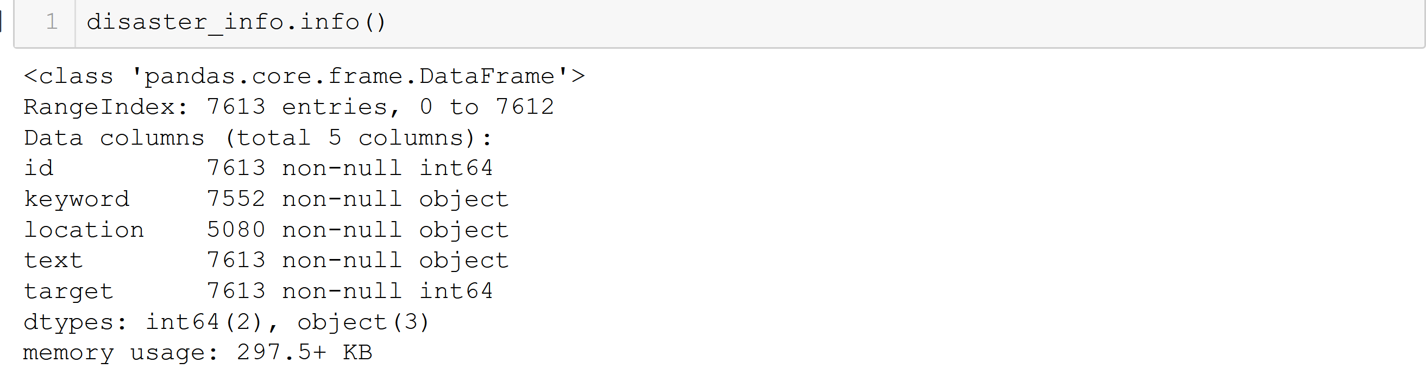
DATA EXPLORATION

Slide 7
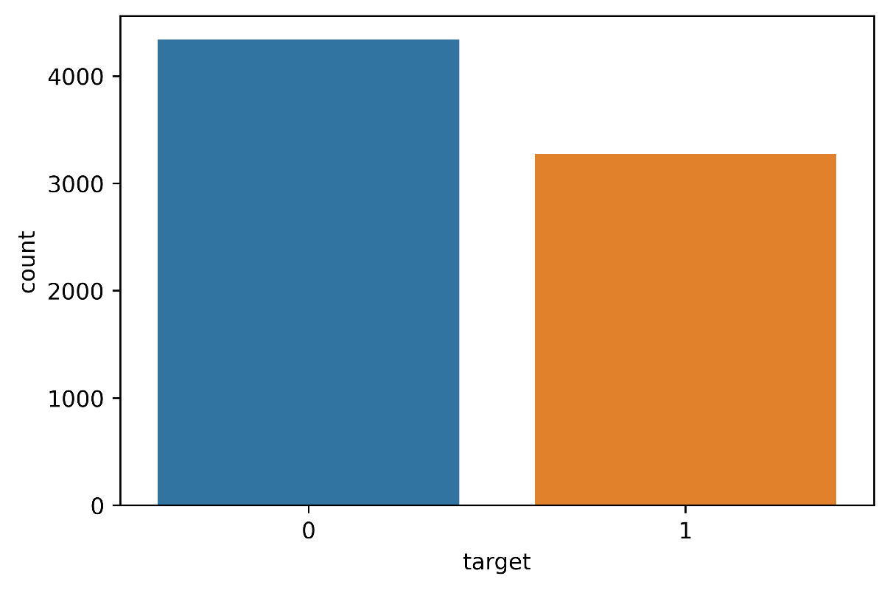
CLASS COUNT

Slide 8
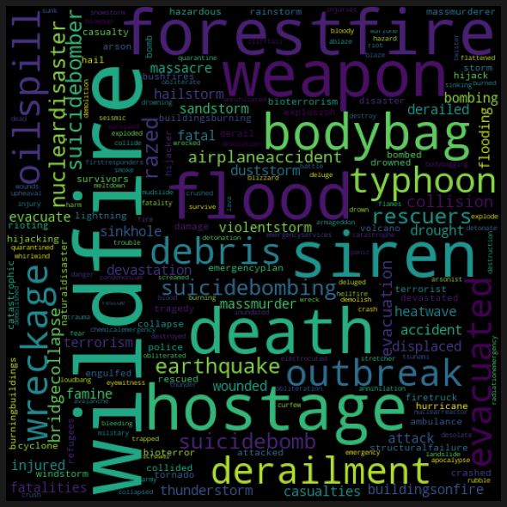
WORD CLOUD OF DISASTER KEYWORDS

Slide 9
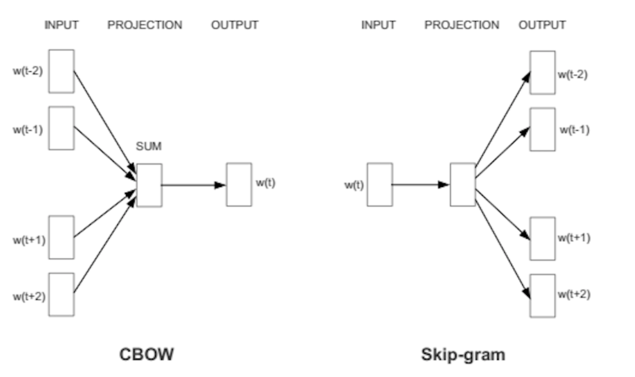
SELF TRAINED MODELS
Word2Vec
CBOW Model (Given the context predict the target)
Skip Gram Model (Given the target predict the context)
Source: Exploiting Similarities among Languages for Machine Translation

Slide 10
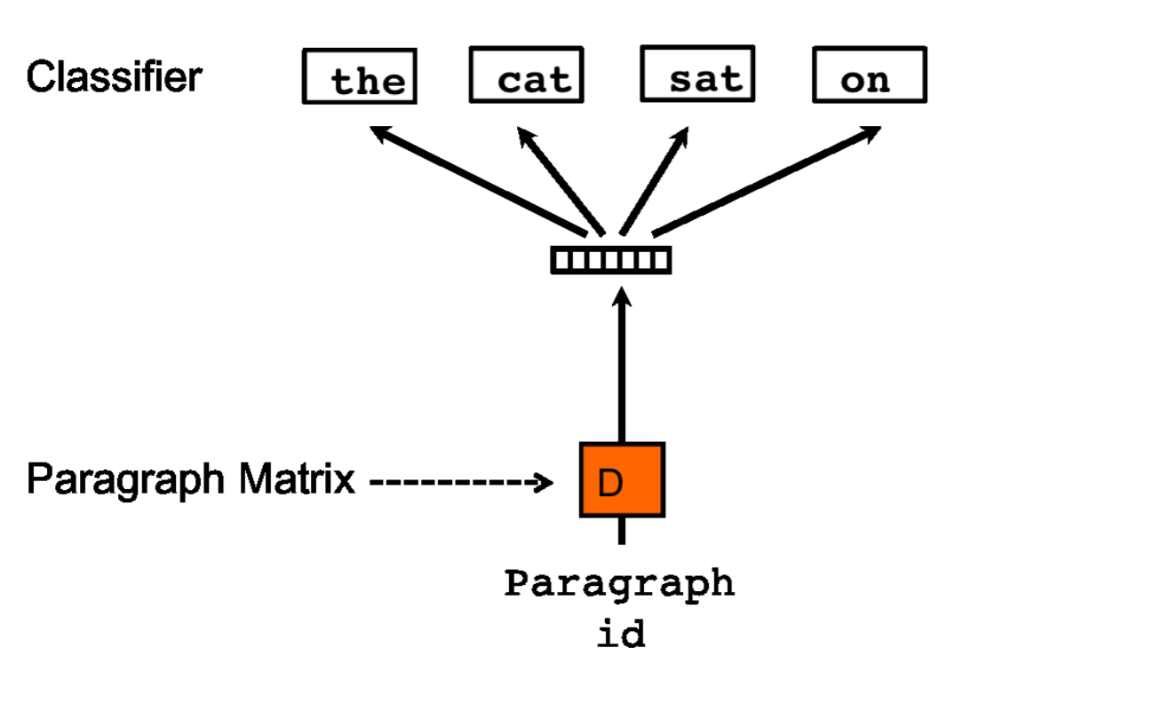
SELF TRAINED MODELS
Doc2Vec
An unsupervised learning algorithm which learns fixed-length representations from variable length text documents.
Each document is represented by a dense vector which is trained to predict words in the document.
It gives the algorithm the potential to overcome the weakness of bag of word models that the sequence or document information is lost.
Source: https://arxiv.org/pdf/1405.4053.pdf

Slide 11
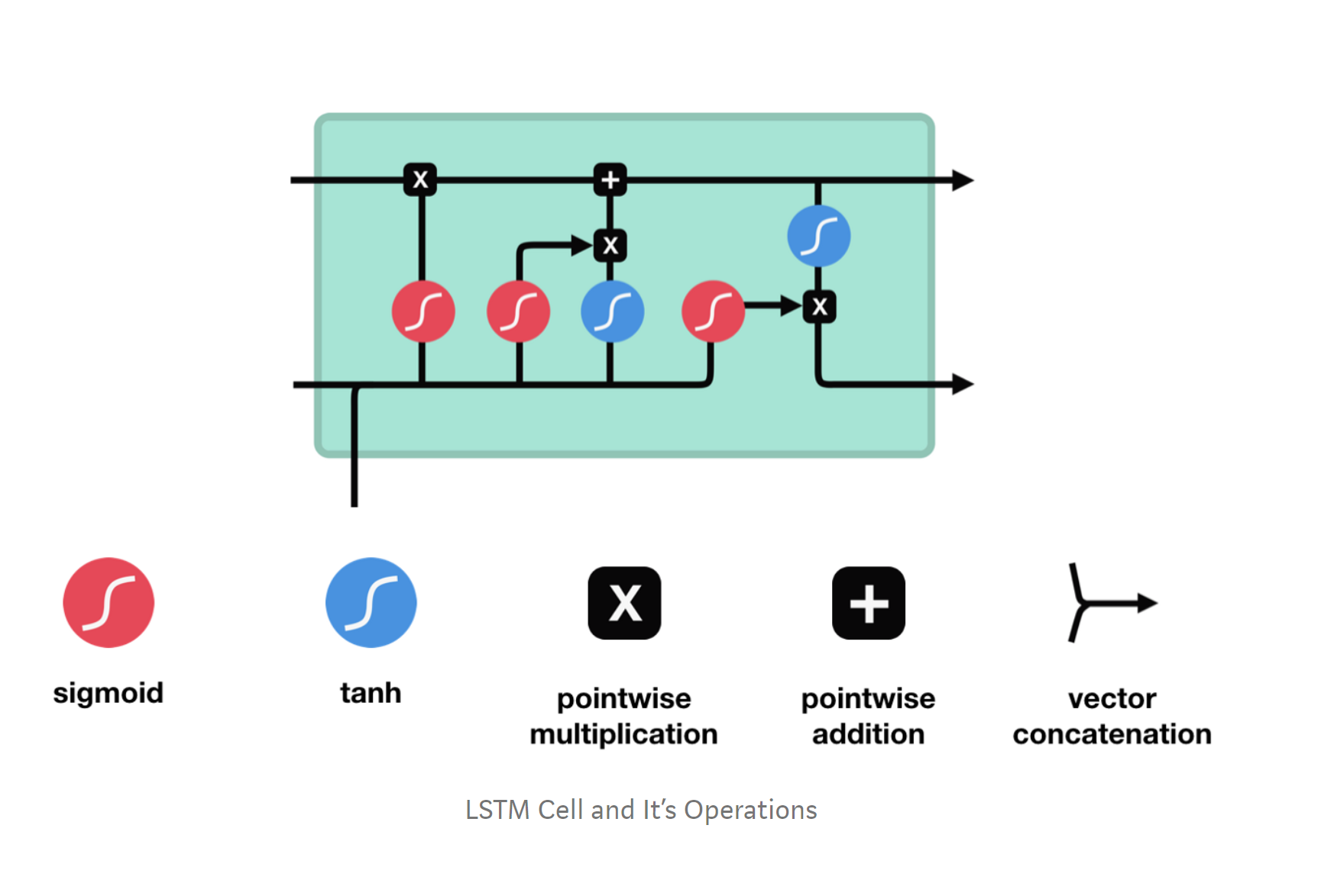
SELF TRAINED MODELS
LSTM Recurrent Neural Network
A recurrent neural network that maintains a cell state that carries relevant information through the network.
This enables the network to take decisions based on previous information.
The information in the cell state is updated by each neuron or unit using different gates.
Gates are different functions that are performed on the previous information and current information and help to update the cell state to keep relevant information and discard the irrelevant one.
Source:
Illustrated Guide to LSTM’s and GRU’s: A step by step explanation

Slide 12
PRE TRAINED MODELS
Google Word2Vec
The model contains 300-dimensional vectors for 3 million words and phrases.
The phrases were obtained using a simple data-driven approach using n-grams.[4]
Archive:GoogleNews-vectors-negative300.bin.gz.
Spacy
Used the web-core-md pre-trained model. The model contains 685k keys, 20k unique vectors (300 dimensions).
Archive: en_core_web_md
GloVe Twitter 25
glove-twitter-25 consists a vocabulary of size 1.2M and 25 dimensional vectors.
Archive: https://nlp.stanford.edu/projects/glove/

Slide 13
CLASSIFICATION MODELS
Logistic Regression
Linear SVM
SVM
Random Forest
KNN

Slide 14
CLASSIFICATION REPORT SELF TRAINED MODEL
Word2Vec
Sr No | Classification Model | Accuracy
1 | Logistic Regression | 70.75%
2 | Random Forest | 68.73%
3 | Linear SVM | 67.77%
4 | SVM | 57.71%
5 | KNN | 68.73%

Slide 15
CLASSIFICATION REPORT SELF TRAINED MODEL
Doc2Vec
Sr No | Classification Model | Accuracy
1 | Logistic Regression | 76.57%
2 | Random Forest | 70.79%
3 | Linear SVM | 75.61%
4 | SVM | 72.85%
5 | KNN | 69.70%

Slide 16
CLASSIFICATION REPORT SELF TRAINED MODEL
LSTM
Sr No | Classification Model | Accuracy
1 | LSTM Model | 80.24%

Slide 17
CLASSIFICATION REPORT PRE -TRAINED MODEL
Google Word2Vec
Sr No | Classification Model | Accuracy
1 | Logistic Regression | 77.71%
2 | Random Forest | 77.01%
3 | Linear SVM | 77.8%
4 | SVM | 77.10%
5 | KNN | 75.35

Slide 18
CLASSIFICATION REPORT PRE -TRAINED MODEL
GloVe Twitter 25
Sr No | Classification Model | Accuracy
1 | Logistic Regression | 78.80%
2 | Random Forest | 77.40%
3 | Linear SVM | 78.50%
4 | SVM | 77.01%
5 | KNN | 75.35%

Slide 19
CLASSIFICATION REPORT PRE -TRAINED MODEL
Spacy
Sr No | Classification Model | Accuracy
1 | Logistic Regression | 80.21%
2 | Random Forest | 74.91%
3 | Linear SVM | 81.34%
4 | SVM | 58.53%
5 | KNN | 76.26%

Slide 20
CONCLUSION
For self-trained models the LSTM Model had the best accuracy.
For pre-trained models the Spacy along with the Linear SVM had the best accuracy.

Slide 21
Thank You

