Slide 1
Project Member Akash Indani(24) Akshay Wagh(76) Shital Chaudhari(15) Shreya Sherugar(66)
Prediction of Box Office Success for Movies

Slide 2
Introduction
Social networking is used by majority of the population around the world.
In this , we present the prediction model for estimating the revenue of the movie.
There are various ways to collect the data and process the data.

Slide 3
Motivation
Entertainment industry has become one of the highest income profession in today’s world.
The audience should know if they are spending on the correct movie.
The managers of the theatres should know how much to expect out of a movie, so that they run their business efficiently.

Slide 4
Problem Definition
An application which collects data from social websites for a movie and predicts the revenue that will be generated.
Sentiment analysis computation technique will be used.
Social websites like Facebook, Twitter, IMDB and Youtube will be used to gather the data in form of likes and comments.

Slide 5
Literature Survey
TOPIC:“Predicting the Near-Weekend ticket sales using Web Based External Factors and Box-Office Data”
MAIN CONTENT: The prediction models used were LM, SVM to predict the ticket sales.
Results with only box-office data and box-office with external data was compared and the accuracy was increased by 9% when the later was used.
IDEA WE LIKED: We Can divide our work in a weekly manner, LM
External data can be used.
TOPIC: “Prediction Of Box Office Success of Movies Using Hype Analysis Of Twitter Data”
MAIN CONTENT: The data of twitter is collected, sentiment analysis is done ,multiple linear regression model is used and predicts success ratio of the movie.
IDEAS WE LIKED: Sentiment analysis
-

Slide 6
Literature Survey
TOPIC:”An Improved Sentiment Analysis Of Online Movie Reviews Based on Clustering For Box-Office Prediction”
MAIN CONTENT: Clustering of the data is done, sentiment analysis was used and auto regression model was used.
IDEA WE LIKED: Our project will be need auto-regression model.
To increase the accuracy what we think to be added is the association between different external factors which affect the results like the search data volume, ratings and the star cast for the movie .

Slide 7
PAPER | PROS | CONS
Predicting the Near-Weekend ticket sales using Web Based External Factors and Box-Office Data | Linear model and support vector machine was used. Accuracy was increased. | Only Comments and post were analyzed. No contributing factors.
Prediction Of Box Office Success of Movies Using Hype Analysis Of Twitter Data | Sentiment analysis. Multiple linear regression model was used. | Only Twitter data was analyzed. No graphical output generated.
An Improved Sentiment Analysis Of Online Movie Reviews Based on Clustering For Box-Office Prediction | Auto-regression model was used. Clustering tool Weka was used for prediction. Accuracy increased. | External factors were not considered and revenue is also not predicted.

Slide 8
Requirements
Our system is based on K-Means Clustering and Artificial Neural Network.
The data is stored in a structured way in database so that it can be easily accessible.
The data is first preprocessed so that the redundant data is deleted from the database.
Using sentiment analysis, polarity of the user comment is calculated that whether it is positive, negative or neutral.
Using the computed Sentiment analysis output and considering various other factors , revenue of the movie is estimated.

Slide 9

Methodology
The various methodologies used by us are:
K-Means Clustering
Sentiment Analysis
Artificial Neural Network
Also, we have used R-Studio to implement our project.
K-Means Clustering:
k-means clustering is a method of classifying/grouping items into k groups (where k is the number of pre-chosen groups). The grouping is done by minimizing the sum of squared distances (Euclidean distances) between items and the corresponding centroid.

Slide 10
ii. Sentiment Analysis:
Sentiment Analysis is a branch wherein the sentiments of the user are analyzed from the written scripts or recorded voice.
The polarity determines the ratio of the positive, negative and neutral tweets. It reflects the emotions that the user wishes to convey through the comments regarding the given movie.

Slide 11
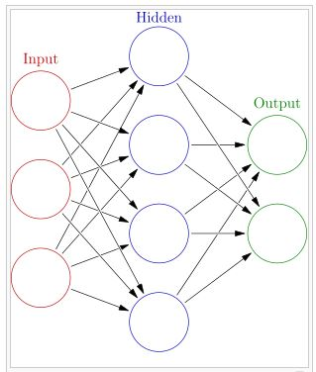
iii. Artificial Neural Network (ANN) :
Interconnected neurons which exchange information.
Weighted neuron value uses previous experience.
Previous predicted value is used for current prediction.
Types of ANN:
Feedforward Neural network
Radial basis function Neural network
Modular Neural network

Slide 12

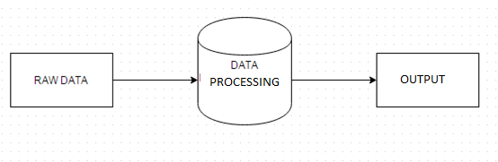
Proposed Design
Basic Structure

Slide 13
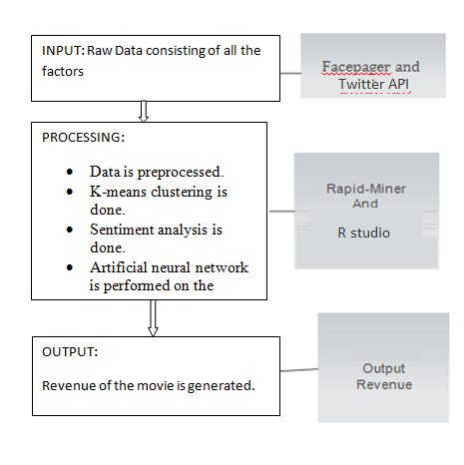
Proposed Design

Slide 14
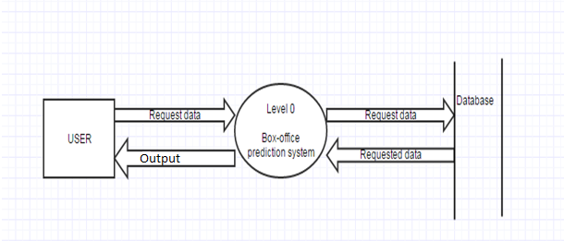
DFD Level 0

Slide 15
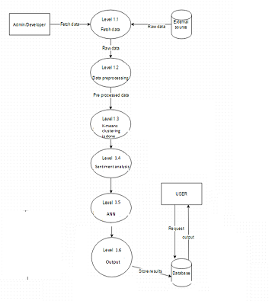
DFD Level 1

Slide 16
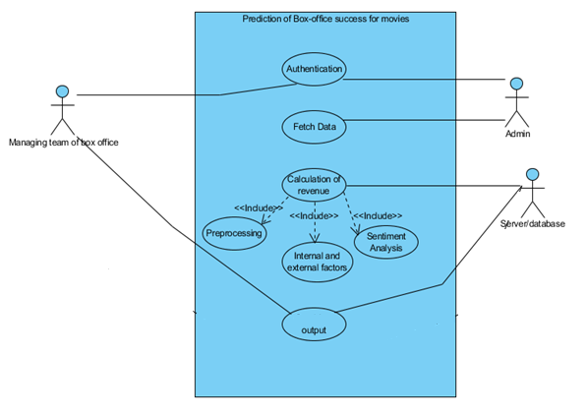
Use Case

Slide 17
Algorithm
Step 1: Fetch data from facebook, youtube and twitter.
Step 2: Storing information in organized manner.
Step 3: Applying text preprocessing on the data to remove the redundant data.
Step 4: Performing K-Means clustering.
Step 5: Performing Sentiment analysis to calculate the polarity of each user review.
Step 6: Calculating other variable internal factors such as star-cast, music, director, etc and external factors such as holiday effect, festival effect, etc
Step 7: Perform Artificial Neural Network on the entire data to obtain the result.
Step 8: Based on above analysis predict the revenue for the movie.

Slide 18
Results and Discussion
The revenue of the movies is predicted.
This data can be used by Box-office managers to lay down their strategy for a particular movie.
It will maximize the profit of that organization by assisting them in their strategical approach.

Slide 19
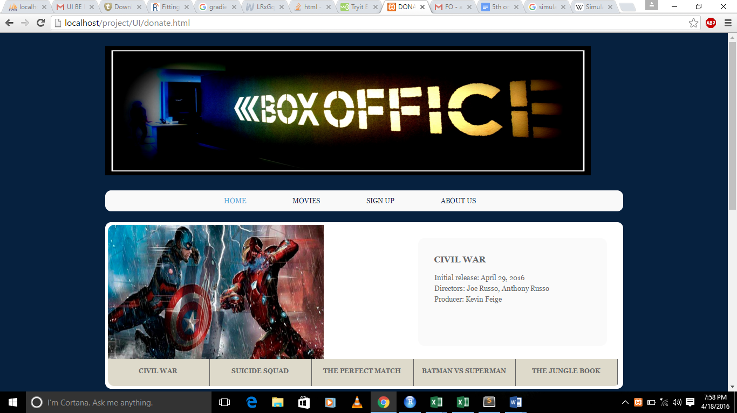
Screenshots

Slide 20
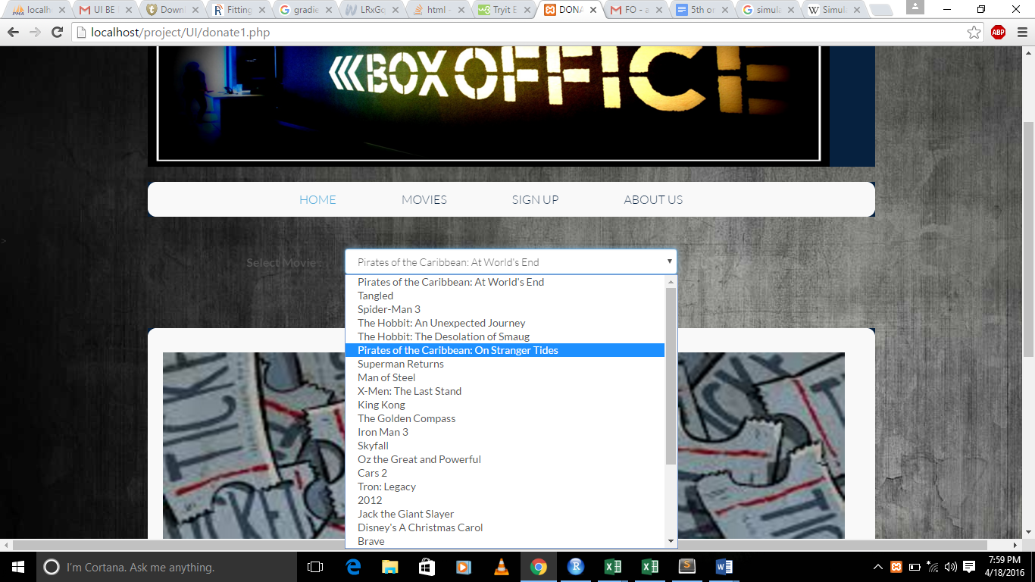
Screenshots

Slide 21
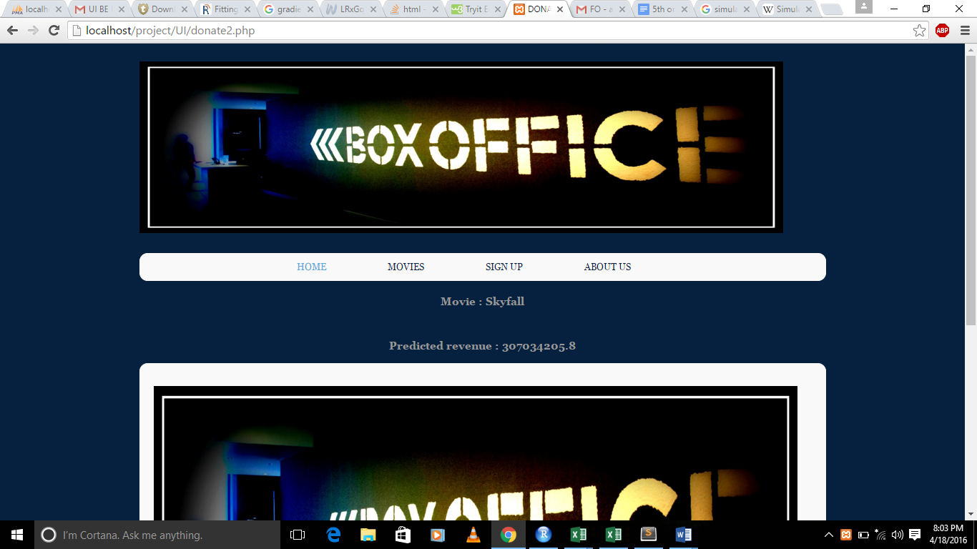
Screenshots

Slide 22
Future Scope :
The Prediction system we generated gives the whole revenue at a time considering different factors before the movie is released. Further we can can work with predicting the revenue on weekly basis, giving the revenue week-wise comparing the actual comments of the movies after release. The output generated i.e the Revenue predicted can be shown in a graphical format on week-wise revenue prediction versus actual box-office collection. Also these predicted revenue figures can be input, along with the show timings to another system which will predict the show timings for which the profit is maximum and help box-office managers to lay down the strategy.

Slide 23
Conclusion
Our goal is to predict revenue of the upcoming movies using box-office data and external factor data such as online reviews, movie ratings.

Slide 24
THANK YOU

