Slide 1
Throwing Darts in the Dark? Detecting Bots with Limited Data using Neural Data Augmentation
GROUP 6
AKASH iNDANI
Nikhil khaladkar

Slide 2
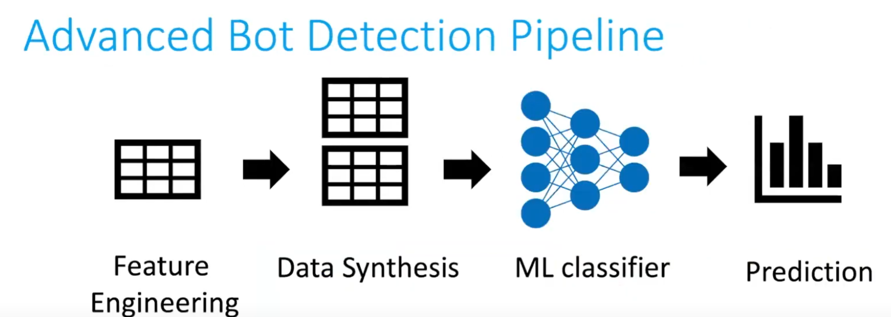

PROJECT FLOW

Slide 3
FEATURE ENGINEERING
Extracted network requests data from .pcap network using Wireshark’s tshark command line tool.
Extracted data had 243902 network request entries.
Each incoming network request was annotated as benign(label=0) or bot(label=1).
Requests were annotated based on the bot attack info regarding the relative time of attack.
IP Sequence a list of consecutive network requests from the same IP address is annotated as bot if even 1 request from the sequence is malicious.

Slide 4
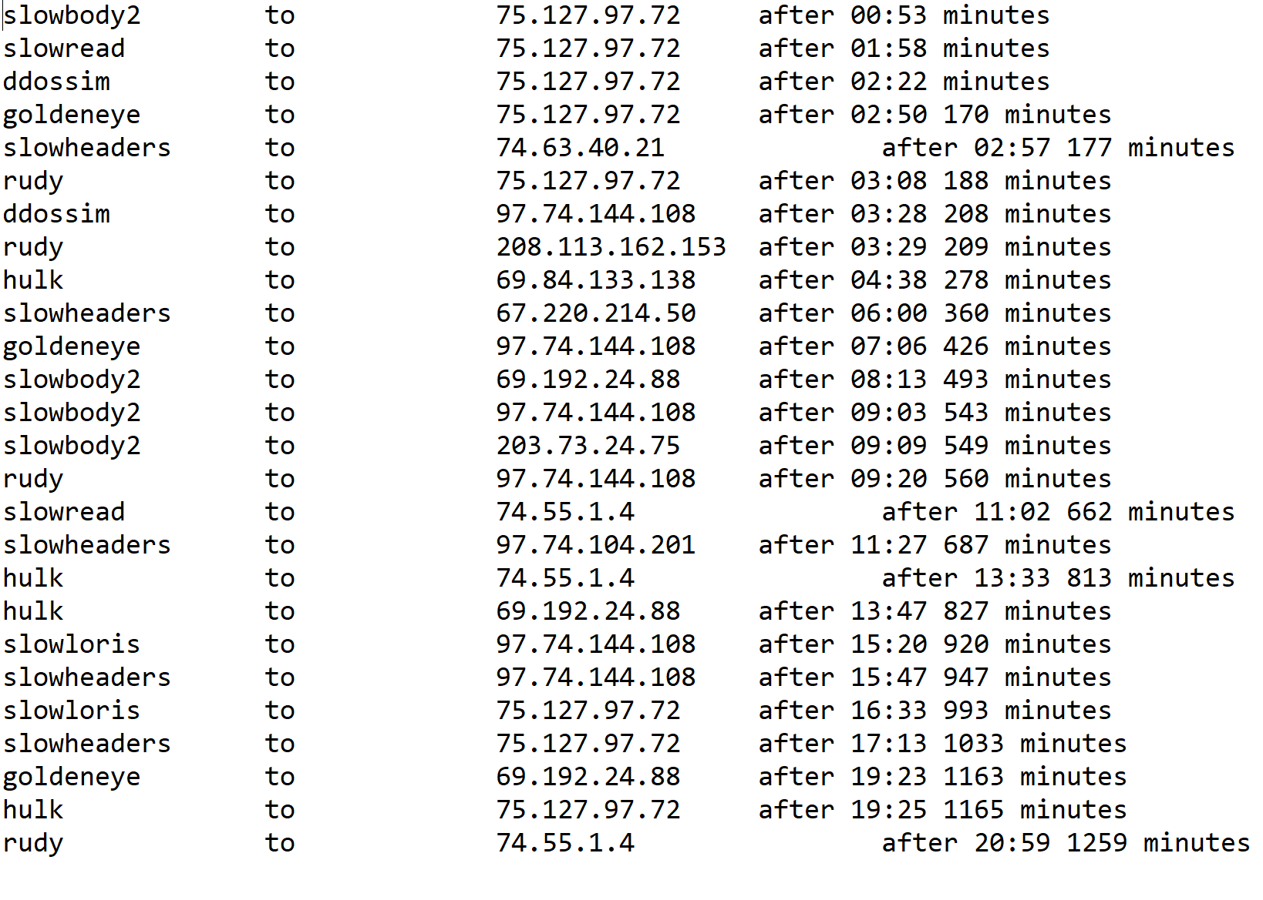
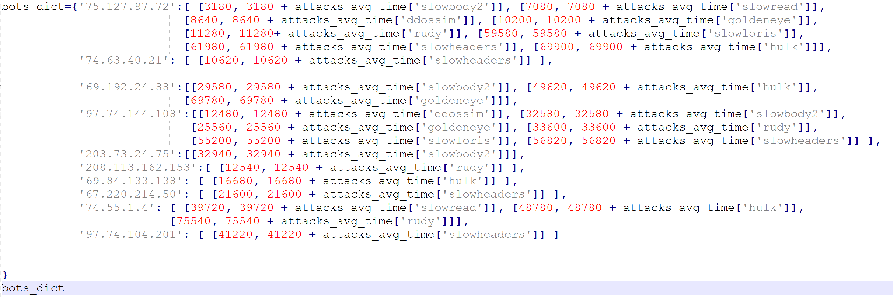
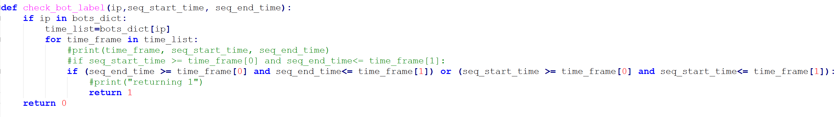
FINDING BOT REQUESTS

Slide 5
DATA SAMPLING AND REDUCTION
As a part of the experimentation ML Classifier are deployed over just 1% of the labeled data.
To achieve sampling of 1% data with equal distribution of benign and bot samples we applied stratified sampling techniques.

Slide 6
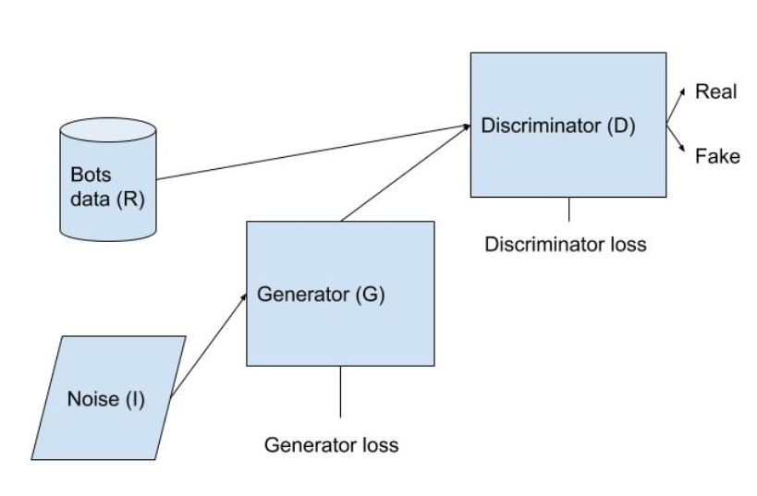
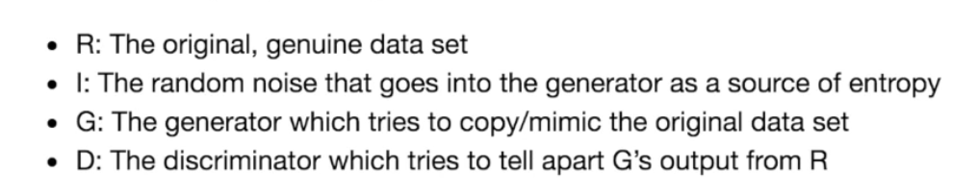
Data Synthesis
Discriminator’s task is to classify if the input is real or fake
We want to synthesize the 1% bot data such that we can always work with less amount of data.
We use Deep Convolution GAN methodology wherein both generator and discriminator are CNN architectures.
Generator takes input as noise of 50 dimensions and discriminator says if the input is fake or real.
Hyperparameters: LR for G = 1e-4, LR for D = , EPOCHS=1500, Batch_size = 32
Notes:
Nn,n

Slide 7
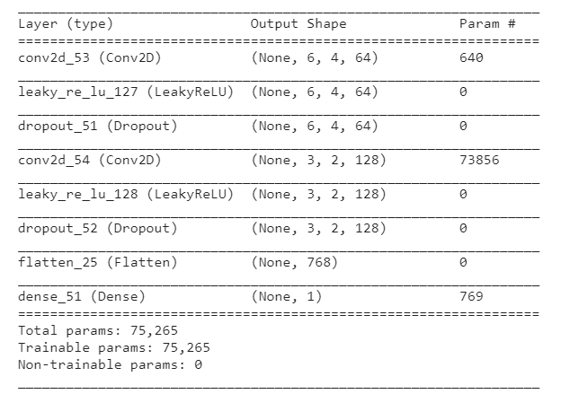
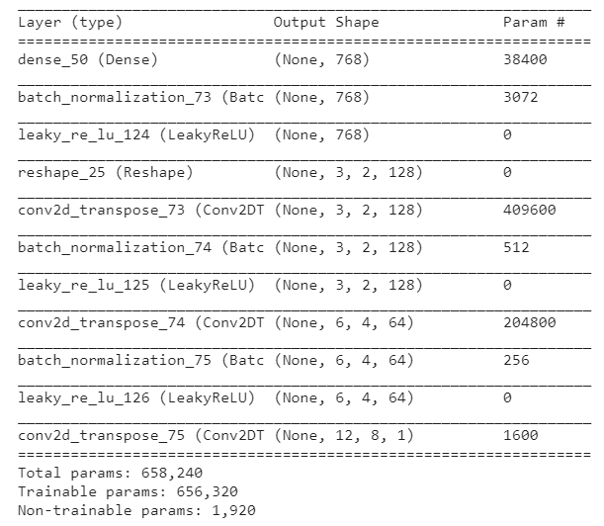
Discriminator summary
Generator summary
Tensorflow models architecture

Slide 8
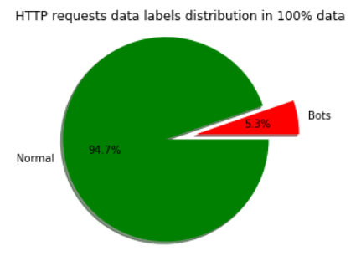
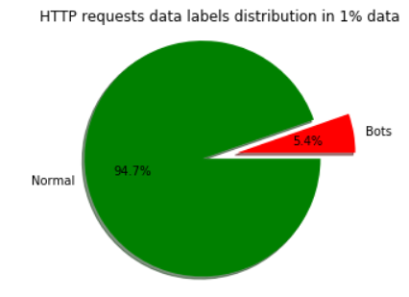
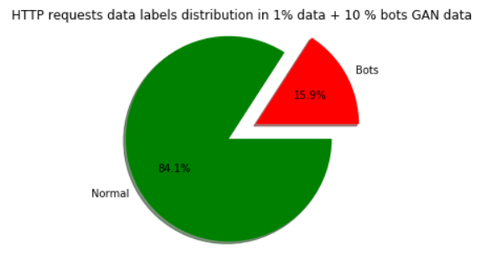
DATA LABELS DISTRIBUTION
Normal: 22,654
Bots : 1,275
Total : 23,929
Normal: 2,265
Bots : 128
Total : 2,393
Normal: 2,265
Bots : 428
Total : 2,693

Slide 9
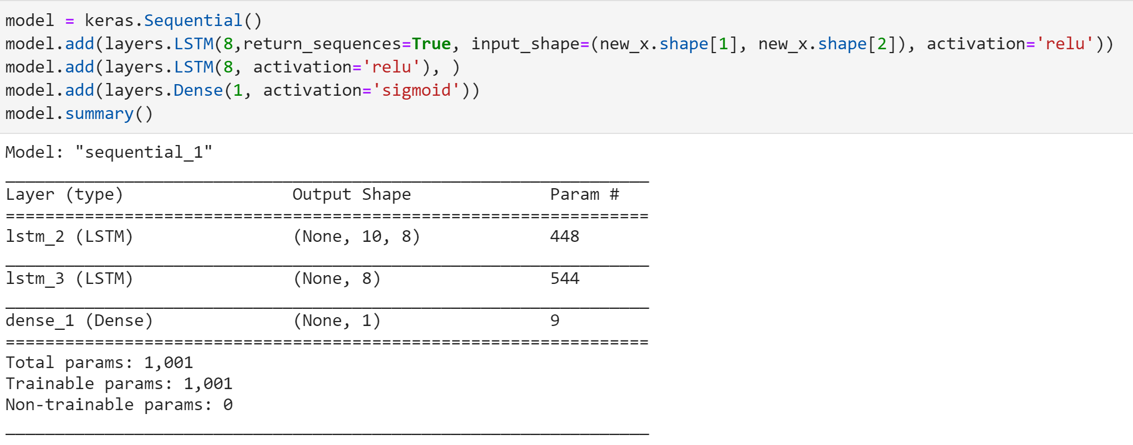
ML CLASSIFIER
Built an LSTM based ML classifier that classifies benign and bot data.
We have 2 LSTM layers in the Sequential Model.
2 Layer LSTM is used to achieve balance between overfitting and training costs.
Hyperparameters: LR = 0.01, epochs = 50, batch_size = 512

Slide 10
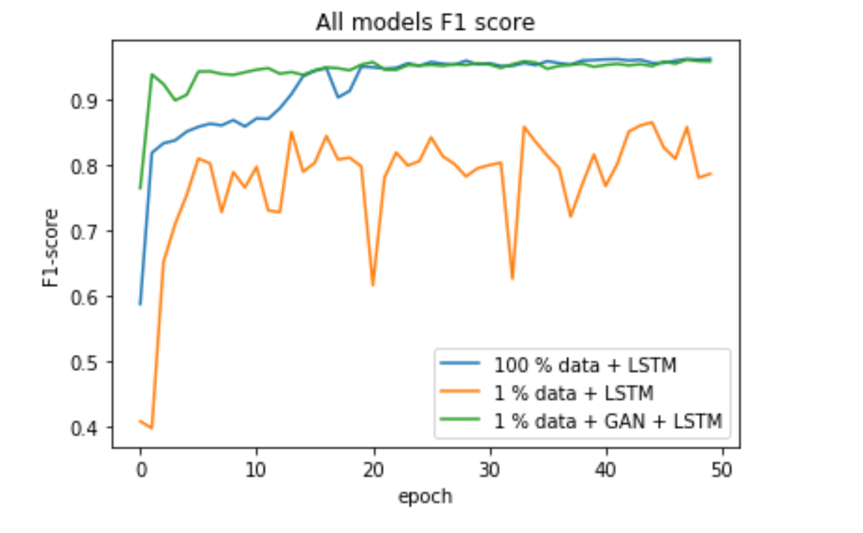
RESULTS
Compared the F1 scores of the classifier trained with all the 3 data distributions.
The 100% data performed well with

Slide 11
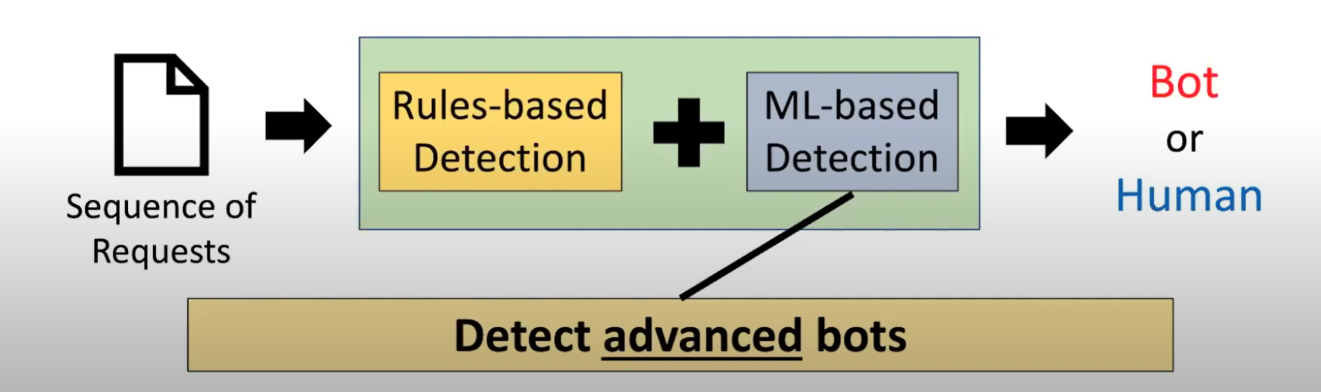
BOT DETECTION SYSTEM
The design principle for the bot detection system follows 2 rules:
Use Rule Based approaches using techniques
Observe network traffic
Anomaly detection
Specification based detection
Use Machine learning to detect advanced complex bot

Slide 12
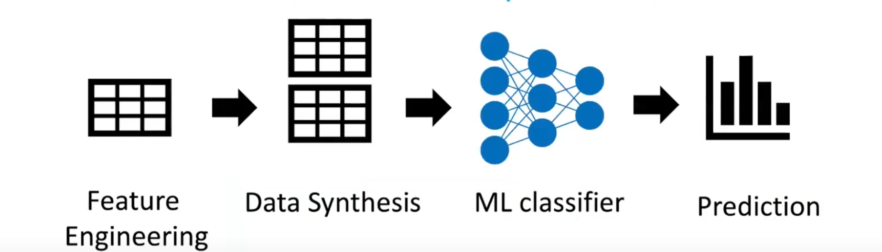
BOT DETECTION PIPELINE

Slide 13
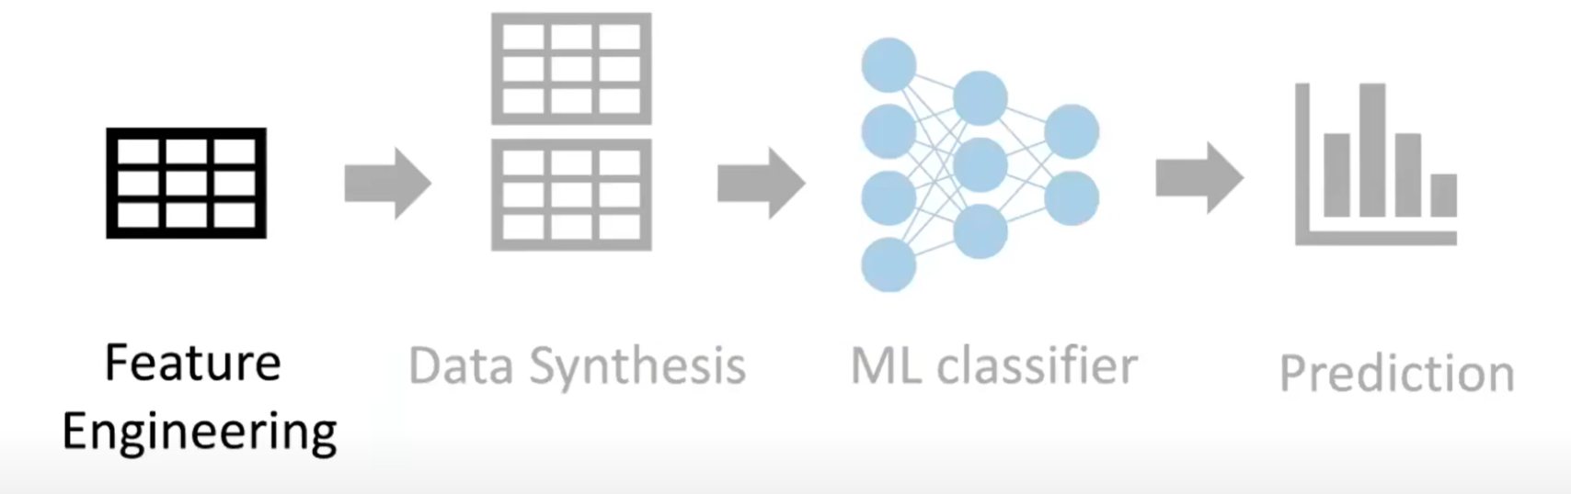
BOT DETECTION PIPELINE

Slide 14
FEATURE ENGINEERING
Feature engineering aims to solve 2 challenges:
Proposed solutions for these two challenges are:
Different bots attack different websites
Bots keep evolving over time
URL
Refrer
Browser Version
Time gap
Cookie Flag
Use Network level information, independent of application
Incorporate new network packets for real-time detection of bots

Slide 15
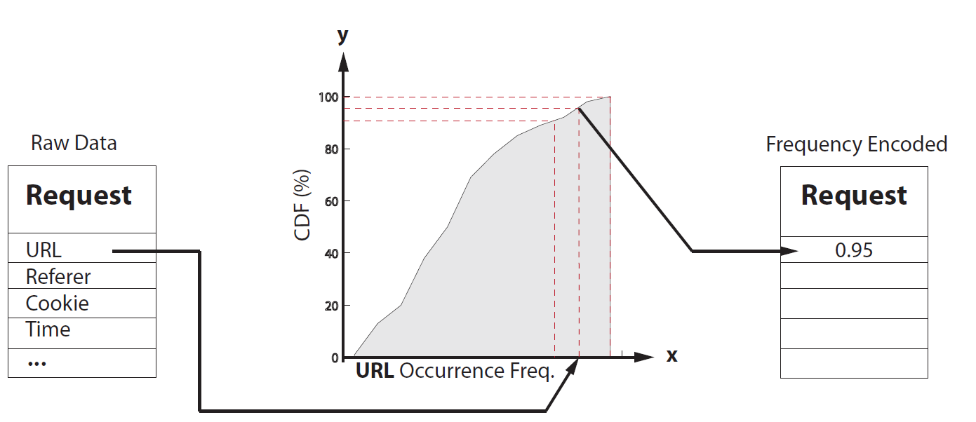
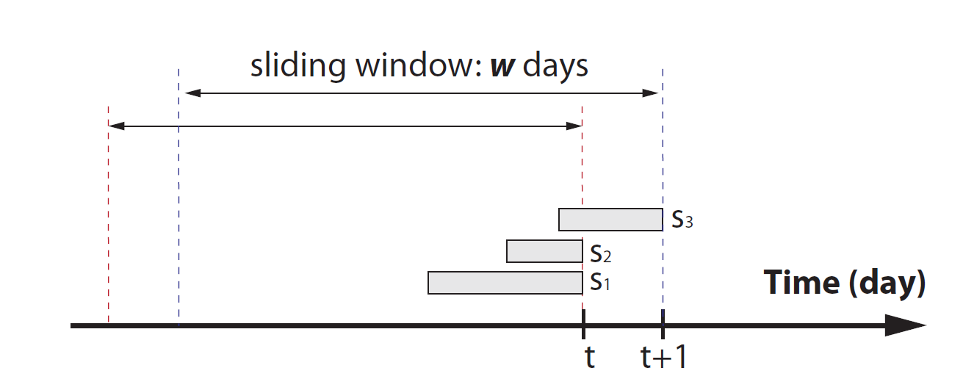
FREQUENCY ENCODING
Frequency based encoding encodes how many times a given parameter appears in network requests over a time period t.
Example if a URL appears frequently with 0.95 percentile it is encoded as 0.95.
For generating the IP sequence, all HTTP requests are sorted by timestamp and then T(=30) requests of the same IP are grouped together to form a sequence.
The encoding is performed in a sliding window approach to meet the need for handling new/rare entities for real-time detection.
Calculate the distribution of IP sequence for t days. Then window shifts by 1 day and recalculate the distribution on t+1 day with constant window size.

Slide 16
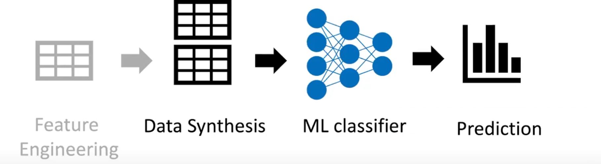
DATA SYNTHESIS AND PREDICTION

Slide 17
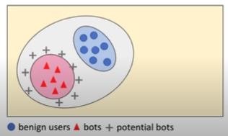
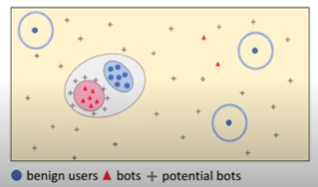
DATA SYNTHESIS STRATEGY
The authors produced two types of data synthesis to cover the unpredictable behavior of bots and generate new potential bots.
These bots are present in the complimentary region of clusters as well as outliers.
(1) Cluster data synthesis
(2) Outlier data synthesis
(1) and (2) are formed using DBSCAN clustering algorithm

Slide 18


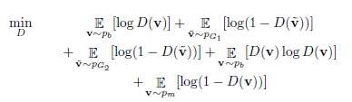
Formulations
For G1, the input is outlier regions which can result in potential bots, while in G2 the input is clustered region which can be benign as well as bot examples. Hence, we need to control the input cluster with the help of α-value so that we consider the maximum bot’s region.
Discriminator is classifying if the input is benign or bot from existing + synthesized data. The first three terms are like those in a regular GAN which are used to distinguish real data from synthesized data. The fourth conditional entropy term encourages the discriminator to recognize real benign data with high confidence (assuming benign data is representative). The last term encourages the discriminator to correctly classify real bots from real benign data. Combining all the terms, the discriminator is trained to classify benign users from both real and synthesized bots.

Slide 19
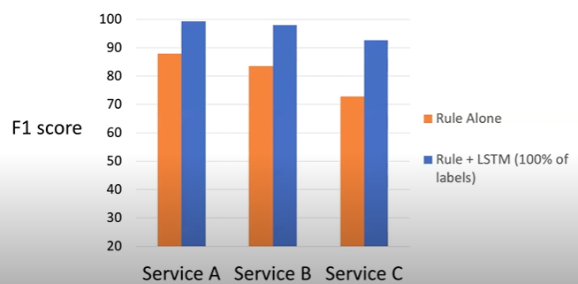
DETECTING BOTS (100% LABELS)
There are two ways: one is only rule based and other is Rules + LSTM classifier with 100 % of labels.
We can see that F1-score is better with LSTM
Major problem with this approach is we need a big number of labeled dataset which takes lot of effort to build.

Slide 20
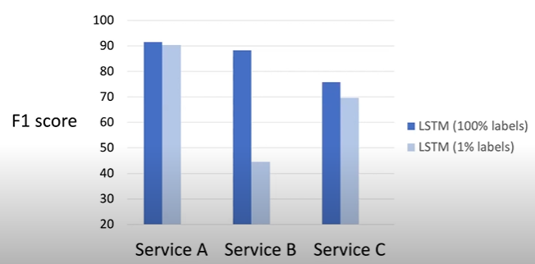
DETECTING BOTS (1 % LABELS)
As it is very difficult to get large source of labelled dataset, we need to sample out data.
To the left are the results of the LSTM classification using 1 % of the labelled data.
We can see there is significant drop in F1 score for website B and C.

Slide 21
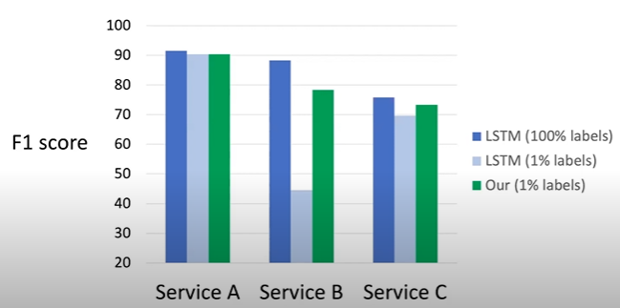
DETECTING BOTS WITH ODDS
Used 1% of labeled data and synthesized that data to generate more malicious examples using ODDS method which we saw previously
As we can see that there is very less difference in F1 score which suggests that odds method can yield more accurate results with very small amount of data.

Slide 22
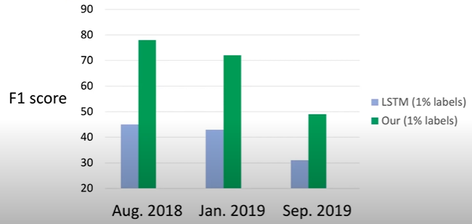
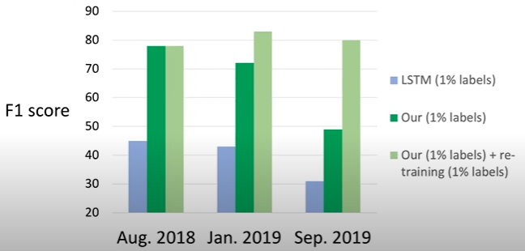
MODEL DECAY OVER TIME
In first figure we can see that the performance of model is degrading. Although as compared to LSTM its better but still its degrading.
This is because the model is trained in Aug while we are trying to predict bots long time in future.
To deal with model decay problem author suggests to do retraining with 1% of data from each month. And as we can see the results in second figure retraining keep the performance of model good.

Slide 23
CONCLUSIONS
This model can detect simple as well as advanced bots.
It can deal with limited labeled data problem and can generate synthesized data to train the classifier.
While generating data the ODDS method not only synthesize training data but also tries to find the outlier region and hence the undiscovered potential bots which can tackle the challenge of changing bot behaviors.
It detected bots with very limited data which was as low as 1%.

Slide 24
THANK YOU

