Slide 1
Gibbs Sampling
Qianji Zheng
Oct. 5th, 2010

Slide 2
Outline
Motivation & Basic Idea
Algorithm
Example
Applications
Why Gibbs Works

Slide 3
Gibbs Sampling: Motivation
Gibbs sampling is a particular form of Markov chain Monte Carlo (MCMC) algorithm for approximating joint and marginal distribution by sampling from conditional distributions.

Slide 4
Gibbs Sampling: Basic Idea
If the joint distribution is not known explicitly or is difficult to sample from directly, but the conditional distribution is known or easy to sample from. Even if the joint distribution is known, the computational burden needed to calculate it may be huge.
Gibbs Sampling algorithm could generate a sequence of samples from conditional individual distributions, which constitutes a Markov chain, to approximate the joint distribution.

Slide 5
Characteristics of Gibbs Sampling Algorithm
A particular Markov Chain Monte Carlo (MCMC) algorithm
Sample from conditional distribution while other parameters are fixed
Update a single parameter at a time

Slide 6
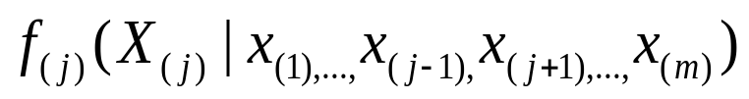


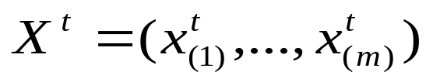

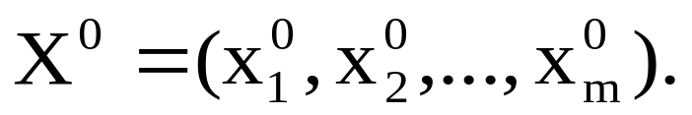
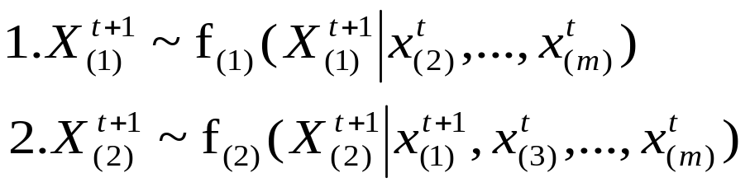
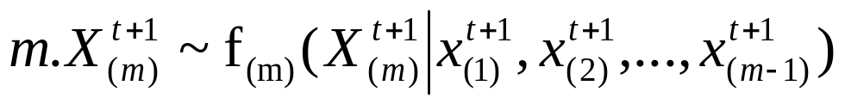
Gibbs Sampling Algorithm
Let be the conditional distribution of the element given all the other parameters minus the , then Gibbs Sampling for an m-component variable is given by the transition from to generated as:
Given an arbitrary initial value

Slide 7
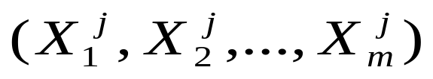
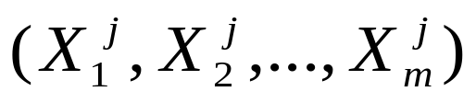
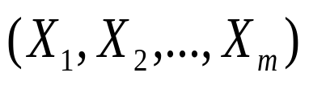

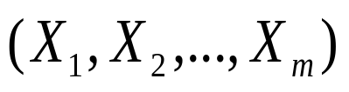


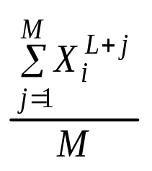
Gibbs Sampling Algorithm Contd…
Steps 1 through m can be iterated J times to get
, j = 1, 2, … , J.
2. The joint and marginal distributions of generated
converge at an exponential rate to joint
and marginal distribution of , as .
3. Then the joint and marginal distributions of
can be approximated by the empirical distributions of M
simulated values (j=L+1,…, L+M).
The mean of the marginal distribution of may be approximated by

Slide 8
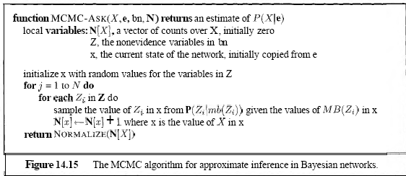
Gibbs Sampling Algorithm In BN

Slide 9
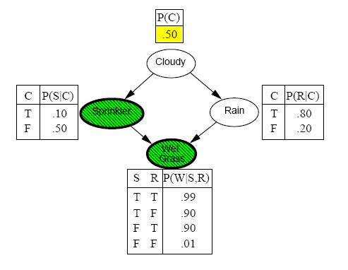
Example

Slide 10
Example
Example refer to
Gibbs Sampling for Approximate Inference in Bayesian Networks
http://www-users.cselabs.umn.edu/classes/Spring-2010/csci5512/notes/gibbs.pdf

Slide 11
Gibbs Sampling: Applications
Gibbs Sampling algorithm has been widely used on a broad class of areas, e.g. , Bayesian networks,
statistical inference, bioinformatics, econometrics.
The power of Gibbs Sampling is:
1. Approximate joint and marginal distribution
2. Estimate unknown parameters
3. Compute an integral (e.g. mean, median, etc)

Slide 12
Why Gibbs Works
The Gibbs sampling can simulate the target distribution by constructing a Gibbs sequence which converges to a stationary distribution that is independent of the starting value.
The stationary distribution is the target distribution.

Slide 13
Online Resources
Gibbs Sampling for Approximate Inference in Bayesian Networks
http://www-users.cselabs.umn.edu/classes/Spring-2010/csci5512/notes/gibbs.pdf
Markov Chain Monte Carlo and Gibbs Sampling
http://membres-timc.imag.fr/Olivier.Francois/mcmc_gibbs_sampling.pdf
Markov Chains, the Gibbs Sampler and Data Augmentation
http://athens.src.uchicago.edu/jenni/econ350/Salvador/h4.pdf
Reference
Kim, C. J. and Nelson, C. R. (1999), State-Space Models with Regime Switching, Cambridge, Massachusetts: MIT Press.

