Slide 1

GEEK ROOM · GLOBAL AI HACKATHON · BIFROST TRACK
StickyRoute
One conversation, one AI provider.
An open-source fix for Bifrost, the AI gateway: weighted routing that keeps every conversation on the same provider, while keeping your traffic split exact.
TEAM MATRIXX
Akash · Rahul · Kanishk · Ronak
FIXES MAXIMHQ/BIFROST#5409 · PR #9908
Notes:
Hi, we are Team Matrixx. We fixed a real open issue in Bifrost, the open-source AI gateway: weighted routing splits one conversation across providers. Our fix keeps each conversation on one provider while keeping the split exact.

Slide 2




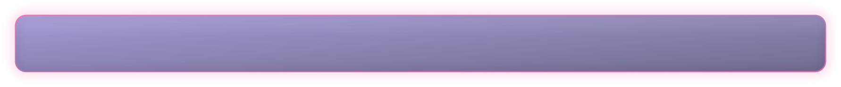
START HERE
The whole project in 30 seconds
1
2
3
What is Bifrost?
What was broken?
What did we build?
An open-source AI gateway. Apps send every AI request to Bifrost, and Bifrost forwards it to a provider such as Claude, GPT or Gemini.
Teams split traffic, say 70% Claude / 30% GPT. Bifrost re-picks the provider on every message, so one chat keeps jumping between models.
One opt-in switch per routing rule, sticky_sessions. Each conversation picks a provider once and stays there. The 70/30 split still holds.
Result on a real Bifrost gateway: 974 of 1,000 conversations switched provider before. 0 of 1,000 after.
Notes:
If you remember one slide: Bifrost is a gateway in front of AI providers. Weighted routing re-rolled the provider on every message. We added a switch that pins each conversation, and measured 974 out of 1000 switching before and zero after.

Slide 3




FOR READERS NEW TO BIFROST
Background: what weighted routing does
Claude 70%
Bifrost
Your app
chatbot, agent, coding tool
routing rule:
70% Claude, 30% GPT
GPT 30%
Why teams split traffic
What a "conversation" is
The catch
Cost, rate limits, a backup provider, or trying a new model on a slice of users.
Many messages sharing one history. Coding agents and chat apps send a session ID with each one.
The split was applied to each message, not each conversation. That is issue #5409.
Notes:
Quick background. Apps talk to Bifrost instead of talking to providers directly. A routing rule can send 70% of traffic to Claude and 30% to GPT. The catch is that the split was applied per message.

Slide 4

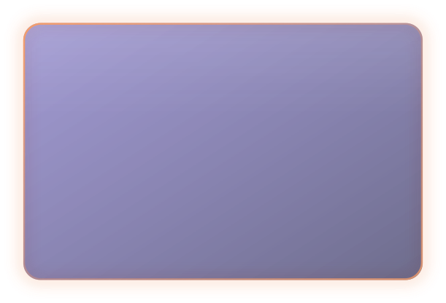

THE PROBLEM
Bifrost splits per message, not per conversation
One real conversation through Bifrost today, rule set to 70% A / 30% B
msg 1
B
msg 2
A
msg 3
A
msg 4
A
msg 5
B
msg 6
A
msg 7
B
msg 8
A
msg 9
B
msg 10
A
7 provider switches in 10 messages
Threads break
Cache is thrown away
Voice changes mid-chat
Providers differ in message format and tool calling, so a mid-thread switch can fail outright.
Each switch lands on a cold prompt cache, so the long shared history is billed again at full price.
Users see the assistant’s style and answers shift halfway through one chat.
Notes:
Here is one real conversation from our run, switching provider again and again in ten messages. That breaks threads, wastes prompt cache, and changes the model mid-chat.

Slide 5

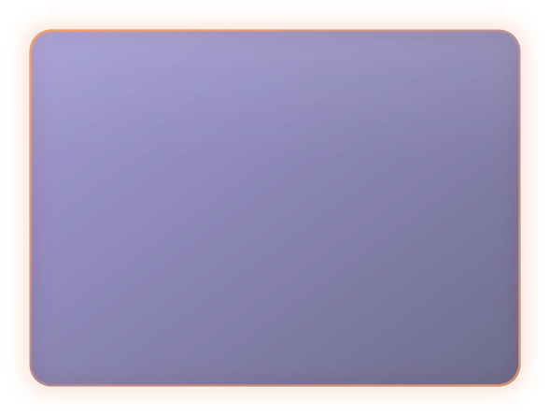

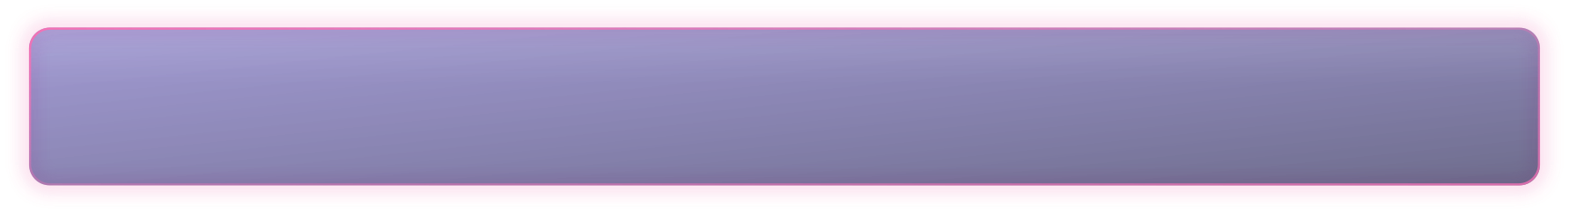
WHY EXISTING FEATURES DID NOT HELP
Weighted rules defeat Bifrost’s own affinity
1
2
3
Message 1
→
Message 2
→
Binding dropped
Rule draws A. Session affinity remembers: this session uses A.
Rule re-rolls and draws B. The list it offers no longer contains A.
Affinity cannot keep a provider it was not offered, so the session moves.
Bifrost already has session affinity. It never gets a chance, because the weighted draw happens first. So the fix belongs in the routing rule, not in a new store.
Notes:
Bifrost already has session affinity, but it only works if the routing chain offers the previous provider. The weighted rule re-rolls first, so affinity is dropped. That is why the fix goes in the rule.

Slide 6
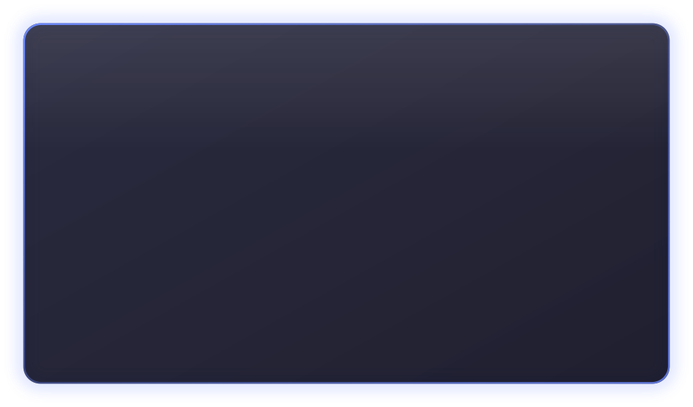
OUR SOLUTION
The fix: one opt-in switch per routing rule
"routing_rules": [{
"name": "claude-gpt-split",
"sticky_sessions": true,
"targets": [
{"provider": "anthropic", "weight": 0.7},
{"provider": "openai", "weight": 0.3}
]
}]
1
Same conversation, same provider
Uses the session ID Bifrost already reads (x-bf-session-id; Claude Code, Codex and OpenCode send one).
2
Nothing else changes
No session ID, or switch off: exactly today’s behaviour.
3
Nothing new to run
No new header, no database, no new failover code.
Also a switch in the Bifrost web UI, in 11 languages.
Notes:
The fix is one opt-in field on a routing rule. Requests with a session ID always go to the same target. Everything else behaves exactly as before.

Slide 7
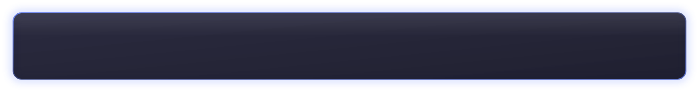



HOW IT WORKS
How it picks: weighted rendezvous hashing
Think of it as every conversation holding a fixed lottery ticket. The ticket is computed from its session ID, so it never changes, and bigger weights win more often.
score(provider) = weight / −ln( hash(session, rule, provider) )
the provider with the highest score answers the whole conversation
70.08%
Stable
Minimal moves
share for a 70% target over 100,000 sessions: the split stays exact
same session ID → same provider, on every gateway node, with no shared state
remove a provider and only its own sessions move; target order does not matter
Why not hash(session) mod total? One weight change would reshuffle almost every live session.
Notes:
Each provider gets a score from a hash of the session, rule and provider, scaled by its weight. The highest wins. It is deterministic, keeps the split exact, and moves the fewest sessions when targets change.

Slide 8
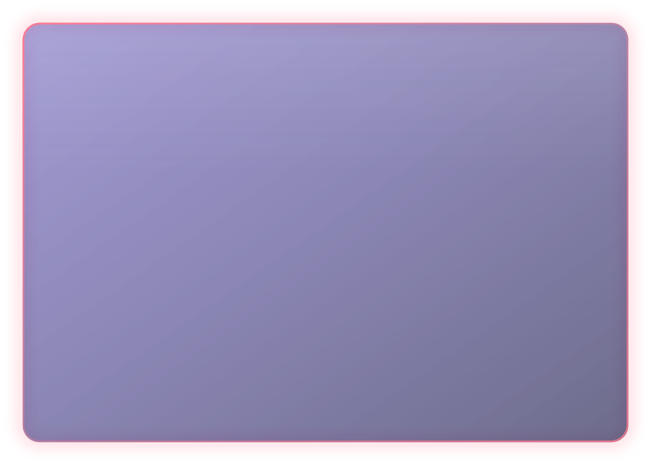

PROOF
Measured on a real Bifrost gateway: 974 → 0
Bifrost today
With sticky_sessions
974
0
of 1,000 conversations switched provider
of 1,000 conversations switched provider
3.76 switches per conversation
Split held: 72.7% / 27.3%
Provider A
Provider B
Provider A
Provider B
Each row is a conversation, each cell a message, coloured by who answered (first 14 shown). Gateway built from our branch, 70/30 rule, 1,000 conversations × 10 messages. Source: bench/results/routing-proof.json
Notes:
We ran 1,000 ten-message conversations through the real gateway. Today 974 of them switched provider, almost 4 times each. With our switch: zero, and the split stayed close to 70/30.

Slide 9



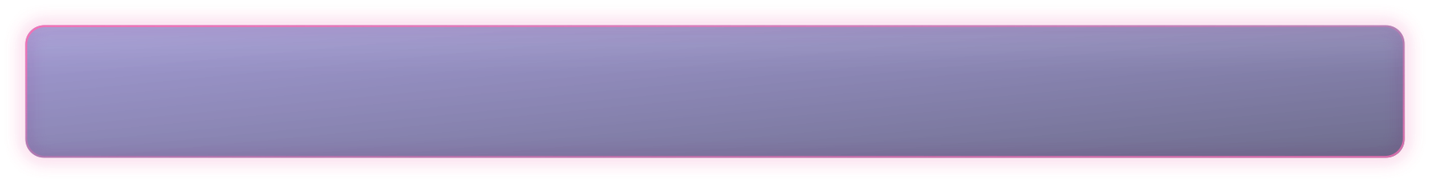
LIVE RUN
And with a real AI provider
9 / 10
0 / 10
120 / 120
conversations switched model
Bifrost today
conversations switched model
with sticky_sessions
real requests answered
no errors
Setup: Gemini free tier through the same gateway, 70/30 across two Gemini models, 10 conversations × 6 messages.
Honest limit: this proves routing on real traffic. It does not measure cache savings; that needs a paid two-provider run.
Source: bench/results/free-gemini-70-30.json
Notes:
We repeated it with real Gemini traffic. Nine of ten conversations switched model today; zero with our switch; every request answered. This proves routing, not cost savings.

Slide 10





ENGINEERING
Built like an upstream contribution
+651 −23
12
11
5 / 5
lines across 28 files
new routing tests, plus config-hash and API round-trip tests
UI languages for the new switch
CodeRabbit review comments answered
Engine, migration, API, config / OpenAPI / Helm schemas and docs in one change
Existing rules keep their config hash: no backfill migration, no spurious resyncs
Respects x-bf-session-affinity: off, and scopes the sticky key per caller
Test suites pass, also under the race detector; UI builds with 0 type errors
Notes:
This is written to be merged: tests first, schemas and docs updated, backward compatible, and reviewed by CodeRabbit with every comment answered.

Slide 11
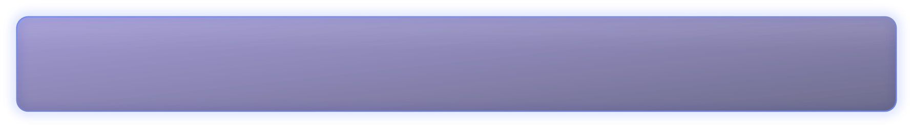
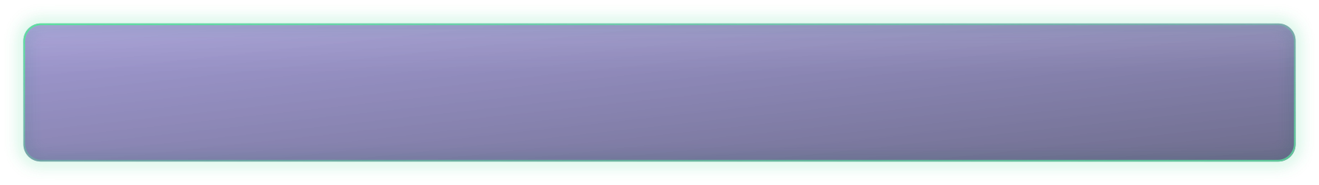
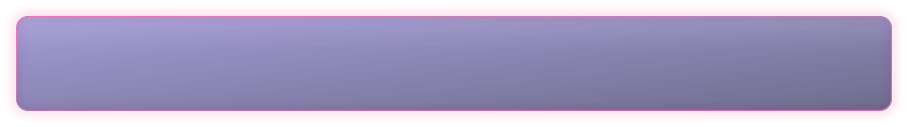
IMPACT
Why it matters
Reliability
Multi-turn agents and tool-calling chats stop breaking when traffic is split.
Cost
Each conversation keeps a warm prompt cache on one provider instead of paying for its history again.
Safe rollouts
Try a new model on 10% of conversations, not 10% of messages, and compare like with like.
Cache savings are the expected effect of staying on one provider; we have not yet measured them with paid providers.
Notes:
Three wins: conversations stop breaking, prompt caches stay warm, and teams can trial models per conversation.

Slide 12

STATUS
Ready for upstream review
Upstream PR
github.com/maximhq/bifrost/pull/9908
Live demo
akashjhajharia123-ui.github.io/stickyroute
Code and results
github.com/akashjhajharia123-ui/stickyroute
NEXT
Paid Claude + GPT run to measure cache savings, an optional selector hook, a per-team stickiness TTL.
TEAM MATRIXX · AKASH · RAHUL · KANISHK · RONAK
Notes:
The PR is open on Bifrost, the demo is live, and every number here comes from a committed results file. Thank you.

Slide 13
STICKYROUTE
Thank you.
Questions?
TEAM MATRIXX · AKASH · RAHUL · KANISHK · RONAK
Notes:
Thank you. Happy to take questions.

