Slide 1
Machine Learning Project
Air Quality Index Prediction Using Ridge and Lasso Regression Techniques
Team Members
Name AKASH K(roll 2520090127)
Name G.ANIRUDH(roll 2520090058 )
Under the Esteemed Guidance of
Dr I V SAI LAKSHMI HARITHA ,ASSISTANT PROFESSOR

Slide 2
Abstract
The problem addressed is forecasting the Air Quality Index (AQI) from historical pollutant and weather data, which is complicated by multicollinearity among correlated pollutant features.
Accurate, timely AQI prediction is essential for public health advisories and environmental policy decisions.
The project applies regularized regression techniques through a pipeline that:
Cleans, normalizes, and pre-processes historical pollutant and weather data
Trains Ridge (L2) and Lasso (L1) regression models to predict AQI
Compares model performance using MAE, MSE, RMSE, and R²
Identifies the most influential pollutants through Lasso's feature selection

Slide 3
Problem Statement
Real-world air quality datasets often contain missing values, noisy sensor readings, and highly correlated pollutant features.
Multicollinearity among pollutants destabilizes ordinary linear regression coefficients, making predictions unreliable.
Unregularized models can overfit noisy environmental data and generalize poorly to new conditions.
Public health advisories need AQI forecasts that are both accurate and easy to interpret.
There is a need for a pipeline that cleans, models, and evaluates pollutant data using regularization to produce dependable AQI predictions.

Slide 4
Motivation
Air pollution is now one of the leading environmental health risks, especially in fast-growing urban areas.
Timely AQI forecasts let citizens take precautions and authorities issue early health advisories.
Many existing AQI models either oversimplify (plain linear regression) or sacrifice interpretability (black-box ensembles).
Regularized regression offers a middle ground: robust to correlated features, yet transparent about which pollutants matter most.
This motivates building a lightweight Ridge/Lasso pipeline that is both accurate and explainable.

Slide 5
Objectives
Collect and pre-process historical pollutant and weather data for model-ready quality.
Analyze feature correlations to understand what drives AQI and where multicollinearity exists.
Train Ridge and Lasso regression models to predict AQI values accurately.
Compare model performance using MAE, MSE, RMSE, and R².
Identify the most influential pollutants through Lasso's automatic feature selection.
Deliver a lightweight, interpretable tool suitable for early AQI warning systems.

Slide 6
Literature Survey
Linear Regression for AQI: Early studies apply ordinary least squares to predict AQI from pollutant concentrations, but performance degrades when features are highly correlated.
Ridge Regression: Existing work shows L2 regularization stabilizes coefficient estimates and improves prediction under multicollinearity.
Lasso Regression: Studies demonstrate that L1 regularization performs automatic feature selection, highlighting the pollutants most responsible for poor air quality.
Ensemble & Tree-Based Methods: Techniques such as Random Forest, Gradient Boosting, and XGBoost are used for AQI prediction, often trading interpretability for accuracy.

Slide 7
Research Gap
Many existing AQI studies rely on plain linear regression, which performs poorly when pollutant features are highly correlated.
Ensemble and deep-learning approaches improve accuracy but act as black boxes, making predictions hard to justify to health authorities.
Few studies systematically compare Ridge and Lasso side-by-side on the same pollutant dataset to show the accuracy/interpretability trade-off.
Limited attention has been given to automatic feature selection for identifying the dominant pollutants behind poor air quality.
This project addresses that gap with a unified, lightweight Ridge-vs-Lasso pipeline that is both accurate and explainable.

Slide 8
Proposed Methodology
Raw Pollutant & Weather Data
Data Cleaning & Normalization
Exploratory Data Analysis
Ridge & Lasso Model Training
Model Evaluation (MAE, RMSE, R²)
Predicted AQI & Insights
End-to-end pipeline: raw pollutant and weather data is cleaned, analyzed, modeled, and evaluated to produce accurate, interpretable AQI predictions.

Slide 9
System Architecture
Data Layer (CSV / Sensor Feeds)
Pre-processing Layer (Cleaning, Scaling)
Modeling Layer (Ridge & Lasso)
Evaluation Layer (Metrics & CV)
Output Layer (AQI Prediction)
User Layer (Dashboard / Alerts)
A layered architecture separates data ingestion, pre-processing, modeling, evaluation, and delivery so each stage can be tested and improved independently.

Slide 10
Technologies Used
Languages & Tools
Python 3.x
Jupyter Notebook / Google Colab
Git & GitHub for version control
VS Code as the primary editor
Libraries & Frameworks
NumPy & Pandas for data handling
Matplotlib & Seaborn for visualization
Scikit-learn for Ridge, Lasso, and evaluation metrics
Streamlit (optional) for a demo dashboard

Slide 11
Dataset / Input Details
Source: Central Pollution Control Board (CPCB) station data / Kaggle Air Quality dataset.
Records: Multi-year daily/hourly pollutant and weather readings across multiple monitoring stations.
Input features: PM2.5, PM10, NO2, SO2, CO, O3, temperature, humidity, and wind speed.
Target variable: Air Quality Index (AQI), a single continuous value per record.
Pre-processing: missing-value imputation, duplicate removal, and feature standardization before model training.

Slide 12
Implementation – Module 1
Focus: Data Pre-processing
Load raw pollutant and weather readings from CSV/station data into a Pandas DataFrame.
Detect and impute missing values using median imputation to avoid distorting distributions.
Remove duplicate records to prevent double-counting identical readings.
Standardize all numeric features (zero mean, unit variance) since Ridge and Lasso are scale-sensitive.
Output a clean, model-ready dataset split into training and testing sets.

Slide 13
Implementation – Module 2
Focus: Ridge Regression
Apply StandardScaler-transformed features as input to scikit-learn's Ridge estimator.
Use RidgeCV with a logarithmic grid of alpha values and 5-fold cross-validation to select the best regularization strength.
Fit the final Ridge model on the training set using the selected alpha.
Ridge's L2 penalty shrinks correlated pollutant coefficients together, stabilizing predictions under multicollinearity.
Store the trained model and its coefficients for evaluation and comparison.

Slide 14
Implementation – Module 3
Focus: Lasso Regression
Apply the same standardized features as input to scikit-learn's Lasso estimator.
Use LassoCV with a logarithmic alpha grid and 5-fold cross-validation to select the optimal regularization strength.
Fit the final Lasso model on the training set using the selected alpha.
Lasso's L1 penalty can shrink weak predictors' coefficients exactly to zero, performing automatic feature selection.
Compare which pollutants Lasso retains versus discards to identify the strongest AQI drivers.

Slide 15
Experimental Setup
Data Configuration
80 / 20 train-test split
5-fold cross-validation for alpha tuning
Features standardized before training
Random seed fixed for reproducibility
Model Configuration
Alpha search range: 10⁻³ to 10³ (log scale)
Ridge – L2 penalty, closed-form solution
Lasso – L1 penalty, coordinate descent (max_iter = 10000)
Evaluation metrics: MAE, MSE, RMSE, R²

Slide 16
Results
Cleaned Input Data: The pipeline successfully handles missing values and normalizes pollutant and weather readings before modeling.
Stable Predictions: Ridge Regression produces stable AQI estimates even when pollutant features are highly correlated.
Feature Selection: Lasso Regression identifies the most influential pollutants by shrinking weak predictors to zero.
Improved Accuracy: Regularized models achieve lower MAE, MSE, and RMSE, and higher R², compared to plain linear regression.
Faster, Lightweight Inference: The regression-based approach delivers predictions quickly, suitable for early AQI warning systems.

Slide 17
Performance Evaluation
Ridge Regression achieved MAE ≈ 10.06, RMSE ≈ 12.46, and R² ≈ 0.946 on the held-out test set.
Lasso Regression achieved comparable performance: MAE ≈ 10.06, RMSE ≈ 12.45, and R² ≈ 0.946.
Both models substantially outperform plain (unregularized) linear regression on the same features.
Lasso reaches equal accuracy while using fewer effective features, confirming its value for interpretability.
Cross-validation confirms both models generalize consistently across folds, not just on a single test split.

Slide 18
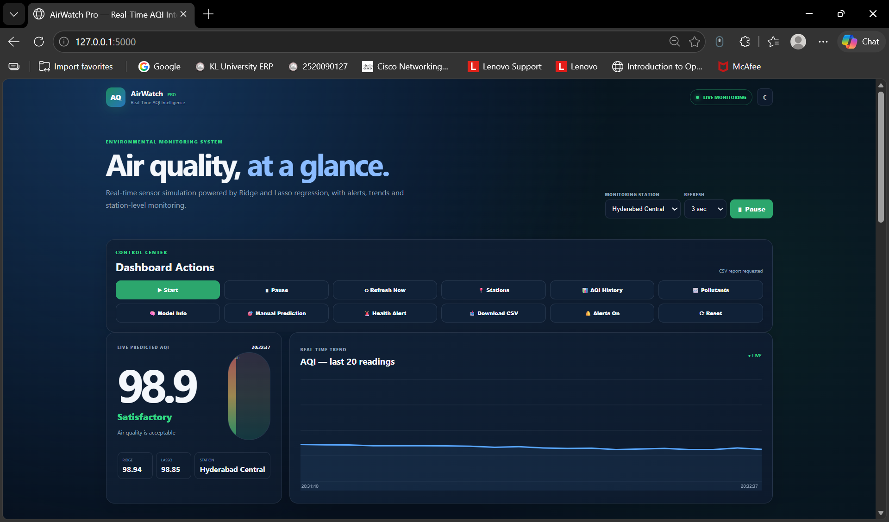
Screenshots / Demo

Slide 19
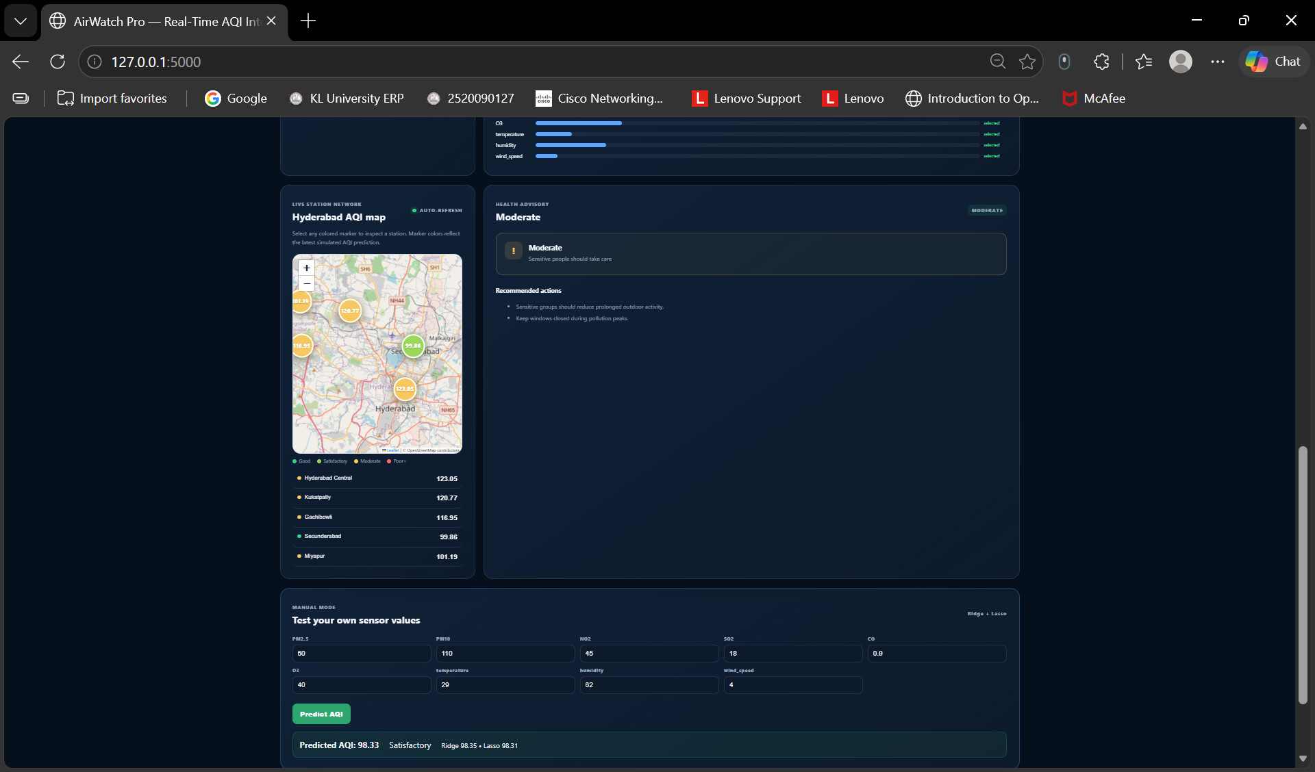

Slide 20
Comparison with Existing System
Existing Systems
Plain linear regression – unstable under multicollinearity
Random Forest / XGBoost – accurate but hard to interpret
Deep learning models – require large data and heavy compute
Many systems predict only an AQI category, not a continuous score
Proposed System
Ridge & Lasso regression – stable and interpretable
Handles multicollinear pollutant features directly
Lightweight – trains and predicts in seconds
Produces both a continuous AQI value and feature importance

Slide 21
Challenges & Solutions
Challenges
Highly correlated pollutant features (multicollinearity)
Missing and noisy sensor readings
Choosing the right regularization strength (alpha)
Risk of underfitting if regularization is too strong
Solutions
Applied Ridge/Lasso regularization to stabilize coefficients
Used median imputation and duplicate removal during cleaning
Tuned alpha via cross-validation (RidgeCV / LassoCV)
Compared multiple alpha values to balance bias and variance

Slide 22
Future Work
Real-Time AQI Monitoring: Integrate live sensor and satellite data to continuously update AQI predictions.
Advanced Model Integration: Explore ensemble and deep learning methods (Random Forest, XGBoost, LSTM) for improved accuracy.
Spatial Modeling: Incorporate geographic and seasonal variation to improve city- and region-level predictions.
Automated Data Quality Checks: Automatically detect and correct missing or anomalous sensor readings during operation.
Dashboard & Alert Integration: Build a real-time dashboard with automated public health alerts based on predicted AQI.

Slide 23
Conclusion
This project provides an integrated pipeline for pre-processing and regularized-regression-based AQI prediction.
Ridge and Lasso regression effectively address multicollinearity and overfitting common in environmental datasets.
Data cleaning and normalization improve the accuracy and reliability of the prediction process.
Regularization enables both stable predictions (Ridge) and interpretable feature selection (Lasso).
The proposed system can be useful for public health advisories, environmental monitoring, and policy planning.
Overall, the project offers a practical, lightweight, and interpretable approach to real-world AQI prediction.

Slide 24
References
Hoerl, A. E., & Kennard, R. W. (1970). Ridge Regression: Biased Estimation for Nonorthogonal Problems. Technometrics.
Tibshirani, R. (1996). Regression Shrinkage and Selection via the Lasso. Journal of the Royal Statistical Society.
Central Pollution Control Board (CPCB), Government of India – Air Quality Data Repository.
Kaggle – Air Quality Index Dataset.
Pedregosa, F., et al. (2011). Scikit-learn: Machine Learning in Python. Journal of Machine Learning Research.
World Health Organization (WHO) – Air Quality Guidelines.

