Slide 1

HR Analytics Dashboard
By:- Akash Chandrashekhar Katte
Skn Sinhgad College of Engineering Korti,Pandharpur

Slide 2

PROBLEM STATEMENT
Designing and develop a comprehensive HR analytics dashboard using Power BI to analyze and visualize attrition trends across various parameters including region, department, and other relevant factors. The dashboard should provide insightful metrics and interactive visuals to help HR professionals understand attrition patterns, identify key drivers, and facilitate data-driven decision-making to improve employee retention strategies.

Slide 3
Project Description Objective: The primary objective of this project is to create a comprehensive HR analytics dashboard that enables HR teams to analyze and visualize attrition data effectively. By aggregating and presenting attrition metrics across various dimensions such as region, department, tenure, performance ratings, salary bands, and other relevant factors, the dashboard will facilitate deeper insights into attrition patterns. These insights will empower HR stakeholders to identify key drivers of attrition, assess retention strategies, and make informed decisions to mitigate turnover.
Key Features and Components:
Data Integration and Preparation:
Data Sources: The dashboard will integrate data from HR systems and databases containing employee demographic information, employment history, exit reasons, performance evaluations, compensation details, and other relevant HR metrics.
Data Cleaning and Transformation: Utilizing Power BI's data preparation capabilities, the project will involve cleaning, transforming, and structuring the data to ensure consistency and reliability for analysis.
Dashboard Design and Visualization:
Interactive Visuals: The dashboard will feature interactive visualizations such as bar charts, line graphs, pie charts, heat maps, and scatter plots to depict attrition trends and correlations.
Key Metrics: Metrics such as attrition rate, average tenure, distribution of exits by department and region, exit reasons analysis, and voluntary vs. involuntary attrition will be prominently displayed.
Filtering and Drill-down: Users will have the ability to filter data by time periods (e.g., monthly, quarterly, annually), departments, regions, job roles, and other dimensions. Drill-down functionalities will allow deeper exploration of data at different levels of granularity.

Slide 4
Advanced Analytics and Insights:
Predictive Analytics: Utilizing Power BI's predictive modeling capabilities (if applicable), the dashboard may include predictive analytics to forecast potential attrition trends based on historical data and identified patterns.
Segmentation Analysis: Segmentation of employees based on attrition risk profiles (e.g., high performers, low engagement) to tailor retention strategies accordingly.
Benchmarking: Comparative analysis against industry benchmarks or organizational targets to assess performance and identify areas for improvement.
User Interface and Accessibility:
User-Friendly Interface: The dashboard will be designed with a user-friendly interface, intuitive navigation, and visually appealing layout to ensure ease of use for HR professionals and stakeholders.
Accessibility: Accessibility considerations will be incorporated to ensure the dashboard is usable by all users, including those with disabilities.
Implementation and Deployment:
Integration with Power BI Service: Once developed, the dashboard will be published and deployed on the Power BI Service for accessibility across the organization.
Training and Documentation: Training sessions and comprehensive documentation will be provided to HR teams and stakeholders to effectively utilize and interpret the dashboard for decision-making purposes.
Benefits:
Data-Driven Decision Making: Enables HR professionals to make informed decisions backed by data insights, enhancing strategic workforce planning and talent management.
Cost Savings: Proactive identification of attrition drivers can lead to cost savings associated with recruitment, onboarding, and training of new employees.
Improved Employee Satisfaction: By understanding and addressing factors contributing to attrition, organizations can improve overall employee satisfaction and retention rates.
Conclusion: The HR analytics dashboard project using Power BI aims to transform how organizations analyze and manage attrition data, providing actionable insights to drive HR strategies and enhance organizational performance. By leveraging the power of data visualization and analytics, the project will contribute to fostering a more engaged and stable workforce, ultimately supporting the long-term growth and success of the organization.

Slide 5
WHO ARE THE END USERS?
HR Professionals:
HR Managers and Analysts: Analyze attrition trends, identify patterns, and develop retention strategies.
Department Managers and Team Leaders:
Monitor departmental attrition rates, understand team dynamics, and support retention efforts.
Executives and Senior Management:
CHRO and C-Suite Executives: Gain insights into overall attrition trends, align HR strategies with business goals, and support strategic decision-making.
Recruitment and Talent Acquisition Teams:
Recruiters and Talent Acquisition Specialists: Refine recruitment strategies, assess candidate quality, and adjust sourcing efforts based on attrition insights.
Finance and Budgeting Teams:
Financial Analysts: Assess financial impacts of attrition on recruitment costs, training expenses, and productivity losses.
Employee Relations and Engagement Teams:
Employee Relations Specialists: Identify issues affecting employee satisfaction and engagement, collaborate on culture improvement initiatives.
Compliance and Legal Teams:
Compliance Officers: Monitor attrition related to legal compliance, ensure HR practices meet regulatory requirements.
Strategy and Operations Teams:
Operations Managers: Optimize workforce planning, resource allocation, and operational efficiency based on attrition data.

Slide 6

Technology Used
Here HR analytics dashboard using Power BI utilizes:
Power BI for data visualization and analytics.
Integration with HR systems and databases.
Optional use of cloud services for scalability.
Potential for predictive analytics and machine learning.
Built-in security features and governance tools.
Integration with collaboration platforms for sharing insights.

Slide 7
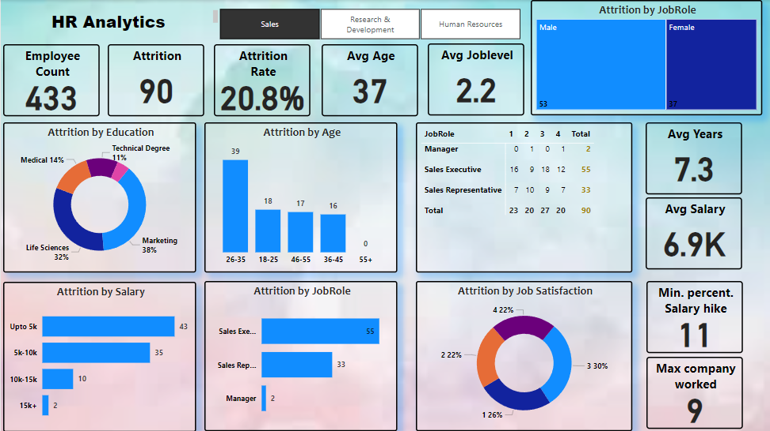
RESULTS

Slide 8
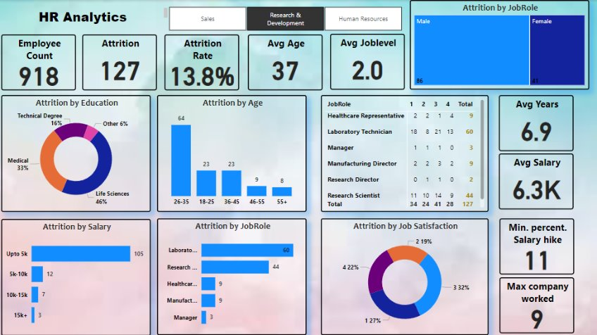

Slide 9
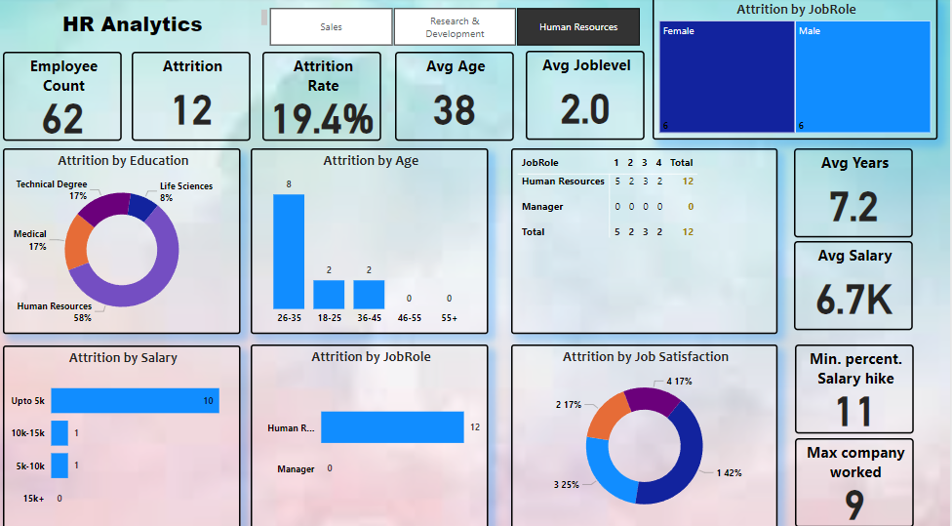

Slide 10
For more details:
Drive<<click here
.
.

Slide 11
Thank you
.
.

