Slide 1
Algorithm classification
Algorithms that use a similar problem-solving approach can be grouped together
The purpose is not to be able to classify an algorithm as one type or another, but to highlight the various ways in which a problem can be attacked

Slide 2
A short list of categories
Algorithm types we will consider include:
Brute force algorithms
Greedy algorithms
Simple recursive algorithms
Backtracking algorithms
Divide and conquer algorithms
Dynamic programming algorithms
Randomized algorithms

Slide 3
Brute force algorithm
Brute Force is a straightforward approach of solving a problem based on the problem statement. It is one of the easiest approaches to solve a particular problem.
It is useful for solving small size dataset problem.
Some examples of brute force algorithms are:
· Bubble-Sort · Selection-Sort · Sequential search in an array
· Computing pow (a, n) by multiplying a, n times · String matching
· Exhaustive search etc.
Most of the times, other algorithm techniques can be used to get a better solution of the same problem

Slide 4
Brute force algorithm
Brute force is the first algorithm that comes into mind when we see some problem.
They are the simplest algorithms that are very easy to understand.
These algorithms rarely provide an optimum solution. Many cases we need to find other effective algorithm that is more efficient than the brute force method.
This is the most simple to understand the kind of problem solving technique

Slide 5
Greedy algorithms
Greedy algorithms are generally used to solve optimization problems.
To find the solution that minimizes or maximizes some value (cost/profit/count etc.).
In greedy algorithm, solution is constructed through a sequence of steps.
At each step, choice is made which is locally optimal.
We always take the next data to be processed depending upon the dataset which we have already processed and then choose the next optimum data to be processed.
Greedy algorithms may not always give optimum solution.
Greedy is a strategy that works well on optimization problems with the following characteristics:
1. Greedy choice: A global optimum can be arrived at by selecting a local optimum.
2. Optimal substructure: An optimal solution to the problem is made from optimal solutions of sub problems.
Notes:
2

Slide 6
Greedy algorithms
Some examples of Greedy algorithms are:
· Minimal spanning tree: Prim’s algorithm, Kruskal’s algorithm
· Dijkstra’s algorithm for single-source shortest path
Approximate solutions:
· Coin exchange problem

Slide 7
Simple recursive algorithms I
A simple recursive algorithm:
Solves the base cases directly
Recurs with a simpler subproblem
Does some extra work to convert the solution to the simpler subproblem into a solution to the given problem

Slide 8
Example recursive algorithms
To count the number of elements in a list:
If the list is empty, return zero; otherwise,
Step past the first element, and count the remaining elements in the list
Add one to the result
To test if a value occurs in a list:
If the list is empty, return false; otherwise,
If the first thing in the list is the given value, return true; otherwise
Step past the first element, and test whether the value occurs in the remainder of the list

Slide 9
Backtracking algorithms
Backtracking algorithms are based on a depth-first recursive search
A backtracking algorithm:
Tests to see if a solution has been found, and if so, returns it; otherwise
For each choice that can be made at this point,
Make that choice
Recur
If the recursion returns a solution, return it
If no choices remain, return failure
Example: searching key of a lock from available bunch of keys.

Slide 10
Divide and Conquer
Divide-and-Conquer algorithms works by recursively breaking down a problem into two or more subproblems (divide), until these sub problems become simple enough so that can be solved directly (conquer).
The solution of these sub problems is then combined to give a solution of the original problem.
Divide-and-Conquer algorithms involve basic three steps
Divide the problem into smaller problems.
Conquer by solving these problems.
Combine these results together.
In divide-and-conquer the size of the problem is reduced by a factor (half, one-third etc.), While in decrease-and-conquer the size of the problem is reduced by a constant.
Notes:
2

Slide 11
Divide and Conquer
Examples of divide-and-conquer algorithms:
· Merge-Sort algorithm (recursion)
· Quicksort algorithm (recursion)
· Computing the length of the longest path in a binary tree (recursion)
· Computing Fibonacci numbers (recursion)
Examples of decrease-and-conquer algorithms:
· Computing POW(a, n) by calculating POW(a, n/2) using recursion
· Binary search in a sorted array (recursion)
· Searching in BST

Slide 12
Dynamic programming algorithms
A dynamic programming algorithm remembers past results and uses them to find new results
Dynamic programming is generally used for optimization problems
Multiple solutions exist, need to find the “best” one
Requires “optimal substructure” and “overlapping subproblems”
Optimal substructure: Optimal solution contains optimal solutions to subproblems
Overlapping subproblems: Solutions to subproblems can be stored and reused in a bottom-up fashion
. Dynamic Programming (DP) is a simple technique but it can be difficult to master.

Slide 13
Dynamic programming algorithms
Dynamic programming and memorization work together.
By using memorization [maintaining a table of sub problems already solved], dynamic programming reduces the exponential complexity to polynomial complexity (O(n² ), O(n³ ), etc.) for many problems.
The major components of DP are:
Recursion: Solves sub problems recursively.
Memorization: Stores already computed values in table (Memoization means caching).
Dynamic Programming = Recursion + Memorization

Slide 14
Let us take an example
Find Maximum Value Contiguous Subsequence: Given an array of n numbers, give an algorithm for finding a contiguous subsequence A(i)... A(j) for which the sum of elements is maximum.
Example: {-2, 11, -4, 13, -5, 2} → 20 and {1, -3, 4, -2, -1, 6} → 7
Note: The algorithms doesn’t work if the input contains all negative numbers. It returns 0 if all numbers are negative.

Slide 15
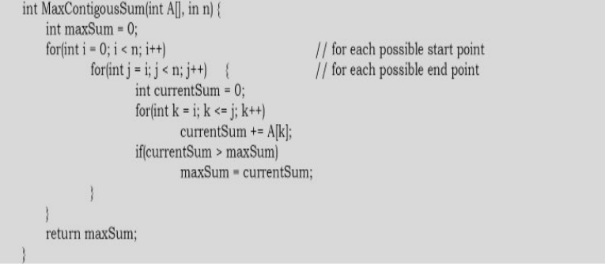
Example: {-2, 11, -4, 13, -5, 2} → 20 and {1, -3, 4, -2, -1, 6} → 7
Time Complexity: O(n³ ). Space Complexity: O(1).

Slide 16
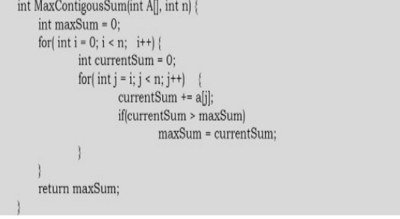
Example: {-2, 11, -4, 13, -5, 2} → 20 and {1, -3, 4, -2, -1, 6} → 7
Time Complexity: O(n² ). Space Complexity: O(1).

Slide 17
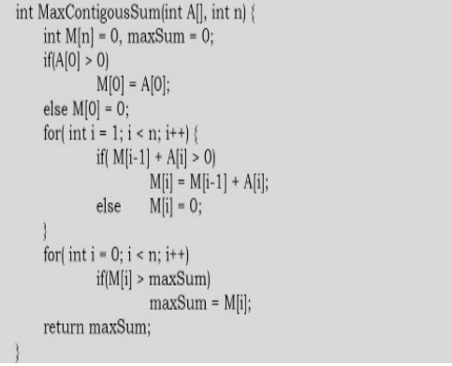
Example: {-2, 11, -4, 13, -5, 2} → 20 and {1, -3, 4, -2, -1, 6} → 7
Time Complexity: O(n). Space Complexity: O(n).

Slide 18
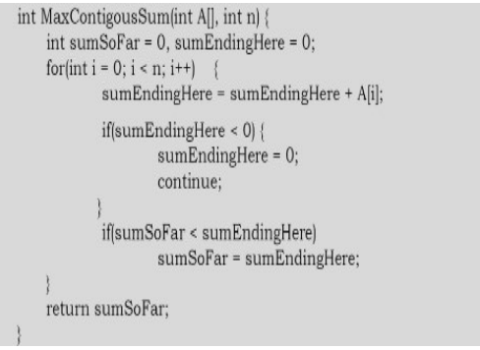
Example: {-2, 11, -4, 13, -5, 2} → 20 and {1, -3, 4, -2, -1, 6} → 7
Time Complexity: O(n). Space Complexity: O(1).

Slide 19
Examples of Dynamic Programming Algorithms:
• Many string algorithms including longest common subsequence, longest increasing subsequence, longest common substring, edit distance.
• Algorithms on graphs can be solved efficiently: Bellman-Ford algorithm for finding the shortest distance in a graph
• Subset Sum

Slide 20
Randomized algorithms
A randomized algorithm uses a random number at least once during the computation to make a decision
Example: In Quicksort, using a random number to choose a pivot
Example: Trying to factor a large prime by choosing random numbers as possible divisors

Slide 21
Thank You!!!!!

