Slide 1


Slide 2
Objectives
At the end of this session you will be able to
List the steps for a request to hit the web server and response sent back to the browser.
State the role of Internet Information Services (IIS).
List the classes involved and their role in sending the request through HTTPPipeline to the worker process.
Create a web application.
Name the coding models for coding web pages.
Explain the compilation steps for ASP.NET application.
List the events in the life cycle of the web page.
State the role of intrinsic objects of Page class.

Slide 3


ASP.NET Architecture
ASP.NET Worker Process
Client m/c
IIS
Request Object
App Domain
ASPNET_ISAPI.dll
Web Page
HTTP request
O/P cache module
Authentication and authorization
Tracing Modules
ISAPI.dll
internet
Proxy server
Pipeline
HTTP response
ASP.dll
Client m/c
CLR
Notes:
How page requested from client passes thru IIS?
Role of ASPNET_ISAPI.
Who initiates Worker Process?
AppDomain
Zoom this diagram later
Request hits web server at port 80
The web server is IIS for Microsoft platform.

Slide 4
Internet Information Services(IIS)
Microsoft’s Web server
  Provides a highly reliable and scalable Web application infrastructure for deploying Web applications
Actually Windows NT service(inetinfo.exe)
Applications hosted on IIS using virtual directory
Tasks performed
  Listens to request
  Reads the file extension and routes the request.
  Requests follows a specific path through pipeline
  Creates a worker process on same OS

Slide 5
Difference
ASP
ASP.NET
ASP is run under the inetinfo.exe(IIS) process space and hence susceptible to application crashes.
Classical ASP had no mechanism of running itself on non- Microsoft technology platforms like the 'The Apache Web Server' .
only two languages were available for scripting VBScript and Jscript/Javascript.
Interpretation
The ASP.NET worker process is a distinct worker process.
ASP.NET could be run on non-Microsoft Platforms also. Cassini is a sample Web server produced by Microsoft which, among other projects, has been used to host ASP.NET with Apache.
C# and VB.Net both server Side languages.
Compilation.

Slide 6
HTTP Pipeline
Stages involved from creating HttpRuntime to HttpHandler is called HttpPipeline.
Classes involved are
  HTTP Runtime
  HTTP Context
  HTTP Request
  HTTP Response
  HTTP Application
  HTTP Module
  HTTP Handler

Slide 7
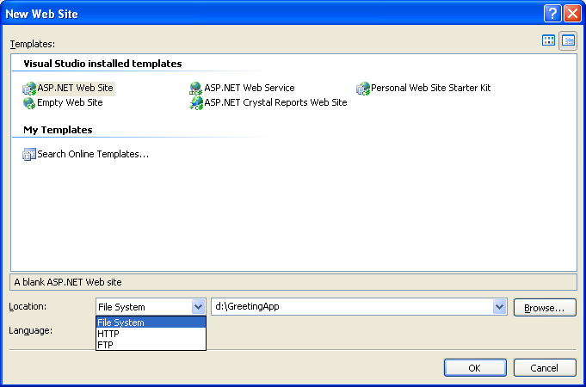
Creating a Web site

Slide 8
Design View - Greet.aspx
%@ Page Language="C#" AutoEventWireup="true" CodeFile="Default.aspx.cs" Inherits="_Default" %>
<!DOCTYPE html PUBLIC "-//W3C//DTD XHTML 1.0 Transitional//EN" "http://www.w3.org/TR/xhtml1/DTD/xhtml1-transitional.dtd">
<html xmlns="http://www.w3.org/1999/xhtml" >
<head runat="server"><title>Greeting</title></head>
<body>
<form id="form1" runat="server">
<div>
<asp:Label ID="Label1" runat="server" Text="Enter your Name"
Width="92px"></asp:Label></td>
<asp:TextBox ID="TextBox1" runat="server"
BackColor="White"></asp:TextBox></td>
<asp:Button ID="Button1" runat="server" OnClick="Button1_Click"
Text="Greet!!!" Width="125px" />
<asp:Label ID="Label2" runat="server" Font-Size="Large"
Height="47px" Width="354px"></asp:Label>
</div>
</form>
</body>
</html>
Notes:
How the page class

Slide 9
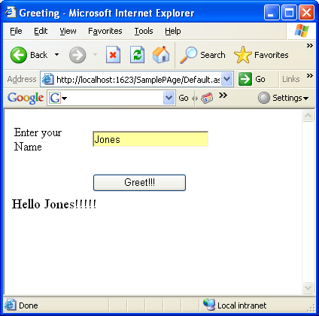
Code File - Greet.aspx.cs
Greet.aspx.cs
using System;
using System.Data;
using System.Web;
using System.Web.UI;
using System.Web.UI.WebControls;
public partial class _Default : System.Web.UI.Page
{
protected void Button1_Click(object sender, EventArgs e)
{Label2.Text = "Hello " + TextBox1.Text + "!!!!!"; }
}

Slide 10
Compilation Model
.aspx page
.dll
same dll rendered
Compiler
csc.exe
Subsequent requests
Cached compiled code
Client
Editing of page

Slide 11
Compilation Internals . . .
Indicates the file that has code behind for the page.
default.aspx
%@ Page Language="C#" AutoEventWireup="true" CodeFile="Default.aspx.cs" Inherits="_Default" %>
. . .
<asp:Button ID="Button1" runat="server" OnClick="Button1_Click" Text="Greet!!!" Width="125px" />
Partial class name
default.aspx.cs
public partial class _Default : System.Web.UI.Page
{
protected void Button1_Click(object sender, EventArgs e)
{
}
}

Slide 12
Postback and ViewState
PostBack
  By default done by clicking a button.
  Causes page to be submitted to web server.
  Other web controls have AutoPostBack feature.
  _doPostBack() javascript function is invoked automatically.
ViewState
  Stores the changes state of the controls in name/value pair during postback.
  Deserializes the information and updates the controls.

Slide 13
Page Life Cycle
Start
HTTPRuntime
Pre - Init
Unload
Init
Render
LoadViewState
Load
PreRender
SaveViewState

Slide 14
Page Life Cycle
When the page is first time requested
When the page is processed during post back event
Notes:
Postback event
IsPostback property
Check page 74-75 of ref book for
ViewState

Slide 15
Intrinsic Objects of Page Class
Application object contains some intrinsic objects exposed as properties of Page class.
  Session
  Application
  Cache
  Request
  Response
  Server
  User
  Trace

Slide 16
ASP.NET Configuration
Managed with XML configuration files
Application’s core settings as well as custom settings are a part of configuration files
  machine.config file
    Resides in c:\Windows\Microsoft.NET\ Framework\v2.0.50727\Config directory
    Supports configuration file sections, configures ASP.NET worker process and advance features like profiles, membership and role based security
  web.config file
    Inherits the settings from Machine.config
    Can be customized for settings to individual web applications
Notes:
Page 176

Slide 17
Quick Recap . . .
All ASP.NET web applications are hosted on IIS ASP.NET.
NET HTTP Pipeline forwards the request from IIS to the worker process.
The worker process is a surrogate process to host web applications in IIS.
HttpRuntime creates a context for each request and fills the necessary information in this context.
Web page is derived from System.Web.UI.Page class
In Inline code model, both the design and the code is stored in same .aspx file whereas in Code Behind Model, the design and code is stored in separate files.
Web Page is created and destroyed with every web request to the same page.
The web page is compiled only once when the page is first time requested. The cached compiled code is stored as .dll.
Application, Session, Request, Response, Cache, Server, User and Trace are some intrinsic objects as a part of application.

