Slide 1


2160707
Advanced Java
Unit-4
Java Server Pages
Prof. Swati R. Sharma
swati.sharma@darshan.ac.in

Slide 2
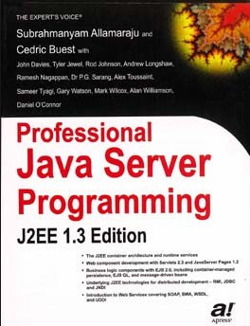
Subject Overview
Sr. No. | Unit | % Weightage
1 | Java Networking | 5
2 | JDBC Programming | 10
3 | Servlet API and Overview | 25
4 | Java Server Pages | 25
5 | Java Server Faces | 10
6 | Hibernate | 15
7 | Java Web Frameworks: Spring MVC | 10
Reference Book:
Professional Java Server Programming by Subrahmanyam Allamaraju, Cedric Buest Wiley Publication
Chapter 10,11

Slide 3
JSP Overview

Slide 4
What is Java Server Pages (JSP)?
Java Server Pages (JSP) is a technology for developing web pages that support dynamic content.
It helps to insert java code in HTML pages by making use of special JSP tags.
Example
<% …JSP Tag… %>
JSP is a server-side program that is similar in design and functionality to java servlet.
A JSP page consists of HTML tags and JSP tags.
JSP pages are saved with .jsp extension

Slide 5
JSP vs Servlet

Slide 6
Comparing JSP with Servlet
JSP | Servlet
JSP is a webpage scripting language that generates dynamic content. | Servlets are Java programs that are already compiled which also creates dynamic web content.
A JSP technically gets converted to a servlet It embed the java code into HTML. E.g. <html> <% java code %> </html> | A servlet is a java class. It put HTML into print statements. E.g. out.println(“<html code>”);
JSPs are extension of servlets which minimizes the effort of developers to write User Interfaces using Java programming. | A servlet is a server-side program and written purely in Java.
JSP runs slower than servlet. As, it has the transition phase for converting from JSP to a Servlet. Once it is converted to a Servlet then it will start the compilation | Servlets run faster than JSP
In MVC architecture JSP acts as view. | In MVC architecture Servlet acts as controller.
We can build custom tags using JSP API | We cannot build any custom tags in servlet.

Slide 7
Advantages of JSP over Servlets
In a JSP page visual content and logic are separated, which is not possible in a servlet.
i.e. JSP separates business logic from the presentation logic.
Servlets use println statements for printing an HTML document which is usually very difficult to use. JSP has no such tedious task to maintain.

Slide 8
GTU question
1. | List advantages of JSP over Servlet.[3] | Win’17 Win’18

Slide 9
Life Cycle of JSP

Slide 10
Life Cycle of JSP
A JSP life cycle can be defined as the entire process from its creation till the destruction.
It is similar to a servlet life cycle with an additional step which is required to compile a JSP into servlet.
A JSP page is converted into Servlet in order to service requests.
The translation of a JSP page to a Servlet is called Lifecycle of JSP.

Slide 11
Life Cycle of JSP
Called only once
jspInit()
Request
_jspService()
Handles multiple request/response
Response
jspDestroy()
Called only once

Slide 12
Life Cycle of JSP
JSP Lifecycle steps
Translation of JSP to Servlet code.
Compilation of Servlet to bytecode.
Loading Servlet class.
Creating servlet instance.
Initialization by calling jspInit() method
Request Processing by calling _jspService() method
Destroying by calling jspDestroy() method

Slide 13
JSP Processing Life Cycle
Web Server
hello.jsp
hello_jsp.java
Step:1
Translation from .jsp to servlet(.java)
Step:2
Compilation of Servlet to bytecode
Web Container
Loading Servlet Class
Step:3
hello_jsp.class
Creating Servlet Instance
Step:4
jspInit()
Step:5
_jspService()
Step:6
jspDestroy()
Step:7

Slide 14
Life Cycle of JSP
Web Container translates JSP code into a servlet source(.java) file.
Then compiles that(.java) into a java servlet class (bytecode).
In the third step, the servlet class bytecode is loaded using classloader in web container.
The Container then creates an instance of that servlet class.
The initialized servlet can now service request.
For each request the Web Container call the _jspService() method.
When the Container removes the servlet instance from service, it calls the jspDestroy() method to perform any required clean up.

Slide 15
JSP Processing
The following steps explain how the web server creates the web page using JSP:
Web browser sends an HTTP request to the web server requesting JSP page. E.g. http://localhost:8080/1.jsp
Web server recognizes that the HTTP request by web browser is for JSP page by checking the extension of the file (i.e .jsp)
Web server forwards HTTP Request to JSP engine.
The JSP engine loads the JSP page from disk and converts it into a servlet content.
The JSP engine compiles the servlet into an executable class and forwards the original request to a servlet engine.

Slide 16
JSP Processing
Servlet engine loads and executes the Servlet class.
Servlet produces an output in HTML format.
Output produced by servlet engine is then passes to the web server inside an HTTP response.
Web server sends the HTTP response to Web browser in the form of static HTML content.
Web browser loads the static page into the browser and thus user can view the dynamically generated page.
“Except the translation phase,
a JSP page is handled exactly like a Servlet”

Slide 17
JSP Processing
Translation Time
Time taken to generate Java Servlet (.java) from .jsp file is termed as Translation Time.
Request Time
Time taken to invoke a Servlet to handle an HTTP request is termed as Request Time.

Slide 18
GTU question
1. | List and explain various phases of JSP life cycle? | Win’17 Win’18 Win’19

Slide 19
JSP Elements

Slide 20
JSP Elements
JSP Element
JSP Directives
JSP Scripting Elements
Actions
page
<jsp:param>
include
<jsp:include>
Traditional
Modern
<jsp:forward>
scriptlet
<jsp:plugin>
EL Scripting
expression
declaration
comments
(html, jsp,java)
Notes:
Template Text
It contains HTML and XML tags and raw data .For the template text no processing is required and it will be passed directly as argument to out.write() in _jspService() method.

Slide 21
JSP Elements
JSP Element
JSP Directives
JSP Scripting Elements
Actions
page
<jsp:param>
include
<jsp:include>
Traditional
Modern
<jsp:forward>
scriptlet
<jsp:plugin>
EL Scripting
expression
declaration
comments
(html, jsp,java)
Notes:
Template Text
It contains HTML and XML tags and raw data .For the template text no processing is required and it will be passed directly as argument to out.write() in _jspService() method.

Slide 22
JSP Scripting Elements

Slide 23
JSP Scripting Elements
The scripting elements provides the ability to insert java code inside the jsp. There are three types of traditional scripting elements:
scriptlet tag
expression tag
declaration tag
JSP Scripting Elements
Traditional
Modern
scriptlet
EL Scripting
expression
declaration
comments
(html, jsp,java)

Slide 24
JSP Elements
JSP Element
JSP Directives
JSP Scripting Elements
Actions
page
<jsp:param>
include
<jsp:include>
Traditional
Modern
<jsp:forward>
scriptlet
<jsp:plugin>
EL Scripting
expression
declaration
comments
(html, jsp,java)
Notes:
Template Text
It contains HTML and XML tags and raw data .For the template text no processing is required and it will be passed directly as argument to out.write() in _jspService() method.

Slide 25
scriptlet
A scriptlet tag is used to execute java source code in JSP.
A scriptlet can contain
Any number of JAVA language statements
Variable
Method declarations
Expressions that are valid in the page scripting language
Syntax
<% // java source code %>
Example
<% out.print("welcome to jsp"); %>
<% int a=10; %>

Slide 26
scriptlet
Everything written inside the scriptlet tag is compiled as java code.
JSP code is translated to Servlet code, in which _jspService() method is executed which has HttpServletRequest and HttpServletResponse as argument.
JSP page can have any number of scriptlets, and each scriptlets are appended in _jspService ().

Slide 27
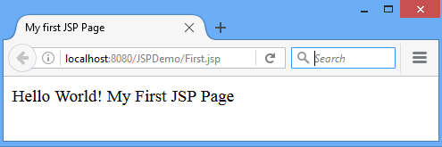
First jsp program: First.jsp using scriptlet
<html>
<body>
<%out.println("Hello World! My First JSP Page");%>
</body>
</html>

Slide 28
JSP Elements
JSP Element
JSP Directives
JSP Scripting Elements
Actions
page
<jsp:param>
include
<jsp:include>
Traditional
Modern
<jsp:forward>
scriptlet
<jsp:plugin>
EL Scripting
expression
declaration
comments
(html, jsp,java)
Notes:
Template Text
It contains HTML and XML tags and raw data .For the template text no processing is required and it will be passed directly as argument to out.write() in _jspService() method.

Slide 29
expression
The code placed within JSP expression tag is written to the output stream of the response.
So you need not write out.print() to write data.
It is mainly used to print the values of variable or method.
Syntax
<%=statement %>
Example
<%= (2*5) %>
“Do not end the statement with semicolon in case of expression tag.“
turns out as
out.print((2*5));

Slide 30
JSP Elements
JSP Element
JSP Directives
JSP Scripting Elements
Actions
page
<jsp:param>
include
<jsp:include>
Traditional
Modern
<jsp:forward>
scriptlet
<jsp:plugin>
EL Scripting
expression
declaration
comments
(html, jsp,java)
Notes:
Template Text
It contains HTML and XML tags and raw data .For the template text no processing is required and it will be passed directly as argument to out.write() in _jspService() method.

Slide 31
declaration
The JSP declaration tag is used to declare variables and methods
The declaration of jsp declaration tag is placed outside the _jspService() method.
Syntax
<%! variable or method declaration %>
Example
<%! int a = 10; %>
<%! int a, b, c; %>
<%! Circle a = new Circle(2.0); %>

Slide 32
JSP Elements
JSP Element
JSP Directives
JSP Scripting Elements
Actions
page
<jsp:param>
include
<jsp:include>
Traditional
Modern
<jsp:forward>
scriptlet
<jsp:plugin>
EL Scripting
expression
declaration
comments
(html, jsp,java)
Notes:
Template Text
It contains HTML and XML tags and raw data .For the template text no processing is required and it will be passed directly as argument to out.write() in _jspService() method.

Slide 33
comments
The comments can be used for documentation.
This JSP comment tag tells the JSP container to ignore the comment part from compilation.
Syntax
<%-- comments --%>
JSP comment | <%-- jsp comment --%>
Java comment | /* java comment */ or // for single line
Html comment | <!-- html comment -->

Slide 34
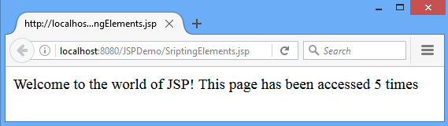
Scripting Elements: Example
<html>
<body>
<%-- comment:JSP Scipting elements --%>
<%! int i=0; %>
<% i++; %>
Welcome to world of JSP!
<%= "This page has been accessed " + i + " times" %>
</body>
</html>
declaration
scriptlet
expression

Slide 35
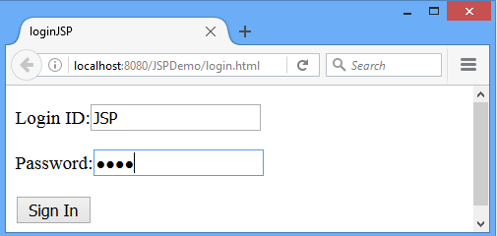
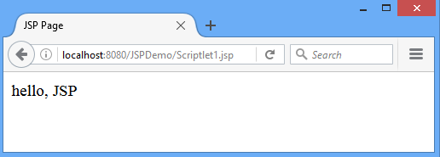
Scriptlet: Assignment 4
Write a JSP program to welcome authenticated user.
login.html
Scriptlet1.jsp

Slide 36
JSP Elements
JSP Element
JSP Directives
JSP Scripting Elements
Actions
page
<jsp:param>
include
<jsp:include>
Traditional
Modern
<jsp:forward>
scriptlet
<jsp:plugin>
EL Scripting
expression
declaration
comments
(html, jsp,java)
Notes:
Template Text
It contains HTML and XML tags and raw data .For the template text no processing is required and it will be passed directly as argument to out.write() in _jspService() method.

Slide 37
JSP Directives
JSP directives provide directions and instructions to the container, telling it how to translate a JSP page into the corresponding servlet.
A JSP directive affects the overall structure of the servlet class.
JSP engine handles directives at Translation time.
There are two types of directives:
page directive
include directive
Syntax
<%@ directive attribute="value" %>

Slide 38
JSP Elements
JSP Element
JSP Directives
JSP Scripting Elements
Actions
page
<jsp:param>
include
<jsp:include>
Traditional
Modern
<jsp:forward>
scriptlet
<jsp:plugin>
EL Scripting
expression
declaration
comments
(html, jsp,java)
Notes:
Template Text
It contains HTML and XML tags and raw data .For the template text no processing is required and it will be passed directly as argument to out.write() in _jspService() method.

Slide 39
JSP Directives
page directive

Slide 40
page directive
The page directive defines attributes that apply to an entire JSP page.
You may code page directives anywhere in your JSP page.
By convention, page directives are coded at the top of the JSP page.
Syntax
<%@page attribute="value" %>
Example
<%@page import="java.util.Date,java.util.List,java.io.*" %>
<%@page contentType="text/html; charset=US-ASCII" %>

Slide 41
page directive
Attributes of JSP page directive
import
contentType
extends
info
Used to import class, interface or all the members of a package
<%@ page import="java.util.Date" %>
Today is: <%= new Date() %>
The contentType attribute defines the MIME type of the HTTP response. The default value is "text/html;charset=ISO-8859-1".
<%@ page contentType=application/msword %>
The extends attribute defines the parent class that will be inherited by the generated servlet
<%@ page extends="javax.servlet.HttpServlet" %>
This attribute simply sets the information of the JSP page which is retrieved later by using getServletInfo() .
<%@ page info=“Authored by : AuthorName" %>
Notes:
MIME:Multipurpose Internet Mail Extension

Slide 42
page directive
The buffer attribute sets the buffer size in kb to handle output generated by the JSP page.
The default size of the buffer is 8Kb.
<%@ page buffer="16kb" %>
<%@ page buffer="none" %>
buffer
language
isELIgnored
autoFlush
The language attribute specifies the scripting language used in the JSP page. The default value is "java".
<%@ page language="java" %>
We can ignore the Expression Language (EL) in jsp by the isELIgnored attribute. By default its value is false i.e. EL is enabled by default.
<%@ page isELIgnored="true" %>//Now EL will be ignored
The autoFlush attribute specifies whether buffered output should be flushed automatically when the buffer is filled.Bydefault it is true.
<%@ page autoFlush="true" %>

Slide 43
page directive
This option marks a page as being thread-safe. By default, all JSPs are considered thread-safe(true). If you set the isThreadSafe = false, the JSP engine makes sure that only one thread at a time is executing your JSP.
<%@ page isThreadSafe ="false" %>
isThreadSafe
session
pageEncoding
errorPage
isErrorPage
The session attribute indicates whether or not the JSP page uses HTTP sessions.
<%@ page session="true" %>//Bydefault it is true
We can set response encoding type with this page directive attribute, its default value is “ISO-8859-1”.
<%@ page pageEncoding ="US-ASCII" %>
It is used to define the error page, if exception occurs in the current page, it will be redirected to the error page.
<%@ page errorPage="myerrorpage.jsp" %>
The isErrorPage attribute is used to declare that the current page is the error page.
<%@ page isErrorPage="true" %>

Slide 44
JSP Elements
JSP Element
JSP Directives
JSP Scripting Elements
Actions
page
<jsp:param>
include
<jsp:include>
Traditional
Modern
<jsp:forward>
scriptlet
<jsp:plugin>
EL Scripting
expression
declaration
comments
(html, jsp,java)
Notes:
Template Text
It contains HTML and XML tags and raw data .For the template text no processing is required and it will be passed directly as argument to out.write() in _jspService() method.

Slide 45
JSP Directives
include directive

Slide 46
include directive
JSP include directive is used to include the contents of another file to the current JSP page during translation time.
The included file can be HTML, JSP, text files etc.
Advantage of Include directive
Code Reusability
Syntax
<%@ include attribute= "value" %>
Example
<%@ include file="1.jsp" %>

Slide 47
JSP Implicit Object

Slide 48
Jsp Implicit Objects
There are 9 jsp implicit objects.
These objects are created by the web container that are available to all the jsp pages.
Implicit Object | Type
out | JspWriter
request | HttpServletRequest
response | HttpServletResponse
config | ServletConfig
session | HttpSession
pageContext | PageContext
page | Object
application | ServletContext
exception | Throwable

Slide 49
Jsp Implicit Objects: out
For writing any data to the buffer, JSP provides an implicit object named out.
It is an object of JspWriter.
Servlet Code
JSP Code
PrintWriter out=
response.getWriter();
response.setContentType
(“text/html”);
out.print(“DIET”);
<html>
<body>
<% out.print(“DIET”); %>
</body>
</html>

Slide 50
Jsp Implicit Objects: request
Instance of javax.servlet.http.HttpServletRequest object associated with the request.
Each time a client requests a page the JSP engine creates a new object to represent that request.
The request object provides methods to get HTTP header information including from data, cookies, HTTP methods etc.

Slide 51
Jsp Implicit Objects: request
Resquest.html
<form action="welcome.jsp">
Login:<input type="text" name="login">
<input type="submit" value="next">
</form>
Welcome.jsp
hello,
<% out.println(request.getParameter("login"));
%>

Slide 52
Jsp Implicit Objects: response
The response object is an instance of a javax.servlet.http.HttpServletResponse object.
Through this object the JSP programmer can add new cookies or date stamps, HTTP status codes, redirect response to another resource, send error etc.

Slide 53
Jsp Implicit Objects: response
Response.html
<form action="welcome.jsp">
<input type="text" name="login">
<input type="submit" value="next">
</form>
Welcome.jsp
<%
response.sendRedirect("www.darshan.ac.in");
%>

Slide 54
Jsp Implicit Objects: config
config is an implicit object of type javax.servlet.ServletConfig.
This object can be used to get initialization parameter for a particular JSP page.
Config.html
<form action="MyConfig">
Login:<input type="text" name="login">
<input type="submit" value="sign_in">
</form>

Slide 55
Jsp Implicit Objects: config
web.xml
<servlet>
<servlet-name>MyConfig</servlet-name>
<jsp-file>/MyConfig.jsp</jsp-file>
<init-param>
<param-name>College</param-name>
<param-value>DIET</param-value>
</init-param>
</servlet>
<servlet-mapping>
<servlet-name>MyConfig</servlet-name>
<url-pattern>/MyConfig</url-pattern>
</servlet-mapping>

Slide 56
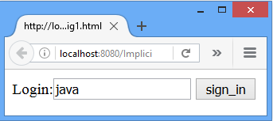
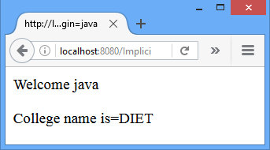
Jsp Implicit Objects: config
MyConfig.jsp
<%
out.print("Welcome "+request.getParameter("login"));
String c_name=config.getInitParameter("College");
out.print("<p>College name is="+c_name+"</p>");
%>

Slide 57
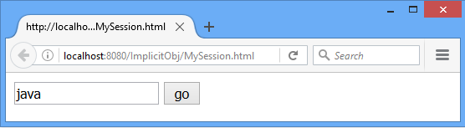
Jsp Implicit Objects: session
In JSP, session is an implicit object of type javax.servlet.http.HttpSession .
The Java developer can use this object to set, get or remove attribute or to get session information.
MySession.html
<form action="MySession1.jsp">
<input type="text" name="uname">
<input type="submit" value="go"><br/>
</form>

Slide 58
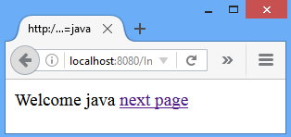
Jsp Implicit Objects: session
MySession1.jsp
<html>
<body>
<%
String name=request.getParameter("uname");
out.print("Welcome "+name);
session.setAttribute("user",name);
%>
<a href="MySession2.jsp">next page</a>
</body>
</html>

Slide 59
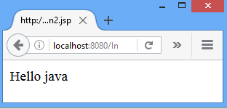
Jsp Implicit Objects: session
MySession2.jsp
<html>
<body>
<%
String name= (String)session.getAttribute("user");
out.print("Hello "+name);
%>
</body>
</html>

Slide 60
Jsp Implicit Objects: pageContext
Instance of javax.servlet.jsp.PageContext
The pageContext object can be used to set, get or remove attribute.
The PageContext class defines several fields, including PAGE_SCOPE, REQUEST_SCOPE, SESSION_SCOPE, and APPLICATION_SCOPE, which identify the four scopes.

Slide 61
Jsp Implicit Objects: pageContext
Context1.jsp
<% pageContext.setAttribute
("user","name",PageContext.APPLICATION_SCOPE);
%>
<a href="Context2.jsp">next page</a>
Context2.jsp
<%
String name= (String)pageContext.getAttribute
("user",PageContext.APPLICATION_SCOPE);
out.print("Hello "+name);
%>

Slide 62
Jsp Implicit Objects: page
This object is an actual reference to the instance of the page.
It is an instance of java.lang.Object
Direct synonym for the this object.
Example: returns the name of generated servlet file
<%= page.getClass().getName() %>

Slide 63
Jsp Implicit Objects: application
Instance of javax.servlet.ServletContext
The instance of ServletContext is created only once by the web container when application or project is deployed on the server.
This object can be used to get initialization parameter from configuration file (web.xml).
This initialization parameter can be used by all jsp pages.
<%
//refers to context parameter of web.xml
String driver=application.getInitParameter("name");
out.print("name is="+driver);
%>

Slide 64
Jsp Implicit Objects: exception
exception is an implicit object of type java.lang.Throwable class. This object can be used to print the exception.
But it can only be used in error pages.
<%@ page isErrorPage="true" %>
<html>
<body>
Sorry following exception occured:
<%=exception %>
</body>
</html>

Slide 65
JSP Elements
JSP Element
JSP Directives
JSP Scripting Elements
Actions
page
<jsp:param>
include
<jsp:include>
Traditional
Modern
<jsp:forward>
scriptlet
<jsp:plugin>
EL Scripting
expression
declaration
comments
(html, jsp,java)
Notes:
Template Text
It contains HTML and XML tags and raw data .For the template text no processing is required and it will be passed directly as argument to out.write() in _jspService() method.

Slide 66
Actions
JSP actions use constructs in XML syntax to control the behavior of the servlet engine.
We can dynamically insert a file, reuse JavaBeans components, forward the user to another page, or generate HTML for the Java plugin.
Syntax
<jsp:action_name attribute="value" />

Slide 67
JSP Elements
JSP Element
JSP Directives
JSP Scripting Elements
Actions
page
<jsp:param>
include
<jsp:include>
Traditional
Modern
<jsp:forward>
scriptlet
<jsp:plugin>
EL Scripting
expression
declaration
comments
(html, jsp,java)
Notes:
Template Text
It contains HTML and XML tags and raw data .For the template text no processing is required and it will be passed directly as argument to out.write() in _jspService() method.

Slide 68
<jsp:param>
This action is useful for passing the parameters to other JSP action tags such as JSP include & JSP forward tag.
This way new JSP pages can have access to those parameters using request object itself.
Syntax
<jsp:param name ="name" value="value" />
Example
<jsp:param name ="date" value="12-02-2018" />
<jsp:param name ="time" value="10:15AM" />
<jsp:param name ="data" value="ABC" />

Slide 69
JSP Elements
JSP Element
JSP Directives
JSP Scripting Elements
Actions
page
<jsp:param>
include
<jsp:include>
Traditional
Modern
<jsp:forward>
scriptlet
<jsp:plugin>
EL Scripting
expression
declaration
comments
(html, jsp,java)
Notes:
Template Text
It contains HTML and XML tags and raw data .For the template text no processing is required and it will be passed directly as argument to out.write() in _jspService() method.

Slide 70
<jsp:include>
The jsp:include action tag is used to include the content of another resource it may be jsp, html or servlet.
The jsp:include tag can be used to include static as well as dynamic pages
Attribute | Description
page | The relative URL of the page to be included.
flush | The boolean attribute determines whether the included resource has its buffer flushed before it is included. By default value is false.

Slide 71
<jsp:include>
Syntax
<jsp:include page="relative URL" flush="true" />
Example
<jsp:include page="Action1.jsp" flush="true">
<jsp:param name="roll_no1" value="401" />
</jsp:include>

Slide 72
Assignment-4
<jsp:include> vs include directive. Also give appropriate example for both.
Notes:
Include directive includes the file at translation time (the phase of JSP life cycle where the JSP gets converted into the equivalent servlet) whereas the include action includes the file at runtime.

Slide 73
JSP Elements
JSP Element
JSP Directives
JSP Scripting Elements
Actions
page
<jsp:param>
include
<jsp:include>
Traditional
Modern
<jsp:forward>
scriptlet
<jsp:plugin>
EL Scripting
expression
declaration
comments
(html, jsp,java)
Notes:
Template Text
It contains HTML and XML tags and raw data .For the template text no processing is required and it will be passed directly as argument to out.write() in _jspService() method.

Slide 74
<jsp:forward>
forwards the request and response to another resource.
Syntax
<jsp:forward page="Relative URL" />
Example
<jsp:forward page="Action2.jsp">
<jsp:param name="roll_no" value="301" />
</jsp:forward>

Slide 75
JSP Elements
JSP Element
JSP Directives
JSP Scripting Elements
Actions
page
<jsp:param>
include
<jsp:include>
Traditional
Modern
<jsp:forward>
scriptlet
<jsp:plugin>
EL Scripting
expression
declaration
comments
(html, jsp,java)
Notes:
Template Text
It contains HTML and XML tags and raw data .For the template text no processing is required and it will be passed directly as argument to out.write() in _jspService() method.

Slide 76
<jsp:plugin>
This tag is used when there is a need of a plugin to run a Bean class or an Applet.
The <jsp:plugin> action tag is used to embed applet in the jsp file.
The <jsp:plugin> action tag downloads plugin at client side to execute an applet or bean.
Syntax
<jsp:plugin type="applet|bean"
code="nameOfClassFile"
codebase= "URL"
/>

Slide 77
<jsp:plugin>
MyApplet.java
import java.applet.*;
import java.awt.*;
public class MyApplet extends Applet {
public void paint(Graphics g) {
g.drawString("Welcome in Java Applet.",40,20);
}}
MyPlugin.jsp
<html> <body>
<jsp:plugin
type="applet"
code="MyApplet.class"
codebase="/JSPClass/MyApplet"/>
</body></html>

Slide 78
JSP Elements
JSP Element
JSP Directives
JSP Scripting Elements
Actions
page
<jsp:param>
include
<jsp:include>
Traditional
Modern
<jsp:forward>
scriptlet
<jsp:plugin>
EL Scripting
expression
declaration
comments
(html, jsp,java)
Notes:
Template Text
It contains HTML and XML tags and raw data .For the template text no processing is required and it will be passed directly as argument to out.write() in _jspService() method.

Slide 79
EL Scripting
Expression Language(EL) Scripting.
It is the newly added feature in JSP technology version 2.0.
The purpose of EL is to produce script less JSP pages.
Syntax
${expr}
Example
EL | output
${a=10} | 10
${10+20} | 30
${20*2} | 40
${10==20} | false
${'a'<'b'} | true

Slide 80
EL Implicit Object
pageScope | It is used to access the value of any variable which is set in the Page scope
requestScope | It is used to access the value of any variable which is set in the Request scope.
sessionScope | It is used to access the value of any variable which is set in the Session scope
applicationScope | It is used to access the value of any variable which is set in the Application scope
pageContext | It represents the PageContext object.

Slide 81
EL Implicit Object
param | Map a request parameter name to a single value
paramValues | Map a request parameter name to corresponding array of string values.
header | Map containing header names and single string values.
headerValues | Map containing header names to corresponding array of string values.
cookie | Map containing cookie names and single string values.

Slide 82
EL Implicit Object
An expression can be mixed with static text/values and can also be combined with other expressions
Example
${param.name}
${sessionScope.user}
Impicit object
Parameter Name
Impicit object
Parameter Name

Slide 83
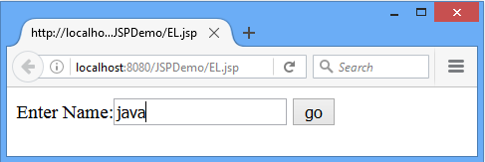
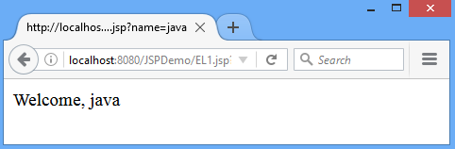
EL Implicit Object: Example
EL.jsp
<form action="EL1.jsp">
Enter Name:<input type="text" name="name" >
<input type="submit" value="go">
</form>
EL1.jsp
1. Welcome, ${ param.name }

Slide 84
EL Implicit Object: Example
<form action="EL2.jsp">
<% Cookie ck=new Cookie("c1","abc");
response.addCookie(ck);
session.setAttribute("sid","054"); //for session
%>
Enter Name:<input type="text" name="name" >
Enter Address:<input type="text" name="address" >
<input type="submit" value="submit">
</form>

Slide 85
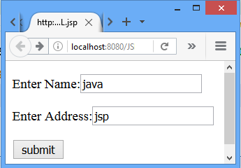
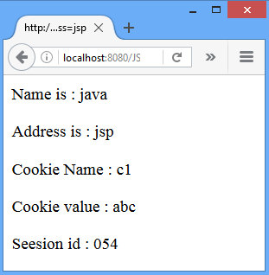
EL Implicit Object: Example
<p>Name is : ${param.name}</p>
<p>Address is : ${param.address}</p>
<p>Cookie Name : ${cookie.c1.name}</p>
<p>Cookie value : ${cookie.c1.value}</p>
<p>Session id : ${sessionScope.sid}</p>
EL.jsp
EL2.jsp

Slide 86
JSP EL Operator
JSP EL Arithmetic Operators
Arithmetic operators are provided for simple calculations in EL expressions. They are +, -, *, / or div, % or mod.
JSP EL Logical Operators
They are && (and), || (or) and ! (not).
JSP EL Relational Operators
They are == (eq), != (ne), < (lt), > (gt), <= (le) and >= (ge).

Slide 87
JSP EL Important Points
EL expressions are always within curly braces prefixed with $ sign, for example ${expr}
We can disable EL expression in JSP by setting JSP page directive isELIgnored attribute value to TRUE.
<%@ page isELIgnored="true" %>
JSP EL can be used to get attributes, header, cookies, init params etc, but we can’t set the values.
JSP EL implicit objects are different from JSP implicit objects except pageContext
JSP EL is NULL friendly, if given attribute is not found or expression returns null, it doesn’t throw any exception.

Slide 88
Exception Handling in JSP

Slide 89
Exception Handling in JSP
JSP provide 3 different ways to perform exception handling:
Using simple try...catch block.
Using isErrorPage and errorPage attribute of page directive.
Using <error-page> tag in Deployment Descriptor.

Slide 90
Exception Handling: try/catch block
Using try...catch block is just like how it is used in Core Java.
Example
<html>
<body>
<%
try{
int i = 100;
i = i / 0;
out.println("The answer is " + i);
}
catch (Exception e){
out.println("An exception occurred: " + e.getMessage());
}
%>
</body>
</html>

Slide 91
Exception Handling: Error Page
Exception Handling using isErrorPage and errorPage attribute of page directive.
MyJSP.jsp
MyErrorPage.jsp
<%@page errorPage= MyErrPage.jsp"%>
>%
<%@page isErrorPage
="true" %>

Slide 92
Exception Handling: Error Page
Exception Handling using isErrorPage and errorPage attribute of page directive.
<%@page errorPage= "2.jsp" %>
<% int i=10;
i=i/0; %>
<%@page isErrorPage="true" %>
<html> <body>
An Exception had occured
<% out.println(exception.toString());%>
</body> </html>
errorPage
1.jsp
If Exception occurs in 1.jsp then forward req to 2.jsp
This attribute designates .jsp page as ERROR PAGE
2.jsp

Slide 93
Exception Handling in JSP: web.xml
Declaring error page in Deployment Descriptor for entire web application.
Specify Exception inside
<error-page> tag in the Deployment Descriptor.
We can even configure different error pages for different exception types, or HTTP error code type(503, 500 etc).

Slide 94
Exception Handling in JSP: web.xml
Declaring an error page for all type of exception
<error-page>
<exception-type>
java.lang.Throwable
</exception-type>
<location>/error.jsp</location>
</error-page>

Slide 95
Exception Handling in JSP: web.xml
Declaring an error page for more detailed exception
<error-page>
<exception-type>
java.lang.ArithmeticException
</exception-type>
<location>/error.jsp</location>
</error-page>

Slide 96
Exception Handling in JSP: web.xml
<error-page>
<error-code>404</error-code>
<location>/error.jsp</location>
</error-page>
<error-page>
<error-code>500</error-code>
<location>/error.jsp</location>
</error-page>

Slide 97
Exception Handling in JSP: web.xml
This approach is better because we don't need to specify the errorPage attribute in each jsp page.
Specifying the single entry in the web.xml file will handle the exception.
In this case, either specify exception-type or error-code with the location element.

Slide 98
JSP with JDBC
<%@page import="java.sql.*" %>
<%
Class.forName("com.mysql.jdbc.Driver");
Connection con=DriverManager.getConnection(
"jdbc:mysql://localhost:3306/GTU","root","root");
Statement stmt=con.createStatement();
ResultSet rs=stmt.executeQuery("select * from diet");
while(rs.next()) {
out.println("<p>"+rs.getString(1));
out.println(rs.getString(2));
out.println(rs.getString(3)+"</p>");
}
con.close();
%>

Slide 99
JSP Session and Cookies Handling

Slide 100
JSP Cookie Handling
Cookies are text files stored on the client computer and they are kept for various information tracking purpose.
JSP transparently supports HTTP cookies using underlying servlet technology.

Slide 101
JSP Cookie Handling
<% Cookie cookie = new Cookie("c1","MyCookie1");
cookie.setMaxAge(60 * 60);
response.addCookie(cookie);
%>
<html><body>
<a href="Cookie2.jsp">Click here</a>
</body></html>
<% Cookie[] c2 = request.getCookies();
for(int i = 0; i < c2.length; i++) {
out.print("<p>"+c2[i].getName()+" "+
c2[i].getValue()+"</p>");
}
%>
Cookie1.jsp
Cookie2.jsp

Slide 102
JSP Session Handling
In JSP, session is an implicit object of type HttpSession.
The Java developer can use this object to set, get or remove attribute or to get session information.
In Page Directive, session attribute indicates whether or not the JSP page uses HTTP sessions.
<%@ page session="true" %> //By default it is true

Slide 103
JSP Session Handling
Session1.jsp
<%@page session="true" %>
<% session.setAttribute("s1","DIET");%>
<html>
<body>
<a href="Session2.jsp">nextPage</a>
</body>
</html>
Session2.jsp
<%@page session="true" %>
<% String str=(String)session.getAttribute("s1");
out.println("session="+str);%>

Slide 104
JSP - Standard Tag Library (JSTL)

Slide 105
JSP - Standard Tag Library (JSTL)
The JSP Standard Tag Library (JSTL) represents a set of tags to simplify the JSP development.
Advantages of JSTL
Fast Development: JSTL provides many tags that simplifies the JSP.
Code Reusability: We can use the JSTL tags in various pages.
No need to use scriptlet tag: It avoids the use of scriptlet tag.
For creating JSTL application, you need to load jstl.jar file.

Slide 106
JSP - Standard Tag Library (JSTL)
Tag Library | Function | URI | prefix
Core tag library | Variable support Flow Control Iterator URL management Miscellaneous | http://java.sun.com/jsp/jstl/core | c
Functions Library | Collection length String manipulation | http://java.sun.com/jsp/jstl/functions | fn
Internationalization tag library | Message formatting Number and date formatting | http://java.sun.com/jsp/jstl/fmt | fmt
SQL tag library | Database manipulation | http://java.sun.com/jsp/jstl/sql | sql
XML tag library | Flow control Transformation | http://java.sun.com/jsp/jstl/xml | x

Slide 107
JSTL: Core tag library
The core group of tags are the most frequently used JSTL tags.
The JSTL core tag provides variable support, URL management, flow control etc.
Syntax to include JSTL Core library in your JSP:
<%@ taglib prefix="c"
uri="http://java.sun.com/jsp/jstl/core" %>

Slide 108
JSTL: Core tag library
Tags | Description
c:out | It display the result of an expression, similar to the way <%=...%> tag work.
c:import | It Retrives relative or an absolute URL and display the contents to either a String in 'var',a Reader in 'varReader' or the page.
c:set | It sets the result of an expression under evaluation in a 'scope' variable.
c:remove | It is used for removing the specified scoped variable from a particular scope.
c:catch | It is used for Catches any Throwable exceptions that occurs in the body.
c:if | It is conditional tag used for testing the condition and display the body content only if the expression evaluates is true.
c:choose, c:when, c:otherwise | It is the simple conditional tag that includes its body content if the evaluated condition is true.
c:forEach | It is the basic iteration tag. It repeats the nested body content for fixed number of times or over collection.
c:forTokens | It iterates over tokens which is separated by the supplied delimeters.
c:param | It adds a parameter in a containing 'import' tag's URL.
c:redirect | It redirects the browser to a new URL and supports the context-relative URLs.
c:url | It creates a URL with optional query parameters.
Notes:
12 COUT tags

Slide 109
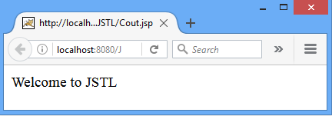
JSTL: Core tag library
1 | c:out | It display the result of an expression, similar to the way <%=...%> tag work.
<%@ taglib uri= "http://java.sun.com/jsp/jstl/core" prefix="c" %>
<html>
<body>
<c:out value="${'Welcome to JSTL'}"/>
</body>
</html>

Slide 110
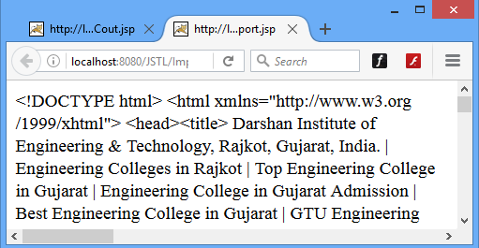
JSTL: Core tag library
2 | c:import | It is similar to jsp 'include', with an additional feature of including the content of any resource either within server or outside the server.
<%@ taglib uri= "http://java.sun.com/jsp/jstl/core" prefix="c" %>
<html>
<body>
<c:import var="data" url="http://www.darshan.ac.in"/>
<c:out value="${data}"/>
</body>
</html>

Slide 111
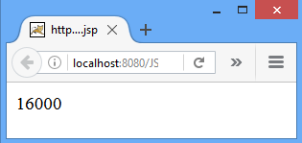
JSTL: Core tag library
3 | c:set | It is used to set the result of an expression evaluated in a 'scope'. This tag is similar to jsp:setProperty action tag.
<%@ taglib uri= "http://java.sun.com/jsp/jstl/core" prefix="c" %>
<html>
<body>
<c:set var="Income" scope="session" value="${4000*4}"/>
<c:out value="${Income}"/>
</body>
</html>

Slide 112
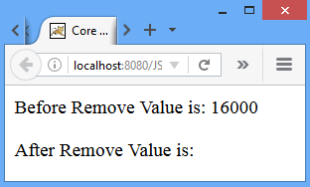
JSTL: Core tag library
4 | c:remove | It is used for removing the specified scoped variable from a particular scope
<%@ taglib uri="http://java.sun.com/jsp/jstl/core" prefix="c" %>
<c:set var="income" scope="session" value="${4000*4}"/>
<p>Before Remove Value is: <c:out value="${income}"/></p>
<c:remove var="income"/>
<p>After Remove Value is: <c:out value="${income}"/></p>

Slide 113
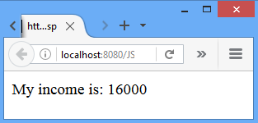
JSTL: Core tag library
5 | c:if | It is conditional tag used for testing the condition and display the body content only if the expression evaluates is true.
<%@ taglib uri="http://java.sun.com/jsp/jstl/core" prefix="c" %>
<c:set var="income" scope="session" value="${4000*4}"/>
<c:if test="${income > 8000}">
<p>My income is: <c:out value="${income}"/></p>
</c:if>

Slide 114
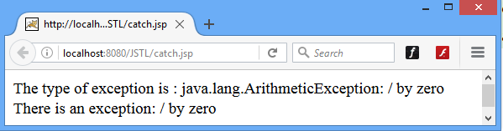
JSTL: Core tag library
6 | c:catch | It is used for catching any Throwable exceptions that occurs in the body and optionally exposes it.
<%@ taglib uri="http://java.sun.com/jsp/jstl/core" prefix="c" %>
<c:catch var ="MyException">
<% int x = 2/0;%>
</c:catch>
<c:if test = "${MyException != null}">
<p>The type of exception is : ${MyException}<br />
There is an exception: ${MyException.message}</p>
</c:if>

Slide 115
JSTL: Core tag library
7 | c:choose | It is a conditional tag that establish a context for mutually exclusive conditional operations. It works like a Java switch statement in which we choose between a numbers of alternatives.
c:when | It is subtag of <choose > that will include its body if the condition evaluated be 'true'.
c:otherwise | It is also subtag of < choose > it follows <when> tags and runs only if all the prior condition evaluated is 'false'.
The <c:when> and <c:otherwise> works like if-else statement.
But it must be placed inside <c:choose tag>.

Slide 116
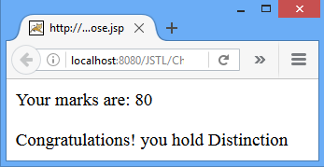
JSTL: Core tag library
Choose.jsp
<%@ taglib uri="http://java.sun.com/jsp/jstl/core" prefix="c" %>
<c:set var="marks" scope="session" value="${80}"/>
<p>Your marks are: <c:out value="${marks}"/></p>
<c:choose>
<c:when test="${marks <= 35}"> Sorry! you are fail.
</c:when>
<c:when test="${marks > 75}">
Congratulations! you hold Distinction
</c:when>
<c:otherwise>
Sorry! Result is unavailable.
</c:otherwise>
</c:choose>

Slide 117
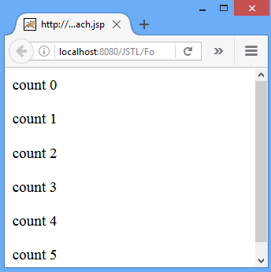
JSTL: Core tag library
8 | c:forEach | It is an iteration tag used for repeating the nested body content for fixed number of times. The < c:for each > tag is most commonly used tag because it iterates over a collection of object.
<%@ taglib uri= "http://java.sun.com/jsp/jstl/core" prefix="c" %>
<html> <body>
<c:forEach var="i" begin="0" end="5">
count <c:out value="${i}"/><p>
</c:forEach>
</body> </html>

Slide 118
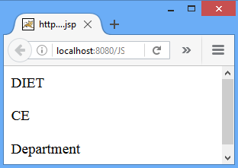
JSTL: Core tag library
9 | c:forTokens | It iterates over tokens which is separated by the supplied delimeters.
<%@ taglib uri= "http://java.sun.com/jsp/jstl/core" prefix="c" %>
<c:forTokens items="DIET-CE-Department" delims="-" var="name">
<c:out value="${name}"/><p>
</c:forTokens>

Slide 119
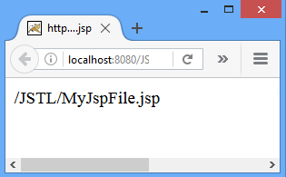
JSTL: Core tag library
10 | c:url | This tag creates a URL with optional query parameter. It is used for url encoding or url formatting. This tag automatically performs the URL rewriting operation.
<%@ taglib uri= "http://java.sun.com/jsp/jstl/core"
prefix="c" %>
<c:url value="/MyJspFile.jsp"/>

Slide 120
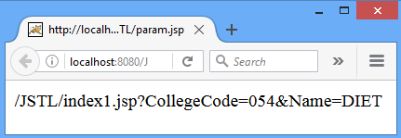
JSTL: Core tag library
11 | c:param | It allow the proper URL request parameter to be specified within URL and it automatically perform any necessary URL encoding.
<%@ taglib uri= "http://java.sun.com/jsp/jstl/core" prefix="c" %>
<c:url value="/index1.jsp" var="completeURL">
<c:param name="CollegeCode" value="054"/>
<c:param name="Name" value="DIET"/>
</c:url>
${completeURL}

Slide 121
JSTL: Core tag library
12 | c:redirect | tag redirects the browser to a new URL. It is used for redirecting the browser to an alternate URL by using automatic URL rewriting.
<%@ taglib uri="http://java.sun.com/jsp/jstl/core" prefix="c" %>
<c:redirect url="http://darshan.ac.in"/>

Slide 122
JSP - Standard Tag Library (JSTL)
Tag Library | Function | URI | prefix
Core tag library | Variable support Flow Control Iterator URL management Miscellaneous | http://java.sun.com/jsp/jstl/core | c
Functions Library | Collection length String manipulation | http://java.sun.com/jsp/jstl/functions | fn
Internationalization tag library | Message formatting Number and date formatting | http://java.sun.com/jsp/jstl/fmt | fmt
SQL tag library | Database manipulation | http://java.sun.com/jsp/jstl/sql | sql
XML tag library | Flow control Transformation | http://java.sun.com/jsp/jstl/xml | x

Slide 123
JSTL -Function Tags List
The JSTL function provides a number of standard functions, most of these functions are common string manipulation functions.
Syntax:
<%@ taglib uri="http://java.sun.com/jsp/jstl/functions" prefix="fn" %>

Slide 124
JSTL -Function Tags List
fn:contains | It is used to test if an input string containing the specified substring in a program.
fn:containsIgnoreCase | It is used to test if an input string contains the specified substring as a case insensitive way.
fn:endsWith | It is used to test if an input string ends with the specified suffix.
fn:startsWith | It is used for checking whether the given string is started with a particular string value.
fn:toLowerCase | It converts all the characters of a string to lower case.
fn:toUpperCase | It converts all the characters of a string to upper case.
fn:length | It returns the number of characters inside a string, or the number of items in a collection.
fn:indexOf | It returns an index within a string of first occurrence of a specified substring.
fn:substring | It returns the subset of a string according to the given start and end position.
fn:replace | It replaces all the occurrence of a string with another string sequence.
fn:trim | It removes the blank spaces from both the ends of a string.

Slide 125
JSTL -Function Tags List
Function.jsp
<%@ taglib uri="http://java.sun.com/jsp/jstl/core" prefix="c" %>
<%@ taglib uri="http://java.sun.com/jsp/jstl/functions" prefix="fn" %>
<c:set var="String1" value=" Welcome to diet CE Department "/>
<c:if test="${fn:contains(String1, 'diet')}">
<p>Found diet string<p>
<p>Index of DIET : ${fn:indexOf(String1, "diet")}</p>
<c:set var="str2" value="${fn:trim(String1)}" />
<p>trim : ${str2}</p>
The string starts with "Welcome": ${fn:startsWith(String1, 'Welcome')}
<p>To UPPER CASE: ${fn:toUpperCase(String1)}</p>
<p>To lower case: ${fn:toLowerCase(String1)}</p>
</c:if>

Slide 126
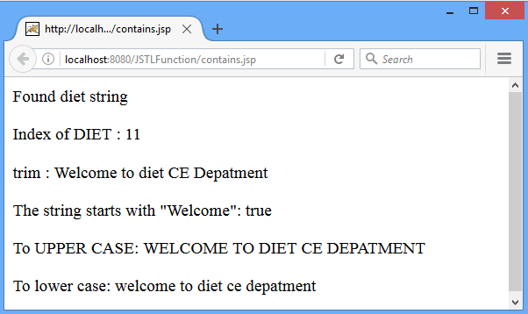
JSTL -Function Tags List

Slide 127
JSP - Standard Tag Library (JSTL)
Tag Library | Function | URI | prefix
Core tag library | Variable support Flow Control Iterator URL management Miscellaneous | http://java.sun.com/jsp/jstl/core | c
Functions Library | Collection length String manipulation | http://java.sun.com/jsp/jstl/functions | fn
Internationalization tag library | Message formatting Number and date formatting | http://java.sun.com/jsp/jstl/fmt | fmt
SQL tag library | Database manipulation | http://java.sun.com/jsp/jstl/sql | sql
XML tag library | Flow control Transformation | http://java.sun.com/jsp/jstl/xml | x

Slide 128
JSTL-Formatting tags
The formatting tags provide support for message formatting, number and date formatting etc.
Syntax
<%@ taglib uri="http://java.sun.com/jsp/jstl/fmt" prefix="fmt"%>

Slide 129
JSTL-Formatting tags
Formatting Tags | Descriptions
fmt:parseNumber | It is used to Parses the string representation of a currency, percentage or number.
fmt:formatNumber | It is used to format the numerical value with specific format or precision.

Slide 130
JSTL-Formatting tags
Number.jsp
<%@ taglib prefix="c" uri="http://java.sun.com/jsp/jstl/core" %>
<%@ taglib prefix="fmt" uri="http://java.sun.com/jsp/jstl/fmt" %>
<c:set var="Amount" value="123123.456789" />
<h3>Parsing Number from String:</h3>
<fmt:parseNumber var="j" type="number" value="${Amount}" />
<p>Amount in parsed integer is: <c:out value="${j}" /></p>

Slide 131
JSTL-Formatting tags
Number.jsp
<h3>Formatting of Number:</h3>
<p> Currency:
<fmt:formatNumber value="${Amount}" type="currency" /></p>
<p>maxIntegerDigits_3:
<fmt:formatNumber type="number" maxIntegerDigits="3" value="${Amount}" /></p>
<p>maxFractionDigits_5:
<fmt:formatNumber type="number" maxFractionDigits="6" value="${Amount}" /></p>
<p>pattern###.###$:
<fmt:formatNumber type="number" pattern="###.###$" value="${Amount}" /></p>

Slide 132
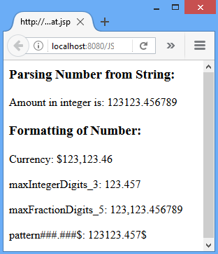
JSTL-Formatting tags

Slide 133
JSTL-Formatting tags
fmt:formatDate | It formats the time and/or date using the supplied pattern and styles.
fmt:parseDate | It parses the string representation of a time and date.
fmt:setTimeZone | It stores the time zone inside a time zone configuration variable.
fmt:timeZone | It specifies a parsing action nested in its body or the time zone for any time formatting.
fmt:message | It display an internationalized message.

Slide 134
JSTL-Formatting tags
TimeZone.jsp
<%@ taglib prefix="c" uri="http://java.sun.com/jsp/jstl/core" %>
<%@ taglib prefix="fmt" uri="http://java.sun.com/jsp/jstl/fmt" %>
<c:set var="date" value="01-01-2019" />
<fmt:parseDate value="${date}" var="parsedDate" pattern="dd-MM-yyyy" />
<p>Date:<c:out value="${parsedDate}" /></p>
<c:set var="Date" value="<%=new java.util.Date()%>" />
<p> Formatted Time :
<fmt:formatDate type="time" value="${Date}" /> </p>
<p> Formatted Date :
<fmt:formatDate type="date" value="${Date}" /> </p>

Slide 135
JSTL-Formatting tags
TimeZone.jsp
<%-- for setting time zone --%>
<fmt:setTimeZone value="IST" />
<c:set var="date" value="<%=new java.util.Date()%>" />
<p><b>Date and Time in Indian Standard Time(IST) Zone:</b> <fmt:formatDate value="${date}"
type="both" timeStyle="long" dateStyle="long" /> </p>
<fmt:setTimeZone value="GMT-10" />
<p><b>Date and Time in GMT-10 time Zone: </b><fmt:formatDate value="${date}"
type="both" timeStyle="long" dateStyle="long" /> </p>

Slide 136
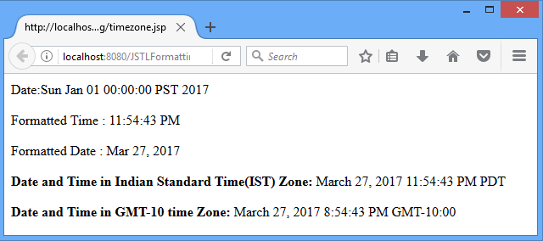
JSTL-Formatting tags

Slide 137
JSP - Standard Tag Library (JSTL)
Tag Library | Function | URI | prefix
Core tag library | Variable support Flow Control Iterator URL management Miscellaneous | http://java.sun.com/jsp/jstl/core | c
Functions Library | Collection length String manipulation | http://java.sun.com/jsp/jstl/functions | fn
Internationalization tag library | Message formatting Number and date formatting | http://java.sun.com/jsp/jstl/fmt | fmt
SQL tag library | Database manipulation | http://java.sun.com/jsp/jstl/sql | sql
XML tag library | Flow control Transformation | http://java.sun.com/jsp/jstl/xml | x

Slide 138
JSTL SQL Tags List
The JSTL sql tags provide SQL support.
Syntax:
<%@ taglib uri="http://java.sun.com/jsp/jstl/sql"
prefix="sql"
%>

Slide 139
JSTL SQL Tags List
SQL Tags | Descriptions
sql:query | It is used for executing the SQL query defined in its sql attribute or the body.
sql:setDataSource | It is used for creating a simple data source suitable only for prototyping.
sql:update | It is used for executing the SQL update defined in its sql attribute or in the tag body.
sql:param | It is used to set the parameter in an SQL statement to the specified value.
sql:dateParam | It is used to set the parameter in an SQL statement to a specified java.util.Date value.
sql:transaction | It is used to provide the nested database action with a common connection.

Slide 140
JSTL SQL Tags List
Sql.jsp
<%@ taglib uri="http://java.sun.com/jsp/jstl/core" prefix="c" %>
<%@ taglib uri="http://java.sun.com/jsp/jstl/sql" prefix="sql"%>
<sql:setDataSource var="db" driver="com.mysql.jdbc.Driver"
url="jdbc:mysql://localhost:3306/gtu"
user="root" password="root"/>
<sql:query dataSource="${db}" var="rs">
SELECT * from diet;
</sql:query>

Slide 141
JSTL SQL Tags List
Sql.jsp
<table border="1" width="100%">
<tr>
<td>Enr_no</td>
<td>Name</td>
<td>Branch</td>
</tr>
<c:forEach var="table" items="${rs.rows}">
<tr>
<td><c:out value="${table.Enr_no}"/></td>
<td><c:out value="${table.Name}"/></td>
<td><c:out value="${table.Branch}"/></td>
</tr>
</c:forEach>
</table>

Slide 142
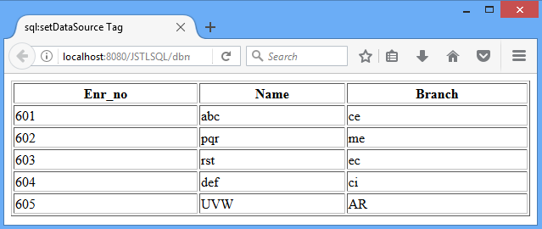
JSTL SQL Tags List

Slide 143
JSP - Standard Tag Library (JSTL)
Tag Library | Function | URI | prefix
Core tag library | Variable support Flow Control Iterator URL management Miscellaneous | http://java.sun.com/jsp/jstl/core | c
Functions Library | Collection length String manipulation | http://java.sun.com/jsp/jstl/functions | fn
Internationalization tag library | Message formatting Number and date formatting | http://java.sun.com/jsp/jstl/fmt | fmt
SQL tag library | Database manipulation | http://java.sun.com/jsp/jstl/sql | sql
XML tag library | Flow control Transformation | http://java.sun.com/jsp/jstl/xml | x

Slide 144
JSTL-XML tag library
The JSTL XML tags are used for providing a JSP-centric way of manipulating and creating XML documents.
The xml tags provide flow control, transformation etc.
Syntax:
<%@ taglib uri="http://java.sun.com/jsp/jstl/xml"
prefix="x" %>

Slide 145
JSTL-XML tag library
XML Tags | Descriptions
x:out | Similar to <%= ... > tag, but for XPath expressions.
x:parse | It is used for parse the XML data specified either in the tag body or an attribute.
x:set | It is used to sets a variable to the value of an XPath expression.
x:choose | It is a conditional tag that establish a context for mutually exclusive conditional operations.
x:when | It is a subtag of that will include its body if the condition evaluated be 'true'.
x:otherwise | It is subtag of that follows tags and runs only if all the prior conditions evaluated be 'false'.
x:if | It is used for evaluating the test XPath expression and if it is true, it will processes its body content.
x:transform | It is used in a XML document for providing the XSL(Extensible Stylesheet Language) transformation.
x:param | It is used along with the transform tag for setting the parameter in the XSLT style sheet.

Slide 146
JSTL-XML tag library
<%@ taglib prefix="c" uri="http://java.sun.com/jsp/jstl/core" %>
<%@ taglib prefix="x" uri="http://java.sun.com/jsp/jstl/xml" %>
<c:set var="myBook">
<books>
<myBook>
<title>TheSecret</title>
<author>RhondaByrne</author>
</myBook>
<myBook>
<title>Meluha</title>
<author>Amish</author>
</myBook>
</books>
</c:set>

Slide 147
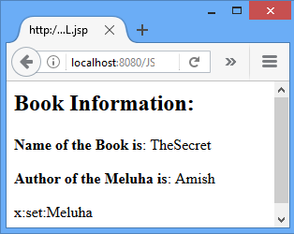
JSTL-XML tag library
<x:parse xml="${myBook}" var="output"/>
<b>Name of the Book is</b>:
<x:out select="$output/books/myBook[1]/title" />
<p><b>Author of the Meluha is</b>:
<x:out select="$output/books/myBook[2]/author" /> </p>
<x:set var="myTitle" select="$output/books/myBook[2]/title"/>
<p>x:set:<x:out select="$myTitle" /></p>

Slide 148
JSP Custom Tag
A custom tag is a user-defined JSP language element.
When a JSP page containing a custom tag is translated into a servlet, the tag is converted to operations on an object called a tag handler.
The Web container then invokes those operations when the JSP page's servlet is executed.
JSP tag extensions let you create new tags that you can insert directly into a JavaServer Page just as you would the built-in tags

Slide 149
How to create Custom Tag?
To create a custom tag we need three things:
1) Tag handler class: In this class we specify what our custom tag will do, when it is used in a JSP page.
2) TLD file: Tag descriptor file where we will specify our tag name, tag handler class and tag attributes.
3) JSP page: A JSP page where we will be using our custom tag
JSP page
Using Custom Tag
TLD file
Defining
-Tag Name
-Tag handler class
Tag handler class
Business Logic of Tag

Slide 150
JSP Custom Tag
JSP page
Using Custom Tag
TLD file
Defining
-Tag Name
-Tag handler class
Tag handler class
Business Logic of Tag

Slide 151
Create the Tag handler class
Define a custom tag named <ex:Hello>
To create a custom JSP tag, you must first create a Java class that acts as a tag handler.
So let us create HelloTag class.

Slide 152
Create the Tag handler class
HelloTag.java
import javax.servlet.jsp.tagext.*;
import javax.servlet.jsp.*;
import java.io.*;
public class HelloTag extends SimpleTagSupport
{
public void doTag() throws JspException, IOException
{
JspWriter out = getJspContext().getOut();
out.println("Hello Custom Tag!");
}
}

Slide 153
JSP Custom Tag
JSP page
Using Custom Tag
TLD file
Defining
-Tag Name
-Tag handler class
Tag handler class
Business Logic of Tag

Slide 154
Create TLD file
Tag Library Descriptor (TLD) file contains information of tag and Tag Hander classes.
It must be contained inside the WEB-INF directory.
mytags.tld (Tag Library Descriptor)
<taglib>
<tlib-version>1.0</tlib-version>
<jsp-version>2.0</jsp-version>
<uri>WEB-INF/tlds/mytags.tld</uri>
<tag>
<name>Hello</name>
<tag-class>MyPackage.HelloTag</tag-class>
<body-content>empty</body-content>
</tag>
</taglib>

Slide 155
JSP Custom Tag
JSP page
Using Custom Tag
TLD file
Defining
-Tag Name
-Tag handler class
Tag handler class
Business Logic of Tag

Slide 156
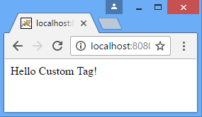
JSP page
<%@taglib prefix="ex"
uri="WEB-INF/tlds/mytags.tld"%>
<html>
<body>
<ex:Hello/>
</body>
</html>

