Slide 1
MANAGEMENT INFORMATION SYSTEM
UNIT-1

Slide 2
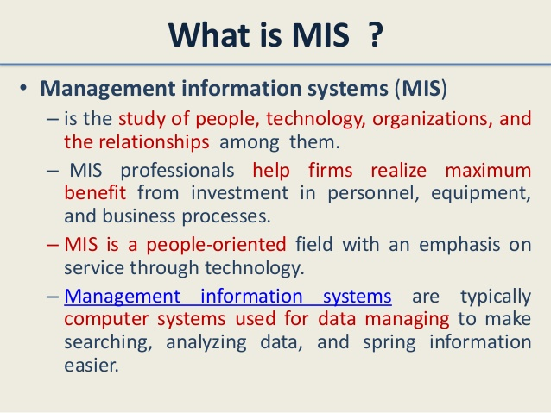

Slide 3
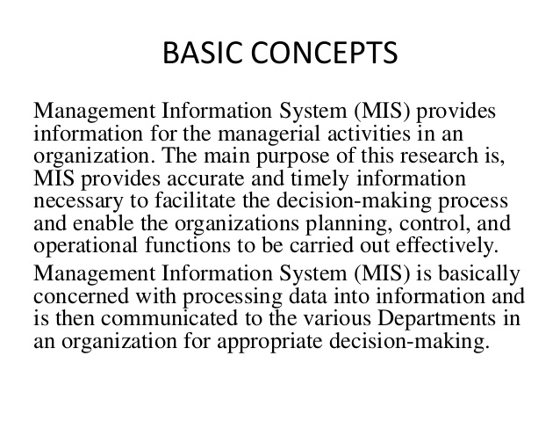

Slide 4
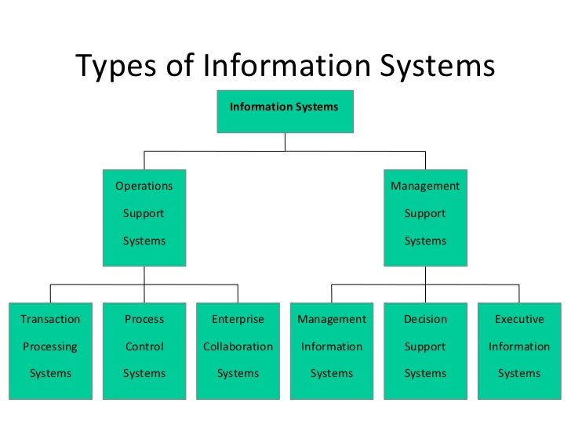

Slide 5
Types of the System in the Management Information Systems
1. Conceptual Systems
a. Are theoretical and explanatory in the nature.
b. Provide the much needed clarification.
c. Provide theoretical framework for which there may or may not be any real life counterpart.
d. E.g. of such systems can be philosophy, theology etc.
2. Empirical Systems
a. Are very practical, specific and also very operational in the nature.
b. Can be based on the conceptual system.
c. Examination system, surgery act as very good examples of the empirical systems.
3. Open Systems
a. Involve continuous interaction with the environment.
b. So exchanges the information, material, energy with the environment.
c. Is open and also self organizing in the nature.
d. Is also adoptive or adaptive to the changing environment as it is flexible.
4. Closed Systems
b. Is rigid in nature.
c. Is not at all amenable to the change.
d. Is also self contained.
e. Is somewhat isolated in the nature.
f. Is having a well defined boundary.
g. Is not at all adaptive in the nature.

Slide 6
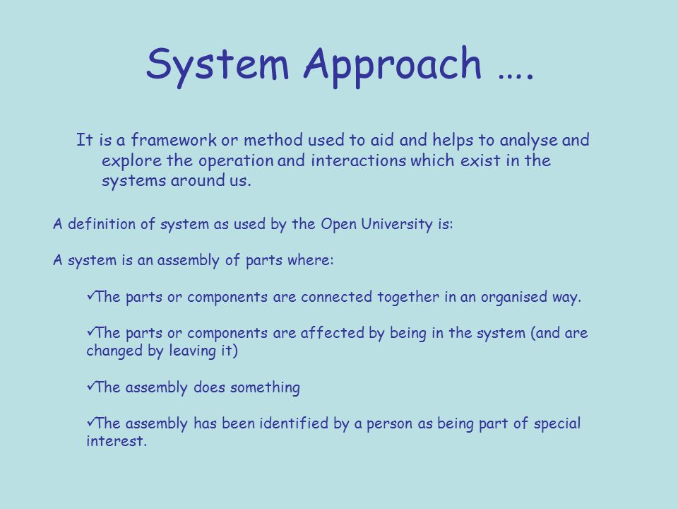

Slide 7
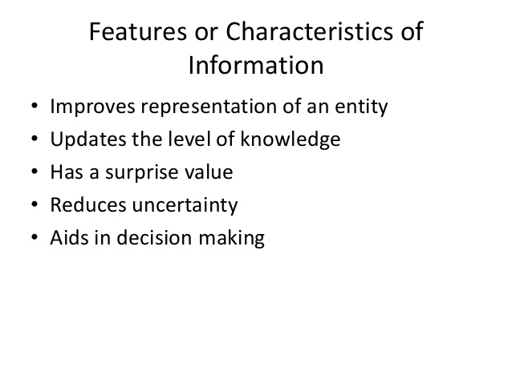

Slide 8
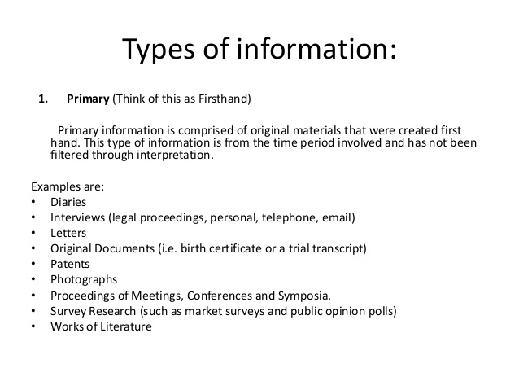

Slide 9
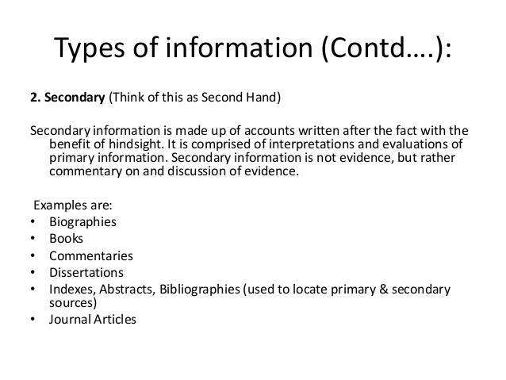

Slide 10
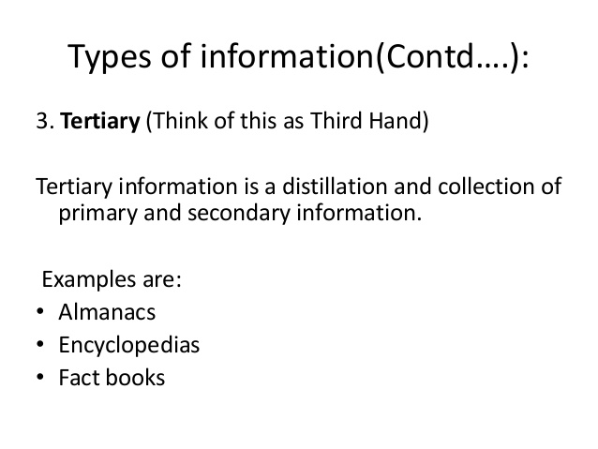

Slide 11
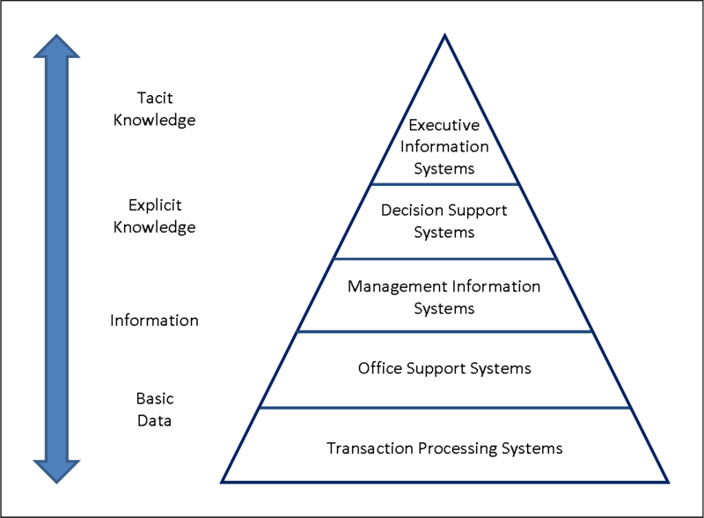

Slide 12
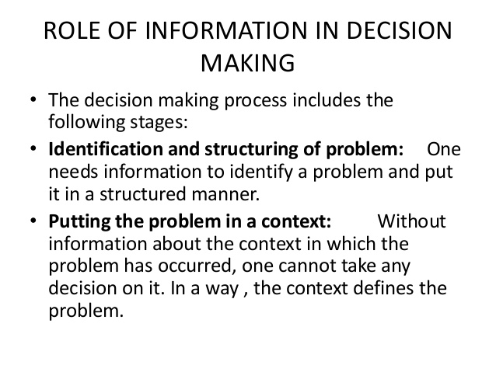

Slide 13
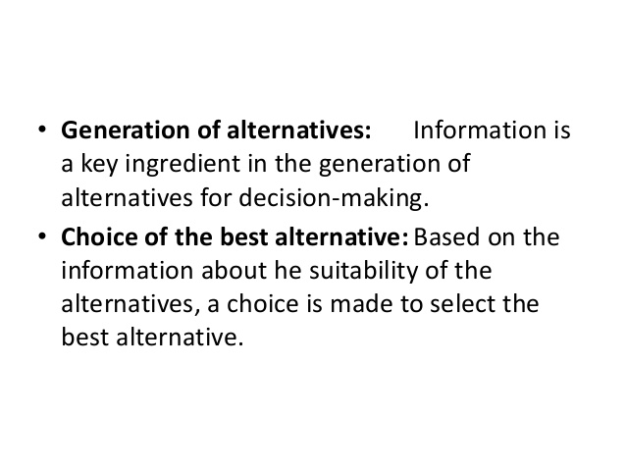

Slide 14
EDP- ELECTRONIC DATA PROCESSING
Electronic data processing (EPD) is the process of collecting data and processing them to produce meaningful information by using computers, processing software and standard database tools. It is the latest technique for processing large chunks of data. It is a fast, efficient and reliable technique.

Slide 15
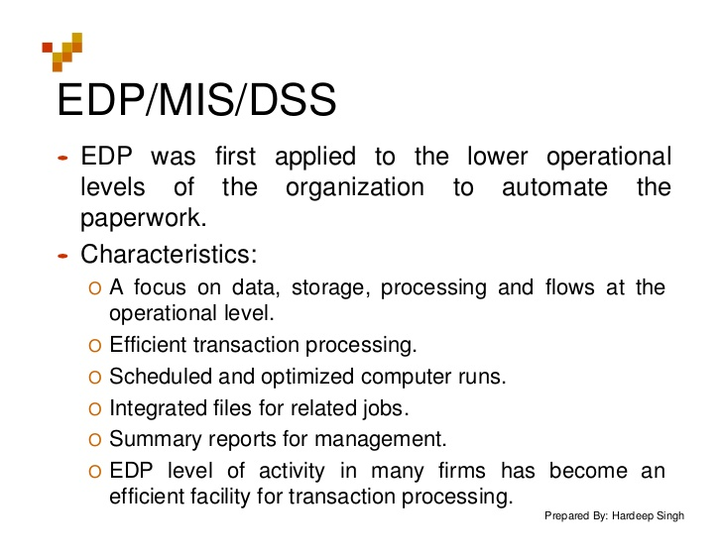

Slide 16
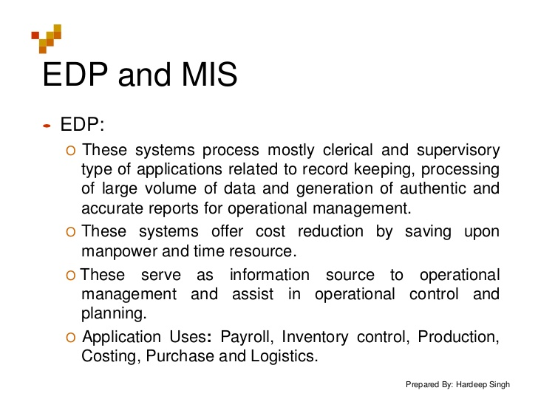

Slide 17
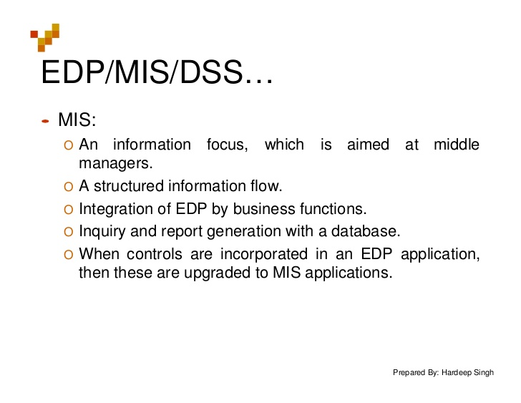

Slide 18
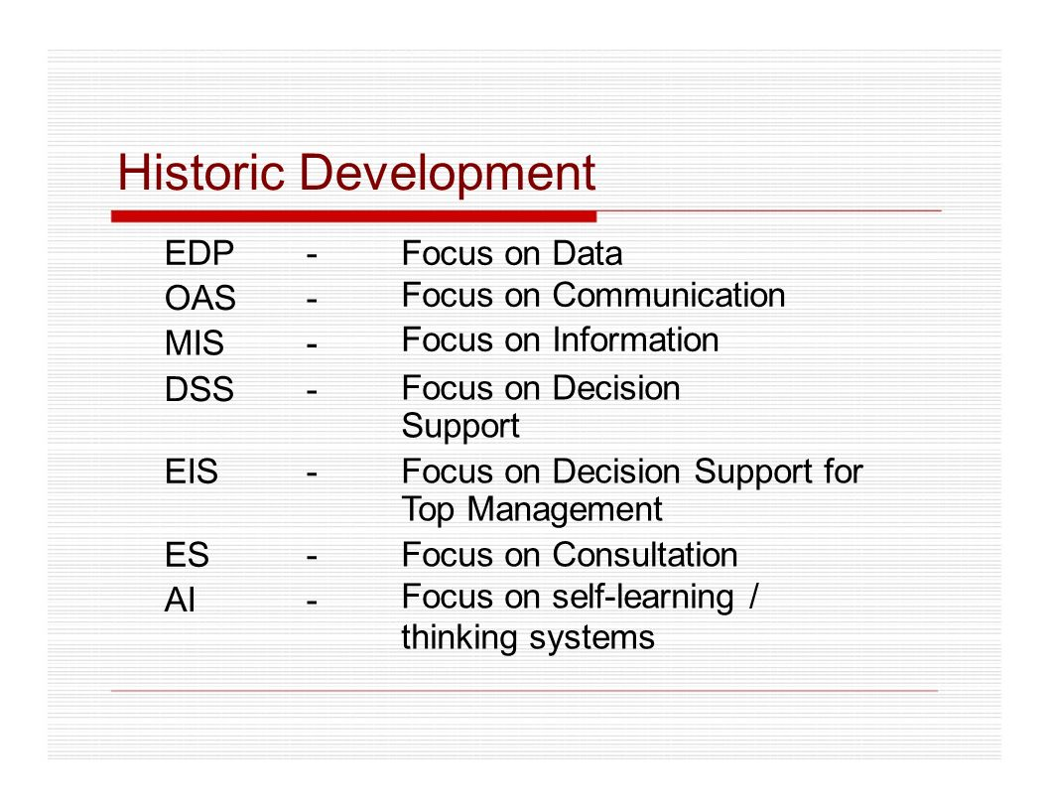

Slide 19
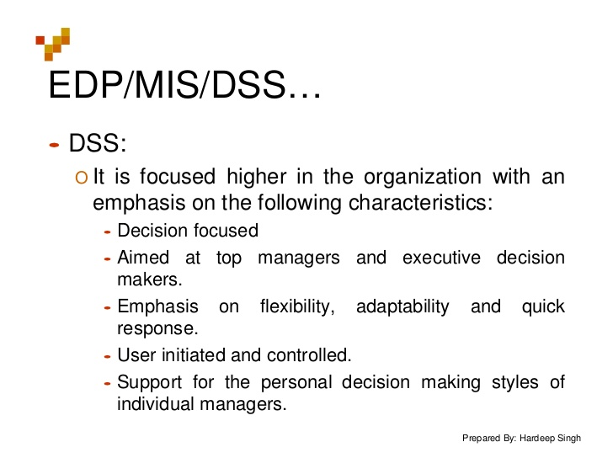

Slide 20
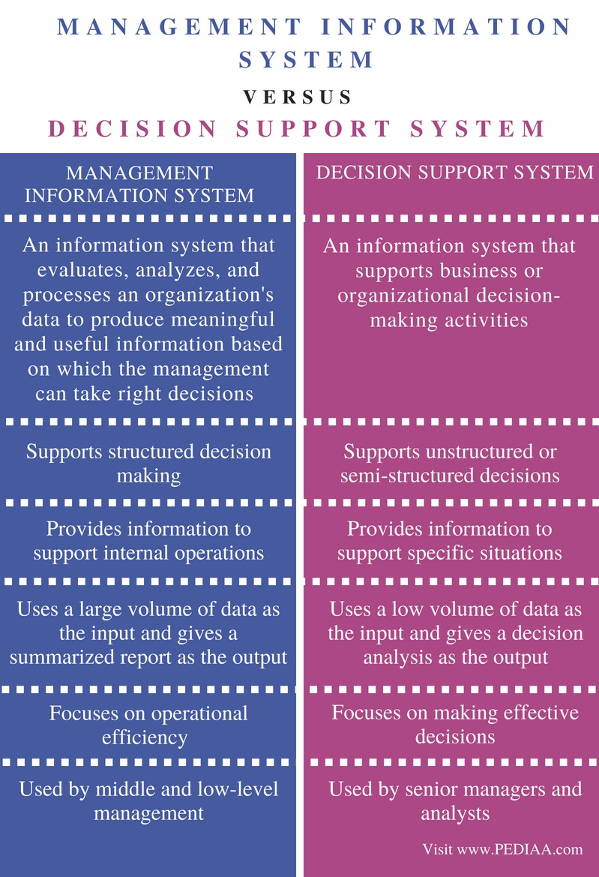

Slide 21
UNIT-2

Slide 22
CHARACTERISTICS OF MIS
Avoid GIGO (Garbage In Garbage Out) : The correct input of a system always gives accurate information. So, GIGO must be avoided.
Information produced should be trust worthy. The processing should not hide vital information which may point out the efficiency of some individuals.
The information should be complete it should include all data, not partial data.
The information should be timely. Delayed information may sometimes be of no use. So, whenever it should be required it should be available.
The information should be presented in such a way that manager may immediately perceives its significance. The graphical presentation of information is a very effective way.
Information should be designed according to the needs of the user and be relevant to him. Because irrelevant information always waste a lot of managers time.

Slide 23
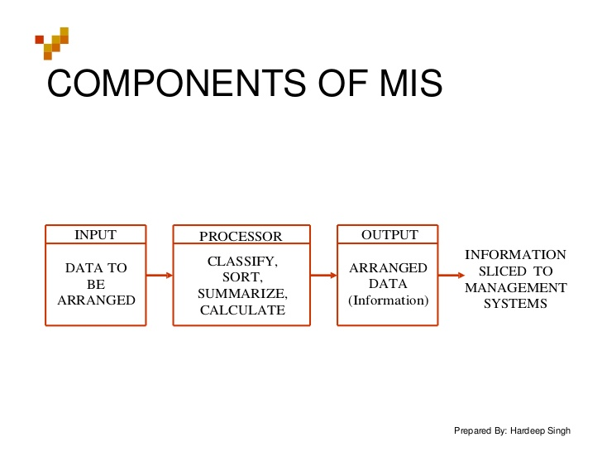

Slide 24
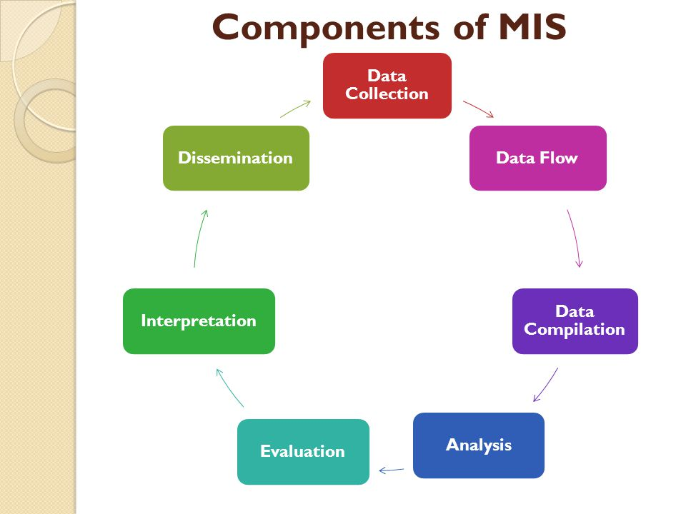

Slide 25
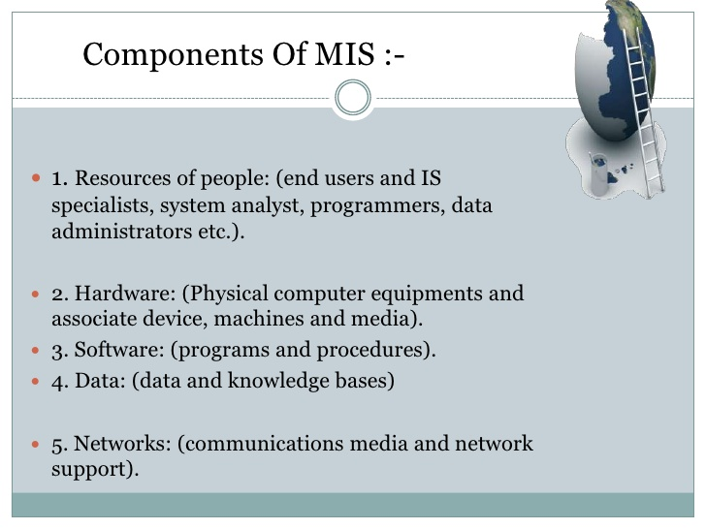

Slide 26
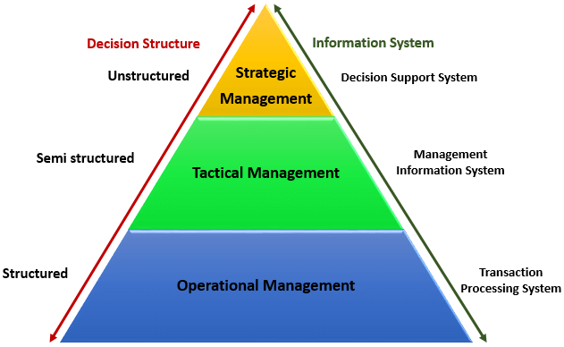
Information requirements & Levels of Management

Slide 27
MANAGEMENT STRUCTURE
In management structure we have three levels.
Top Level
Middle Level and
Line Managers(Operating Management)
A graphical representation of management structure is known as organisation chart.

Slide 28
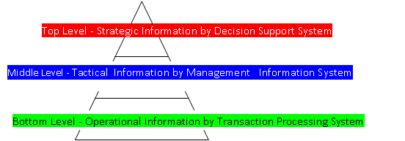

Slide 29
Top Level : Top Management performs the strategic planning processes. The basic function in strategic planning are to establishes the polices, plans, and objectives of the company, as well as a general budget framework under which the various departments will operate. These factors are passes down to middle level or management.
Middle Level : Middle Management manages the management control processes (tactical planning processes). The middle level translate the factors passed by top management into specific revenue, cost, and profit goals using tactical planning. These are reviewed, analysed and modified in accordance with the overall planes and policies untill agreement is reached. Then middle management, issues the specific schedules and measurement scales to operating level.
Line Managers : Line managers manages the operational planning process. This level has the job of producing the goods and services required to meet the revenue and profit goals, which in turn will enable the company to reach its overall plans and objectives.
Hence, we can say in simple words the middle level managers reports to the top level manager who is the overall incharge of the organisation. The middle level managers have many assistants who are responsible for specific day to day operations. They are known as line managers.

Slide 30
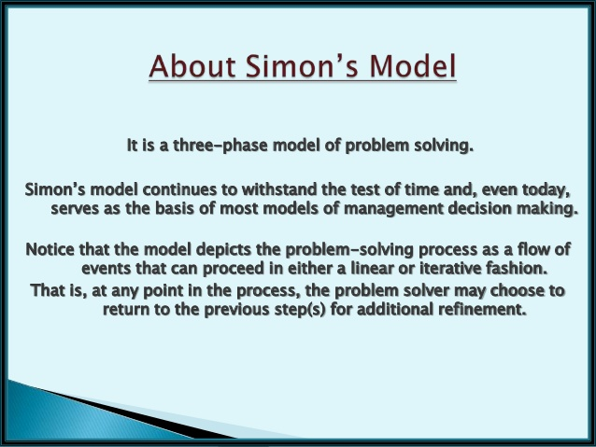

Slide 31
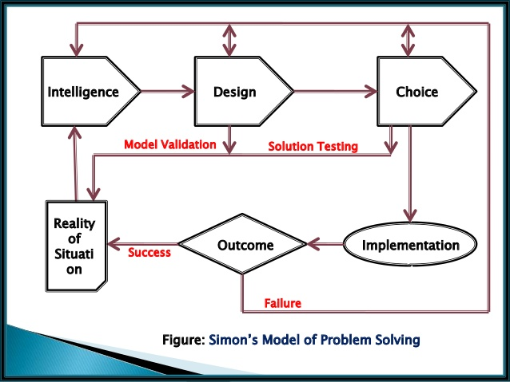

Slide 32
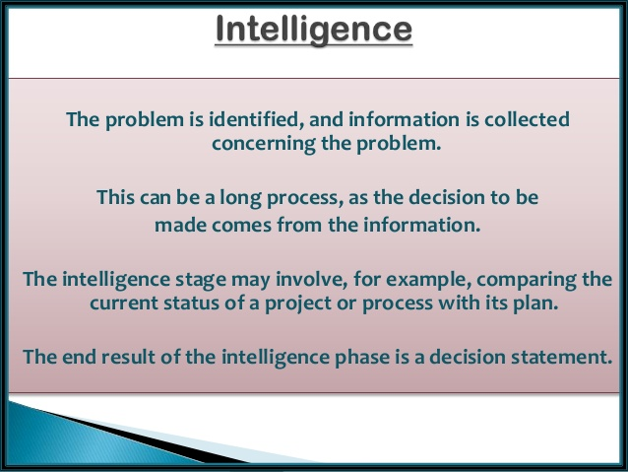

Slide 33
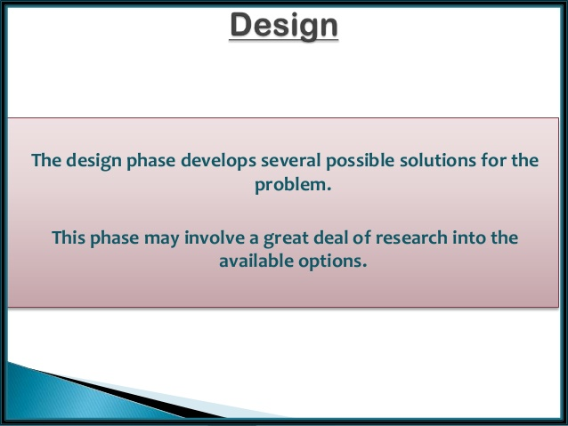

Slide 34


Slide 35
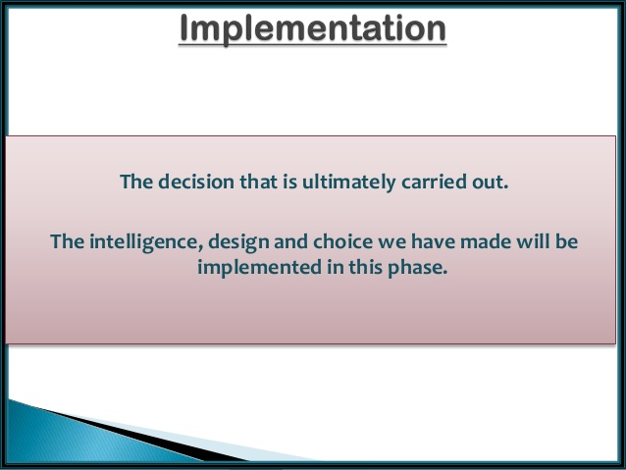

Slide 36
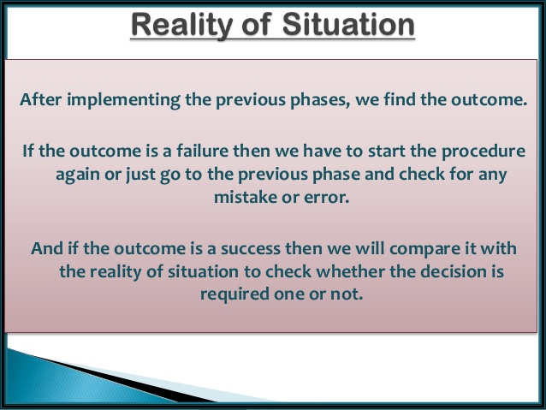

Slide 37
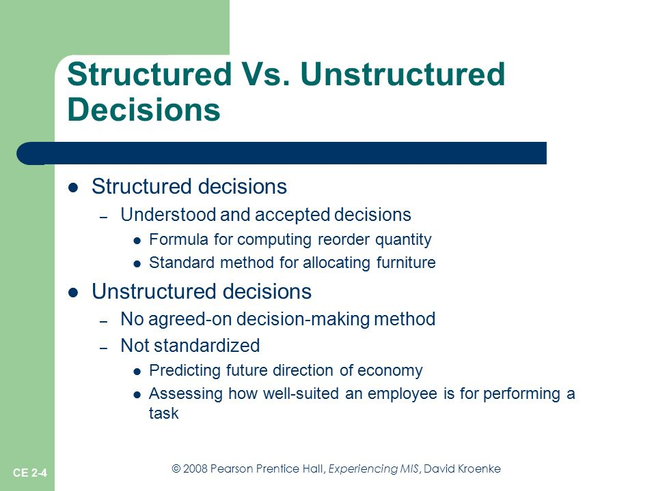

Slide 38
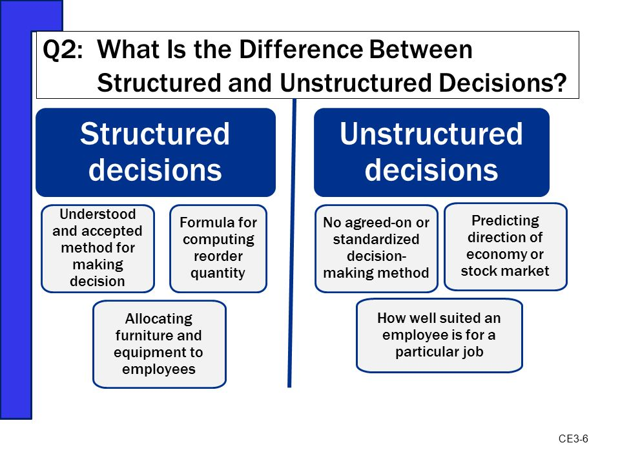

Slide 39
Formal Information System:
A formal information system is based on the organisation represented by the organization chart. The chart is a map of position and their authority relationship,indicated by boxes and connected by straight lines. it is concerned with the pattern of authority, communication and work flow.
Informal Information System:
The informal information system is employee based system design to meet personnel and vocational needs and to help in the solution of work-related problems. it also funnels information upward through indirect channels. In this way, it is considered to be a useful system because it works within the framework of the business and its stated policies.

Slide 40
Unit-3

Slide 41
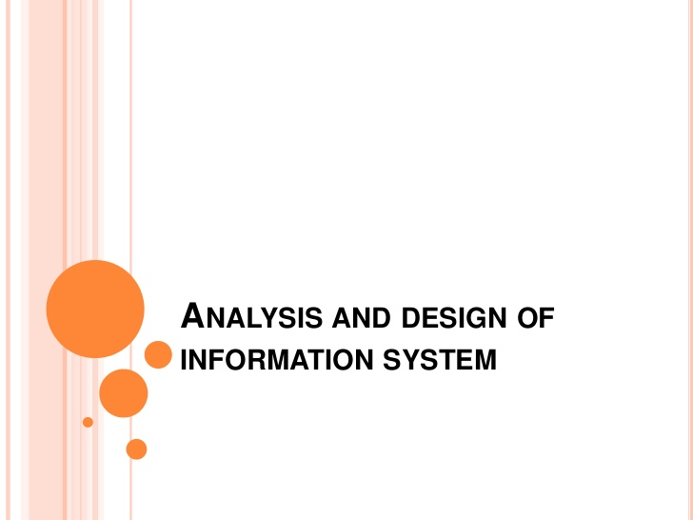

Slide 42
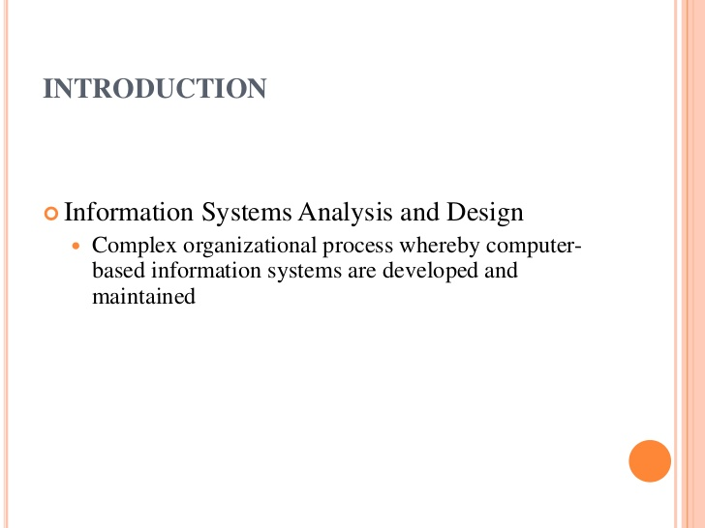

Slide 43
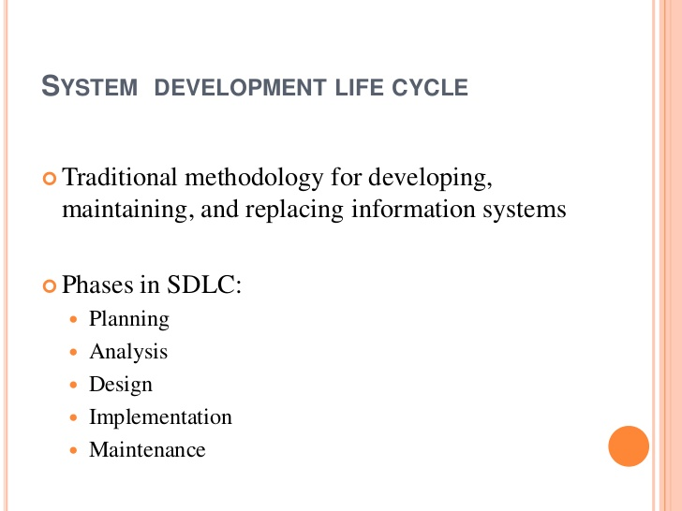

Slide 44
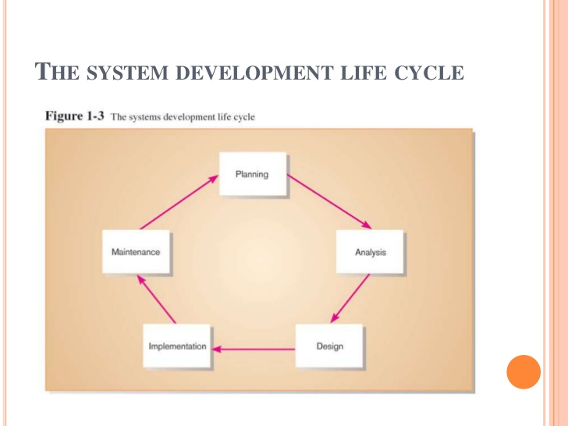

Slide 45
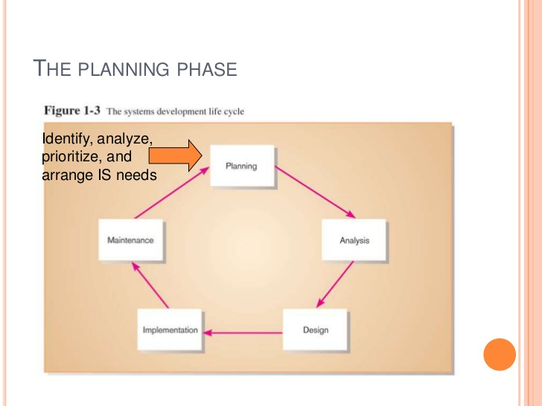

Slide 46
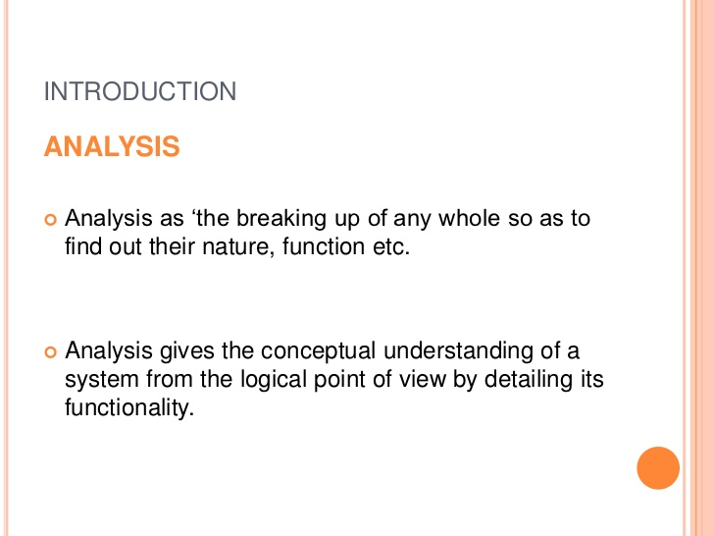

Slide 47
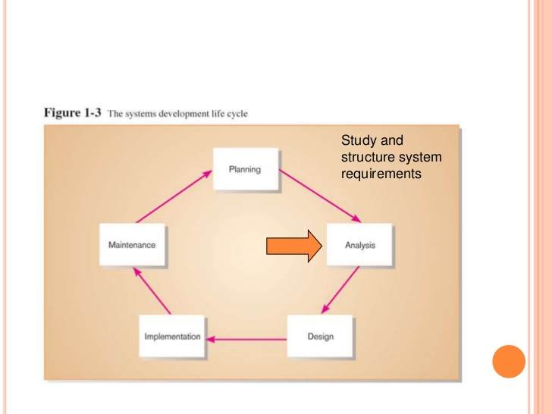

Slide 48
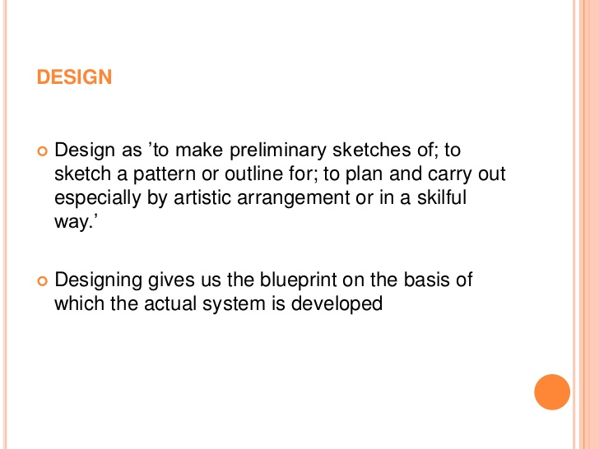

Slide 49
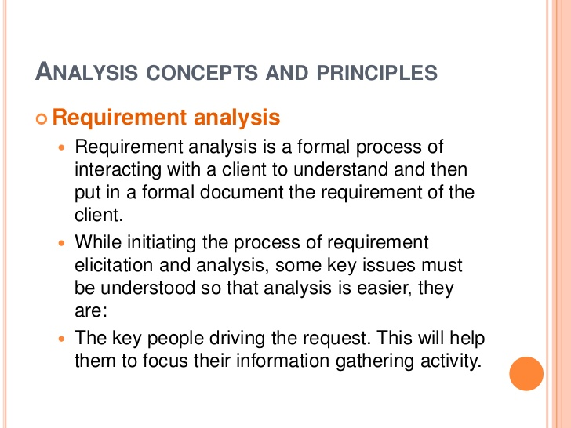

Slide 50
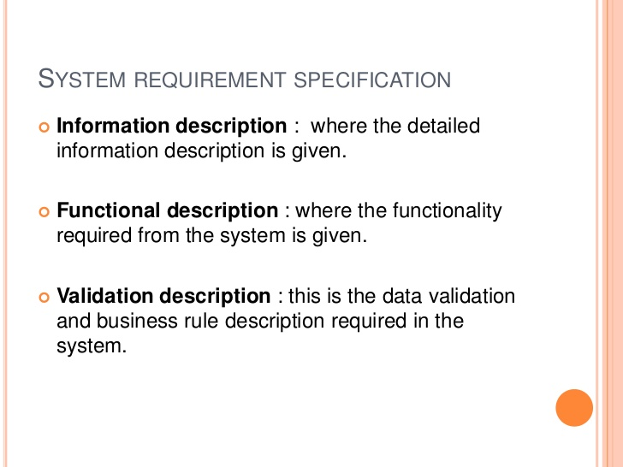

Slide 51
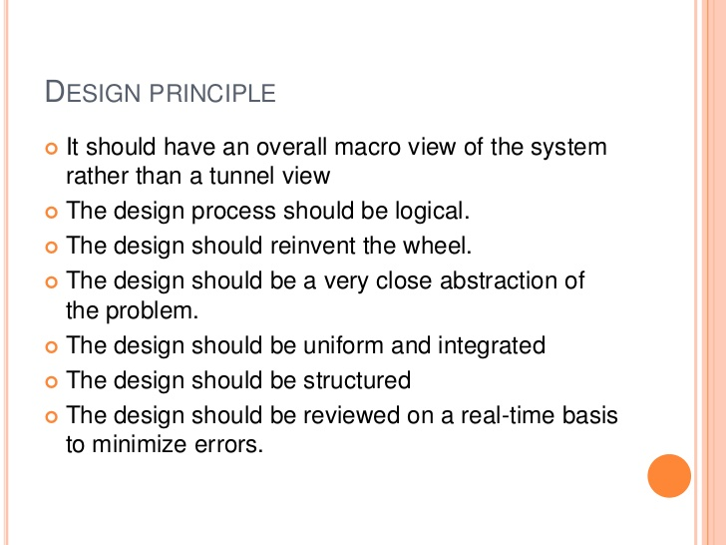

Slide 52
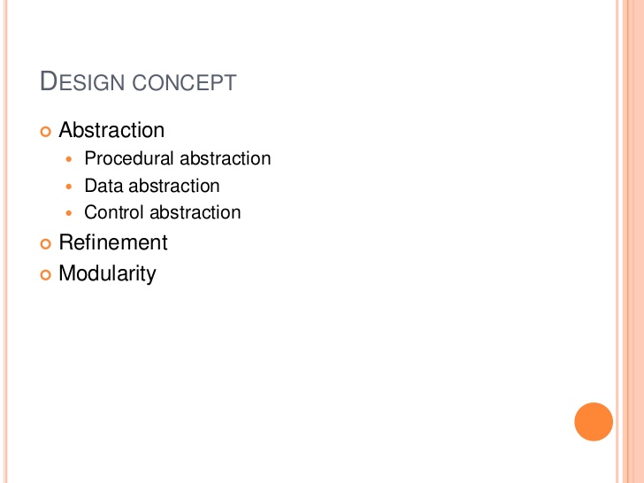

Slide 53
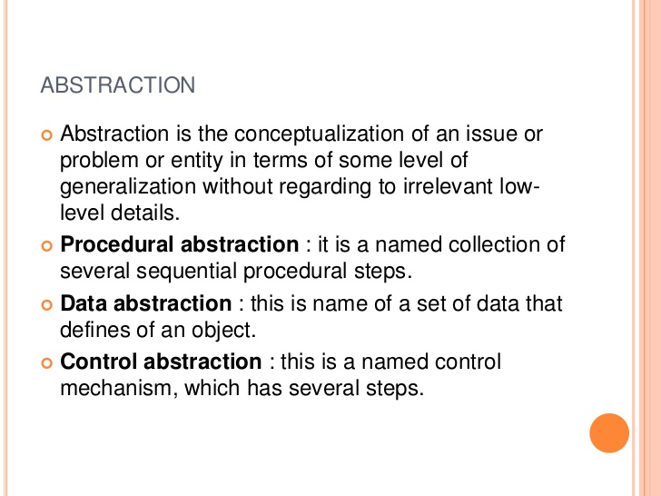

Slide 54
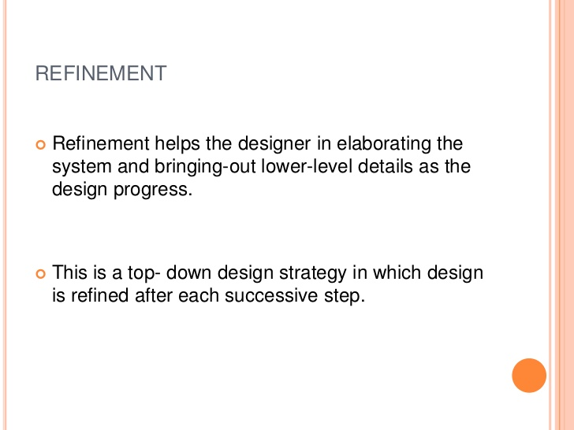

Slide 55
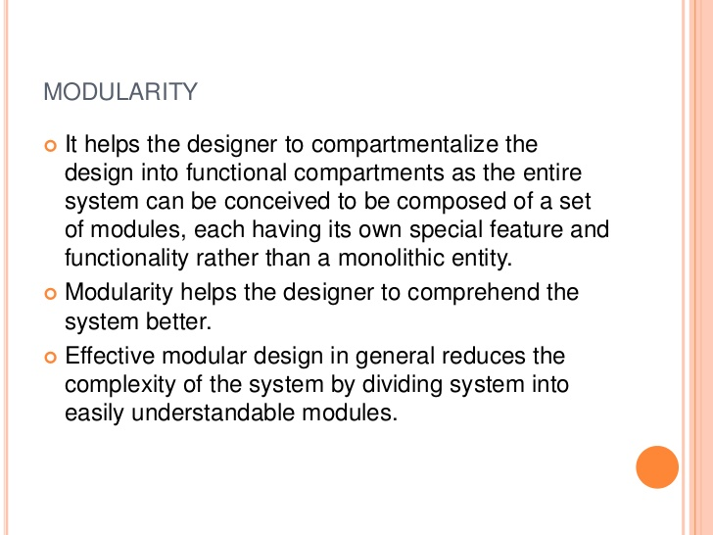

Slide 56
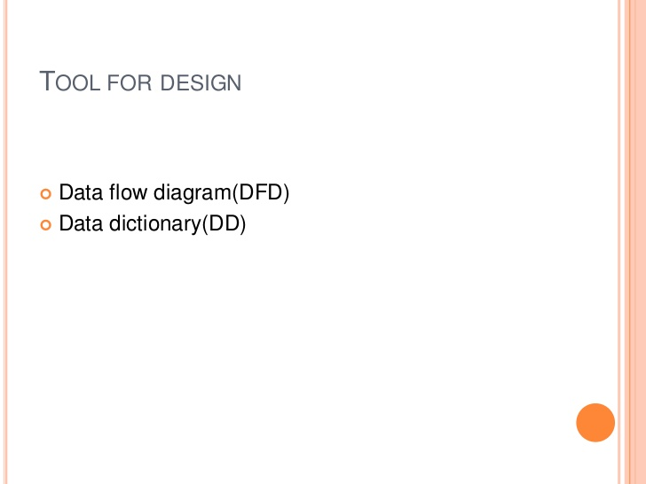

Slide 57
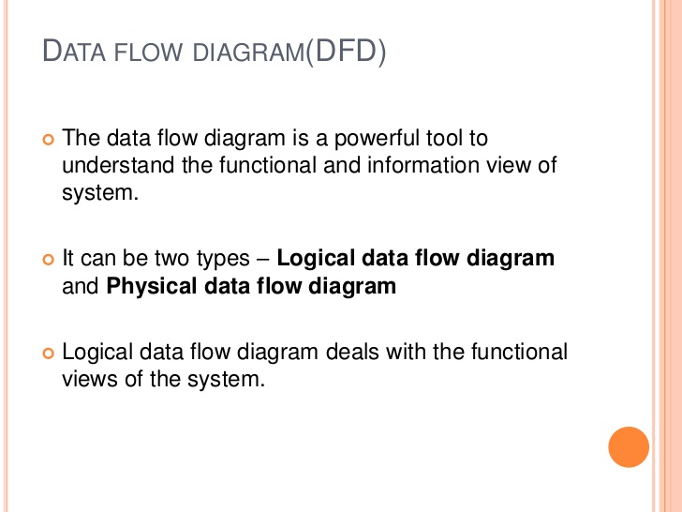

Slide 58
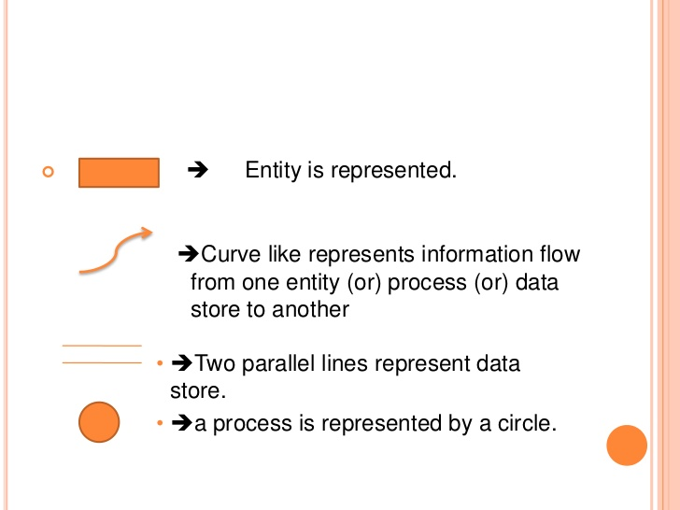

Slide 59
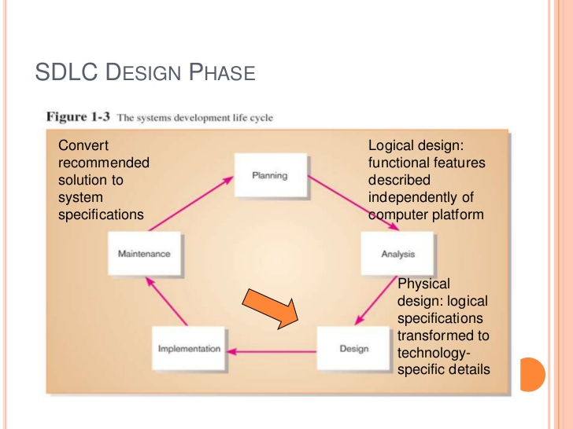

Slide 60
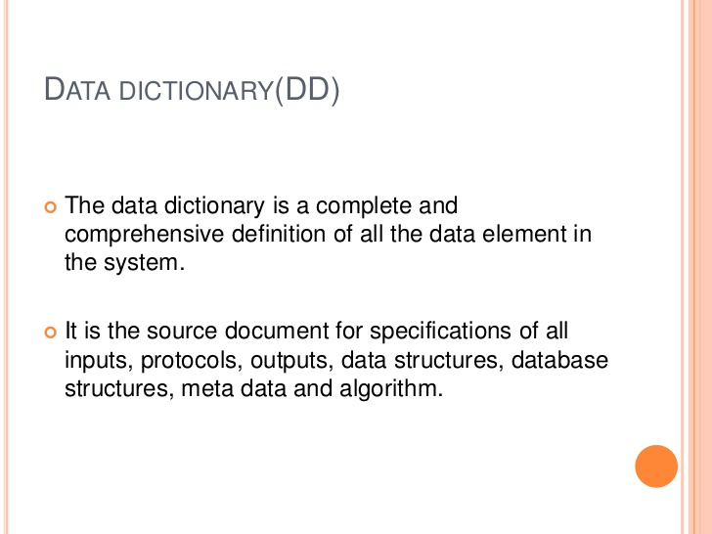

Slide 61


Slide 62


Slide 63
Unit-4

Slide 64


Slide 65


Slide 66


Slide 67


Slide 68


Slide 69


Slide 70


Slide 71


