Slide 1
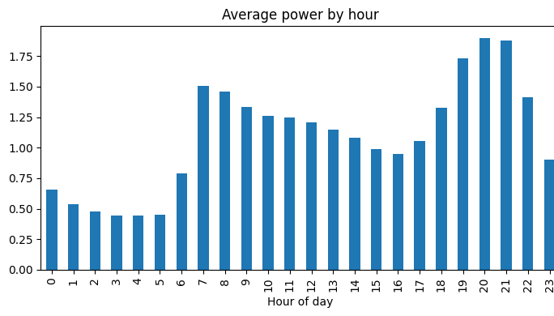
Household Electricity Consumption Forecasting Using Machine Learning
B.Tech Predictive Analytics Project
Abhinava Akash Kotha
PRN: 23070521075
B.Tech Computer Science (Honours in AI/ML), Semester 7
Symbiosis Institute of Technology, Nagpur
Course: Predictive Analytics
Dataset: UCI Household Electric Power Consumption
Average power by hour of day (from the notebook)
Notes:
Introduce yourself and the project. The goal is to predict how much electricity one household will use in the next hour. The chart shows the daily pattern in the data: low at night, peaks in the morning and evening.

Slide 2
Problem Statement
Why forecast household electricity use?
Input: recent history
Past usage, hour, day, month
Helps suppliers plan electricity supply
Supports smart homes and demand response
Helps households understand their own usage
One household's usage is spiky and hard to predict
Machine learning model
Learns patterns from past data
Output: next hour
Mean active power (kW)
Question: how much electricity will this household use in the next hour?
Notes:
Explain why forecasting is useful. The model looks at recent usage and calendar information and predicts the average power in the next hour. Remind the audience this is a single household, so usage changes quickly.

Slide 3
Dataset
UCI Individual Household Electric Power Consumption Dataset
2,075,259
2006–2010
34,168
33,999
raw minute-level records
Dec 2006 to Nov 2010
hourly records
rows used for modelling
Target (what we predict)
Measurements recorded (7)
Mean active power (kW)
For the next hour
Active and reactive power, voltage, current
Three sub-meter readings
One household only
Notes:
The data come from one household and are recorded every minute. After averaging to hours we have 34,168 records, and 33,999 rows after creating the features.

Slide 4
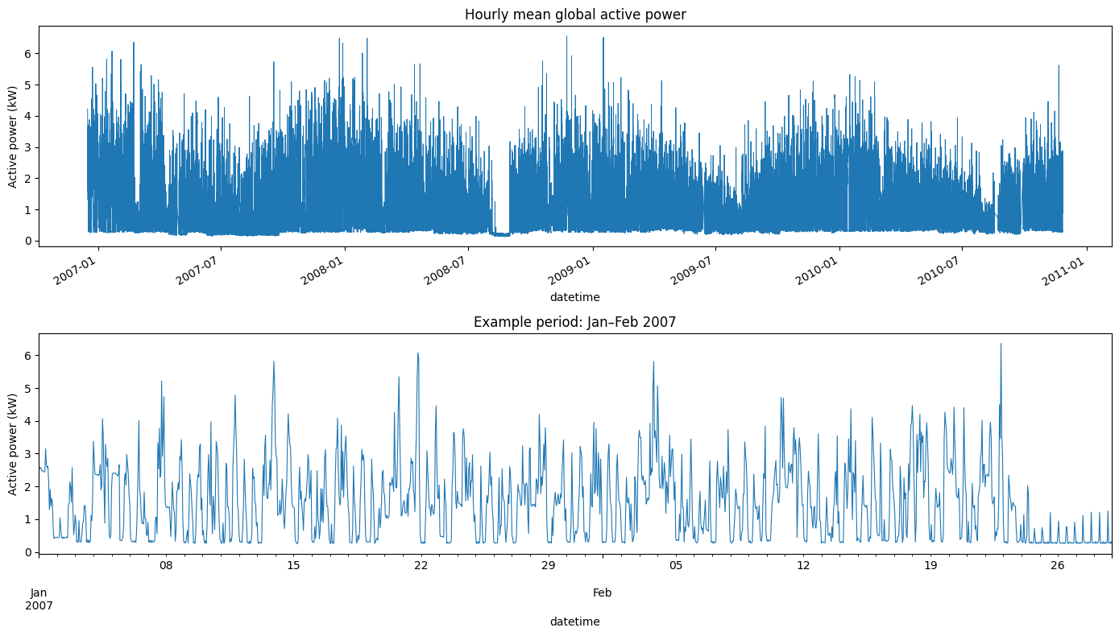
Data Understanding and Preprocessing
Missing values: 25,979 per column (about 1.25%), marked “?”
No duplicate rows found
Date + Time joined into one datetime, sorted
Hourly average: 2,075,259 minute records became 34,168 hourly records
Outliers kept, because high usage can be real
Hourly mean active power (notebook plot): a clear repeating daily pattern with spikes
Notes:
Explain that missing values were marked with a question mark, about 1.25 percent of rows, and were ignored when averaging. Minute data was averaged into hourly values. The plot shows the repeating daily pattern.

Slide 5
Predictive Modelling Workflow (KDD)
1
2
3
4
Problem definition
Predict next-hour power
Data understanding
UCI data, 9 columns
Preprocessing
Missing values, hourly mean
EDA
Daily and weekly patterns
5
6
7
8
Feature engineering
Calendar, lag, rolling
Model development
6 models compared
Evaluation
Time split, 4 metrics
Interpretation
Feature importance
Each step prepares the data or results for the next one.
Notes:
Walk through the eight steps in order, row by row. This follows the Knowledge Discovery in Databases process: understand the problem, prepare the data, build models, check them and interpret the results.

Slide 6
Feature Engineering and Models
14 features (past data only)
6 approaches compared
Calendar (5)
Hour, day of week, day of month, month, weekend flag
Lag (6)
Usage 1, 2, 3, 24, 48 and 168 hours earlier
Rolling statistics (3)
Mean of last 3 h, mean and spread of last 24 h
Baseline (training mean)
Linear Regression
Ridge Regression
Random Forest
Extra Trees
Hist Gradient Boosting
All models use the same features and the same training data.
Notes:
Calendar features tell the model the time of day and week. Lag features give recent and same-time-yesterday and last-week usage. Rolling statistics summarize the recent past. The simple baseline predicts the training average and shows how much the other models add.

Slide 7
Evaluation Method
Training
70%
Validation
15%
Test
15%
23,799 rows
Dec 2006 to Sep 2009
5,100 rows
Sep 2009 to
Apr 2010
5,100 rows
Apr 2010 to
Nov 2010
Time order is kept: train on the past, test on the future. Validation picks the model; the test set is used once.
MAE
RMSE
MAPE
R²
Average size of the error (kW)
Like MAE, but big errors count more
Error as a % of the actual value (actual above 0.05 kW)
Share of the ups and downs the model explains
Notes:
Because this is a time series, the data is never shuffled. The first 70 percent of time is for training, the next 15 percent for validation, and the last 15 percent for the final test. Then briefly explain the four metrics. For MAE, RMSE and MAPE lower is better; for R-squared higher is better.

Slide 8
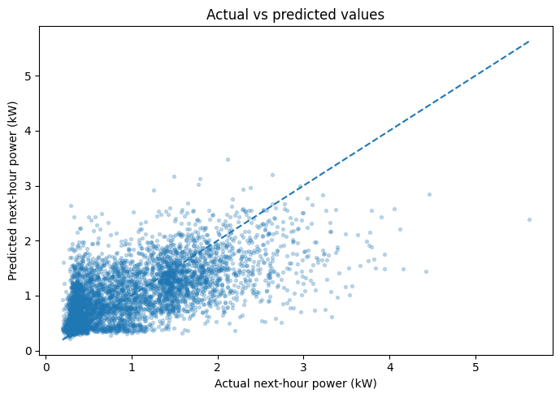
Results and Discussion
Selected model: Hist Gradient Boosting (lowest validation RMSE)
Held-out test results (selected model)
Actual vs predicted (test set)
MAE
0.3958
RMSE
0.5455
MAPE
57.1879%
R²
0.4088
Notes:
Hist Gradient Boosting had the lowest validation RMSE, 0.6181, compared with 0.9077 for the baseline. On the test period it gets MAE 0.3958, RMSE 0.5455, MAPE 57.19 percent and R-squared 0.4088. MAPE excludes actual values at or below 0.05 kW. Be honest: the model follows the daily pattern but misses many peaks, so accuracy is moderate, not high. In the scatter plot, points spread widely around the diagonal and high values are mostly under-predicted.

Slide 9
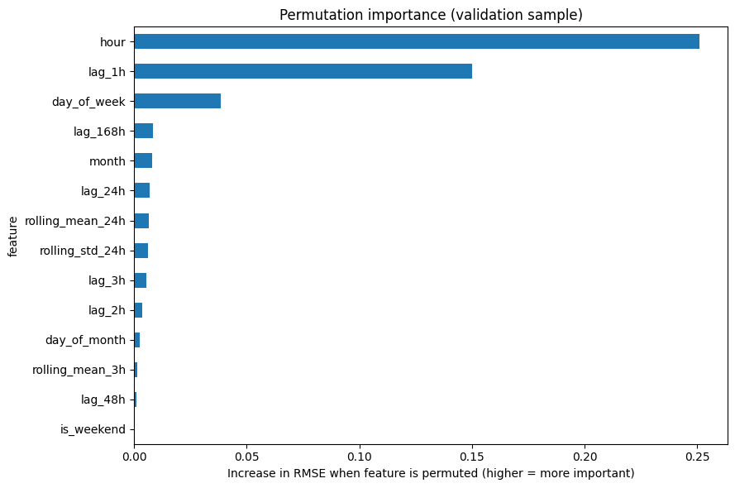
Interpretation and Limitations
What the model uses most
Hour of day matters most
Previous hour's usage is second
Day of week is third; the rest are small
Limitations
One household only (2006–2010)
Moderate accuracy: R² 0.41, MAPE 57%
Only calendar and past-usage features, so there is room to improve
Permutation importance (validation sample)
Notes:
Permutation importance shows how much the error increases when a feature is shuffled. Hour of day is by far the most important, then the previous hour, then day of week. The weekend flag has zero importance because day of week already contains that information. Stress that results apply to this one household and the model is only moderately accurate.

Slide 10
Conclusion
Work completed
Learned from KDD
Future work
Cleaned over 2 million minute records
Built hourly data and 14 features
Compared 6 models with a time-ordered split
Selected Hist Gradient Boosting
Each step feeds the next one
A time-ordered split avoids using future data
A baseline shows what models add
Report moderate results honestly
Add the current-hour value and other measurements
Add a seasonal baseline
Add weather and holiday data
Tune models, try LSTM, use more households
A study model with moderate accuracy (test R² 0.4088). Not production-ready.
Notes:
Summarize: the full workflow was completed and Hist Gradient Boosting performed best, but accuracy is moderate. The KDD process helped keep the work organised and free of data leakage. Future work: add more information and stronger baselines.

