Slide 1

AI & Machine Learning Based Intelligent Learning Platform
Project Review – I
Presented by: AKASH SANKAR • Roll No.: 5
Guided by: ASHWATHI MISS • Department of Computer Applications, CEV
Notes:
1.7.2013
1
‹#›

Slide 2
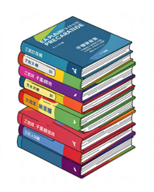

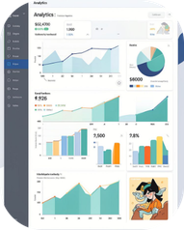
Abstract & Introduction
An intelligent platform designed for competitive examination preparation that fuses Artificial Intelligence and Machine Learning with curated study content. The system delivers personalized learning assistance derived from each student’s activities, performance, and preferences.
Integrated Content
Role-Based Modules
Data-Driven
Study materials, quizzes, current affairs feeds, and audio lessons in a single place.
Continuous logging of activities to enable ML-driven insights and reports.
Dedicated Student, Mentor, and Administrator modules with role-specific interfaces.
Notes:
1.7.2013
2
‹#›

Slide 3
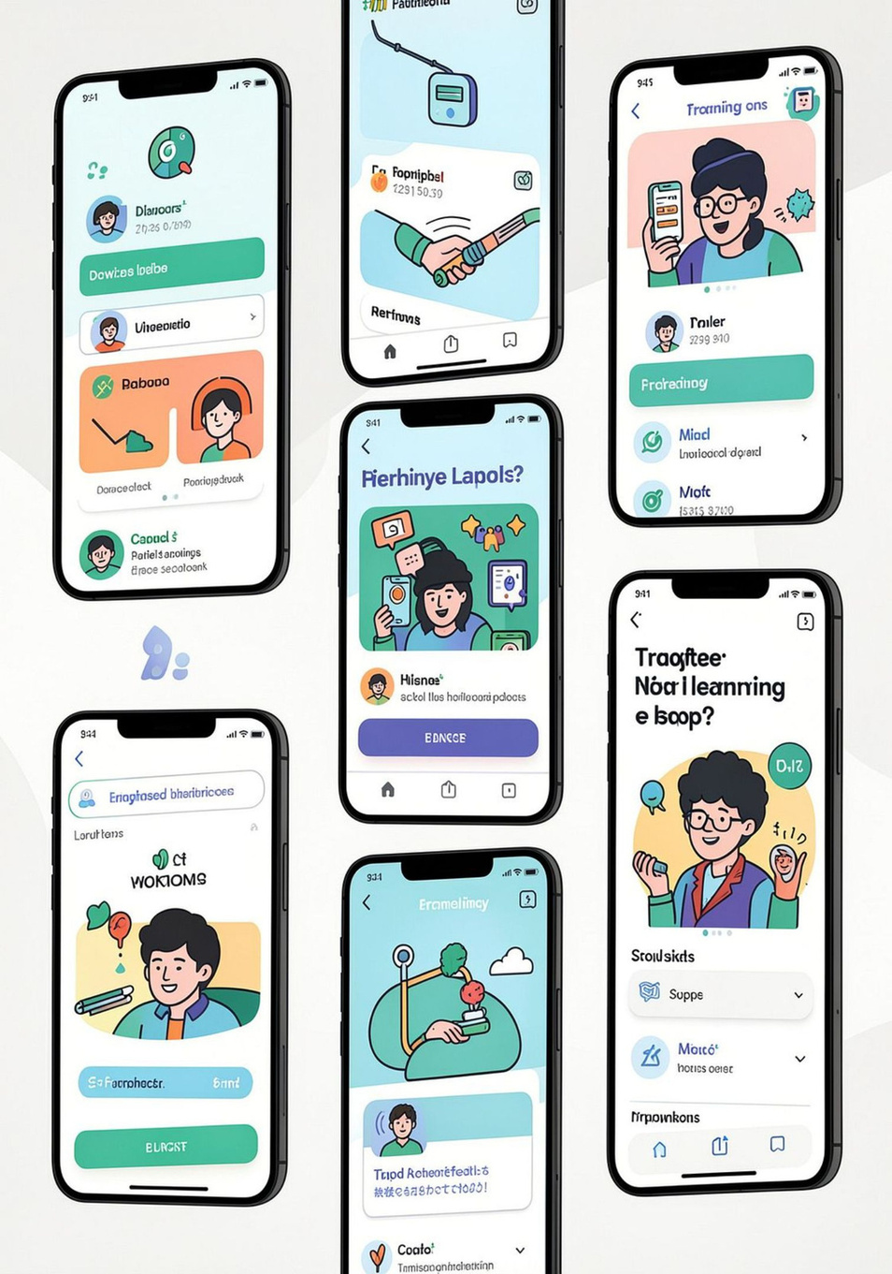




Existing System — Problems
    Resources scattered across platforms; learners lose context and continuity.
    Minimal or no personalized guidance; one-size-fits-all content delivery.
    Performance tracking is manual and time-consuming for mentors.
    Current-affairs require separate searching and curation by students.
    Weak student–mentor integration limits actionable guidance.
Proposed System — Highlights
Centralized Platform
AI-Powered Assistance
All resources and workflows under one authoritative environment.
Contextual answers, hints, and adaptive content delivery.
ML Performance Analysis
Integrated Current Affairs
Automated pattern detection and personalized recommendations.
Automated ingestion and RAG-enabled retrieval for up-to-date context.
Notes:
1.7.2013
3
‹#›

Slide 4


Slide 5
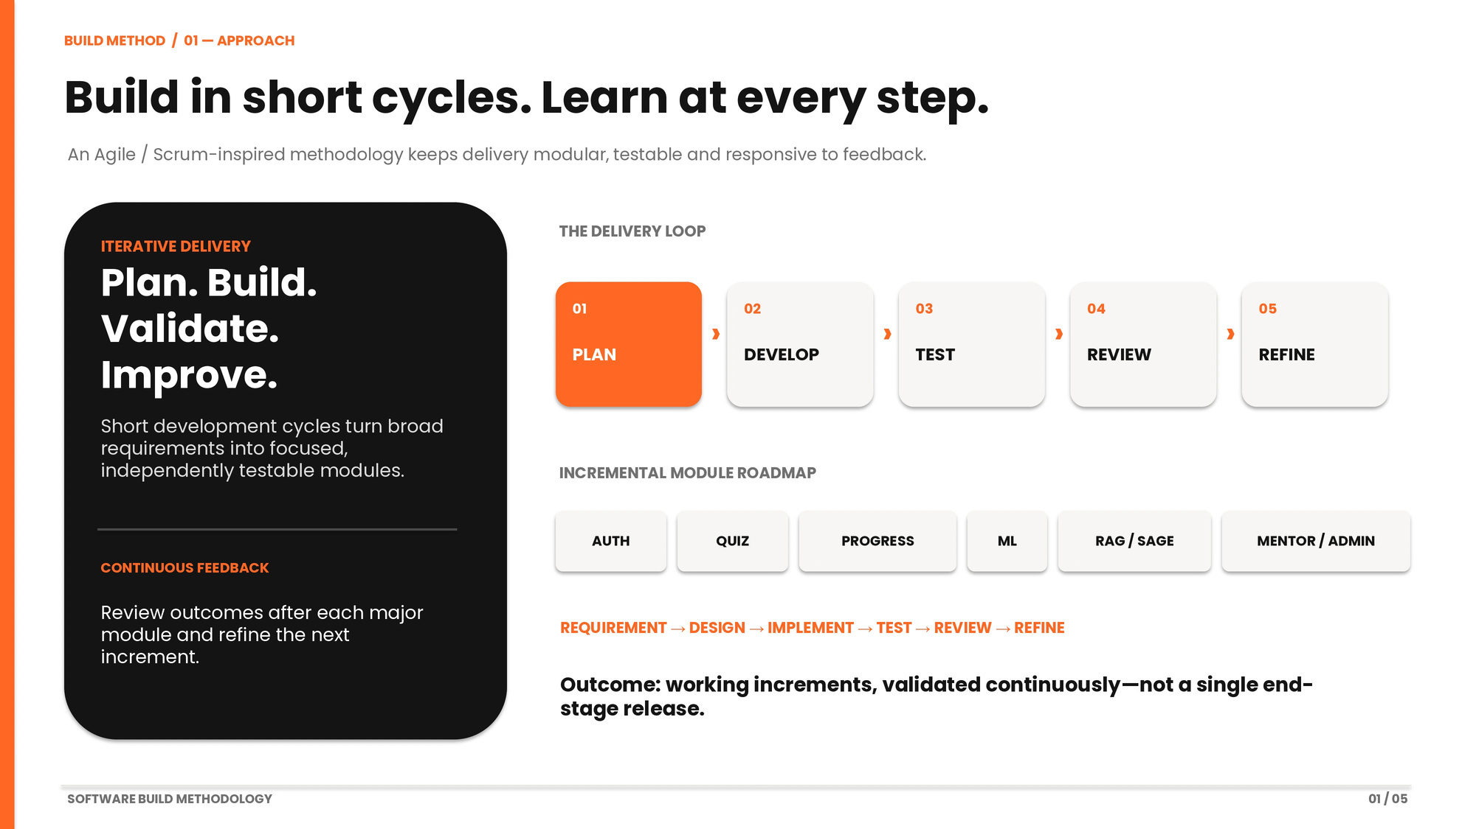

Slide 6
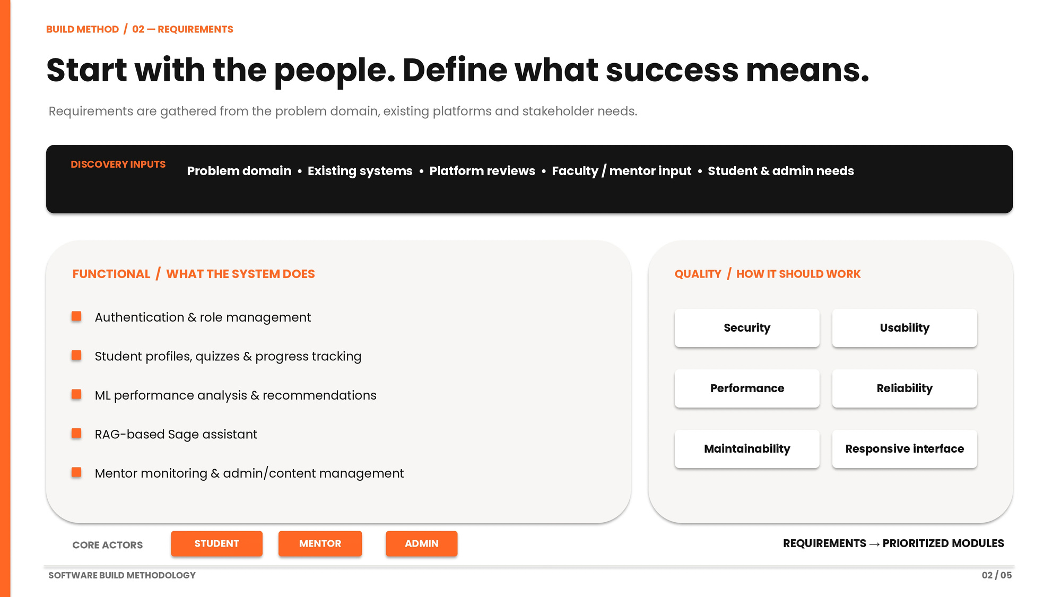

Slide 7
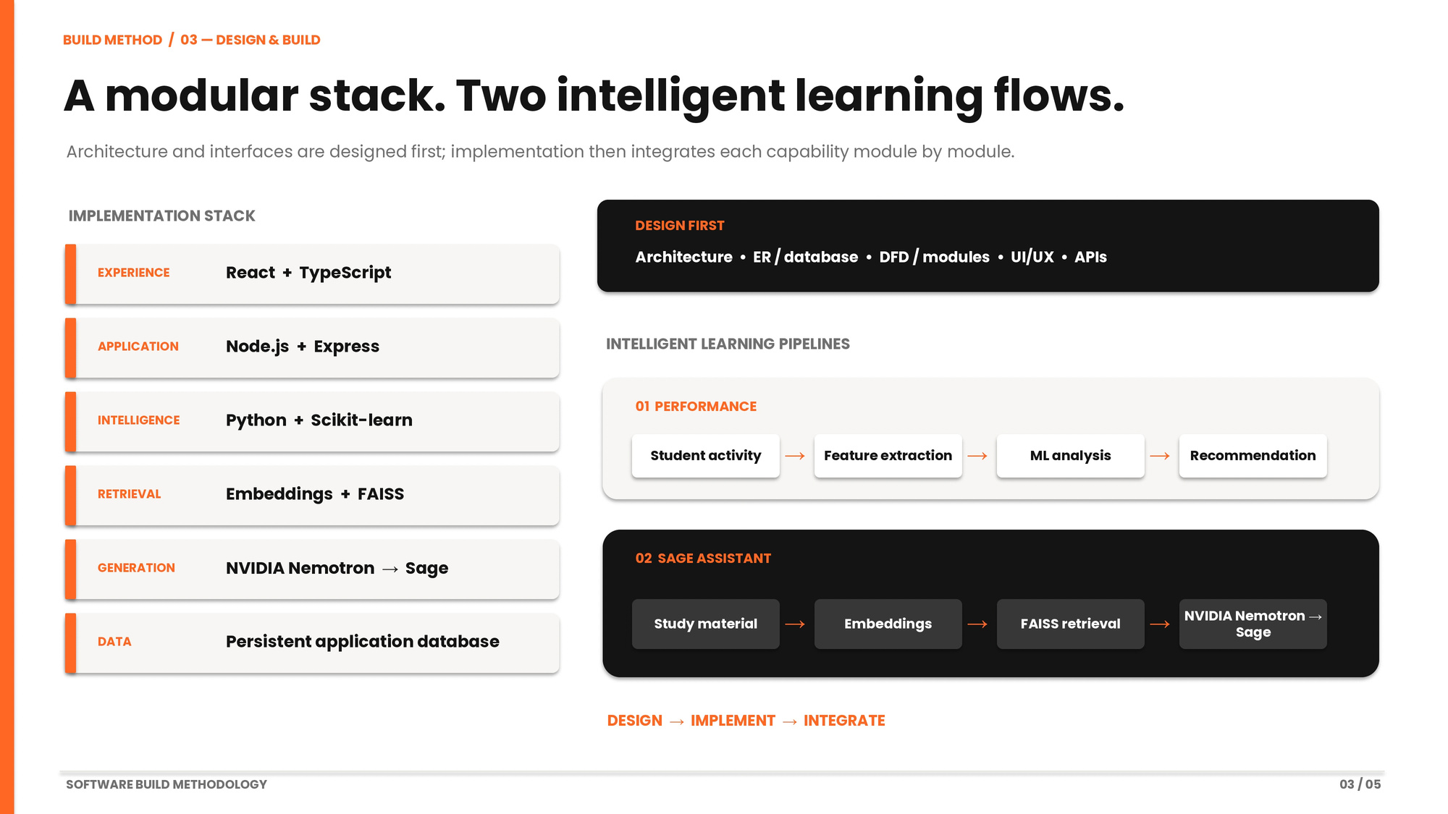

Slide 8
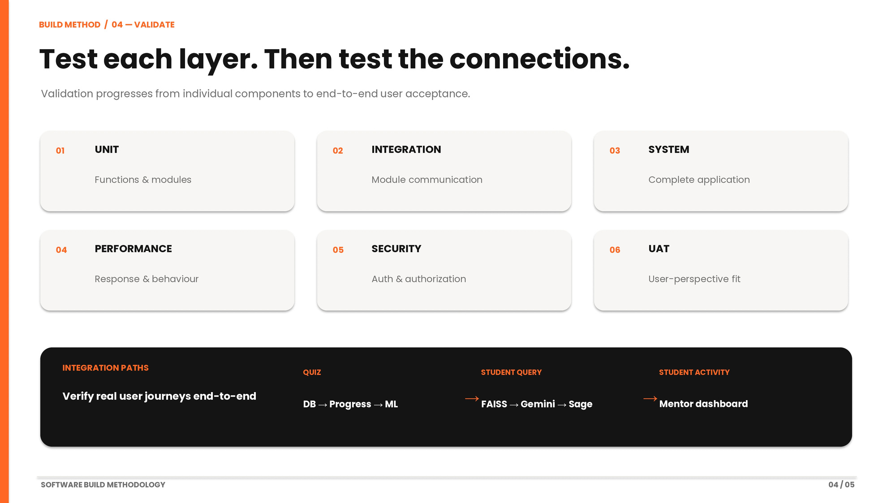

Slide 9
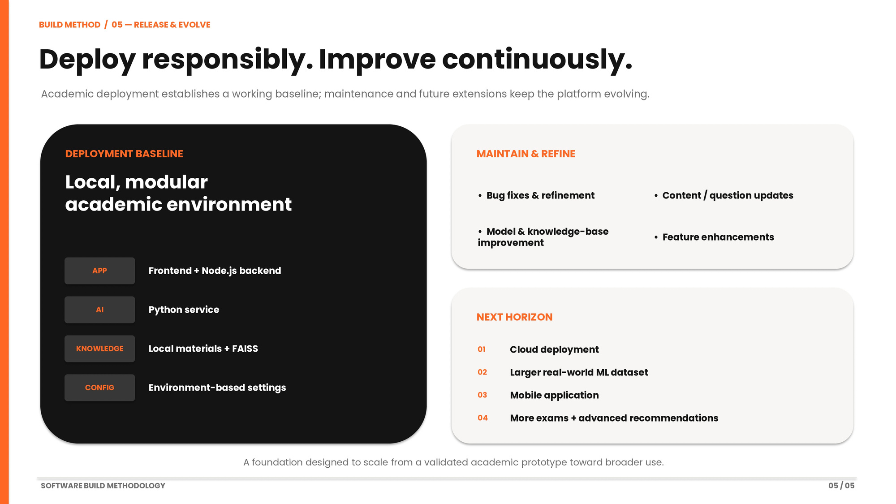

Slide 10
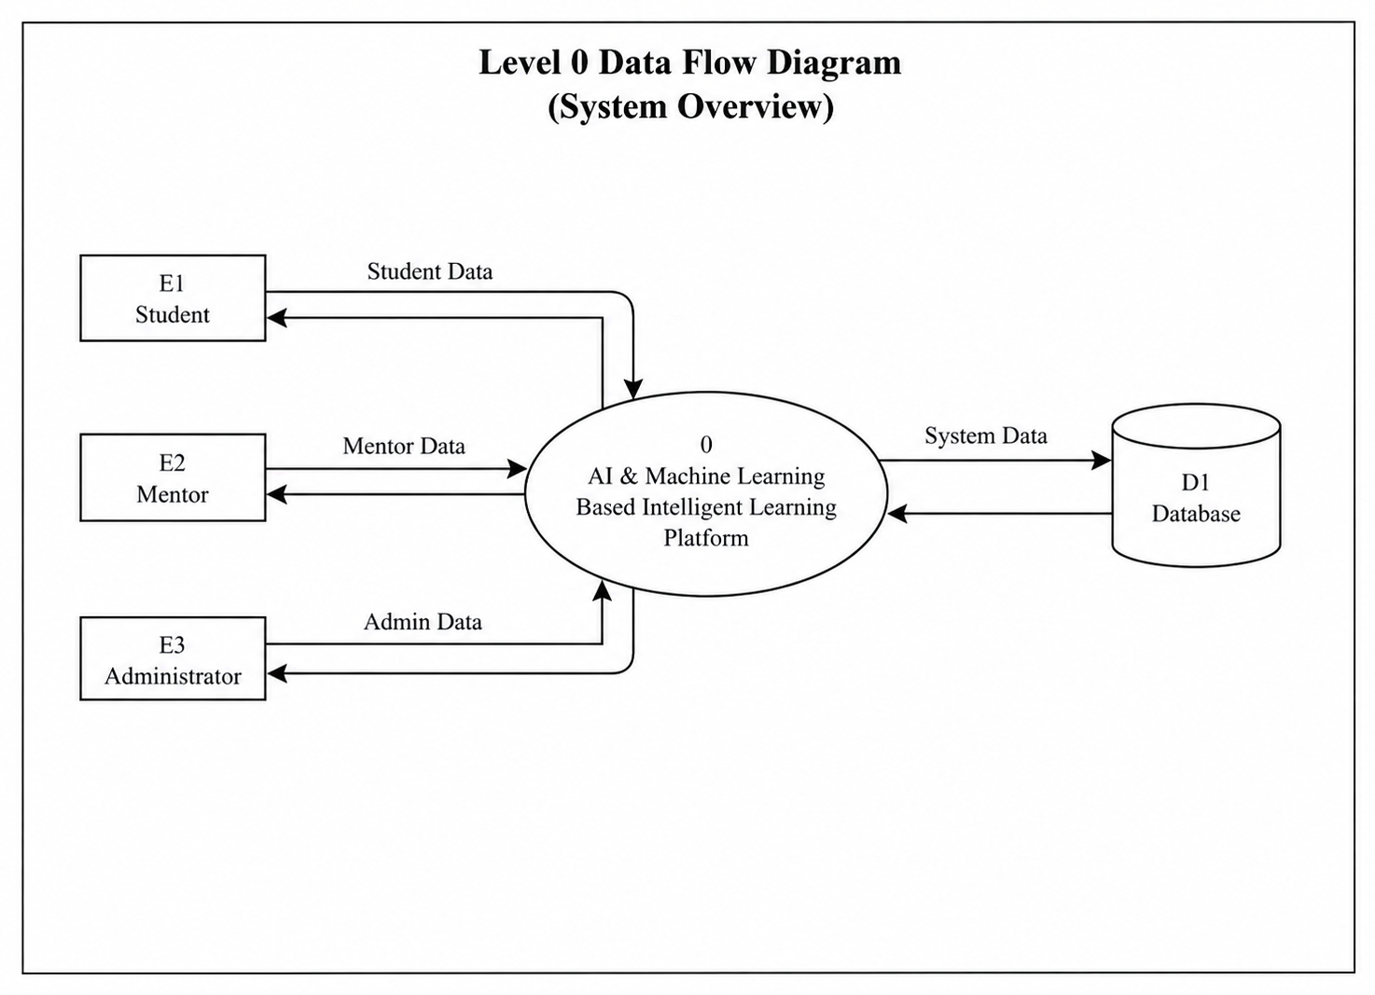

Slide 11
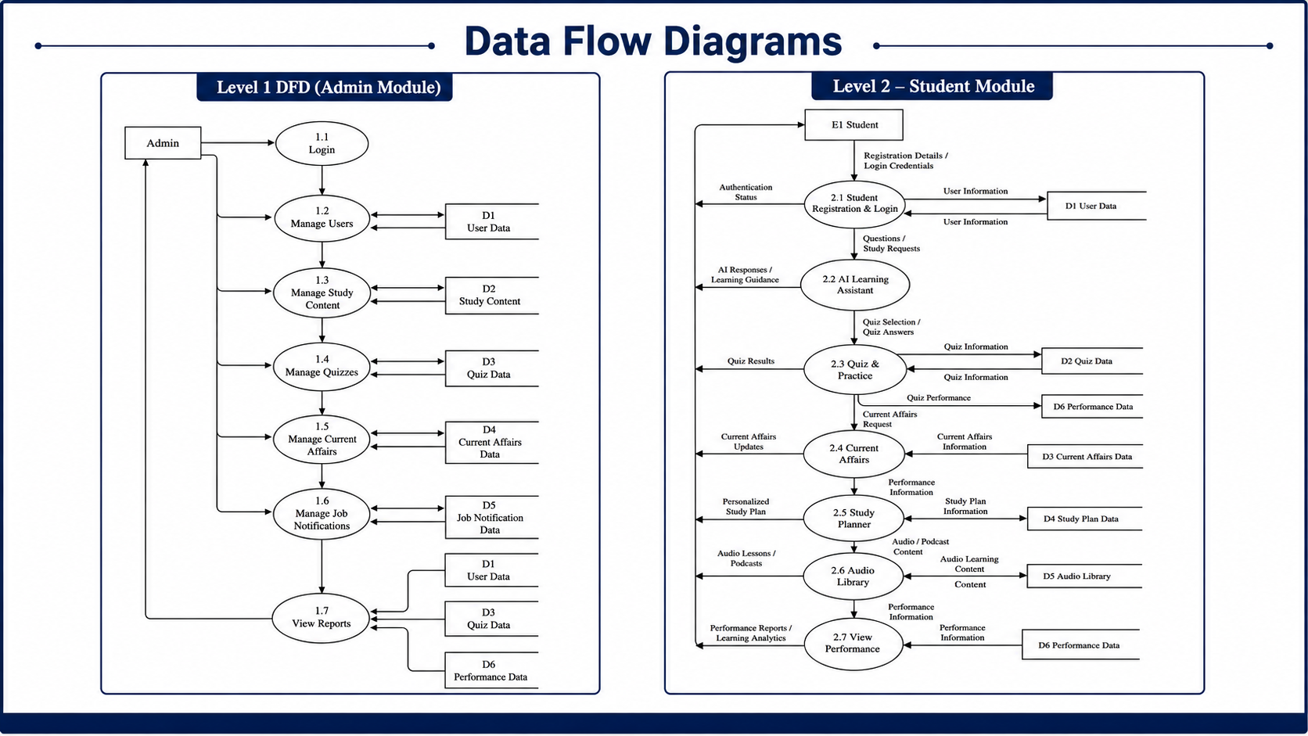

Slide 12
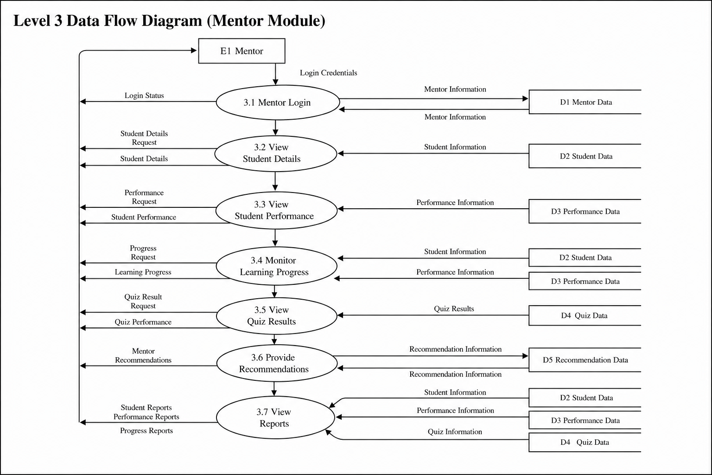

Slide 13
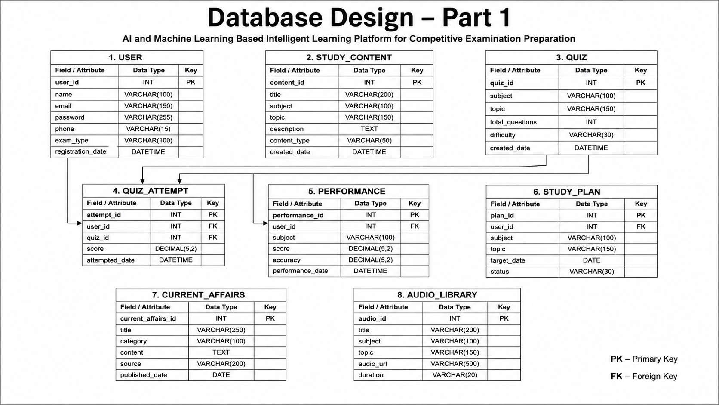

Slide 14
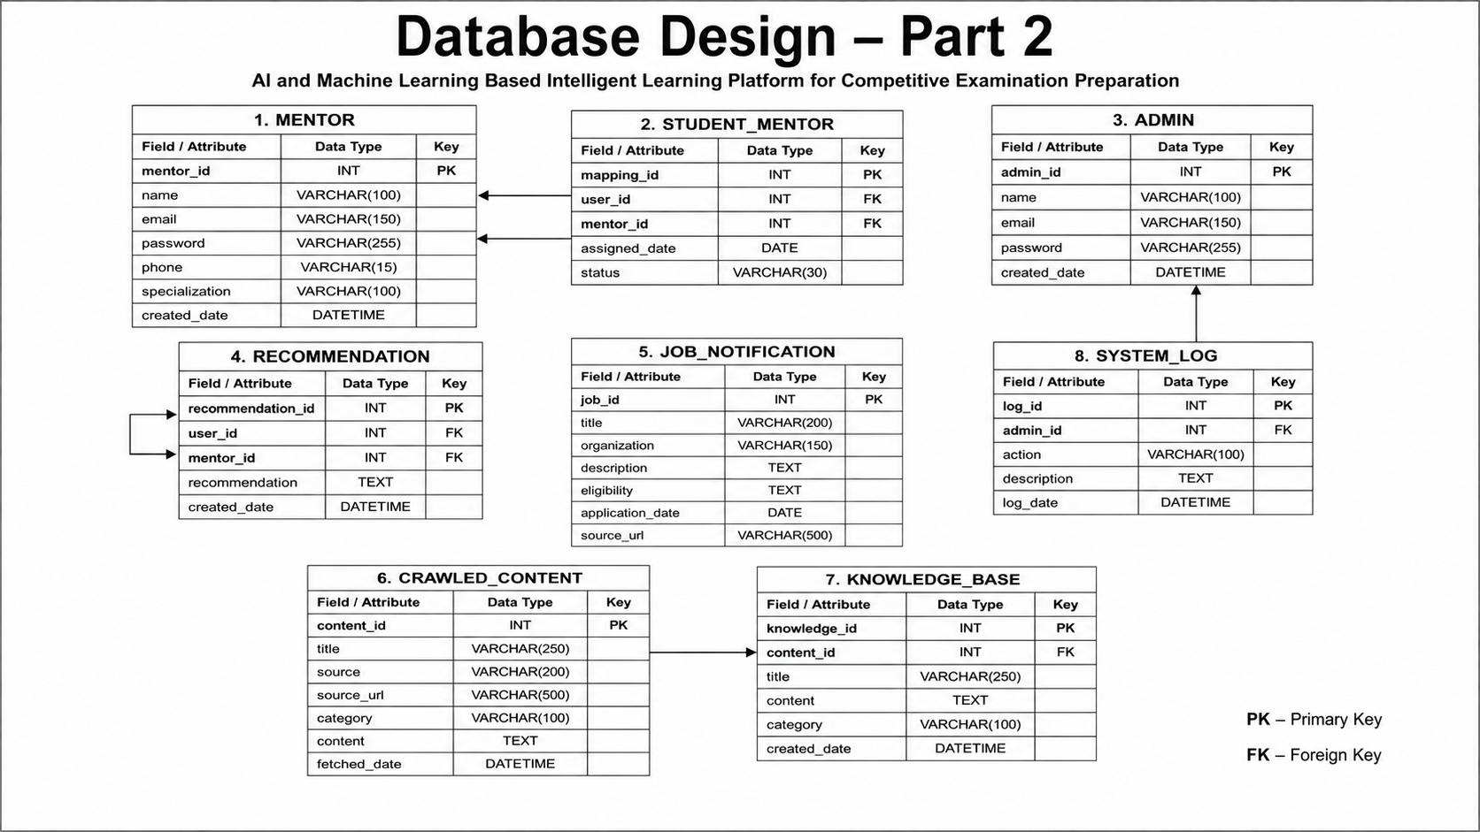

Slide 15



Cloud LLM & Machine Learning Components
Cloud LLM
Machine Learning
Serves AI-powered Q&A and contextual tutoring. RAG provides retrieved context to maintain factuality. Examination-focused datasets support domain adaptation and targeted prompting or fine-tuning.
Models analyze quiz outcomes, time-on-task, and concept gaps to:
    Identify weaknesses and mastery trajectories
    Generate personalized study plans and spaced-repetition schedules
    Provide mentors with actionable alerts and cohort insights
Notes:
1.7.2013
7
‹#›

Slide 16


Slide 17
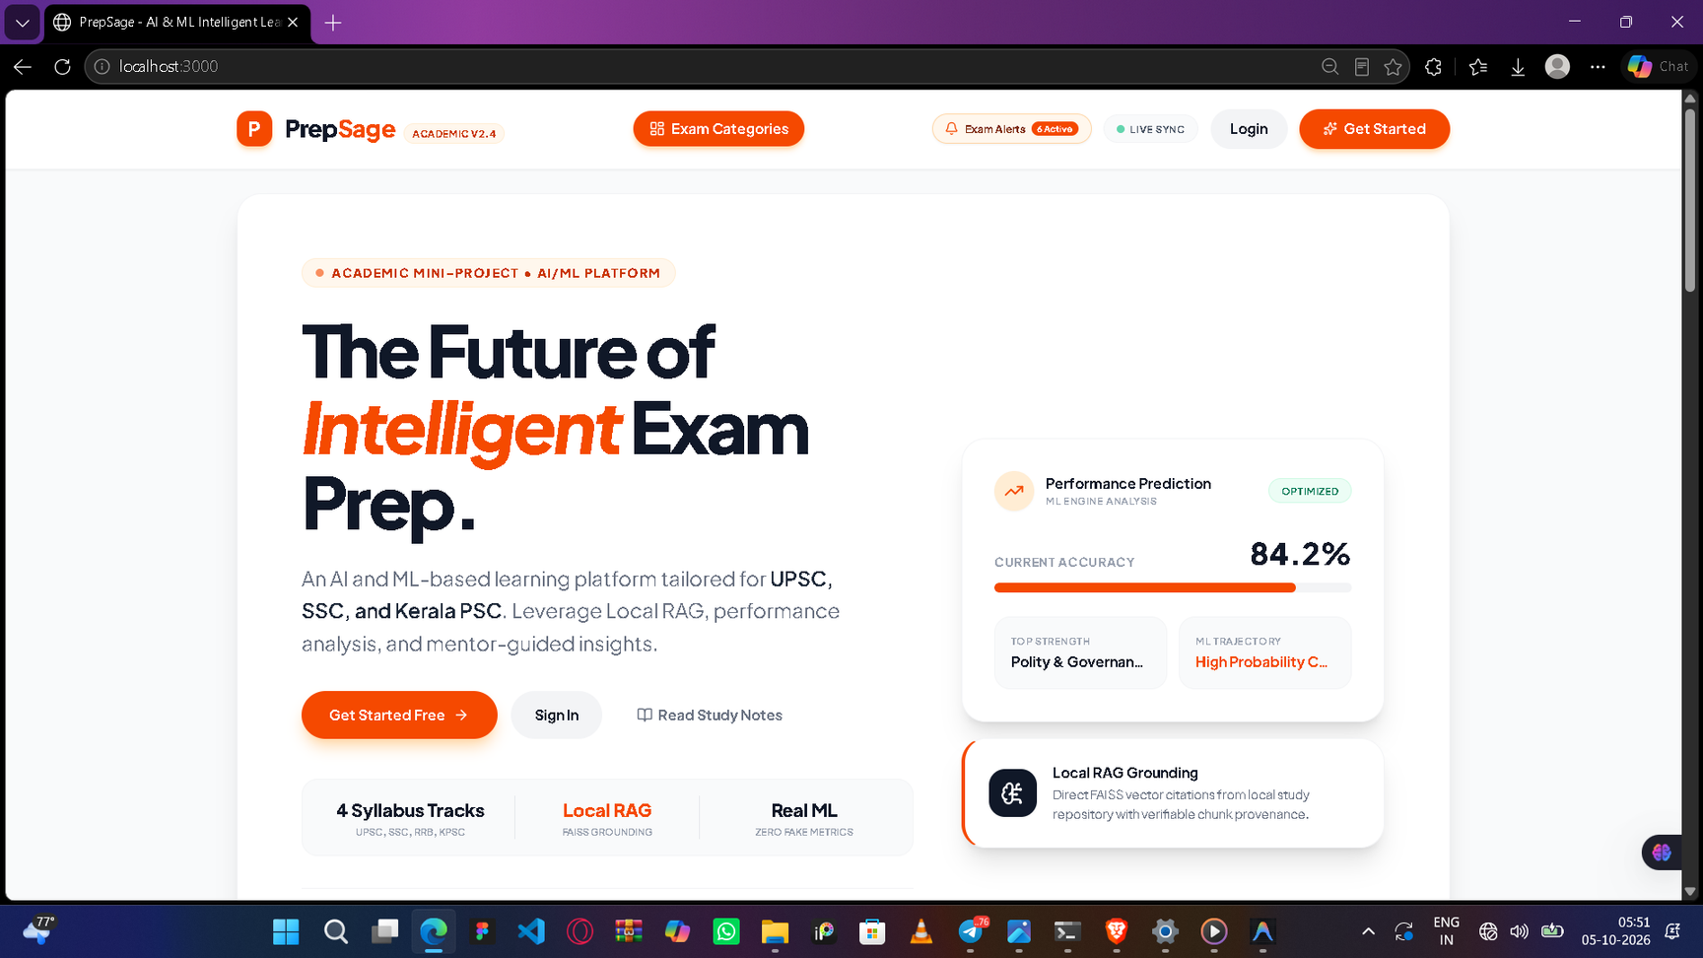
1.0 LANDING PAGE

Slide 18
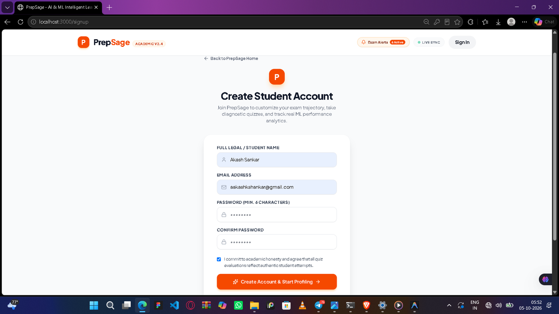
1.1 USER AUTHENTICATION

Slide 19
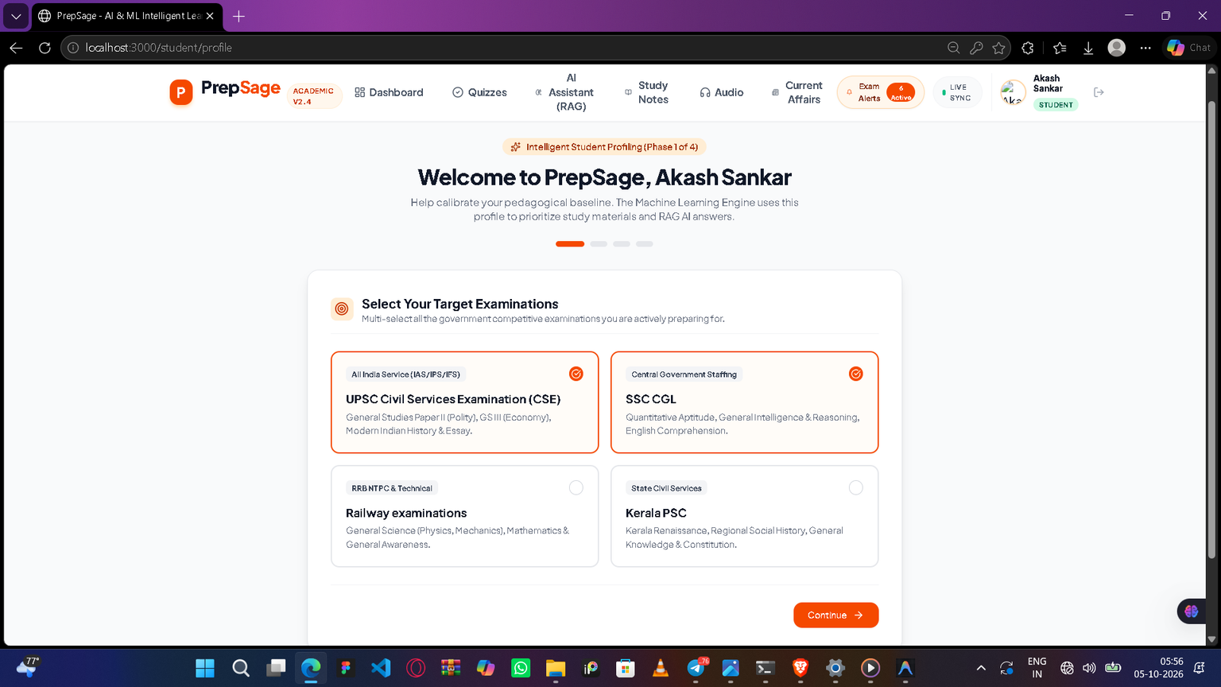
1.3 NEW USER PROFILING FOR ML CALIBERATION

Slide 20
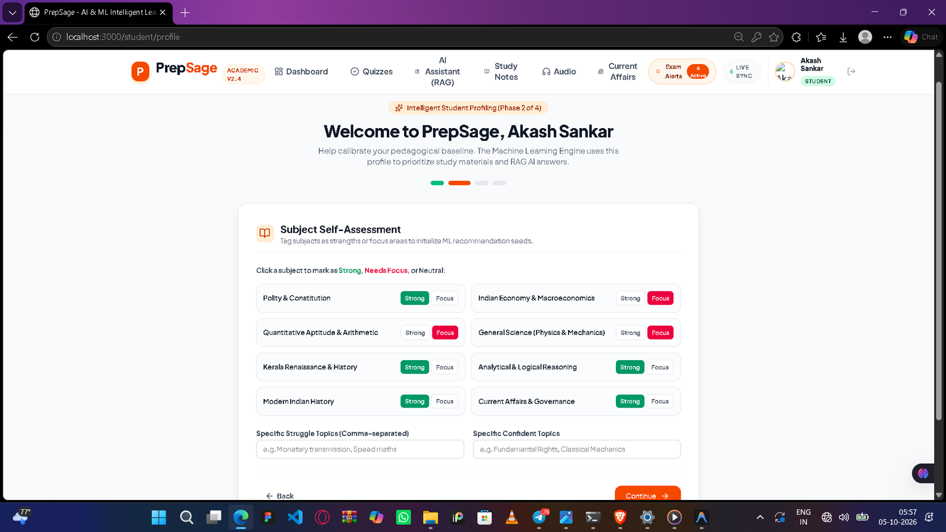
1.4 NEW USER PROFILING FOR ML CALIBERATION

Slide 21
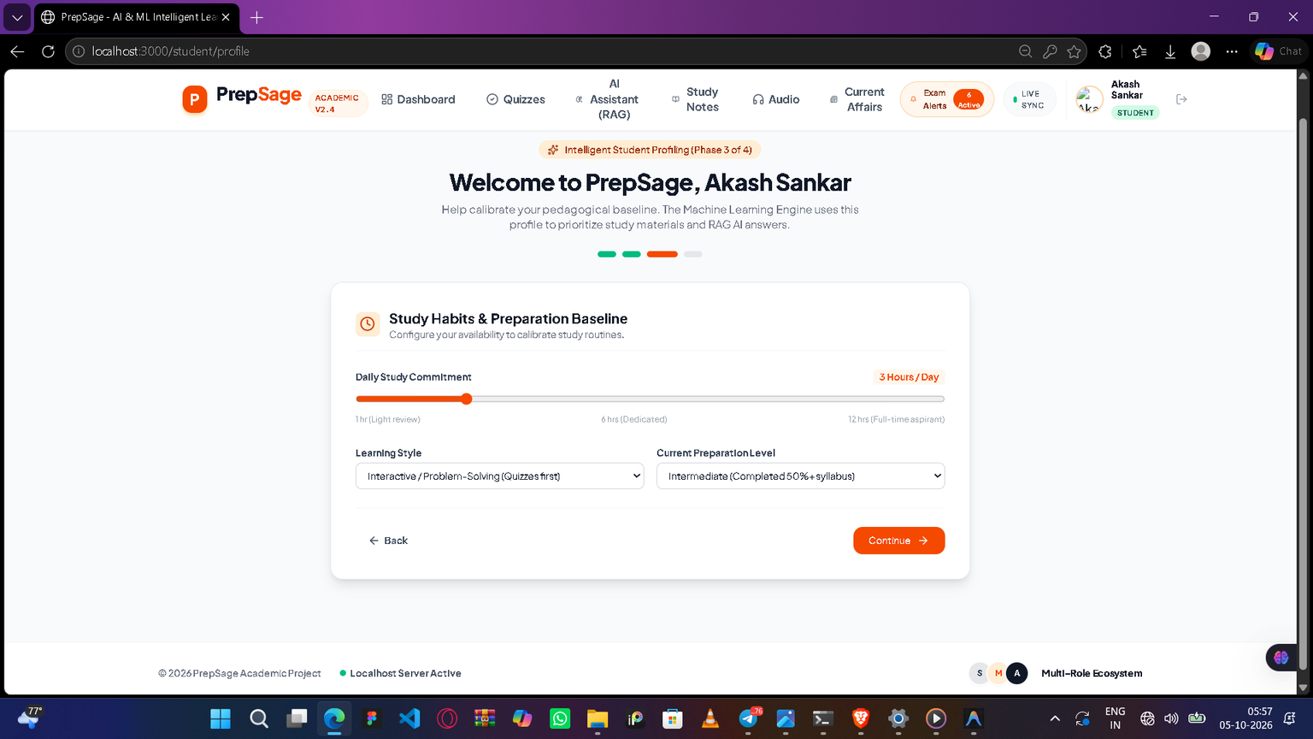
1.5 NEW USER PROFILING FOR ML CALIBERATION

Slide 22
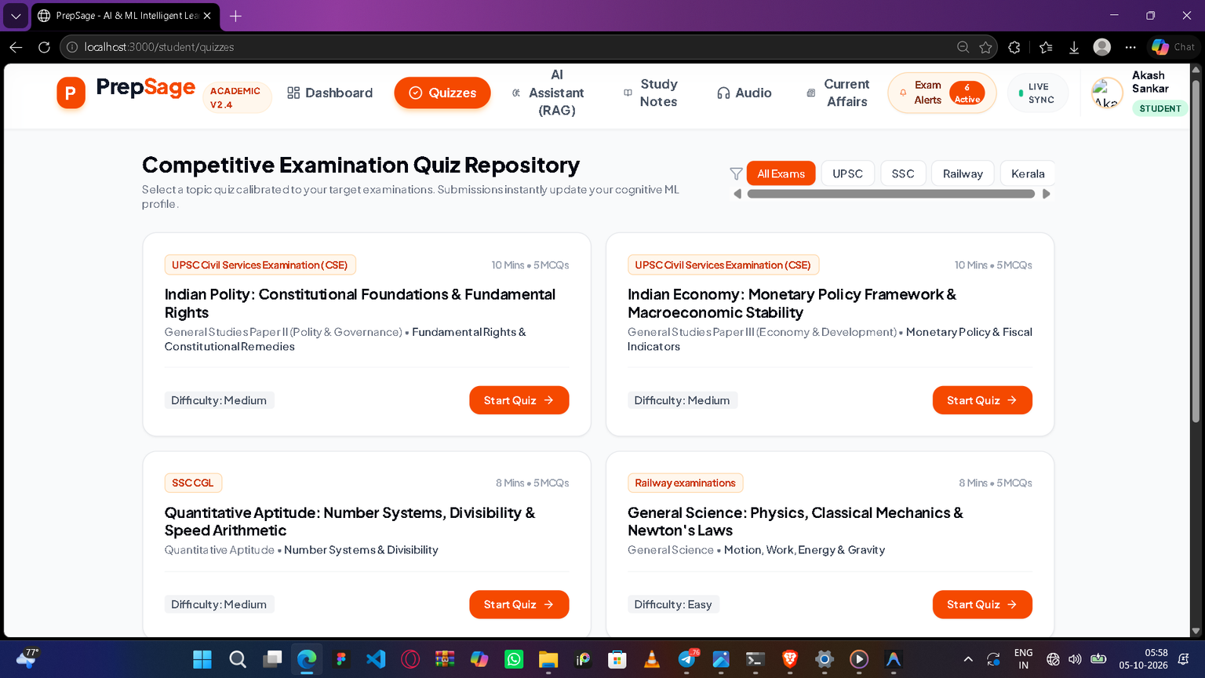
1.6 COMPETITIVE EXAM MCQ QUIZ

Slide 23
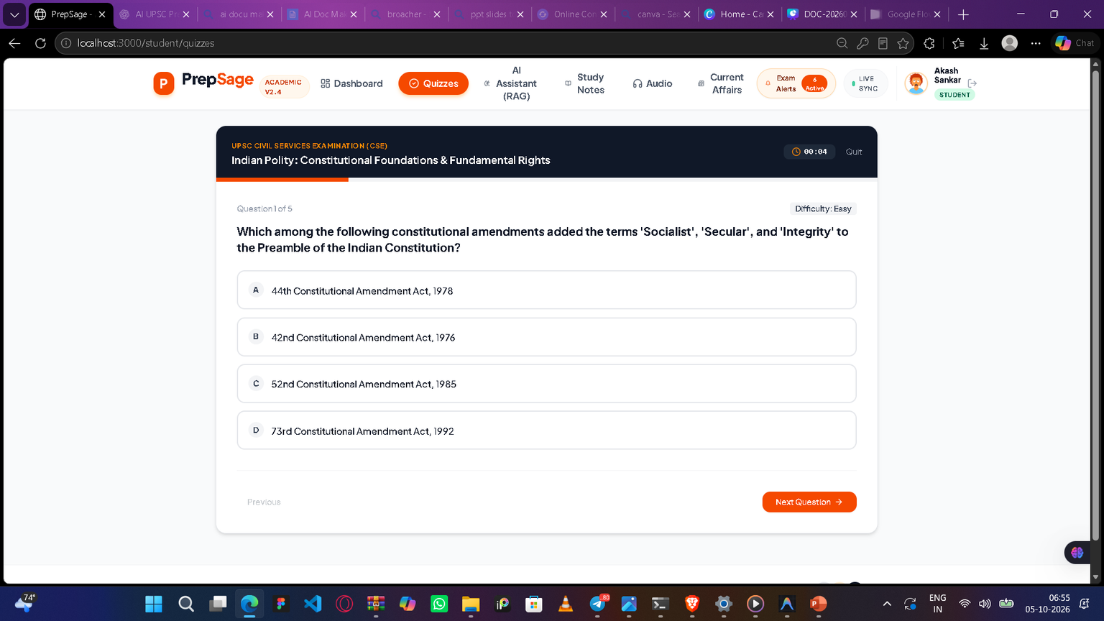
1.6 COMPETITIVE EXAM MCQ QUIZ

Slide 24
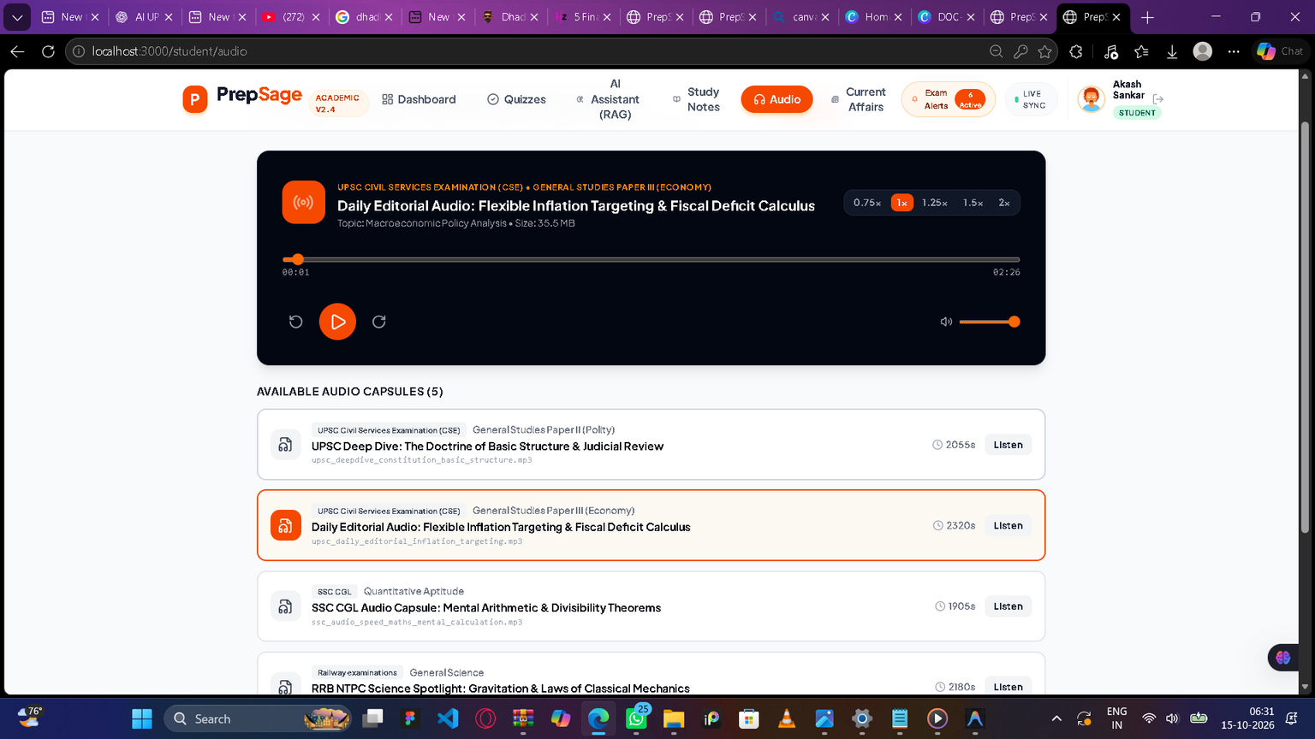
1.7 AUDIO LIBRARY PODCAST

Slide 25
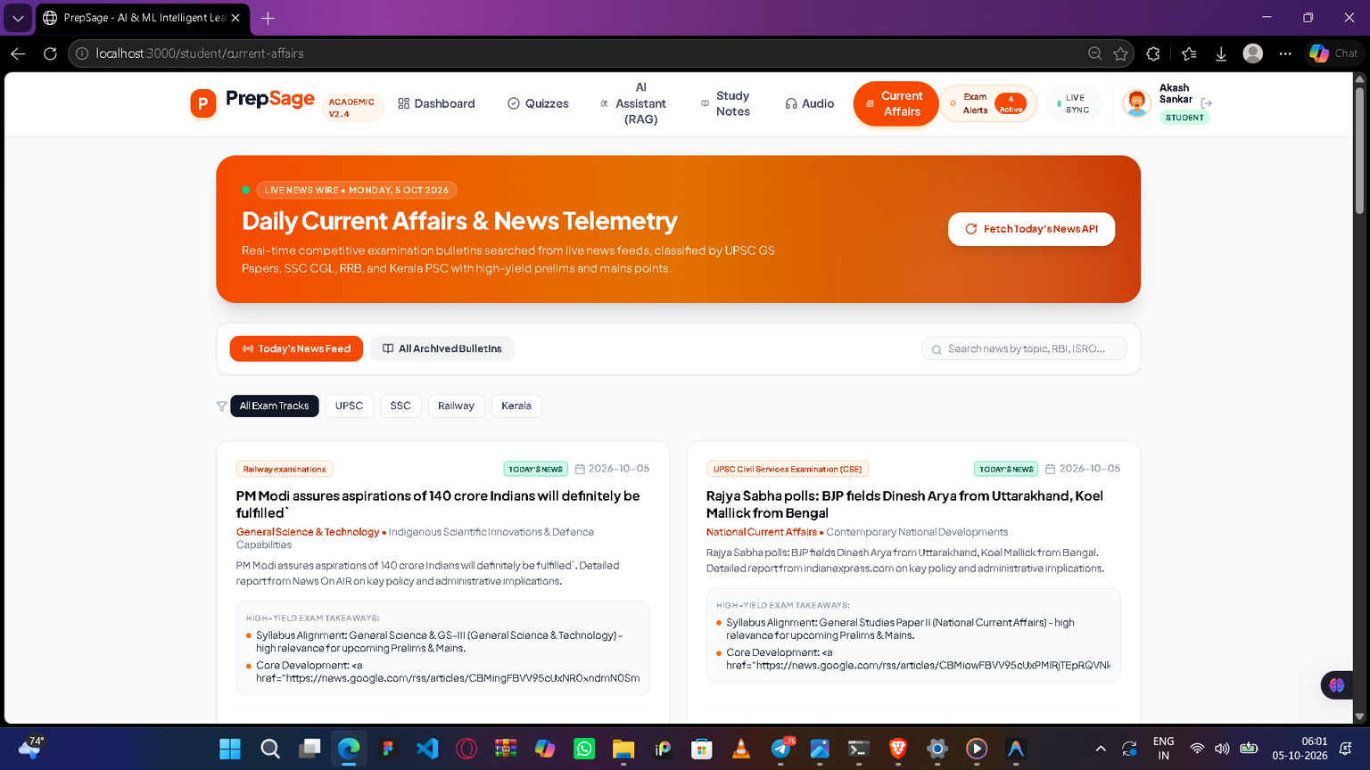
1.8 REAL TIME CURRENT AFFAIRS

Slide 26
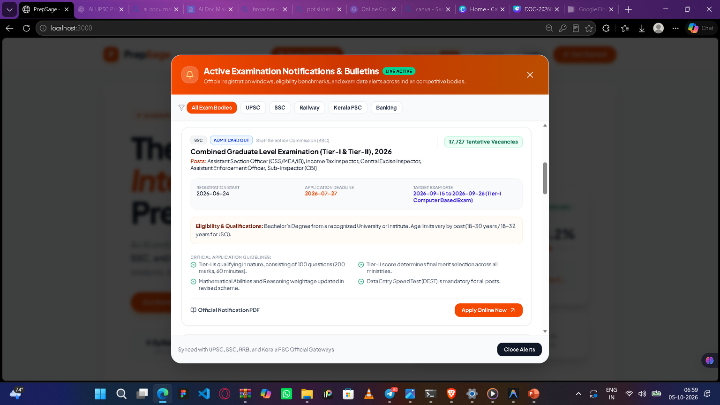
1.9 EXAM NOTIFICATION

Slide 27
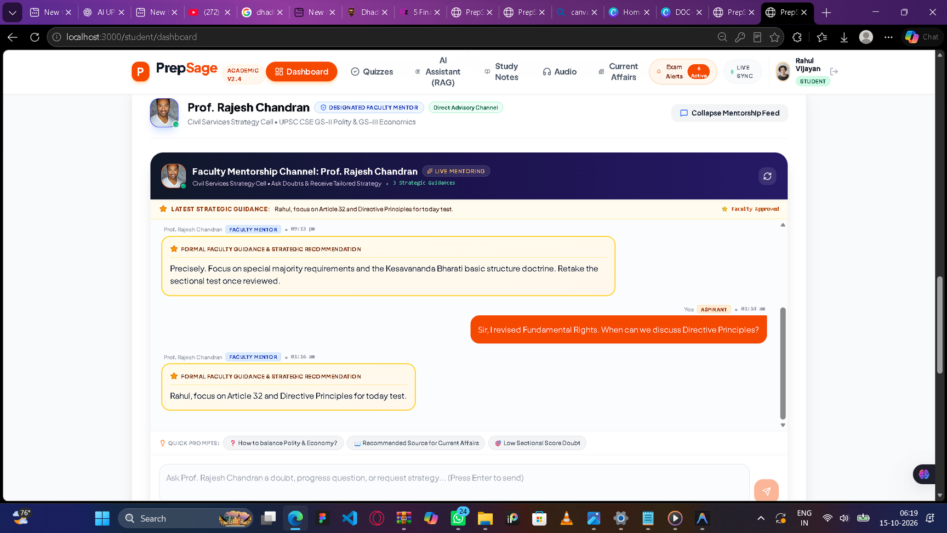

Slide 28
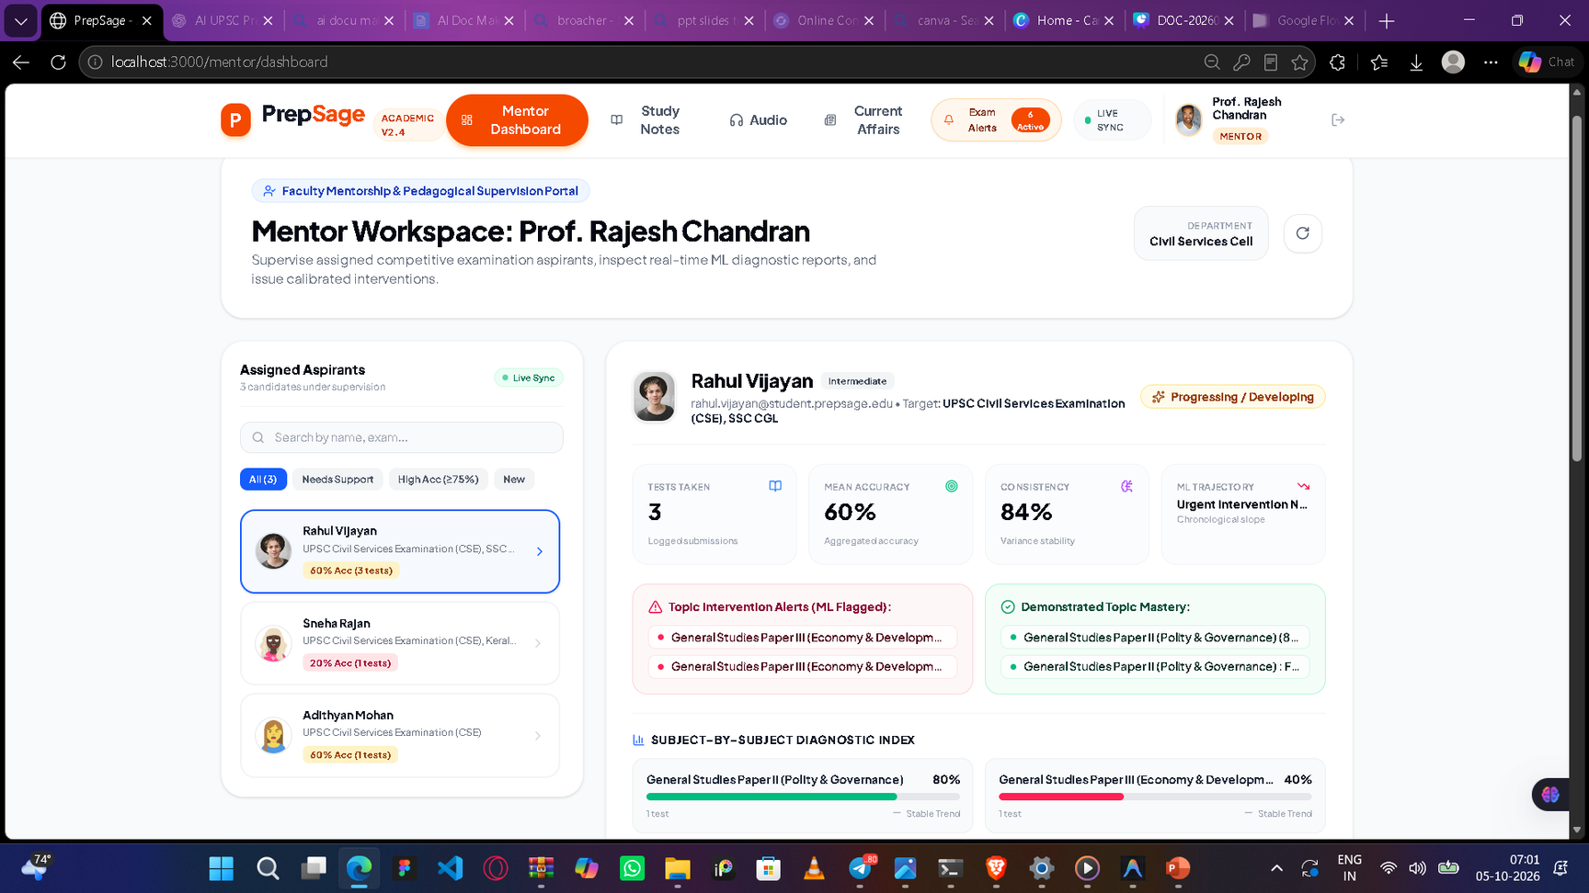
2.1 MENTOR MODULE

Slide 29
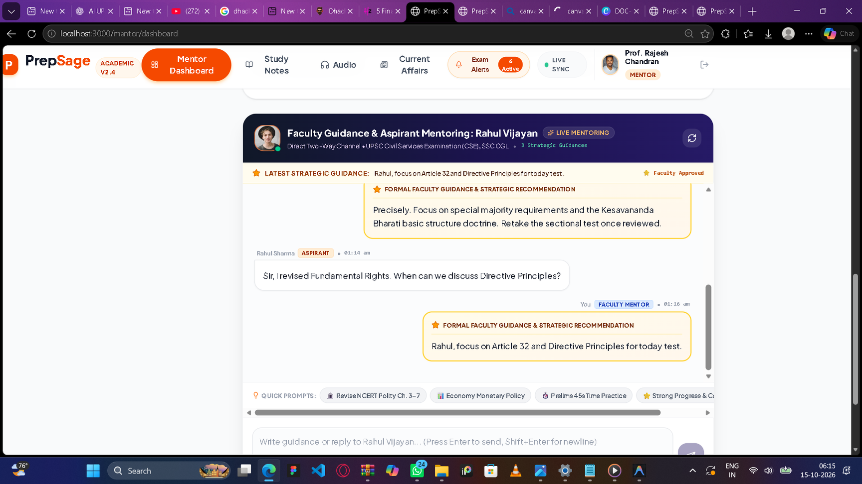

Slide 30
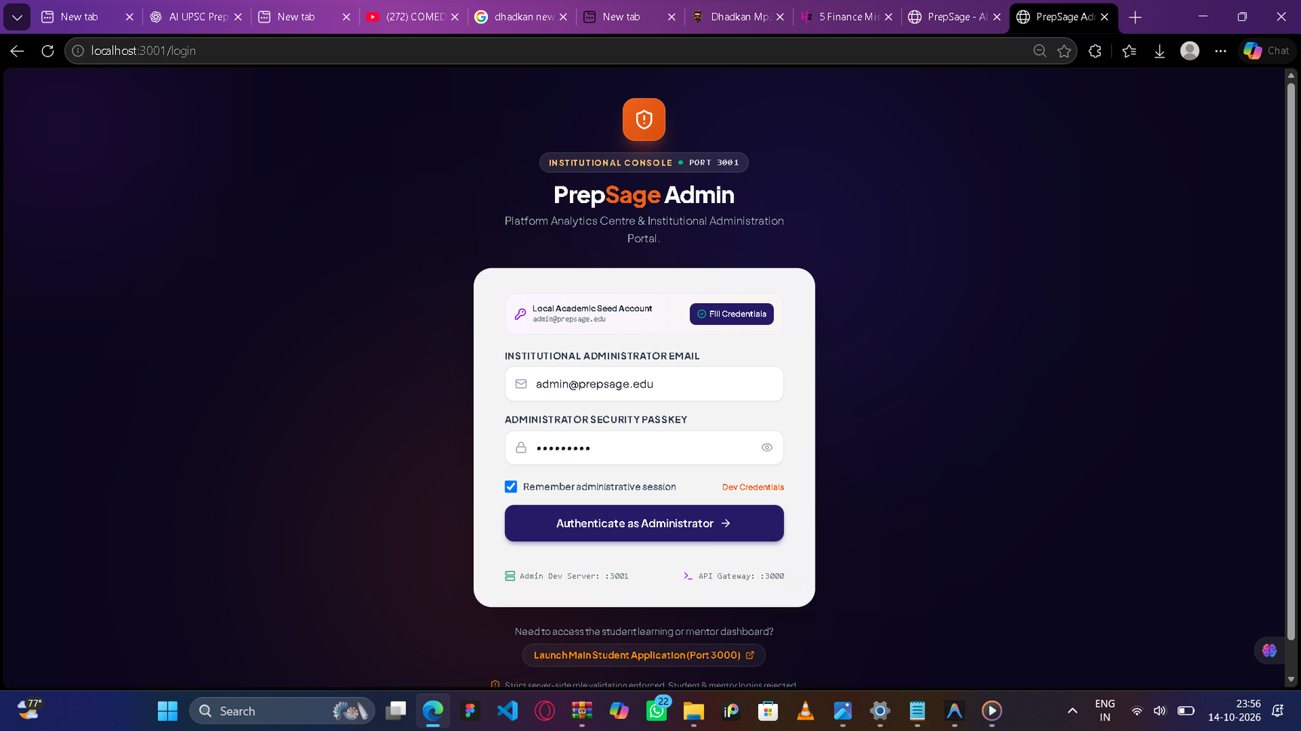
3.1 ADMIN MODULE

Slide 31
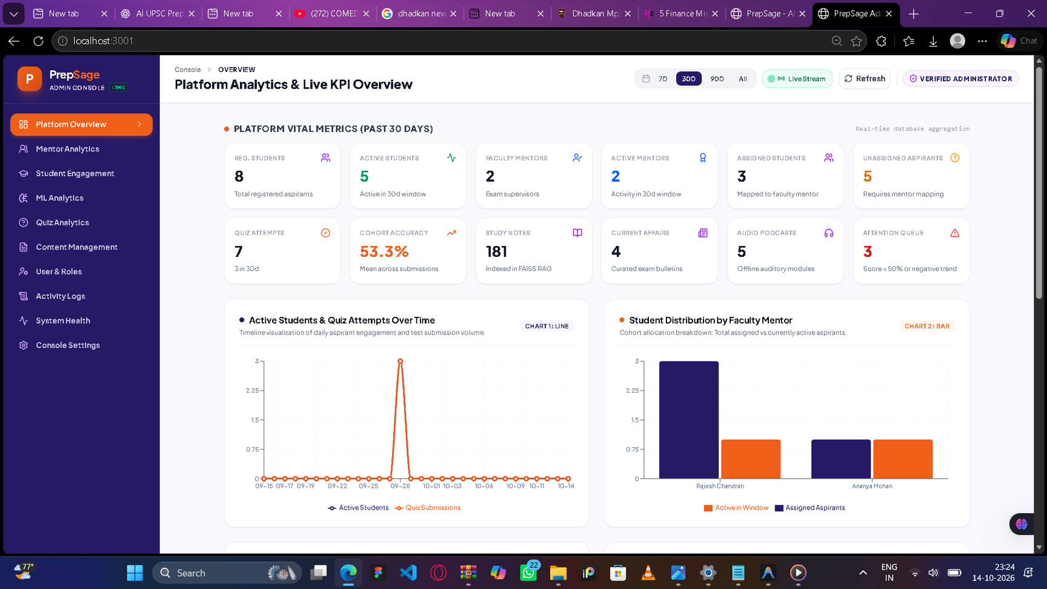

Slide 32
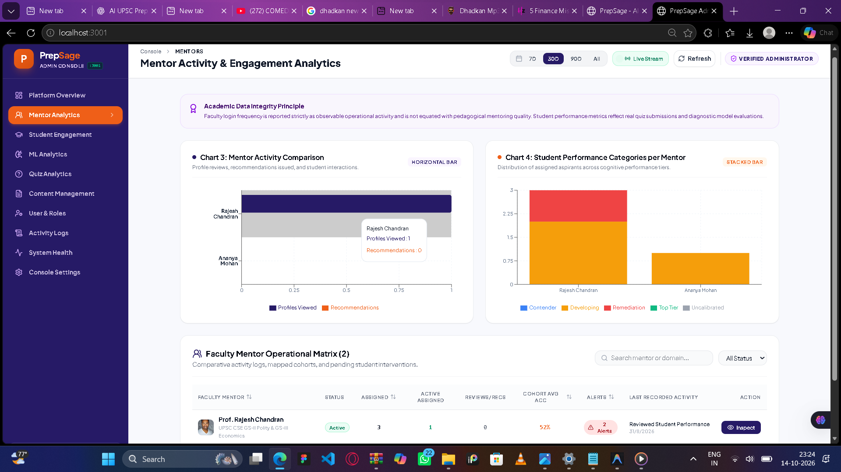

Slide 33
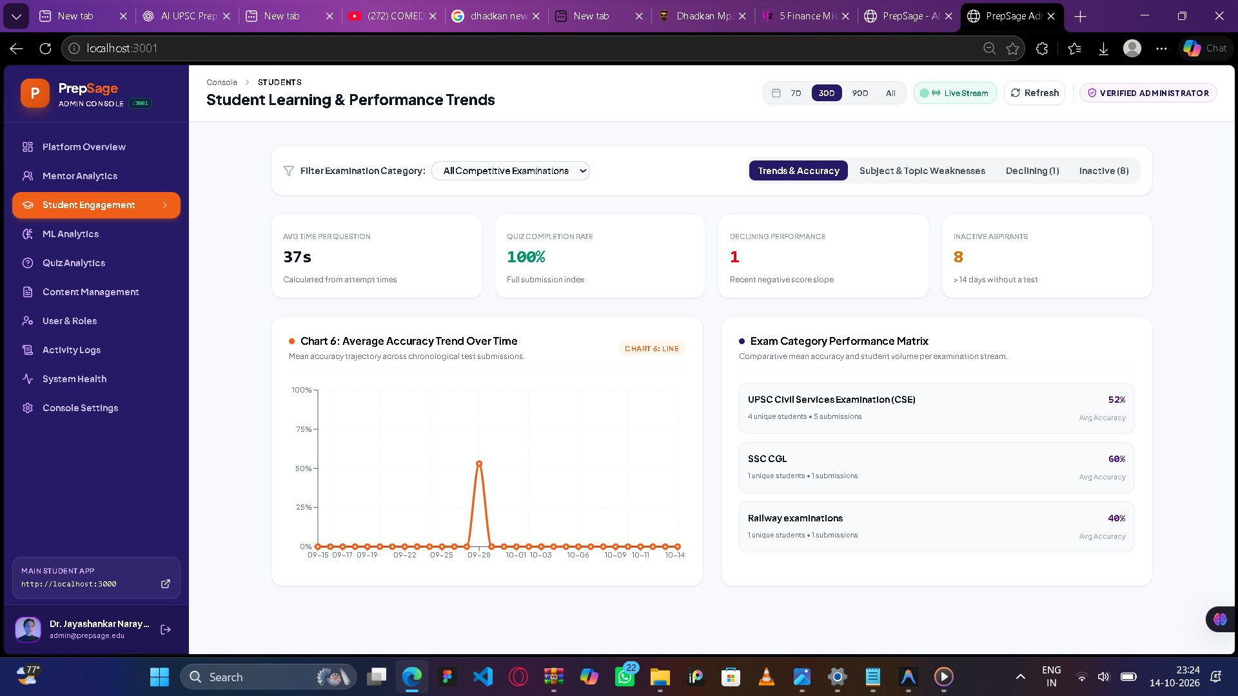

Slide 34
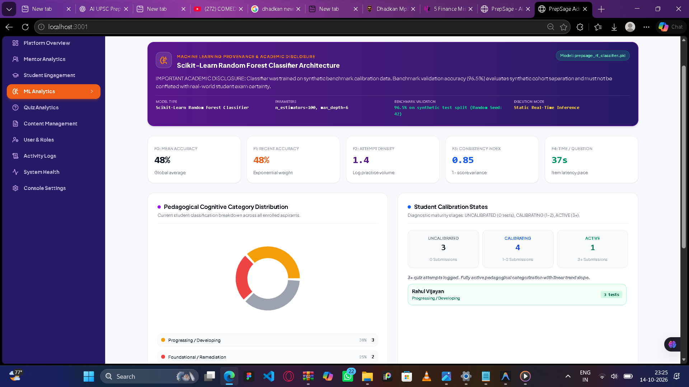

Slide 35
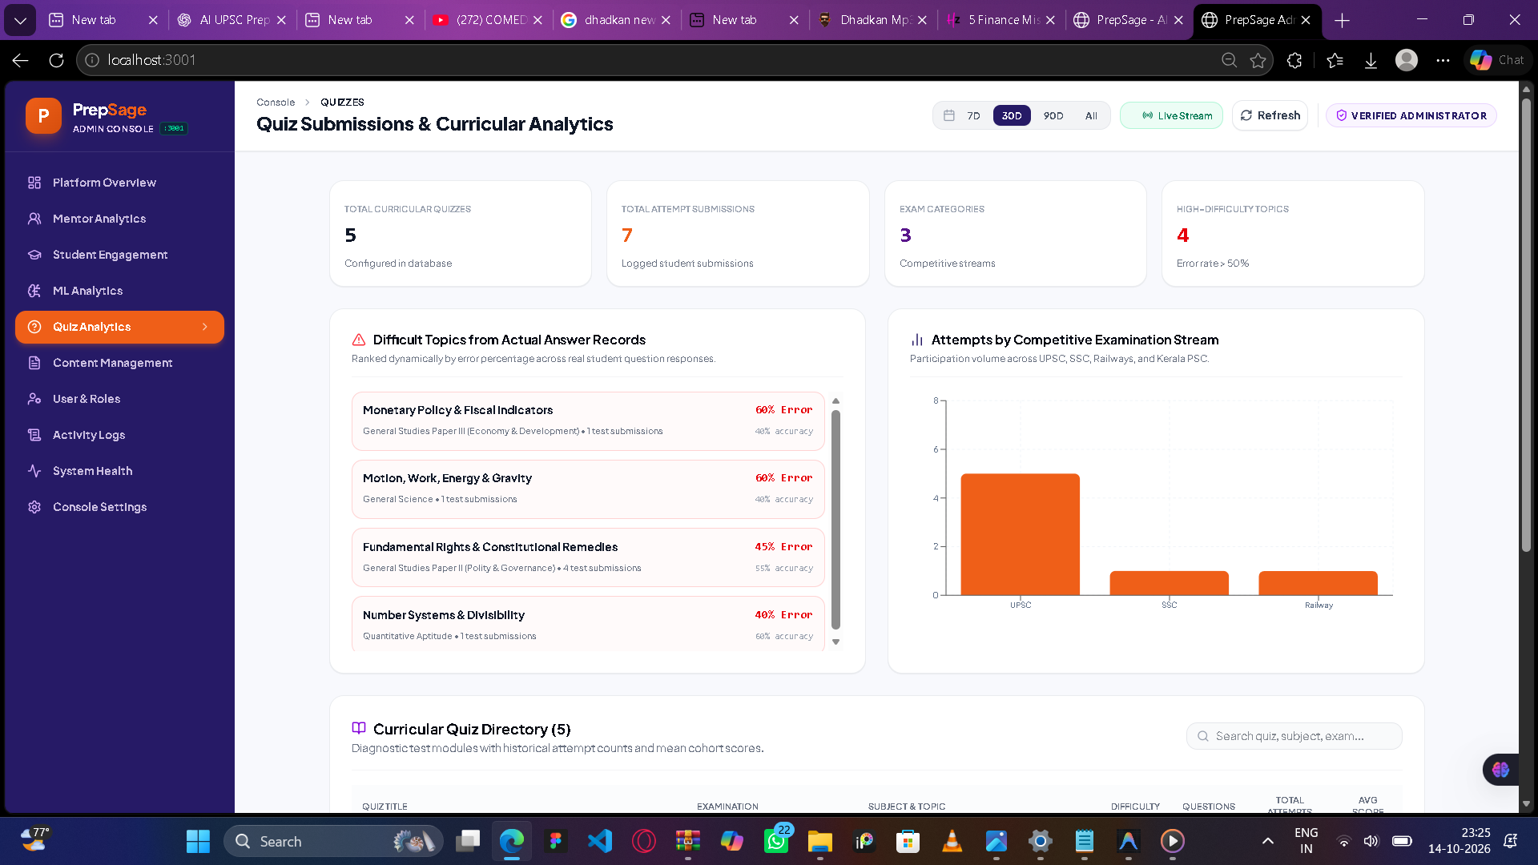

Slide 36
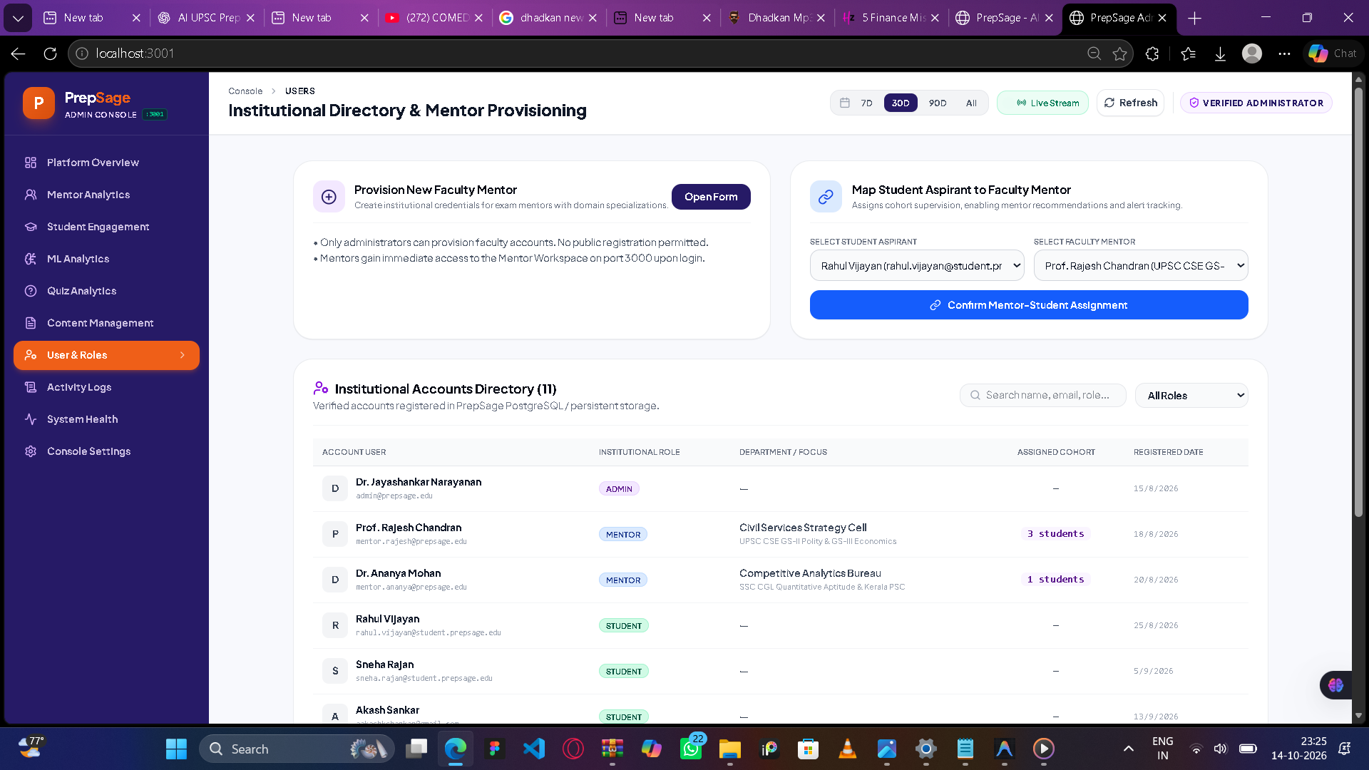

Slide 37
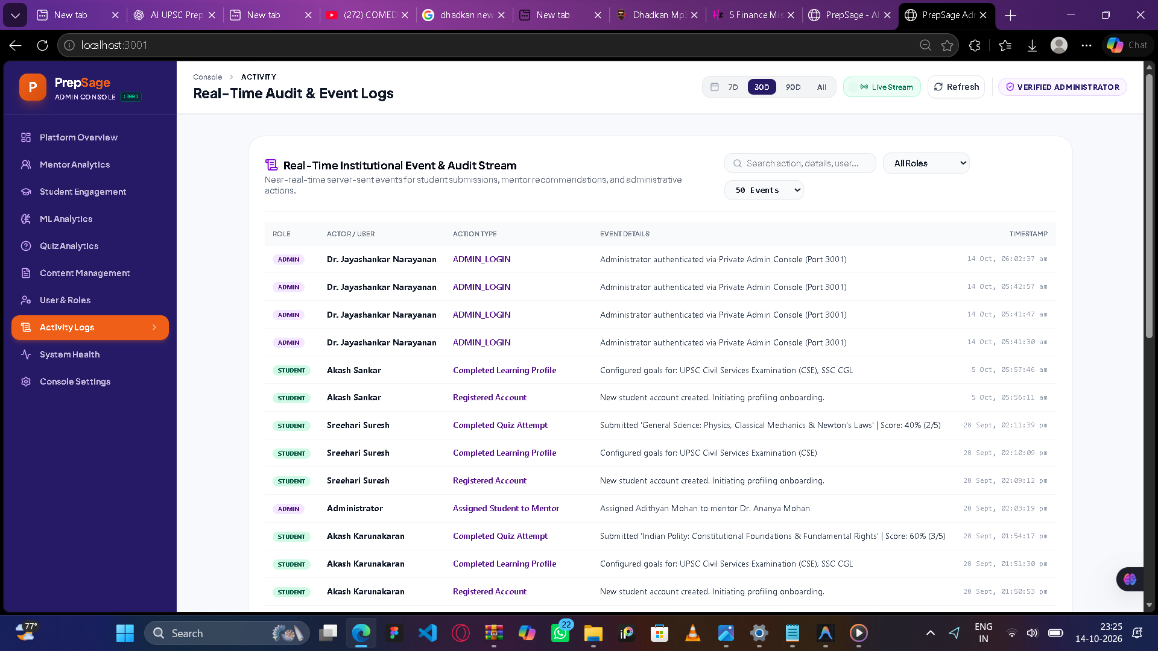

Slide 38
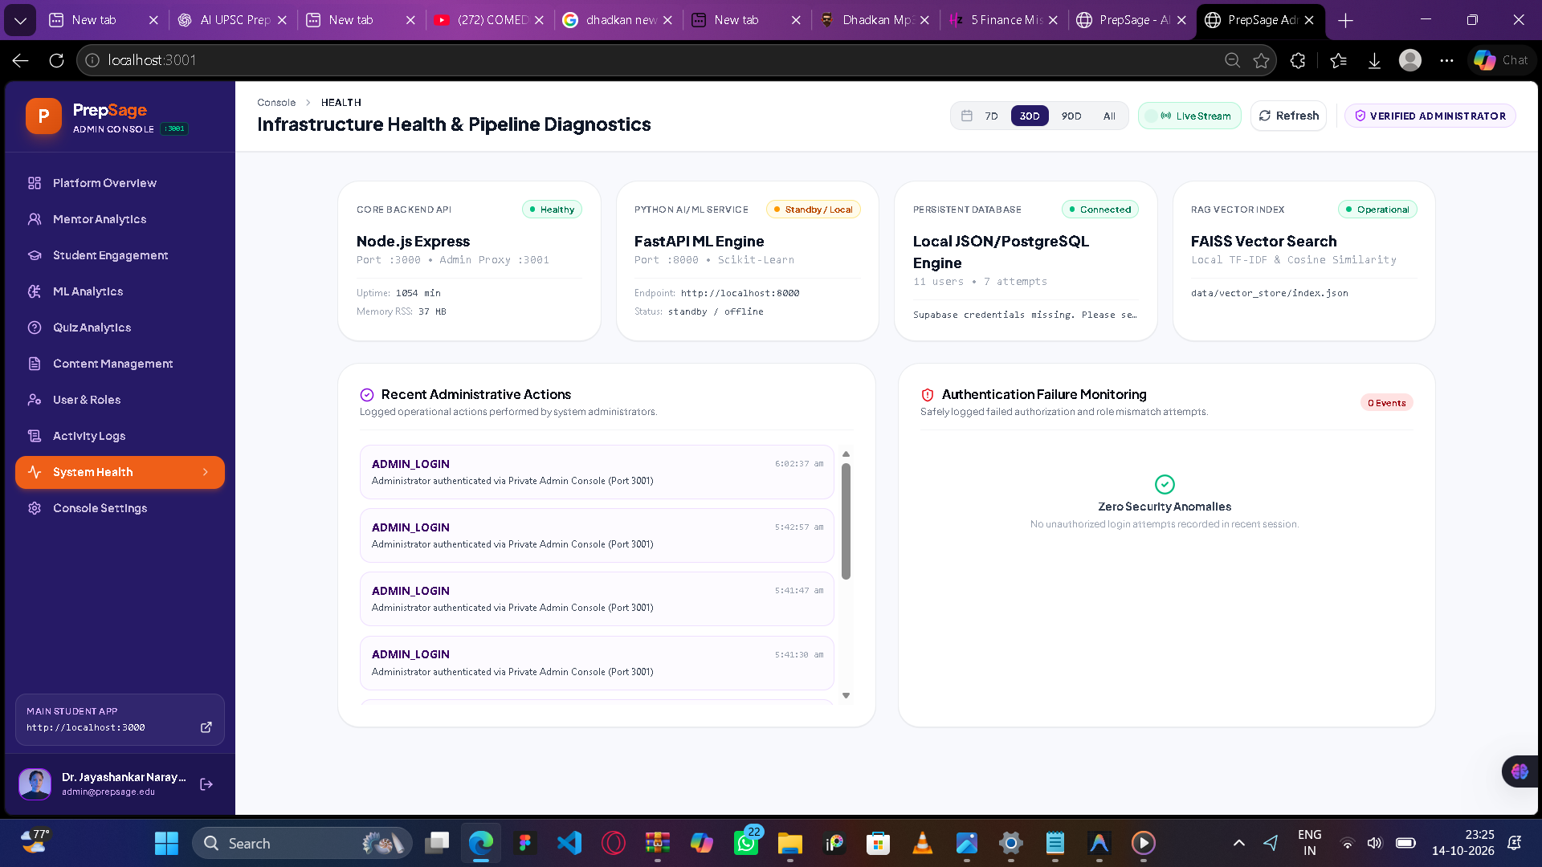

Slide 39
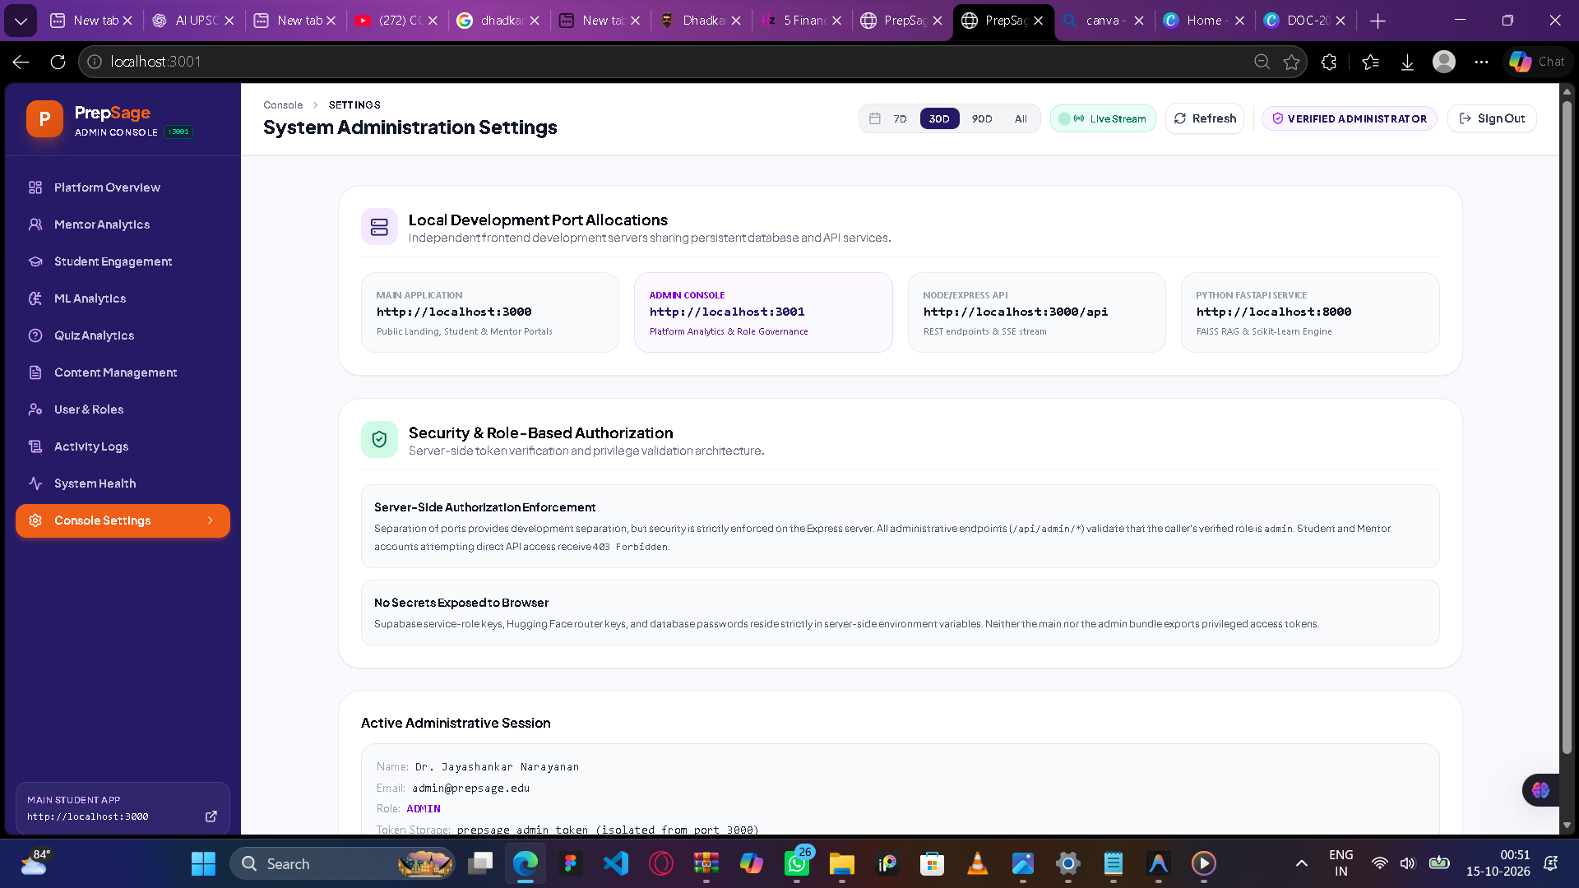

Slide 40







Conclusion & Future Scope
This platform unifies AI, ML, RAG, and automated data ingestion to provide personalized competitive-exam preparation and connect students, mentors, and administrators efficiently.
1
2
3
Multilingual AI
Advanced Prediction
Additional Exams & Mobile App
Extend assistance to multiple languages to broaden accessibility.
Improved performance forecasting and early-warning for at-risk students.
Scale to more exam types and deliver native mobile experiences.
4
Recommendation Enhancements
Stronger personalization through hybrid models and richer feature engineering.
Thank you — Questions & Feedback welcome
Notes:
1.7.2013
9
‹#›

