Slide 1


Major Project
Title: Disease Prediction using Patient Data
Presented by:
500124889 – Abhishek Uniyal
500124804 – Akash Kumar Yadav
500125986 – Devansh Pratap Singh
500125583 – Prince Nagarkoti
500125640 – Sumit Singh Kaintura
Guided By:
Dr. Pooja Singh
IBM

Slide 2
Content
Introduction
Literature Review
Objectives
Methodology
Working Model
Conclusion
References

Slide 3
Introduction
Why disease prediction matters?
Early diagnosis can save lives
Efficient use of healthcare resources
Early Implementation of Preventive Strategies
Uses Machine Learning to learn and predict
Notes:
Since the internet is accessible to all and its openness makes transactions easy,
there are also errors associated with this service.
Fraud detection is major necessity to carry out these operations.

Slide 4
Introduction
Algorithms Used
Machine Learning
Supervised Machine Learning
Random Forest
Decision Trees
Support Vector Machine
Notes:
Since the internet is accessible to all and its openness makes transactions easy,
there are also errors associated with this service.
Fraud detection is major necessity to carry out these operations.

Slide 5
Literature Review
Sharma, S. and Parmar, M., 2020. Heart diseases prediction using deep learning neural network model. Using SVM, accuracy for Heart Diseases 84.07%, Diabetes 78.26%, Random Forest 85.15% for heart diseases
D. Dahiwade, G. Patle and E. Meshram, "Designing Disease Prediction Model Using Machine Learning Approach.
S. Grampurohit and C. Sagarnal, "Disease Prediction using Machine Learning Algorithms.
Xie, S., Yu, Z. and Lv, Z., 2021. Multi-disease prediction based on deep learning: a survey.
Bhatt, C.M., Patel, P., Ghetia, T. and Mazzeo, P.L., 2023. Effective heart disease prediction using machine learning techniques. SVM accuracy 93.19%

Slide 6
Literature Review
SWOT Analysis
Strengths
Real Time Prediction.
User-friendly Interface.
PDF Report Generation.
Scalable and Modular.
Weaknesses
Limited Dataset Size.
Model Interpretability.
UI Overload.
Static PDF reports.
Opportunities
Integration with Health Care Systems.
Adding Visual Analytics.
Mobile App Version.
Threats
Over-Reliance on Predictions
Bias in Dataset.
Rapid Evolution of Medical Standards.
Traditional Statistical Approaches: Classical statistical methods such as logistic regression, decision trees, and Bayesian networks have been used for fraud detection.
Machine Learning and Data Mining Techniques: These techniques have gained popularity due to their ability to handle large volumes of data and identify complex patterns. Common algorithms include neural networks, support vector machines, random forests, and ensemble methods.

Slide 7
Objective
Objectives
Build an intelligent system to predict multiple diseases

Slide 8
Objective
Objectives
Build an intelligent system to predict multiple diseases
Use real-world patient data with health & lifestyle factors

Slide 9
Objective
Build an intelligent system to predict multiple diseases
Use real-world patient data with health & lifestyle factors
Generate downloadable health reports in PDF format

Slide 10
Objective
Use real-world patient data with health & lifestyle factors
Generate downloadable health reports in PDF format

Slide 11
Methodology
Steps
Generate downloadable health reports in PDF format
Through exploratory analysis, we analyzed the different datasets in detail and identified possible predictors of disease prediction.
Identified important features and discarded the unnecessary ones
We have experimented with supervised machine learning techniques – Decision Trees, Random Forest, and SVM.

Slide 12
Dataset
Dataset Name: Diabetes Prediction Dataset
Source: Kaggle (DIABETES_PREDICTION_DATASET.csv)
Size: 100000, 9
Attributes:
Gender
Age
Hypertension
Heart Disease
Smoking History
BMI
HBA1C Level
Blood Glucose Level
Diabetes (target column)

Slide 13
Dataset
Key Characteristics:
Data Types: Continuous and Boolean attributes.
Statistical Summary: Mean, median, and other descriptive statistics to be analysed.
Example Data Points:
gender | age | hypertension | heart_disease | smoking_history | bmi | HbA1c_level | blood_glucose_level | diabetes
Female | 80 | 0 | 1 | never | 25.19 | 6.6 | 140 | 0
Female | 54 | 0 | 0 | No Info | 27.32 | 6.6 | 80 | 0
Male | 28 | 0 | 0 | never | 27.32 | 5.7 | 158 | 0
Female | 36 | 0 | 0 | current | 23.45 | 5 | 155 | 0
Male | 76 | 1 | 1 | current | 20.14 | 4.8 | 155 | 0
Female | 20 | 0 | 0 | never | 27.32 | 6.6 | 85 | 0
Female | 44 | 0 | 0 | never | 19.31 | 6.5 | 200 | 1
Female | 79 | 0 | 0 | No Info | 23.86 | 5.7 | 85 | 0
Male | 42 | 0 | 0 | never | 33.64 | 4.8 | 145 | 0
Female | 32 | 0 | 0 | never | 27.32 | 5 | 100 | 0
Female | 53 | 0 | 0 | never | 27.32 | 6.1 | 85 | 0
Female | 54 | 0 | 0 | former | 54.7 | 6 | 100 | 0
Female | 78 | 0 | 0 | former | 36.05 | 5 | 130 | 0
Female | 67 | 0 | 0 | never | 25.69 | 5.8 | 200 | 0
Female | 76 | 0 | 0 | No Info | 27.32 | 5 | 160 | 0
Male | 78 | 0 | 0 | No Info | 27.32 | 6.6 | 126 | 0
Male | 15 | 0 | 0 | never | 30.36 | 6.1 | 200 | 0
Female | 42 | 0 | 0 | never | 24.48 | 5.7 | 158 | 0
Female | 42 | 0 | 0 | No Info | 27.32 | 5.7 | 80 | 0

Slide 14
Dataset
Dataset Name: Indicators of Heart Disease
Source: Google Datasets (HEART_DISEASE_DATASET.csv)
Size: 445132, 40
Attributes:
Sex
General Health
Physical Activities
Sleephours
HadHeartAttack (target column)
HadAngina
HadStroke
HadAsthma
HadSkinCancer
HadCOPD
HadDepression
HadKidneyDisease
HadArthritis
HadDiabetes
HearingIssue
VisionIssue
DifficultyConcentrating
DifficultyWalking
DIfficultyErrands
SmokerStatus
ChestScan
AgeCategory
Height
Weight
BMI
AlcoholDrinkers
HighRiskLastYear

Slide 15
Dataset
Key Characteristics:
Data Types: Continuous and Boolean attributes.
Statistical Summary: Mean, median, and other descriptive statistics to be analysed.
Example Data Points:
Sex | GeneralHealth | PhysicalActivities | HadHeartAttack | HadAngina | HadStroke | HadAsthma | HadSkinCancer | HadCOPD | HadDepressiveDisorder | HadKidneyDisease | HadArthritis | HadDiabetes | DeafOrHardOfHearing | BlindOrVisionDifficulty | DifficultyConcentrating | DifficultyWalking | DifficultyDressingBathing | DifficultyErrands | SmokerStatus | ChestScan | HeightInMeters | WeightInKilograms | BMI | AlcoholDrinkers | HIVTesting | HighRiskLastYear
0 | 3 | 1 | 0 | 0 | 0 | 0 | 0 | 0 | 0 | 0 | 1 | 0 | 0 | 0 | 0 | 0 | 0 | 0 | 1 | 0 | 1.6 | 71.67 | 27.99 | 0 | 0 | 0
1 | 3 | 1 | 0 | 0 | 0 | 0 | 0 | 0 | 0 | 0 | 1 | 1 | 0 | 0 | 0 | 0 | 0 | 0 | 1 | 0 | 1.78 | 95.25 | 30.13 | 0 | 0 | 0
1 | 3 | 0 | 0 | 0 | 0 | 0 | 0 | 0 | 0 | 0 | 1 | 0 | 0 | 1 | 0 | 1 | 0 | 0 | 1 | 1 | 1.85 | 108.86 | 31.66 | 1 | 0 | 0
0 | 1 | 1 | 0 | 0 | 0 | 0 | 1 | 0 | 1 | 0 | 1 | 0 | 0 | 0 | 0 | 1 | 0 | 0 | 0 | 0 | 1.7 | 90.72 | 31.32 | 0 | 0 | 0
0 | 2 | 1 | 0 | 0 | 0 | 0 | 0 | 0 | 0 | 0 | 1 | 0 | 0 | 0 | 0 | 0 | 0 | 0 | 0 | 0 | 1.55 | 79.38 | 33.07 | 0 | 0 | 0
1 | 2 | 1 | 0 | 0 | 0 | 0 | 0 | 0 | 0 | 0 | 0 | 0 | 0 | 0 | 0 | 0 | 0 | 0 | 0 | 1 | 1.85 | 120.2 | 34.96 | 1 | 1 | 0
0 | 2 | 1 | 0 | 0 | 1 | 0 | 0 | 0 | 0 | 0 | 0 | 1 | 0 | 0 | 0 | 0 | 0 | 0 | 0 | 1 | 1.63 | 88 | 33.3 | 0 | 0 | 0
1 | 1 | 1 | 1 | 1 | 0 | 0 | 1 | 0 | 0 | 0 | 1 | 1 | 0 | 0 | 0 | 0 | 0 | 0 | 0 | 1 | 1.75 | 74.84 | 24.37 | 0 | 1 | 0
1 | 2 | 0 | 0 | 0 | 0 | 0 | 0 | 0 | 0 | 0 | 1 | 0 | 1 | 0 | 0 | 0 | 0 | 0 | 1 | 1 | 1.7 | 78.02 | 26.94 | 0 | 0 | 0
0 | 3 | 1 | 0 | 0 | 0 | 1 | 1 | 0 | 0 | 0 | 1 | 0 | 0 | 0 | 0 | 0 | 0 | 0 | 1 | 1 | 1.68 | 63.5 | 22.6 | 0 | 0 | 0
1 | 3 | 1 | 0 | 0 | 0 | 0 | 0 | 0 | 0 | 0 | 0 | 0 | 0 | 0 | 0 | 0 | 0 | 0 | 0 | 1 | 1.83 | 122.47 | 36.62 | 1 | 0 | 0
0 | 2 | 1 | 0 | 0 | 0 | 0 | 0 | 0 | 0 | 0 | 1 | 1 | 0 | 0 | 0 | 1 | 0 | 0 | 0 | 0 | 1.52 | 108.86 | 46.87 | 0 | 0 | 0
1 | 2 | 1 | 1 | 0 | 0 | 0 | 1 | 0 | 0 | 0 | 1 | 0 | 0 | 0 | 1 | 1 | 0 | 0 | 2 | 1 | 1.88 | 115.67 | 32.74 | 0 | 0 | 0
0 | 2 | 0 | 0 | 0 | 0 | 0 | 0 | 0 | 0 | 0 | 0 | 0 | 0 | 0 | 0 | 0 | 0 | 0 | 1 | 0 | 1.52 | 81.65 | 35.15 | 0 | 0 | 0
1 | 1 | 0 | 0 | 1 | 0 | 0 | 0 | 0 | 1 | 1 | 1 | 0 | 1 | 0 | 1 | 1 | 1 | 0 | 0 | 1 | 1.78 | 86.18 | 27.26 | 0 | 0 | 0
0 | 2 | 1 | 0 | 0 | 0 | 0 | 0 | 0 | 1 | 0 | 0 | 1 | 0 | 0 | 0 | 0 | 0 | 0 | 1 | 1 | 1.5 | 63.5 | 28.28 | 0 | 0 | 0
0 | 2 | 1 | 0 | 0 | 0 | 1 | 0 | 0 | 0 | 0 | 0 | 0 | 0 | 0 | 0 | 0 | 0 | 0 | 2 | 1 | 1.73 | 76.2 | 25.54 | 0 | 0 | 0
0 | 2 | 0 | 0 | 0 | 0 | 0 | 0 | 0 | 0 | 0 | 0 | 0 | 0 | 0 | 0 | 1 | 0 | 0 | 2 | 1 | 1.65 | 54.88 | 20.14 | 1 | 0 | 0
0 | 4 | 1 | 0 | 0 | 1 | 0 | 0 | 0 | 0 | 0 | 0 | 1 | 0 | 0 | 0 | 0 | 0 | 0 | 0 | 0 | 1.7 | 72.57 | 25.06 | 0 | 0 | 0

Slide 16
Dataset
Dataset Name: Kidney Disease Prediction
Source: Kaggle Datasets (KIDNEY_DISEASE_DATASET.csv)
Size: 20538, 42
Attributes:
Age
Blood Pressure
Specific gravity in urine
Albumin in urine
Red blood cells in urine
Pus cells in urine
Pus cell clumps in urine
Bacteria in urine
Random blood glucose level (mg/dl)
Blood urea (mg/dl)
Serum creatinine (mg/dl)
Sodium level (mEq/L)
Potassium level (mEq/L)
Hemoglobin level (gms)
Packed cell volume (%)
BMI

Slide 17
Dataset
Key Characteristics:
Data Types: Continuous and Boolean attributes.
Statistical Summary: Mean, median, and other descriptive statistics to be analysed.
Example Data Points:
Sex | GeneralHealth | PhysicalActivities | HadHeartAttack | HadAngina | HadStroke | HadAsthma | HadSkinCancer | HadCOPD | HadDepressiveDisorder | HadKidneyDisease | HadArthritis | HadDiabetes | DeafOrHardOfHearing | BlindOrVisionDifficulty | DifficultyConcentrating | DifficultyWalking | DifficultyDressingBathing | DifficultyErrands | SmokerStatus | ChestScan | HeightInMeters | WeightInKilograms | BMI | AlcoholDrinkers | HIVTesting | HighRiskLastYear
0 | 3 | 1 | 0 | 0 | 0 | 0 | 0 | 0 | 0 | 0 | 1 | 0 | 0 | 0 | 0 | 0 | 0 | 0 | 1 | 0 | 1.6 | 71.67 | 27.99 | 0 | 0 | 0
1 | 3 | 1 | 0 | 0 | 0 | 0 | 0 | 0 | 0 | 0 | 1 | 1 | 0 | 0 | 0 | 0 | 0 | 0 | 1 | 0 | 1.78 | 95.25 | 30.13 | 0 | 0 | 0
1 | 3 | 0 | 0 | 0 | 0 | 0 | 0 | 0 | 0 | 0 | 1 | 0 | 0 | 1 | 0 | 1 | 0 | 0 | 1 | 1 | 1.85 | 108.86 | 31.66 | 1 | 0 | 0
0 | 1 | 1 | 0 | 0 | 0 | 0 | 1 | 0 | 1 | 0 | 1 | 0 | 0 | 0 | 0 | 1 | 0 | 0 | 0 | 0 | 1.7 | 90.72 | 31.32 | 0 | 0 | 0
0 | 2 | 1 | 0 | 0 | 0 | 0 | 0 | 0 | 0 | 0 | 1 | 0 | 0 | 0 | 0 | 0 | 0 | 0 | 0 | 0 | 1.55 | 79.38 | 33.07 | 0 | 0 | 0
1 | 2 | 1 | 0 | 0 | 0 | 0 | 0 | 0 | 0 | 0 | 0 | 0 | 0 | 0 | 0 | 0 | 0 | 0 | 0 | 1 | 1.85 | 120.2 | 34.96 | 1 | 1 | 0
0 | 2 | 1 | 0 | 0 | 1 | 0 | 0 | 0 | 0 | 0 | 0 | 1 | 0 | 0 | 0 | 0 | 0 | 0 | 0 | 1 | 1.63 | 88 | 33.3 | 0 | 0 | 0
1 | 1 | 1 | 1 | 1 | 0 | 0 | 1 | 0 | 0 | 0 | 1 | 1 | 0 | 0 | 0 | 0 | 0 | 0 | 0 | 1 | 1.75 | 74.84 | 24.37 | 0 | 1 | 0
1 | 2 | 0 | 0 | 0 | 0 | 0 | 0 | 0 | 0 | 0 | 1 | 0 | 1 | 0 | 0 | 0 | 0 | 0 | 1 | 1 | 1.7 | 78.02 | 26.94 | 0 | 0 | 0
0 | 3 | 1 | 0 | 0 | 0 | 1 | 1 | 0 | 0 | 0 | 1 | 0 | 0 | 0 | 0 | 0 | 0 | 0 | 1 | 1 | 1.68 | 63.5 | 22.6 | 0 | 0 | 0
1 | 3 | 1 | 0 | 0 | 0 | 0 | 0 | 0 | 0 | 0 | 0 | 0 | 0 | 0 | 0 | 0 | 0 | 0 | 0 | 1 | 1.83 | 122.47 | 36.62 | 1 | 0 | 0
0 | 2 | 1 | 0 | 0 | 0 | 0 | 0 | 0 | 0 | 0 | 1 | 1 | 0 | 0 | 0 | 1 | 0 | 0 | 0 | 0 | 1.52 | 108.86 | 46.87 | 0 | 0 | 0
1 | 2 | 1 | 1 | 0 | 0 | 0 | 1 | 0 | 0 | 0 | 1 | 0 | 0 | 0 | 1 | 1 | 0 | 0 | 2 | 1 | 1.88 | 115.67 | 32.74 | 0 | 0 | 0
0 | 2 | 0 | 0 | 0 | 0 | 0 | 0 | 0 | 0 | 0 | 0 | 0 | 0 | 0 | 0 | 0 | 0 | 0 | 1 | 0 | 1.52 | 81.65 | 35.15 | 0 | 0 | 0
1 | 1 | 0 | 0 | 1 | 0 | 0 | 0 | 0 | 1 | 1 | 1 | 0 | 1 | 0 | 1 | 1 | 1 | 0 | 0 | 1 | 1.78 | 86.18 | 27.26 | 0 | 0 | 0
0 | 2 | 1 | 0 | 0 | 0 | 0 | 0 | 0 | 1 | 0 | 0 | 1 | 0 | 0 | 0 | 0 | 0 | 0 | 1 | 1 | 1.5 | 63.5 | 28.28 | 0 | 0 | 0
0 | 2 | 1 | 0 | 0 | 0 | 1 | 0 | 0 | 0 | 0 | 0 | 0 | 0 | 0 | 0 | 0 | 0 | 0 | 2 | 1 | 1.73 | 76.2 | 25.54 | 0 | 0 | 0
0 | 2 | 0 | 0 | 0 | 0 | 0 | 0 | 0 | 0 | 0 | 0 | 0 | 0 | 0 | 0 | 1 | 0 | 0 | 2 | 1 | 1.65 | 54.88 | 20.14 | 1 | 0 | 0
0 | 4 | 1 | 0 | 0 | 1 | 0 | 0 | 0 | 0 | 0 | 0 | 1 | 0 | 0 | 0 | 0 | 0 | 0 | 0 | 0 | 1.7 | 72.57 | 25.06 | 0 | 0 | 0

Slide 18
Methodology
Timeline
First Week: Understanding the need of model generator and the model
Second Week: Synopsis Report and Literature Review
Third Week: Data Collection and Preprocessing
Fourth Week: Understanding advanced machine learning
Fifth Week: Implementation
Sixth Week: Analysis and Documentation

Slide 19
Models Used
SVM
Support Vector Machines (SVMs) are powerful supervised learning algorithms primarily used for classification and regression tasks. SVM work by identifying the optimal hyperplane that separates data points of different classes in a high-dimensional space, maximizing the margin between the closest points of each class, known as support vectors.
Decision Trees
Decision Trees are a supervised machine learning algorithm that splits data into branches based on feature values to make predictions. Each internal node represents a decision on an attribute, and each leaf node represents an outcome or class label.
Random Forest
Random Forest is an ensemble learning method that builds multiple decision trees and combines their outputs for more accurate and stable predictions. It reduces overfitting by averaging the results of randomly generated trees.

Slide 20
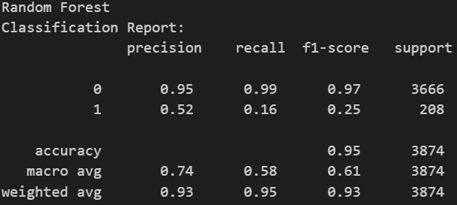
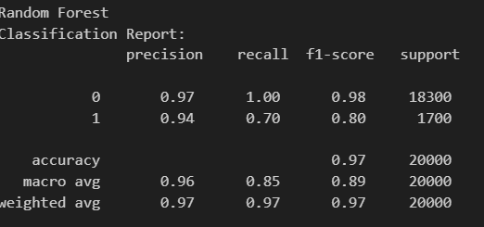
Model Used
Heart Disease Model
using Random Forest
Diabetes Disease Model
using Random Forest

Slide 21
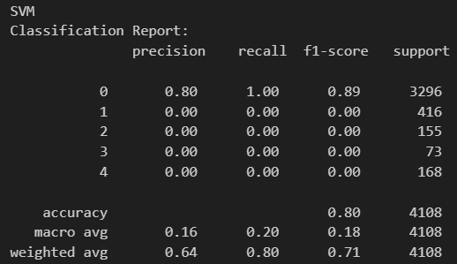
Model Used
Kidney Disease Model
using Support Vector Classifier

Slide 22
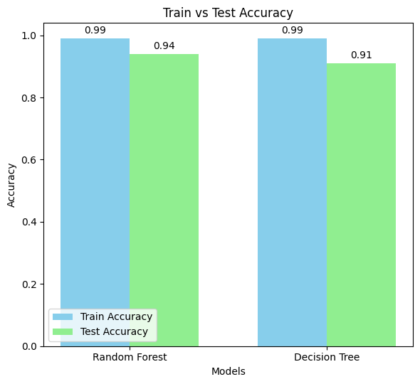
Model Comparison
Random Forest
achieved an accuracy of 99.91% on train data for Heart Disease Prediction.
achieved an accuracy of 94.77% on test data for Heart Disease Prediction.

Slide 23
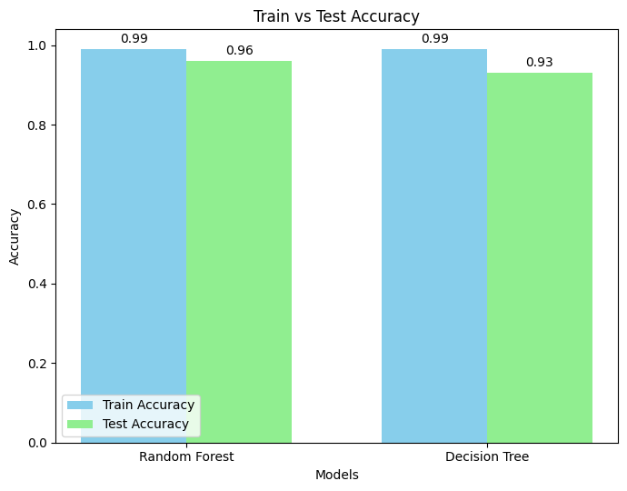
Model Comparison
.
Random Forest
achieved an accuracy of 99.95% on train data for Diabetes Prediction.
achieved an accuracy of 96.12% on test data for Diabetes Prediction.

Slide 24
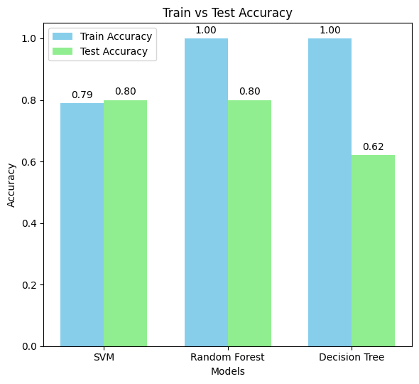
Model Comparison
SVM
achieved an accuracy of 79.95% on train data for Kidney Disease Prediction.
achieved an accuracy of 80.23% on test data for Kidney Disease Prediction.

Slide 25
Deliverables

Slide 26
Conclusion
In conclusion, we have experimented with several supervised machine learning algorithms – Decision Trees, Random Forest, and SVM., compared accuracies, analyzed confusion matrices and chose the best suited.
This interface will prove to be helpful with patients and doctors for diagnosis and prediction using past data through user input.
We developed a web interface that takes user input and makes a prediction using python microframework Flask and framework Dash.

Slide 27
Thank You

