Slide 2
Direct Address Table
Direct Address Table is a data structure that has the capability of mapping records to their corresponding keys using arrays.
In direct address tables, records are placed using their key values directly as indexes.
They facilitate fast searching, insertion and deletion operations.

Slide 3
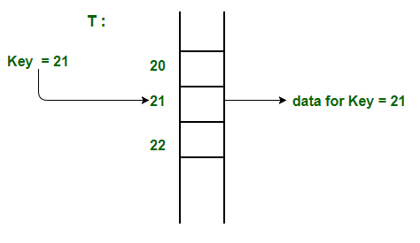
Direct Address Table
We can understand the concept using the following example. We create an array of size equal to maximum value plus one (assuming 0 based index) and then use values as indexes.
For example, in the following diagram key 21 is used directly as index.

Slide 4
Advantages:
Searching in O(1) Time: Direct address tables use arrays which are random access data structure, so, the key values (which are also the index of the array) can be easily used to search the records in O(1) time.
Insertion in O(1) Time: We can easily insert an element in an array in O(1) time. The same thing follows in a direct address table also.
Deletion in O(1) Time: Deletion of an element takes O(1) time in an array. Similarly, to delete an element in a direct address table we need O(1) time.

Slide 5
Limitations:
Prior knowledge of maximum key value
Practically useful only if the maximum value is very less.
It causes wastage of memory space if there is a significant difference between total records and maximum value.
Hashing can overcome these limitations of direct address tables.

Slide 6
Hashing
Hashing is an improvement over Direct Address Table.
The idea is to use hash function that converts a given phone number or any other key (Large Number) to a smaller number and uses the small number as index in a table called hash table.

Slide 7
Hashing
Hash Function: A function that converts a given big phone number to a small practical integer value. The mapped integer value is used as an index in hash table. In simple terms, a hash function maps a big number or string to a small integer that can be used as index in hash table.
A good hash function should have following properties 1) Efficiently computable. 2) Should uniformly distribute the keys (Each table position equally likely for each key)
For example, for phone numbers a bad hash function is to take first three digits. A better function is to consider last three digits. Please note that this may not be the best hash function. There may be better ways.

Slide 8
Hashing
Hash Table: An array that stores pointers to records corresponding to a given phone number (key). An entry in hash table is NIL if no existing phone number has hash function value equal to the index for the entry.
Collision Handling: Since a hash function gets us a small number for a big key, there is possibility that two keys result in same value. The situation where a newly inserted key maps to an already occupied slot in hash table is called collision and must be handled using some collision handling technique. Following are the ways to handle collisions:
Chaining:The idea is to make each cell of hash table point to a linked list of records that have same hash function value. Chaining is simple, but requires additional memory outside the table.
Open Addressing: In open addressing, all elements are stored in the hash table itself. Each table entry contains either a record or NIL. When searching for an element, we one by one examine table slots until the desired element is found or it is clear that the element is not in the table.

Slide 9
Hash Function
In general, a hash function should depend on every single bit of the key, so that two keys that differ in only one bit or one group of bits (regardless of whether the group is at the beginning, end, or middle of the key or present throughout the key) hash into different values. Thus, a hash function that simply extracts a portion of a key is not suitable.
Similarly, if two keys are simply digited or character permutations of each other (such as 139 and 319), they should also hash into different values.

Slide 10
Hash Function
The two heuristic methods are hashing by division and hashing by multiplication which are as follows:
The mod method (The division Method):
In this method for creating hash functions, we map a key into one of the slots of table by taking the remainder of key divided by table_size.
That is, the hash function is
h(key) = key mod table_size
i.e. key % table_size

Slide 11
Hash Function
Example: Considering a table size of 17.
For key = 37599, its hash is
37599 % 17 = 12
But for key = 573, its hash function is also
573 % 17 = 12
Hence it can be seen that by this hash function, many keys can have the same hash. This is called Collision.

Slide 12
Hash Function
Multiplication Method
The hash function used for the multiplication method is :
h(k) = floor( n( kA mod 1 ) )
Here, k is the key and A can be any constant value between 0 and 1.
Both k and A are multiplied and their fractional part is separated.
This is then multiplied with n (table size) to get the hash value.

Slide 13
Hash Function
An example of the Multiplication Method is as follows:
k=123
n=100
A=0.618033
h(123) = 100 (123 * 0.618033 mod 1)
= 100 (76.018059 mod 1)
= 100 (0.018059)
= 1

Slide 14
Hash Function
Mid Square Method
The mid square method is a very good hash function.
It involves squaring the value of the key and then extracting the middle r digits as the hash value.
The value of r can be decided according to the size of the hash table.

Slide 15
Hash Function
An example of the Mid Square Method is as follows:
Suppose the hash table has 100 memory locations. So r=2 because two digits are required to map the key to memory location.
k = 50
k*k = 2500
h(50) = 50
The hash value obtained is 50

Slide 16
Collision Handling Techniques (Chaining)
Separate Chaining: The idea is to make each cell of hash table point to a linked list of records that have same hash function value.
Let us consider a simple hash function as “key mod 7” and sequence of keys as 50, 700, 76, 85, 92, 73, 101.

Slide 17
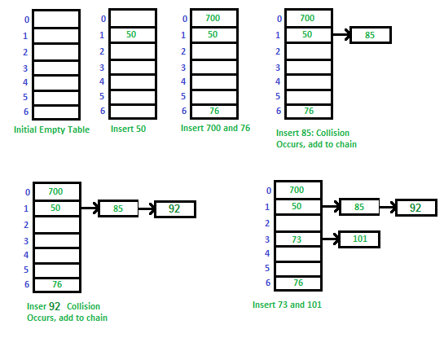
Collision Handling Techniques (Chaining)

Slide 18
Collision Handling Techniques (Chaining)
Advantages: 1) Simple to implement.
2) Hash table never fills up, we can always add more elements to the chain. 3) It is mostly used when it is unknown how many and how frequently keys may be inserted or deleted.
Disadvantages:
Cache performance of chaining is not good as keys are stored using a linked list. Open
addressing provides better cache performance as everything is stored in the same table. 2) Wastage of Space (Some Parts of hash table are never used) 3) If the chain becomes long, then search time can become O(n) in the worst case. 4) Uses extra space for links.

Slide 19
Collision Handling Techniques (Open Addressing)
Open Addressing
Like separate chaining, open addressing is a method for handling collisions. In Open Addressing, all elements are stored in the hash table itself. So at any point, size of the table must be greater than or equal to the total number of keys.

Slide 20
Collision Handling Techniques (Open Addressing)
Insert(k): Keep probing until an empty slot is found. Once an empty slot is found, insert k.
Search(k): Keep probing until slot’s key doesn’t become equal to k or an empty slot is reached.
Delete(k): Delete operation is interesting. If we simply delete a key, then search may fail. So slots of deleted keys are marked specially as “deleted”.
Insert can insert an item in a deleted slot, but the search doesn’t stop at a deleted slot.

Slide 21
Collision Handling Techniques (Open Addressing)
Open Addressing is done in the following ways:
Linear Probing: In linear probing, we linearly probe for next slot.
For example, typical gap between two probes is 1 as taken in below example also. Let hash(x) be the slot index computed using hash function and S be the table size
Let us consider a simple hash function as “key mod 7” and sequence of keys as 50, 700, 76, 85, 92, 73, 101.

Slide 22
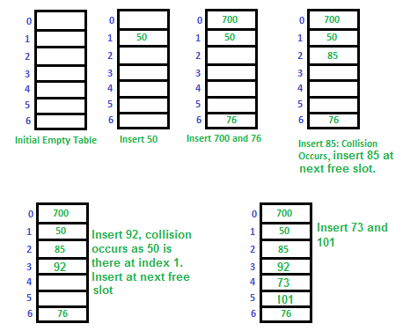
Collision Handling Techniques (Open Addressing)

Slide 23
Collision Handling Techniques (Open Addressing)
Quadratic Probing We look for i²’th slot in i’th iteration.
let hash(x) be the slot index computed using hash function.
If slot hash(x) is full, then we try (hash(x) + 1*1) % S
If (hash(x) + 1*1) % S is also full, then we try (hash(x) + 2*2) % S
If (hash(x) + 2*2) % S is also full, then we try (hash(x) + 3*3) % S
..................................................
..................................................

