Slide 1
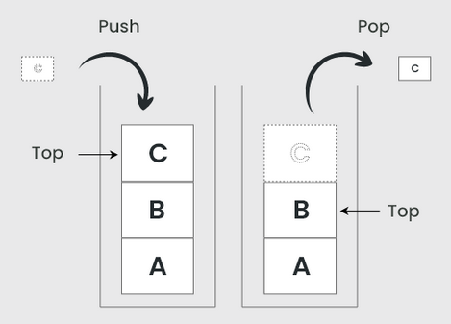
Stack Data Structure
Stack is a linear data structure that follows a particular order in which the operations are performed.
The order may be LIFO(Last In First Out) or FILO(First In Last Out).

Slide 2
Stack Using Linked List
#include<stdio.h>
struct Node
{
int data;
struct Node *next;
}*top = NULL;
void push(int);
void pop();
void display();
void main() {
int choice, value;
printf("\n:: Stack using Linked List ::\n");
while(1){
printf("1. Push\n2. Pop\n3. Display\n4. Exit\nEnter your choice: ");
scanf("%d",&choice);
switch(choice){
case 1: printf("Enter the value to be inserted: ");
scanf("%d", &value);
push(value); break;
case 2: pop(); break;
case 3: display(); break;
case 4: exit(0);
default: printf("\nWrong selection!!");
} } }
void pop()
{
if(top == NULL)
printf("\nStack is Empty!!!\n");
else{
struct Node *temp = top;
printf("\nDeleted element: %d", temp->data);
top = temp->next;
free(temp);
}
}
void push(int value)
{
struct Node *newNode;
newNode = (struct Node*)malloc(sizeof(struct Node));
newNode->data = value;
if(top == NULL)
newNode->next = NULL;
else
newNode->next = top;
top = newNode;
printf("\nInsertion Successful!!!\n");
}
void display()
{
if(top == NULL)
printf("\nStack is Empty!!!\n");
else{
struct Node *temp = top;
while(temp->next != NULL){
printf("%d--->",temp->data);
temp = temp -> next;
}
printf("%d--->NULL",temp->data);
}
}

Slide 3
Basic Idea → PUSH & POP
TOP
Push(6);
Push(14);
Push(25);
Push(56);
Pop(56);
Pop(25);
56
25
14
6

Slide 4
#include<stdio.h>
struct Node
{
int data;
struct Node *next;
}*top = NULL;
TOP
DATA next
Node

Slide 5
Push Operation------ push(6)
Push function called , value=6
void push(int value)
{
struct Node *newNode;
newNode = (struct Node*)malloc(sizeof(struct Node));
newNode->data = value;
if(top == NULL)
newNode->next = NULL;
else
newNode->next = top;
top = newNode;
printf("\nInsertion is Success!!!\n");
}
A struct node type pointer is created i.e newnode
Malloc function is used to allocate dynamic memory (space size is equal to the memory space of structure node) to newnode pointer
TOP
Value 6 is inserted successfully
6
newnode
Now, TOP is pointing to newnode
Value 6 is assigned to the data part of newnode
Condition TOP= NULL is true so next part of newnode is assigned a NULL value
Else part will not execute

