Slide 1
Functions in C

Slide 2
Function Introduction
C functions are basic building blocks in a program.
All C programs are written using functions to improve re-usability, understandability and to keep track on them.
A function is a group of statements that together perform a task.
Every C program has at least one function, which is main()

Slide 3
Uses of C Functions
C functions are used to avoid rewriting same logic/code again and again in a program.
There is no limit in calling C functions to make use of same functionality wherever required.
We can call functions any number of times in a program and from any place in a program.
A large C program can easily be tracked when it is divided into functions.
The core concept of C functions are, re-usability, dividing a big task into small pieces to achieve the functionality and to improve understandability of very large C programs.

Slide 4
Types of functions in C
Depending on whether a function is defined by the user or already included in C compilers, there are two types of functions in C programming:-
Standard library functions
User defined functions

Slide 5
Standard library functions
The standard library functions are in-built functions in C programming to handle tasks such as mathematical computations, I/O processing, string handling etc.
These functions are defined in the header file. When you include the header file, these functions are available for use.
For example:
The printf() is a standard library function to display output on the screen. This function is defined in "stdio.h" header file.

Slide 6
Study the following header files and their important functions:-
stdio.h
stdlib.h
limits.h
math.h
ctype.h
time.h
float.h
string.h

Slide 7
User-defined functions
C language allows programmer to define functions. Such functions created by the user are called user-defined functions.
Depending upon the complexity and requirement of the program, you can create as many user-defined functions as you want.

Slide 8
Advantages of user-defined function
The program will be easier to understand, maintain and debug.
Reusable codes that can be used in other programs.
A large program can be divided into smaller modules. Hence, a large project can be divided among many programmers.

Slide 9
C function aspects
There are 3 aspects in each C function. They are,
Function declaration – This informs compiler about the function name, function parameters and return value’s data type.
Function call – This calls the actual function
Function definition – This contains all the statements to be executed.

Slide 10
C function aspects
S.no | C function aspects | syntax
1 | function declaration | return_type function_name ( argument list );
2 | function call | function_name ( arguments list );
3 | Function definition | return_type function_name ( arguments list ) { Body of function; }

Slide 11
Simple example of C function
#include<stdio.h>
void message(); //function prototype/declaration
void main()
{
message(); //function call
printf(“You are in main…”);
}
void message() //function definition
{
printf(“Hello user!!\n”);
}

Slide 12
Defining a Function
A function definition in C programming consists of the following −
Return Type − A function may return a value. The return_type is the data type of the value the function returns. Some functions perform the desired operations without returning a value. In this case, the return_type is the keyword void.
Function Name − This is the actual name of the function. The function name and the parameter list together constitute the function signature.
Parameters − A parameter is like a placeholder. When a function is invoked, you pass a value to the parameter. This value is referred to as actual parameter or argument. The parameter list refers to the type, order, and number of the parameters of a function. Parameters are optional; that is, a function may contain no parameters.
Function Body − The function body contains a collection of statements that define what the function does.

Slide 13
How the return statement works?
First you need to understand how the function call works. When you call a function two things happen
The execution of the current function is paused.
The function that you call starts executing
This is what we call a transfer of control. When you call a function the control of the program is transferred from the calling function to the called function.
The return statement returns the control to the previous routine. That function will continue its execution from the point where it was paused.
On the contrary, a function that calls the return statement is finished. It is not in a paused state and it cannot resume.

Slide 14
C – Argument & return value
All C functions can be called either with arguments or without arguments in a C program. These functions may or may not return values to the calling function.
C functions can basically be called in one of the following four ways:-
C function without arguments (parameters) and without return value
C function without arguments (parameters) and with return value
C function with arguments (parameters) and without return value
C function with arguments (parameters) and with return value

Slide 15
C function without arguments (parameters) and without return value
#include<stdio.h>
void sum(); //function declaration
void main()
{
sum(); //function call
}
void sum() //function definition
{
int a = 50, b = 80;
int c=a+b;
printf(“sum of %d and %d = %d”,a,b,c);
}

Slide 16
C function without arguments (parameters) and with return value
#include<stdio.h>
int sum(); //function declaration
void main()
{
int s = sum(); //function call
printf("sum=%d\n",s);
}
int sum() //function definition
{
int a,b,c;
printf("enter values of a and b\n");
scanf("%d%d",&a,&b);
c=a+b;
return c;
}

Slide 17
C function with arguments (parameters) and without return value
#include<stdio.h>
void sum(int x, int y);
void main()
{
int a,b;
printf("enter the values of a and b\n");
scanf("%d%d",&a,&b);
sum(a,b);
}
void sum(int x, int y)
{
int c=x+y;
printf("sum = %d",c);
}

Slide 18
C function with arguments (parameters) and with return value
#include<stdio.h>
int sum ( int x, int y ); // function declaration
void main( )
{
int a, b, ans ;
printf ( "\nEnter the values of a and b\n");
scanf ( "%d%d", &a,&b ) ;
ans = sum( a,b ) ; // function call
printf ( "\nSum of %d and %d is %d",a,b, ans );
}
int sum ( int x, int y ) // function definition
{
int p ;
p = x + y ;
return ( p ) ;
}

Slide 19
Function with Local and Global Variables
#include<stdio.h>
// Global variables
int A;
int B;
int Add()
{
return A + B;
}
int main()
{
int answer; // Local variables
A = 5;
B = 7;
answer = Add();
printf("%d\n",answer);
return 0;
}

Slide 20
Function with Local and Global Variables
#include<stdio.h>
int Add(int output1,int output2 )
{
printf("%d", output1);
printf("%d", output2);
return output1 + output2;
}
int main()
{
int answer, input1, input2;
scanf("%d", &input1);
scanf("%d", &input2);
answer = Add(input1,input2);
printf(" answer = %d\n", answer);
return 0;
}

Slide 21
Recursion in C
A function that calls itself is known as recursive function. And, this technique is known as recursion.
The C programming language supports recursion. But while using recursion, programmers need to be careful to define an exit condition from the function, otherwise it will go into an infinite loop.
Recursive functions are very useful to solve many mathematical problems, such as calculating the factorial of a number, generating Fibonacci series, etc.

Slide 22
How recursion works?
void main()
{ ...
...
recurse();
...
... }
void recurse()
{ ...
...
recurse();
...
... }

Slide 23
Example: Sum of ‘n’ Natural Numbers Using Recursion
#include <stdio.h>
int sum(int n);
void main()
{ int number, result;
printf("Enter a positive integer: ");
scanf("%d", &number);
result = sum(number);
printf("sum=%d", result);
}
int sum(int n)
{ if (n!=0)
return n + sum(n-1); // sum() function calls itself
else return n;
}

Slide 24
Example: Factorial of a Number Using Recursion
#include <stdio.h>
int factorial(unsigned int i);
void main()
{ int i;
printf("Enter any number: ");
scanf("%d",&i);
printf("Factorial of %d is %d\n", i, factorial(i));
}
int factorial(unsigned int i)
{
if(i <= 1)
return 1;
return i * factorial(i - 1);
}

Slide 25
Example: Fibonacci Series Using Recursion
#include <stdio.h>
int fibonaci(int i);
void main()
{ int i,n;
printf("Enter the value of n: ");
scanf("%d",&n);
for (i = 0; i <n; i++)
printf("%d\t\n", fibonaci(i));
}
int fibonaci(int i)
{
if(i == 0)
{return 0;}
if(i == 1)
{ return 1;}
return fibonaci(i-1) + fibonaci(i-2);
}

Slide 26
What will be the output?
#include<stdio.h>
void demo(int);
void main()
{
int a=30;
demo(a);
printf(“a=%d\n”,a);
}
void demo(int b)
{
b=60;
printf(“b=%d”,b);
}

Slide 27
What will be the output?
#include<stdio.h>
int demo(int);
void main()
{
int a=30;
int d = demo(a);
printf(“a=%d\n”,a);
printf(“d = %d\n”,d);
}
int demo(int b)
{
printf(“b=%d”,b);
b=60;
printf(“b=%d”,b);
return b;
}

Slide 28
Pointers in C
C Pointer is a variable that stores/points the address of another variable.
C Pointer is used to allocate memory dynamically i.e. at run time.
The pointer variable might be belonging to any of the data type such as int, float, char, double, short etc.
Syntax : data_type *var_name;
Example : int *p; char *p;
int *p means that the value at the address contained in p is an integer.

Slide 29
How to Use Pointers?
The use of pointers can be divided into three steps:
Pointer Declaration
Pointer Initialization
Dereferencing

Slide 30
1. Pointer Declaration
In pointer declaration, we only declare the pointer but do not initialize it. To declare a pointer, we use the ( * ) dereference operator before its name.
Example:
int *ptr;
The pointer declared here will point to some random memory address as it is not initialized. Such pointers are called wild pointers.

Slide 31
2. Pointer Initialization
Pointer initialization is the process where we assign some initial value to the pointer variable. We generally use the (&) addressof operator to get the memory address of a variable and then store it in the pointer variable.
Example
int var = 10;
int * ptr;
ptr = &var; //This method is called pointer definition as the pointer is declared and initialized at the same time.

Slide 32
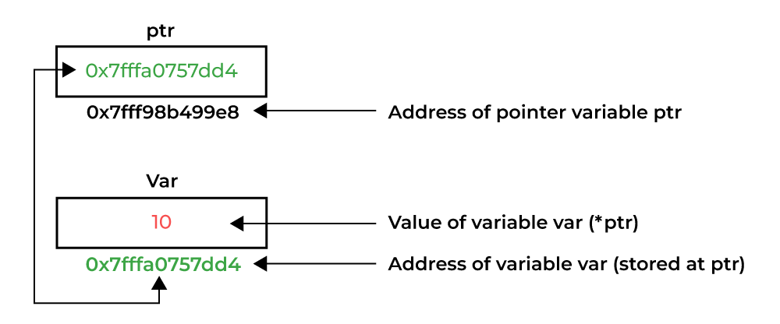
3. Dereferencing
Dereferencing a pointer is the process of accessing the value stored in the memory address specified in the pointer. We use the same ( * ) dereferencing operator that we used in the pointer declaration.

Slide 33
What will be the output?
#include<stdio.h>
void main()
{
int i=5, *j;
j=&i;
printf(“%d”,&i);
printf(“%d”,j);
printf(“%d”,&j);
printf(“%d”,j);
printf(“%d”,i);
printf(“%d”,*(&i));
printf(“Value of i=%d”,*j);
}

Slide 34
Pointers to Pointers
We already know that a pointer points to a location in memory and thus used to store address of variables.
So, when we define a pointer to pointer. The first pointer is used to store the address of second pointer.
Syntax:
int **ptr;

Slide 35
What will be the output?
#include<stdio.h>
void main()
{
int i=10, *j, **k;
j=&i;
k=&j;
printf(“%d”,&i);
printf(“%d”,j);
printf(“%d”,*k);
printf(“%d”,&j);
printf(“%d”,k);
printf(“%d”,&k);
printf(“%d”,i);
printf(“%d”,*j);
printf(“%d”,**k);
}

Slide 36
Swapping two variables using Call by Value
#include<stdio.h>
void swap(int , int); // Declaration of function
void main( )
{ int a = 10, b = 20 ; // call by value
swap(a,b); // a and b are actual parameters
printf ( "\n a = %d b = %d", a, b ) ;
}
void swap( int x, int y ) // x and y are formal parameters
{ int temp ;
temp = x ;
x = y ;
y = temp ;
printf ( "\nx = %d y = %d", x, y ) ;
}

Slide 37
Swapping two variables using Call by Reference
#include <stdio.h>
void swap(int*, int*);
void main()
{ int x, y;
printf("Enter the value of x and y\n");
scanf("%d%d",&x,&y);
printf("Before Swapping\nx = %d\ny = %d\n", x, y);
swap(&x, &y);
printf("After Swapping\nx = %d\ny = %d\n", x, y);
}
void swap(int *a, int *b)
{ int temp;
temp = *b;
*b = *a;
*a = temp;
}

