Slide 1
DATA STRUCTURES

Slide 2
Introduction to Data Structures
Data Structure is a way of collecting and organizing data in such a way that we can perform operations on these data in an effective way.
In other words, Data Structures are structures programmed to store ordered data, so that various operations can be performed on it easily.

Slide 3
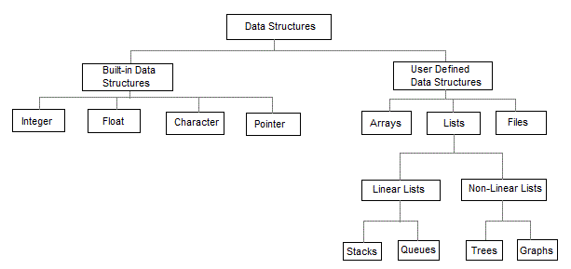
types of Data Structures

Slide 4
STACKS

Slide 5
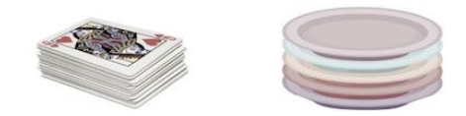
STACK
A stack is an Abstract Data Type (ADT), commonly used in most programming languages.
It is named stack as it behaves like a real-world stack, for example – a deck of cards or a pile of plates, etc.

Slide 6
STACK
A real-world stack allows operations at one end only. For example, we can place or remove a card or plate from the top of the stack only.
Likewise, Stack allows all data operations at one end only. At any given time, we can only access the top element of a stack.
This feature makes it LIFO data structure. LIFO stands for Last-in-first-out.
Here, the element which is placed (inserted or added) last, is accessed first.
In stack terminology, insertion operation is called PUSH operation and deletion operation is called POP operation.

Slide 7
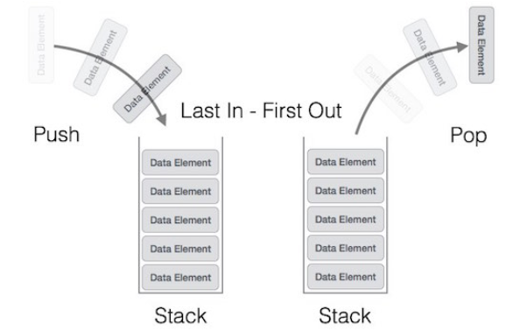
Stack Representation
The following diagram depicts a stack and its operations −

Slide 8
Stack Representation
A stack can be implemented by using Array or Linked List.
Stack can either be a fixed size one or it may have a sense of dynamic resizing.
Here, we are going to implement stack using arrays, which makes it a fixed size stack implementation.

Slide 9
Basic Operations
Stack operations may involve initializing the stack, using it and then de-initializing it. Apart from these basic stuffs, a stack is used for the following two primary operations −
push() − Pushing (storing) an element on the stack.
pop() − Removing (accessing) an element from the stack.

Slide 10
Basic Operations
To use a stack efficiently, we need to check the status of stack as well. For the same purpose, the following functionality is added to stacks −
peek() − get the top data element of the stack, without removing it.
isFull() − check if stack is full.
isEmpty() − check if stack is empty.

Slide 11
Basic Operations
At all times, we maintain a pointer to the last PUSHed data on the stack.
As this pointer always represents the top of the stack, hence named top.
The top pointer provides top value of the stack without actually removing it.

Slide 12
peek()
Algorithm
begin procedure peek
return stack[top]
end procedure
Example
int peek()
{
return stack[top];
}

Slide 13
isfull()
Algorithm
begin procedure isfull
if top equals to MAX
return true
else
return false
endif
end procedure
Example
bool isfull()
{
if(top = = MAX)
return true;
else
return false;
}

Slide 14
isempty()
Implementation of isempty() function in C programming language is slightly different.
We initialize top at -1, as the index in array starts from 0.
So we check if the top is below zero or -1 to determine if the stack is empty.

Slide 15
isempty()
Algorithm
begin procedure isempty
if top less than 0
return true
else
return false
endif
end procedure
Example
bool isempty()
{
if(top = = -1)
return true;
else
return false;
}

Slide 16
Push Operation
The process of putting a new data element onto stack is known as a Push Operation. Push operation involves a series of steps −
Step 1 − Check if the stack is full.
Step 2 − If the stack is full, produce an error and exit.
Step 3 − If the stack is not full, increment top to point next empty space.
Step 4 − Add data element to the stack location, where top is pointing.
Step 5 − Return success.

Slide 17
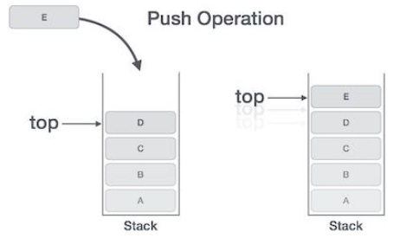
Push Operation

Slide 18
Algorithm for PUSH Operation
begin procedure push: stack, data
if stack is full
return null
endif
top ← top + 1
stack[top] ← data
end procedure

Slide 19
Example
void push(int data)
{
if(!isFull())
{
top = top + 1;
stack[top] = data;
}
else
{
printf("Could not insert data, Stack is full.\n");
}
}

Slide 20
Pop Operation
Accessing the content while removing it from the stack, is known as a Pop Operation.
In an array implementation of pop() operation, the data element is not actually removed, instead top is decremented to a lower position in the stack to point to the next value.
But in linked-list implementation, pop() actually removes data element and deallocates memory space.

Slide 21
Pop Operation
A Pop operation may involve the following steps −
Step 1 − Check if the stack is empty.
Step 2 − If the stack is empty, produce an error and exit.
Step 3 − If the stack is not empty, access the data element at which top is pointing.
Step 4 − Decrease the value of top by 1.
Step 5 − Return success.

Slide 22
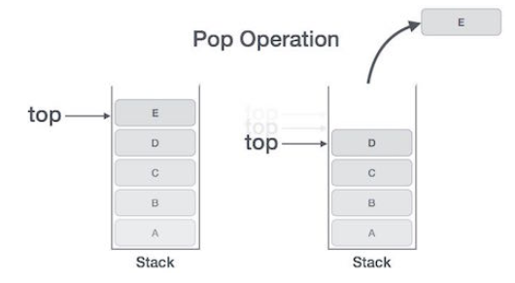
Pop Operation

Slide 23
Algorithm for Pop Operation
begin procedure pop: stack
if stack is empty
return null
endif
data ← stack[top]
top ← top - 1
return data
end procedure

Slide 24
Example
int pop(int data)
{
if(!isempty())
{
data = stack[top];
top = top - 1;
return data;
}
else
{
printf("Could not retrieve data, Stack is empty.\n");
}
}

Slide 25
QUEUES

Slide 26
Queue
Queue is an abstract data structure, somewhat similar to Stacks.
Unlike stacks, a queue is open at both its ends.
One end is always used to insert data (enqueue) and the other is used to remove data (dequeue).
Queue follows First-In-First-Out (FIFO) methodology, i.e., the data item stored first will be accessed first.

Slide 27

Queue
A real-world example of queue can be a single-lane one-way road, where the vehicle that enters first, exits first.
More real-world examples can be seen as queues at the ticket windows and bus-stops.

Slide 28
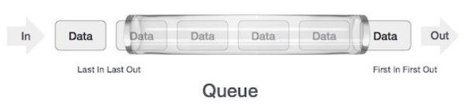
Queue Representation
As we now understand that in queue, we access both ends for different reasons. The following diagram given below tries to explain queue representation as data structure −
As in stacks, a queue can also be implemented using Arrays, Linked-lists, Pointers and Structures. For the sake of simplicity, we shall implement queues using one-dimensional array.

Slide 29
Basic Operations
Queue operations may involve initializing or defining the queue, utilizing it, and then completely erasing it from the memory.
Here we shall try to understand the basic operations associated with queues −
enqueue() − add (store) an item to the queue.
dequeue() − remove (access) an item from the queue.

Slide 30
Basic Operations
Few more functions are required to make the above-mentioned queue operation efficient. These are −
peek() − Gets the element at the front of the queue without removing it.
isfull() − Checks if the queue is full.
isempty() − Checks if the queue is empty.

Slide 31
Basic Operations
In queue, we always dequeue (or access) data pointed by front pointer and while enqueing (or storing) data in the queue we take help of rear pointer.
Rear
- - - - | c | b | a
Front
Insertion
Deletion

Slide 32
peek(): This function helps to see the data at the front of the queue.
Algorithm
begin procedure peek
return queue[front]
end procedure
Example
int peek()
{
return queue[front];
}

Slide 33
isfull()
As we are using single dimension array to implement queue, we just check for the rear pointer to reach at MAXSIZE to determine that the queue is full.
In case we maintain the queue in a circular linked-list, the algorithm will differ.

Slide 34
isfull()
Algorithm
begin procedure isfull
if rear equals to MAXSIZE
return true
else
return false
endif
end procedure
Example
bool isfull()
{
if(rear = = MAXSIZE)
return true;
else
return false;
}

Slide 35
isempty()
Algorithm
begin procedure isempty
if front is less than MIN OR front is greater than rear
return true
else
return false
End if
end procedure
Example
bool isempty()
{
if(front < 0 || front > rear)
return true;
else
return false;
}

Slide 36
Enqueue Operation
Queues maintain two data pointers, front and rear. Therefore, its operations are comparatively difficult to implement than that of stacks.
The following steps should be taken to enqueue (insert) data into a queue −
Step 1 − Check if the queue is full.
Step 2 − If the queue is full, produce overflow error and exit.
Step 3 − If the queue is not full, increment rear pointer to point the next empty space.
Step 4 − Add data element to the queue location, where the rear is pointing.
Step 5 − return success.

Slide 37
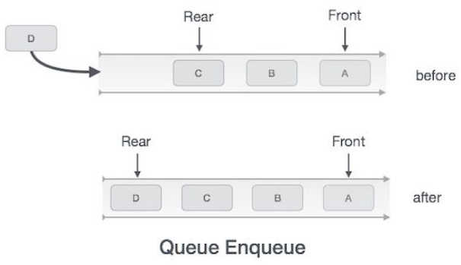
Enqueue Operation

Slide 38
Algorithm for enqueue operation
procedure enqueue(data)
if queue is full
return overflow
End if
rear ← rear + 1
queue[rear] ← data
return true
end procedure

Slide 39
Example
int enqueue(int data)
if(isfull())
return 0;
rear = rear + 1;
queue[rear] = data;
return 1;
end procedure

Slide 40
Dequeue Operation
Accessing data from the queue is a process of two tasks − access the data where front is pointing and remove the data after access.
The following steps are taken to perform dequeue operation −
Step 1 − Check if the queue is empty.
Step 2 − If the queue is empty, produce underflow error and exit.
Step 3 − If the queue is not empty, access the data where front is pointing.
Step 3 − Increment front pointer to point to the next available data element.
Step 5 − Return success.

Slide 41
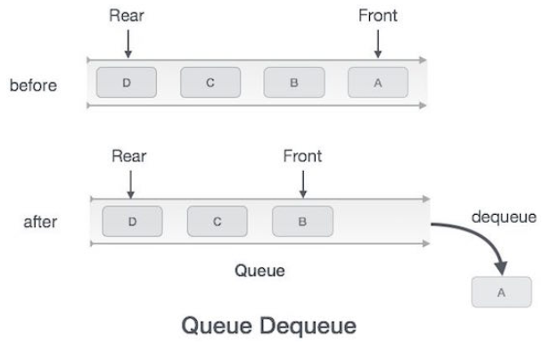
Dequeue Operation

Slide 42
Algorithm for dequeue operation
procedure dequeue
if queue is empty
return underflow
end if
data = queue[front]
front ← front + 1
return true
end procedure

Slide 43
Example
int dequeue()
{
if(isempty())
return 0;
int data = queue[front];
front = front + 1;
return data;
}

Slide 44
Linked List implementation of queue
Insertion Algorithm
Step 1: Allocate the space for the new node PTR
Step 2: SET PTR -> DATA = VAL
Step 3: IF FRONT = NULL SET FRONT = REAR = PTR SET FRONT -> NEXT = REAR -> NEXT = NULL ELSE SET REAR -> NEXT = PTR SET REAR = PTR SET REAR -> NEXT = NULL [END OF IF]
Step 4: END

Slide 45
Linked List implementation of queue
Deletion Algorithm
Step 1: IF FRONT = NULL Write " Underflow " Go to Step 5 [END OF IF]
Step 2: SET PTR = FRONT
Step 3: SET FRONT = FRONT -> NEXT
Step 4: FREE PTR
Step 5: END

