Slide 1
TREE Data Structure

Slide 2
What is a Tree data structure?
A tree data structure is a hierarchical structure that is used to represent and organize data in a way that is easy to navigate and search.
It is a collection of nodes that are connected by edges and has a hierarchical relationship between the nodes.
The topmost node of the tree is called the root, and the nodes below it are called the child nodes.
Each node can have multiple child nodes, and these child nodes can also have their own child nodes, forming a recursive structure.

Slide 3
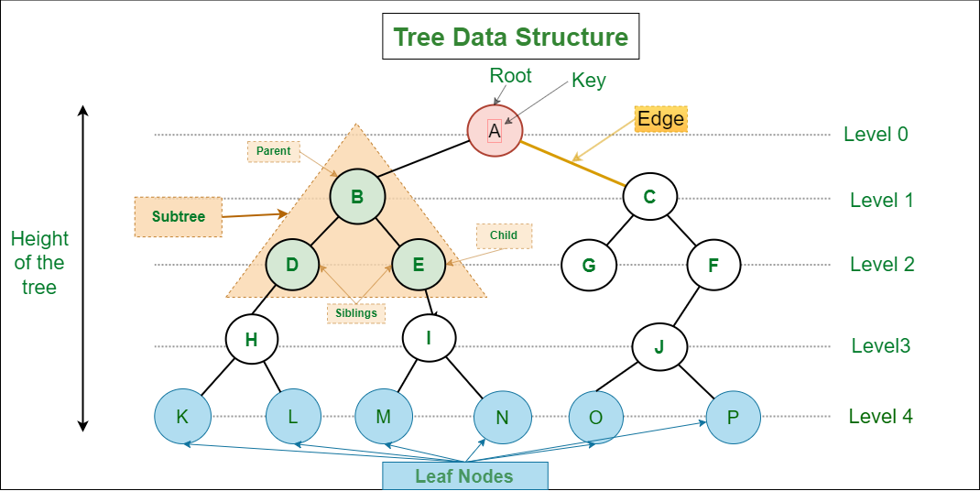

Slide 4
Basic Terminologies In Tree Data Structure:
Parent Node: The node which is a predecessor of a node is called the parent node of that node. {B} is the parent node of {D, E}.
Child Node: The node which is the immediate successor of a node is called the child node of that node. Examples: {D, E} are the child nodes of {B}.
Root Node: The topmost node of a tree or the node which does not have any parent node is called the root node. {A} is the root node of the tree. A non-empty tree must contain exactly one root node and exactly one path from the root to all other nodes of the tree.
Leaf Node or External Node: The nodes which do not have any child nodes are called leaf nodes. {K, L, M, N, O, P} are the leaf nodes of the tree.
Ancestor of a Node: Any predecessor nodes on the path of the root to that node are called Ancestors of that node. {A,B} are the ancestor nodes of the node {E}

Slide 5
Basic Terminologies In Tree Data Structure:
Descendant: Any successor node on the path from the leaf node to that node. {E,I} are the descendants of the node {B}.
Sibling: Children of the same parent node are called siblings. {D,E} are called siblings.
Level of a node: The count of edges on the path from the root node to that node. The root node has level 0.
Internal node: A node with at least one child is called Internal Node.
Neighbor of a Node: Parent or child nodes of that node are called neighbors of that node.
Subtree: Any node of the tree along with its descendant.

Slide 6
Properties of a Tree:
Number of edges: An edge can be defined as the connection between two nodes. If a tree has N nodes then it will have (N-1) edges. There is only one path from each node to any other node of the tree.
Depth of a node: The depth of a node is defined as the length of the path from the root to that node. Each edge adds 1 unit of length to the path. So, it can also be defined as the number of edges in the path from the root of the tree to the node.
Height of a node: The height of a node can be defined as the length of the longest path from the node to a leaf node of the tree.
Height of the Tree: The height of a tree is the length of the longest path from the root of the tree to a leaf node of the tree.
Degree of a Node: The total count of subtrees attached to that node is called the degree of the node. The degree of a leaf node must be 0. The degree of a tree is the maximum degree of a node among all the nodes in the tree.

Slide 7
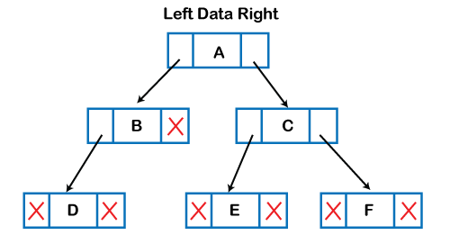
Implementation of Tree
struct Node { int data; struct Node *left_child; struct Node *right_child; };

Slide 8
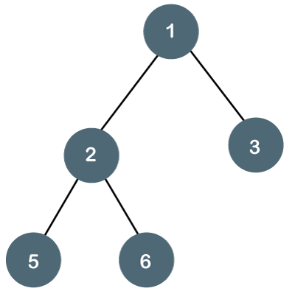
What is Binary Tree Data Structure?
Binary Tree is defined as a tree data structure where each node has at most 2 children.
Since each element in a binary tree can have only 2 children, we typically name them the left and right child.

Slide 9
Types of Binary Tree
There are five types of Binary tree:
Full/ proper/ strict Binary tree
Complete Binary tree
Perfect Binary tree
Degenerate Binary tree
Balanced Binary tree

Slide 10

1. Full/ proper/ strict Binary tree
The tree can only be considered as the full binary tree if each node must contain either 0 or 2 children.
The full binary tree can also be defined as the tree in which each node must contain 2 children except the leaf nodes.

Slide 11
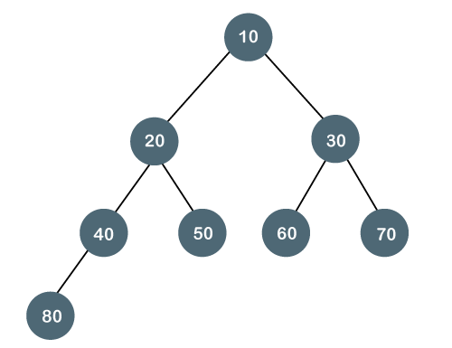
2. Complete Binary Tree
The complete binary tree is a tree in which all the nodes are completely filled except the last level.
In the last level, all the nodes must be as left as possible.
In a complete binary tree, the nodes should be added from the left.

Slide 12
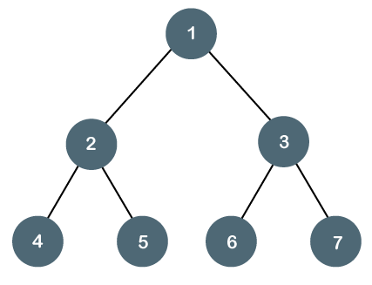
3. Perfect Binary Tree
A tree is a perfect binary tree if all the internal nodes have 2 children, and all the leaf nodes are at the same level.

Slide 13
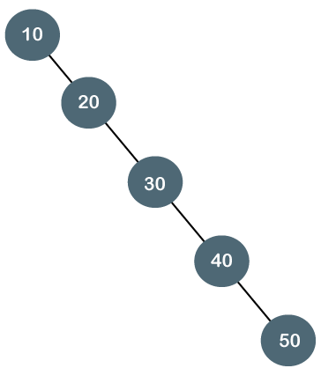
4. Degenerate Binary Tree
The degenerate binary tree is a tree in which all the internal nodes have only one children.
It is also known as a right-skewed tree as all the nodes have a right child only.

Slide 14
5. Balanced Binary Tree
The balanced binary tree is a tree in which the height of left and right sub-trees differ by atmost 1.
For example, AVL and Red-Black trees are balanced binary tree.

Slide 15
Tree Traversal
Traversal is a process to visit all the nodes of a tree and may print their values too. Because, all nodes are connected via edges (links) we always start from the root (head) node. That is, we cannot randomly access a node in a tree.
Unlike linear data structures (Array, Linked List, Queues, Stacks, etc) which have only one logical way to traverse them, trees can be traversed in different ways.
In-order Traversal
Pre-order Traversal
Post-order Traversal

Slide 16
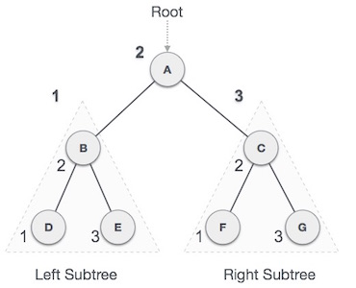
In-order Traversal
Algorithm
Until all nodes of the tree are not visited
Step 1: Traverse the left subtree recursively.
Step 2: Visit the root node.
Step 3: Traverse the right subtree recursively.
D → B → E → A → F → C → G

Slide 17
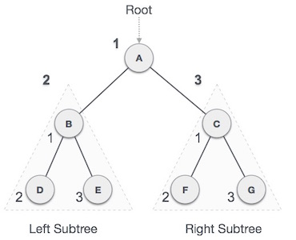
Pre-order Traversal
Algorithm
Until all nodes of the tree are not visited
Step 1: Visit the root node
Step 2: Traverse the left subtree recursively.
Step 3: Traverse the right subtree recursively.
A → B → D → E → C → F → G

Slide 18
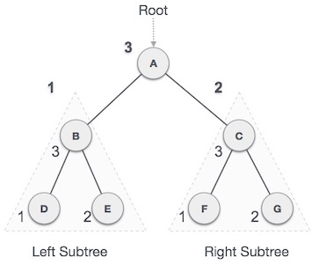
Post-order Traversal
Algorithm
Until all nodes are traversed
Step 1: Recursively traverse left subtree.
Step 2: Recursively traverse right subtree.
Step 3: Visit root node.
D → E → B → F → G → C → A

Slide 19
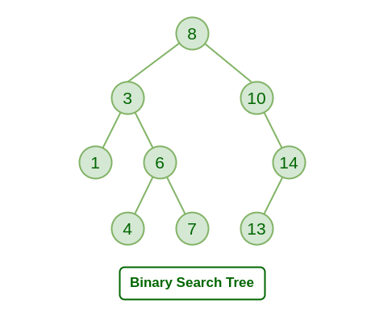
Binary Search Tree
Binary Search Tree is a node-based binary tree data structure which has the following properties:
The left subtree of a node contains only nodes with keys lesser than the node’s key.
The right subtree of a node contains only nodes with keys greater than the node’s key.
The left and right subtree each must also be a binary search tree.

Slide 20
Insertion of a key (new node) in BST
A new key is always inserted at the leaf.
We start searching for a key from the root until we hit a leaf node.
Once a leaf node is found, the new node is added as a child of the leaf node.

Slide 21
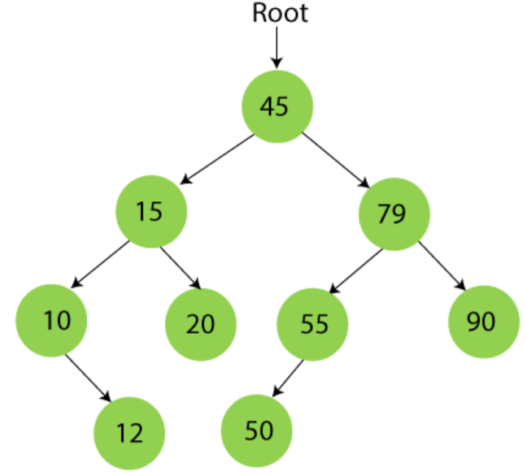
Create a BST using the given data.
45, 15, 79, 90, 10, 55, 12, 20, 50

Slide 22
Searching in Binary search tree
First, compare the element to be searched with the root element of the tree.
If root is matched with the target element, then return the node's location.
If it is not matched, then check whether the item is less than the root element, if it is smaller than the root element, then move to the left subtree.
If it is larger than the root element, then move to the right subtree.
Repeat the above procedure recursively until the match is found.
If the element is not found or not present in the tree, then return NULL.

Slide 23
Searching in Binary search tree
// C function to search a given key in a given BST
struct node* search(struct node* root, int key)
{
// Base Cases: root is null or key is present at root
if (root == NULL || root->key == key)
return root;
// Key is greater than root's key
if (root->key < key)
return search(root->right, key);
// Key is smaller than root's key
return search(root->left, key);
}

Slide 24
Deletion in Binary Search tree
In a binary search tree, we must delete a node from the tree by keeping in mind that the property of BST is not violated.
To delete a node from BST, there are three possible situations occur –
The node to be deleted is the leaf node, or,
The node to be deleted has only one child, and,
The node to be deleted has two children

Slide 25
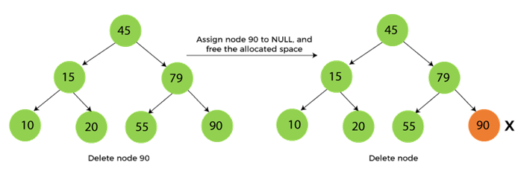
Case 1: When the node to be deleted is the leaf node
It is the simplest case to delete a node in BST. Here, we have to replace the leaf node with NULL and simply free the allocated space.

Slide 26
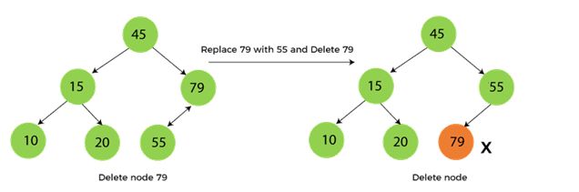
Case 2: When the node to be deleted has only one child
In this case, we have to replace the target node with its child, and then delete the child node.
For eg. Delete node 79 from the given tree:

Slide 27
Case 3: When the node to be deleted has two children
First, find the in-order successor of the node to be deleted.
After that, replace that node with the in-order successor until the target node is placed at the leaf of tree.
And at last, replace the node with NULL and free up the allocated space.
In-order predecessor can also be used.

Slide 28
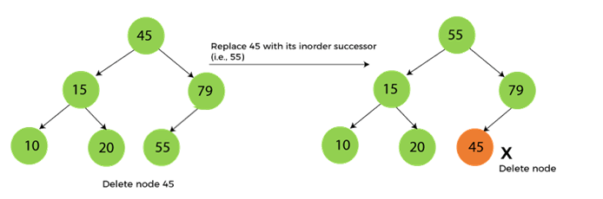
Case 3: When the node to be deleted has two children

Slide 29
Construct a BST using the given data and then delete 11.
11, 6, 8, 19, 4, 10, 5, 17, 43, 49, 31

Slide 30
Threaded Binary Tree
In the linked representation of binary trees, more than one half of the link fields contain NULL values which results in wastage of storage space.
If a binary tree consists of n nodes then n+1 link fields contain NULL values.
So in order to effectively manage the space, a method was devised by Perlis and Thornton in which the NULL links are replaced with special links known as threads.
Such binary trees with threads are known as threaded binary trees.
Each node in a threaded binary tree either contains a link to its child node or thread to other nodes in the tree.

Slide 31
Types of Threaded Binary Tree
There are two types of threaded Binary Tree:
One-way threaded Binary Tree
Two-way threaded Binary Tree

Slide 32
One-way threaded Binary trees:
In one-way threaded binary trees, a thread will appear either in the right or left link field of a node.
If it appears in the right link field of a node then it will point to the next node that will appear on performing in-order traversal. Such trees are called Right threaded binary trees.
If thread appears in the left field of a node then it will point to the nodes in-order predecessor. Such trees are called Left threaded binary trees.

Slide 33
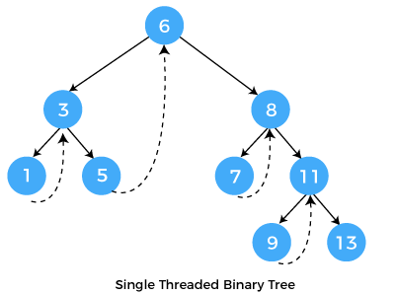
One-way threaded Binary trees:

Slide 34

Two-way threaded Binary Trees:
In two-way threaded Binary trees, the right link field of a node containing NULL values is replaced by a thread that points to nodes in-order successor and left field of a node containing NULL values is replaced by a thread that points to nodes in-order predecessor.

