Slide 1





SIDDAGANGA INSTITUTE OF TECHNOLOGY
(An Autonomous Institute under Visvesaraya Technological University, Belgavi)
DEPARTMENT OF ARTIFICIAL INTELLIGENCE AND DATA SCIENCE (4th SEMISTER)
OPERATING SYSTEM
VMWARE - PROJECT
TOOL TO CAPTURE DYNAMIC MEMORY CONSUMPTION OF THE APPLICATION
Presented by:
Akash L - 1SI21AD007
Suprith T S - 1SI21AD050
Atchutha Rao T A - 1SI21AD064

Slide 2
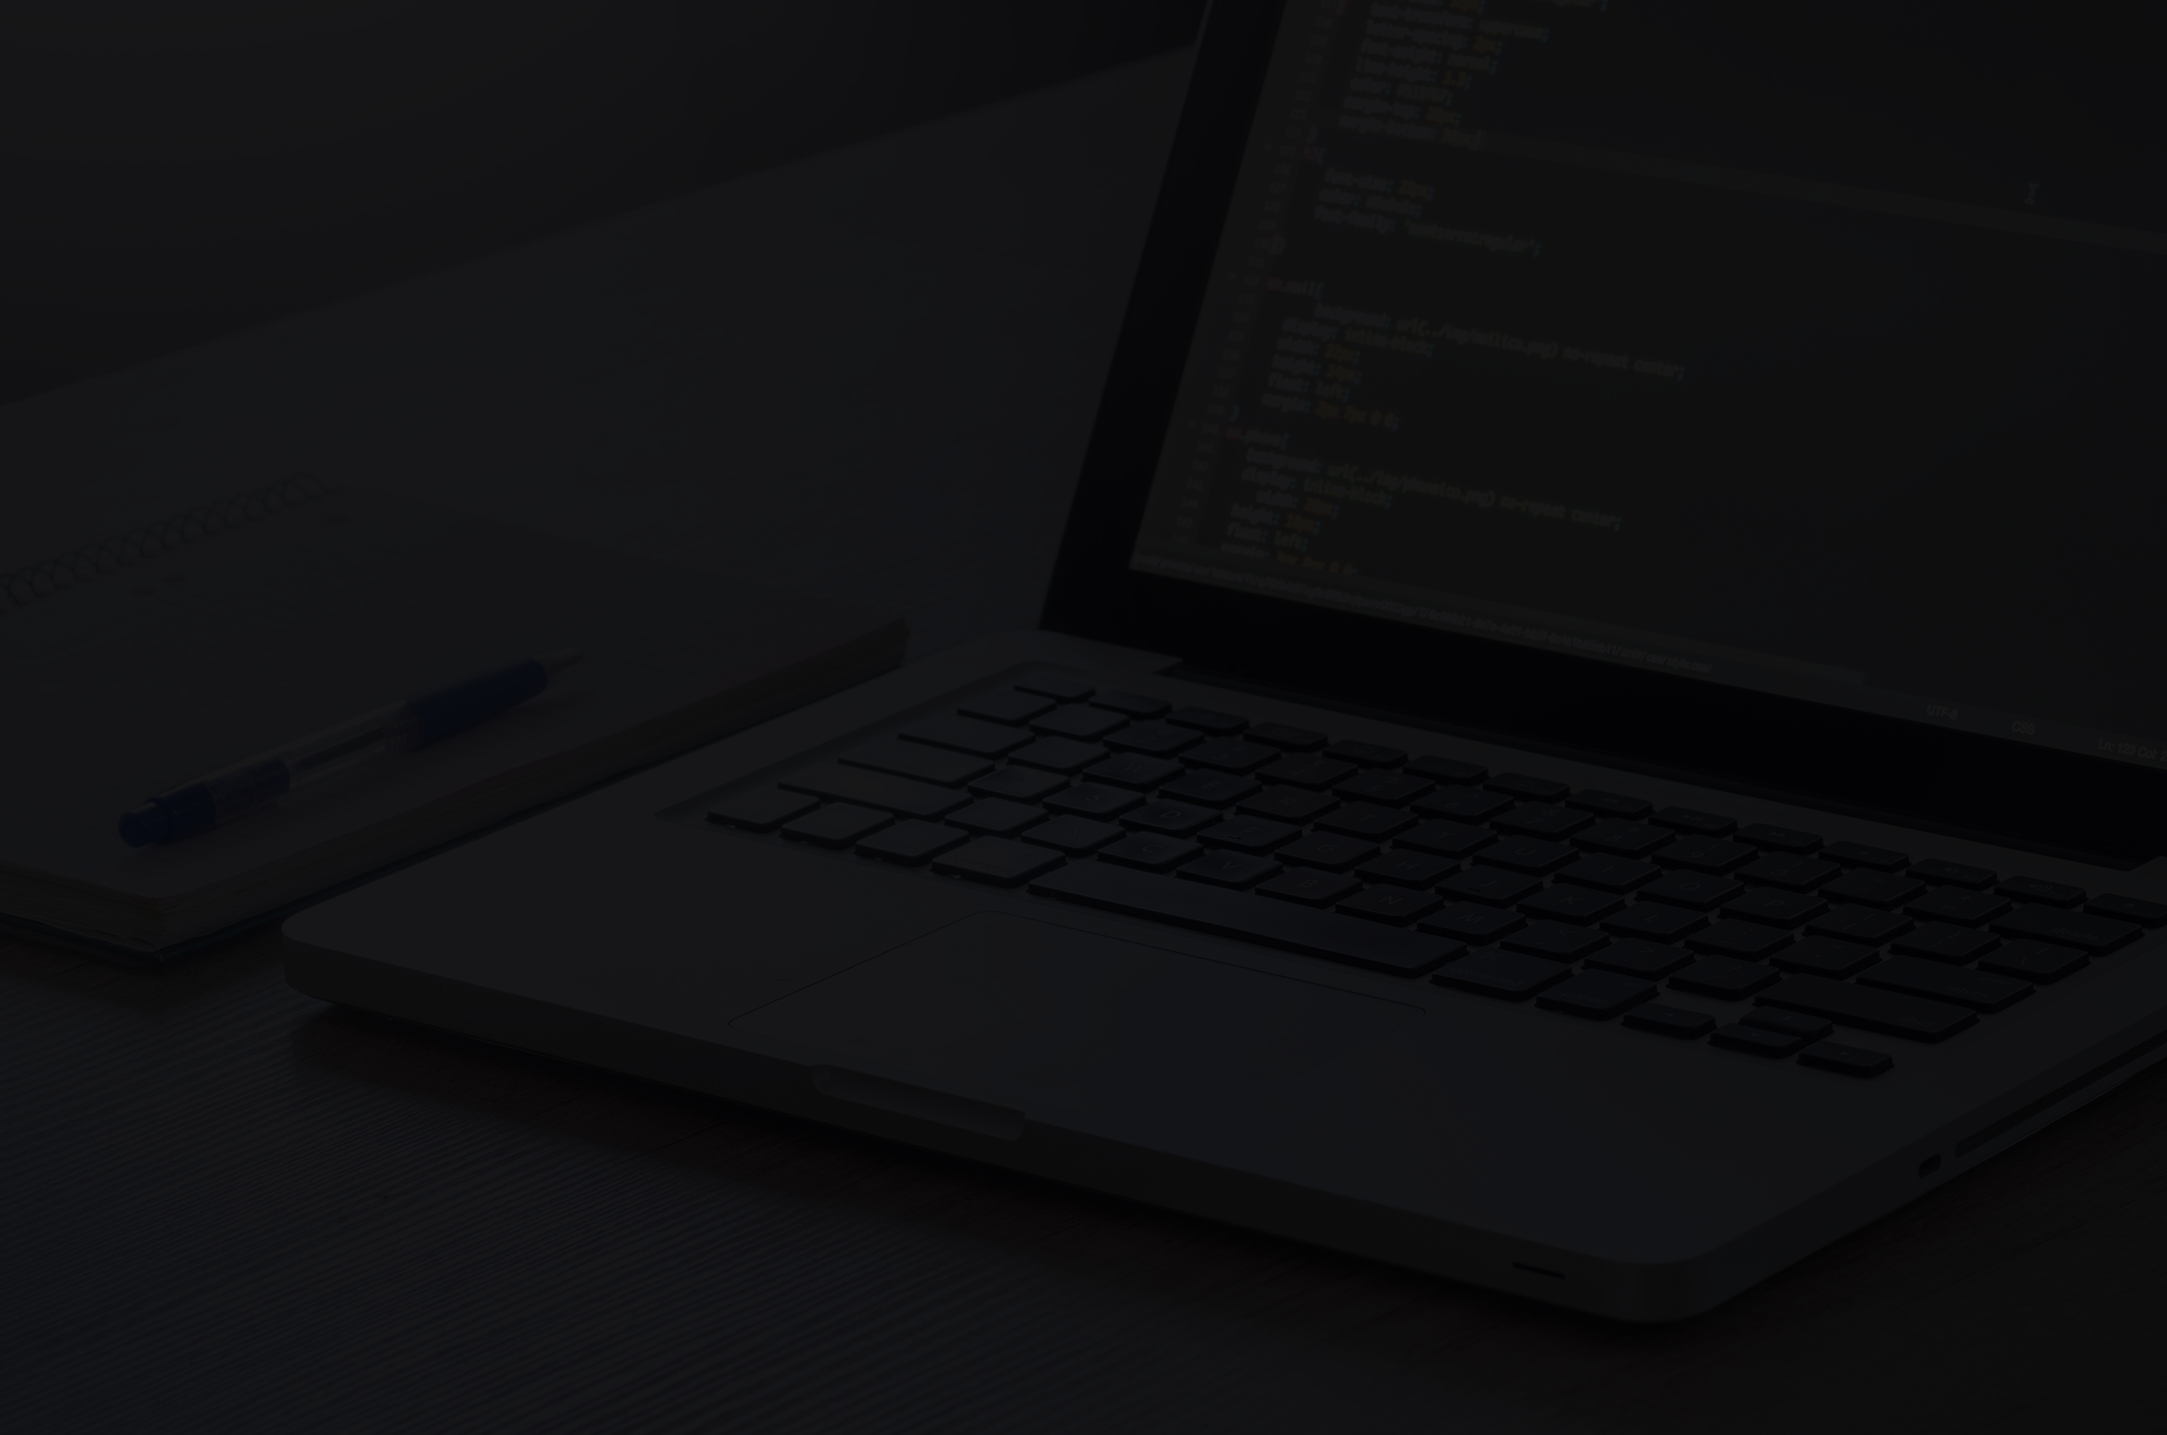
Table of
CONTENTS
01
02
03
04
05
INTRODUCTION TO VM-WARE TOPIC
Real-time Data Update Module
Description and algorithm
Result Snippets
Conclusion

Slide 3

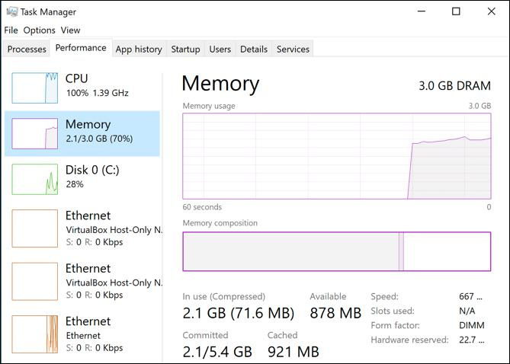
TOOL TO CAPTURE DYNAMIC MEMORY CONSUMPTION:
01
INTRODUCTION TO VM-WARE TOPIC
TOOLS:
1.Performance Monitoring Tools:
Task Manager (Windows): The built-in Task Manager in Windows provides real-time information about running processes, memory usage, and resource consumption.
2.Real Time Monitoring Tool:
Some tools offer real-time monitoring, allowing developers to observe memory consumption as the application runs. This can be crucial for identifying sudden spikes in memory usage or gradual memory leaks.

Slide 4
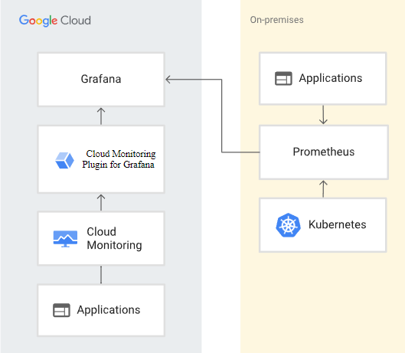
TOOL TO CAPTURE DYNAMIC MEMORY CONSUMPTION:
3.Profiling and Monitoring Tools:
Valgrind: A powerful instrumentation framework for debugging and profiling. Memcheck, a tool within Valgrind, can track memory leaks and invalid memory access.
GDB (GNU Debugger): GDB can help debug memory-related issues using features like memory breakpoints and watchpoints.
4.Cloud Platform Monitoring:
Cloud platforms like Amazon Web Services (AWS) and Microsoft Azure offer monitoring tools for applications hosted on their platforms, including memory usage metrics.

Slide 5
TOOL TO CAPTURE DYNAMIC MEMORY CONSUMPTION:
02
Real-time Data Update Module
REAL-TIME MONITORING:
Some tools offer real-time monitoring, allowing developers to observe memory consumption as the application runs. This can be crucial for identifying sudden spikes in memory usage or gradual memory leaks.
USES:
Performance Optimization: Real-time monitoring helps administrators identify memory bottlenecks and resource contention. By tracking memory consumption, they can allocate resources more effectively, ensuring that VMs have sufficient memory to operate without causing performance degradation.
Predictive Analytics: Advanced monitoring tools can analyze historical data and provide predictions about future memory consumption trends. This helps in optimizing resource provisioning and avoiding resource shortages.

Slide 6
TOOL TO CAPTURE DYNAMIC MEMORY CONSUMPTION:
Functionality:
Real-time data update module focused on monitoring memory usage of a specific application. This module continuously tracks and displays the memory consumption of the chosen application, updating the information at regular intervals.
Tools Used:
1. psutil library:
used to access memory-related information and monitor memory usage of specific applications.
2. time module:
It allows you to work with time intervals, sleep for specific durations, and measure time intervals between events
3. os module:
It allows you to execute system-level commands, retrieve environment variables, and perform various system-related tasks. In this code

Slide 7
Description:
03
The program provides a simple command-line dashboard to display memory information, monitor memory usage of specific applications, and stop applications based on user input. It uses the psutil library to gather process and memory information from the system.
Description and algorithm
Algorithm:
Display a dashboard with the following options:
Display memory information
Monitor memory usage of a specific application
Stop a specific application
Exit
Get the user's choice from the dashboard.
If the user chooses to display memory information, then do the following:
Get the total memory, available memory, used memory, and memory usage percentage from the operating system.
Display the memory information to the user.

Slide 8
4. If the user chooses to monitor memory usage of a specific application, then do the following:
Get the name of the application from the user.
Get the list of all running processes from the operating system.
Find all processes that have the specified application name.
Get the total memory usage of all the processes that have the specified application name.
Display the memory usage of the application to the user.
5. If the user chooses to stop a specific application, then do the following:
Get the name of the application from the user.
Get the list of all running processes from the operating system.
Find the process that has the specified application name.
Stop the process.
Display a message to the user that the application has been stopped.
6. If the user chooses to exit, then do the following:
Exit the program.

Slide 9

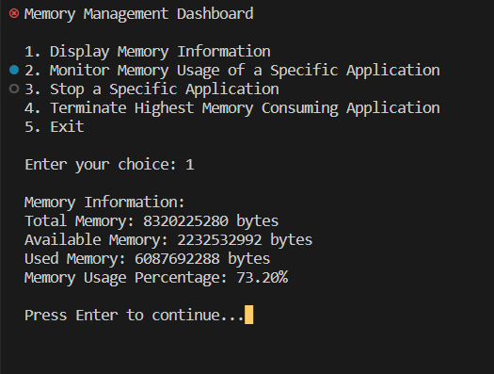
Results
04
Result Snippets
Choosing option 1:

Slide 10
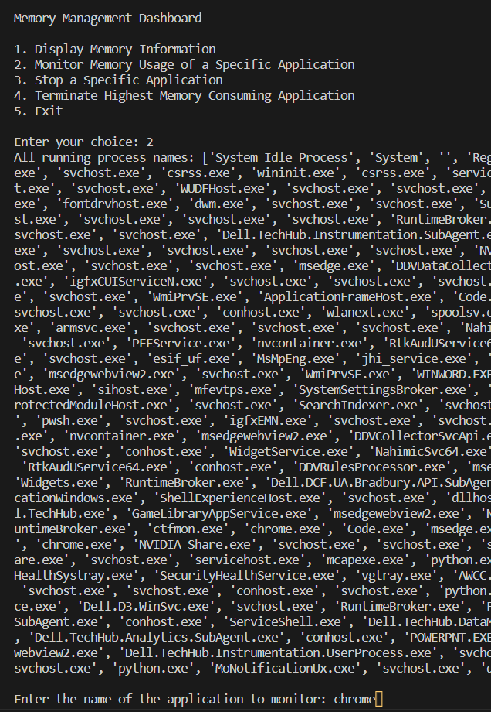
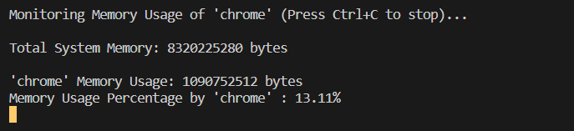
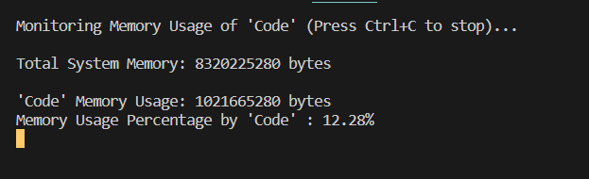
Choosing option :2

Slide 11
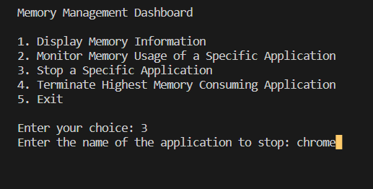
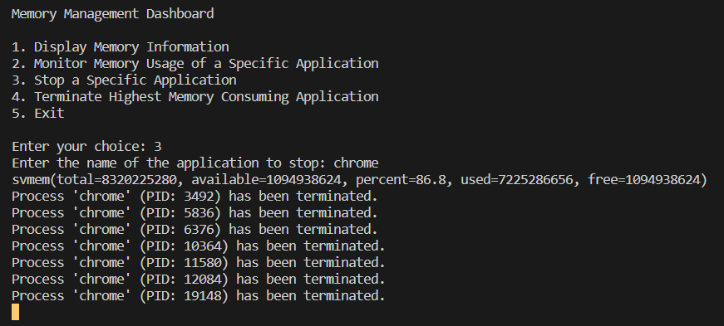
Choosing option :3

Slide 12
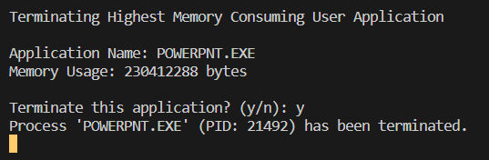
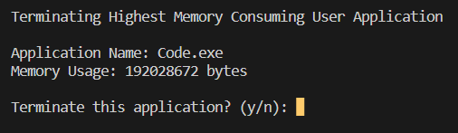
Choosing option :4
1. Highest memory consuming application :
2. Second highest memory consuming application :

Slide 13
Conclusion:
05
Conclusion
This dashboard offers several functionalities related to memory management and monitoring of running applications. Let's conclude by summarizing the main features and potential improvements of the project:
Features:
1. Memory Information Display: The dashboard provides an option to display general memory information, including total memory, available memory, used memory, and memory usage percentage.
2. Monitor Memory Usage: Users can choose to monitor the memory usage of a specific application by entering its name. The dashboard continuously updates and displays the memory usage of the selected application in terms of memory used and percentage of total memory.
3. Stop Application: The dashboard allows users to stop a specific application by entering its name. The code tries to terminate the process associated with that application.
4. User-Friendly Interface: The dashboard utilizes a simple text-based interface with clear prompts, making it easy for users to navigate and interact with the different options.

Slide 14
Potential Improvements:
1. Error Handling: The code could benefit from more robust error handling. For instance, when monitoring memory usage, it should handle cases where the specified application name doesn't match any running processes.
2. Enhanced User Experience: Implementing more user-friendly messages and prompts could improve the overall experience. Additionally, providing more detailed instructions or information about each option might help users understand their choices better.
3. Monitoring Multiple Applications: The current code focuses on monitoring a single application. Extending it to monitor multiple applications simultaneously could be a useful enhancement.
4. Graphical Visualization: Adding graphical representation of memory usage, such as plots or progress bars, could provide users with a quicker and more intuitive understanding of memory trends.
In conclusion, the provided memory management dashboard project offers a foundation for monitoring and managing memory usage of specific applications. It demonstrates how to use the `psutil` library to gather memory and process information, and it provides a starting point for further development and customization based on specific needs and user feedback.

Slide 15
THANK YOU

