Slide 1
MIM/MOSCAP Electrical Characterizations
Akash Levy, Jung-Soo Ko

Slide 2
Characterized Structures
N-type highly phosphorus-doped very low resistivity (0.01-0.09 Ω cm) wafers
This should be close to a MIM structure
10nm (100 cycles) thermal ALD alumina
No seed layer
Rest are stockroom I-test wafers: P-type boron-doped w/resistivity 0.1-0.9 Ω cm
AJA-deposited Al seed layer (nm) | Fiji2-deposited thermal alumina (nm)
0.5 | 5 (first)
1 | 5
1.5 | 5
0.5 | 10 (second)
1 | 10
1.5 | 10
2 | 10
2 | 10

Slide 3
Back-gate contact
Scratch surface for probe
Breakdown MIM structure
Use broken-down MIM structure as back-gate contact
Advantage: physically closer to structures being tested so less IR drop

Slide 4
Breakdown I-V Curves

Slide 5
Breakdown I-V Curves

Slide 6
Breakdown I-V Curves

Slide 7
Breakdown I-V Curves

Slide 8
Breakdown I-V Curves

Slide 9
Breakdown I-V Curves

Slide 10
Breakdown I-V Curves

Slide 11
Breakdown I-V Curves

Slide 12
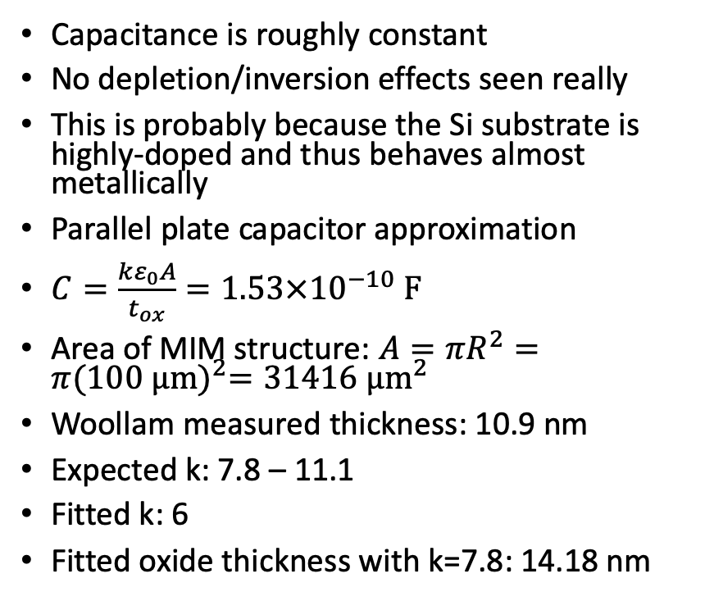
MIM: 10 nm ALD alumina (no seed)
Capacitance is roughly constant
No depletion/inversion effects seen really
This is probably because the Si substrate is highly-doped and thus behaves almost metallically
Parallel plate capacitor approximation
$C=\frac{kε_{0}A}{t_{ox}}=1.53×{10}^{−10} F$
Area of MIM structure: $A=πR^{2}=π{(100 μm)}^{2}=31416$ $μm^{2}$
Woollam measured thickness: 10.9 nm
Expected k: 7.8 – 11.1
Fitted k: 6
Fitted oxide thickness with k=7.8: 14.18 nm

Slide 13
C-V Curves

Slide 14
C-V Curves

Slide 15
C-V Curves

Slide 16
C-V Curves with Possible Soft Breakdown

Slide 17
C-V Curves with Possible Soft Breakdown

Slide 18
TODOs on data analysis
Will fit C-V curves to determine doping density and oxide capacitance
Will plot breakdown voltage as a function of seed/oxide thickness
Will try to fit breakdown behavior in soft breakdown regime

