Slide 1
MIM/MOSCAP Electrical Characterizations
Akash Levy, Jung-Soo Ko

Slide 2
Characterized Structures
N-type highly phosphorus-doped very low resistivity (0.01-0.09 Ω cm) wafers
This should be close to a MIM structure
10nm (100 cycles) thermal ALD alumina
No seed layer
Rest are stockroom I-test wafers: P-type boron-doped w/resistivity 0.1-0.9 Ω cm
AJA-deposited Al seed layer (nm) | Fiji2-deposited thermal alumina (nm)
0.5 | 0 or 1 (???)
1 | 5
1.5 | 5
1 | 10
1.5 | 10
2 | 10
2n (???) | 10

Slide 3
Back-gate contact
Scratch surface for probe
Breakdown MIM structure
Use broken-down MIM structure as back-gate contact
Advantage: physically closer to structures being tested so less IR drop

Slide 4
MIM: 10 nm ALD alumina (no seed)
5 samples
100 mA compliance current

Slide 5
MIM: 10 nm ALD alumina (no seed)
Capacitance is roughly constant
No depletion/inversion effects seen really
This is probably because the Si substrate is highly-doped and thus behaves almost metallically

Slide 6
MOSCAP: 0.5 nm seed layer with 1 nm Al2O3
Can see accumulation, inversion, depletion regions
Can see difference between low-freq. and high-freq. C-V curves
Will do fitting to extract parameters soon

Slide 7
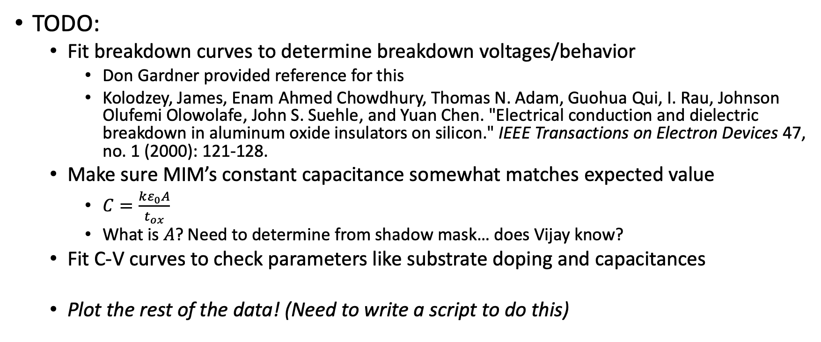
Rest of the plots to come soon! ☺
TODO:
Fit breakdown curves to determine breakdown voltages/behavior
Don Gardner provided reference for this
Kolodzey, James, Enam Ahmed Chowdhury, Thomas N. Adam, Guohua Qui, I. Rau, Johnson Olufemi Olowolafe, John S. Suehle, and Yuan Chen. "Electrical conduction and dielectric breakdown in aluminum oxide insulators on silicon." IEEE Transactions on Electron Devices 47, no. 1 (2000): 121-128.
Make sure MIM’s constant capacitance somewhat matches expected value
$C=\frac{kε_{0}A}{t_{ox}}$
What is $A$? Need to determine from shadow mask… does Vijay know?
Fit C-V curves to check parameters like substrate doping and capacitances
Plot the rest of the data! (Need to write a script to do this)

