Slide 1

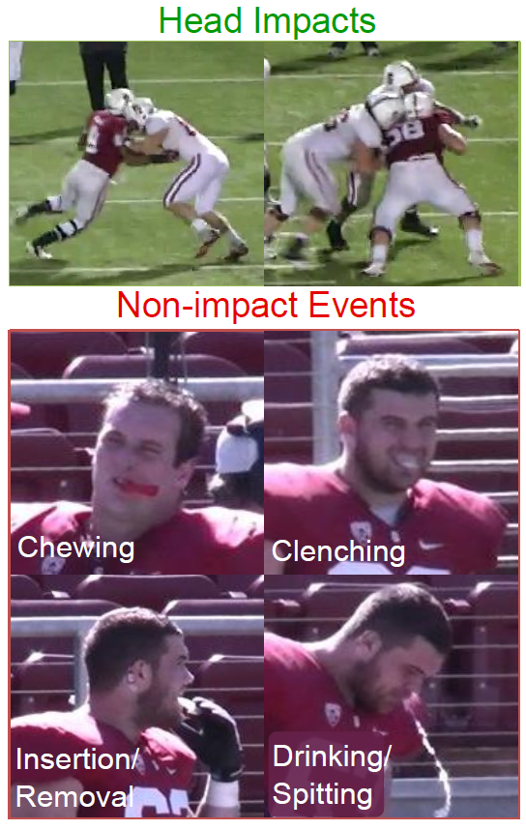
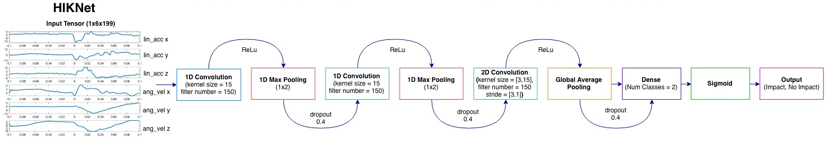
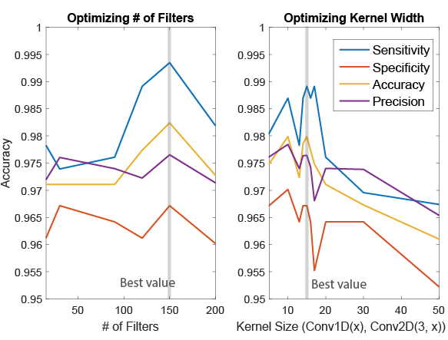
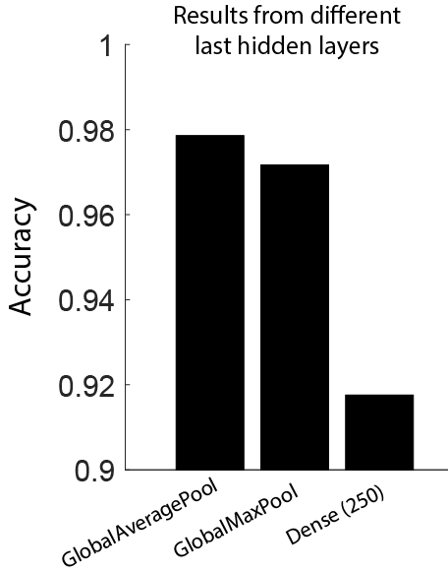
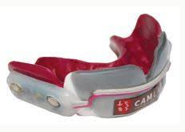
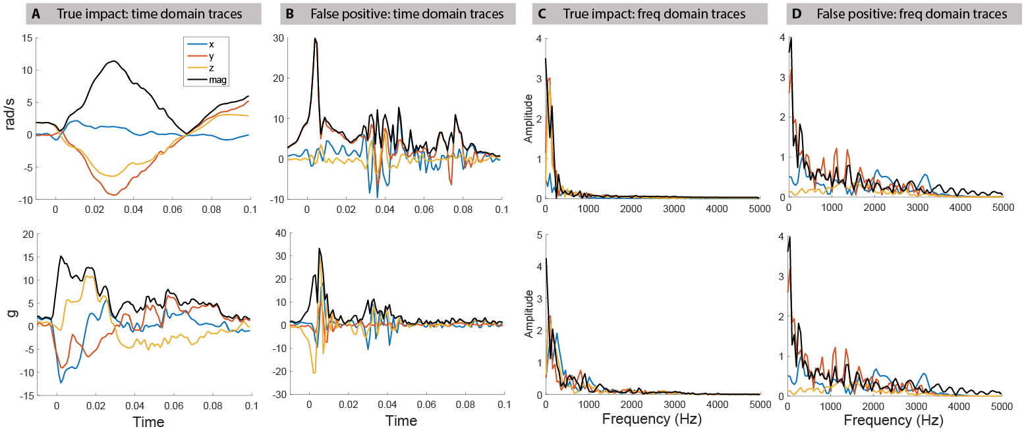
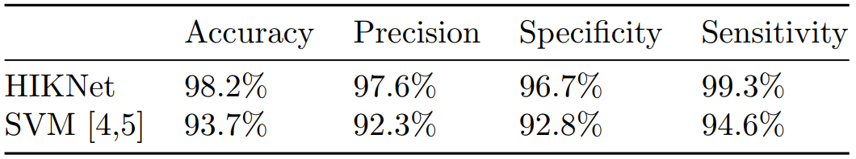
HIKNet: A Neural Network for Detecting Head Impacts from Kinematic Data
Michael Fanton¹, Nicholas Gaudio², Alissa Ling²
¹Department of Mechanical Engineering, Stanford University, ²Department of Electrical Engineering, Stanford University
BACKGROUND and MOTIVATION
2. NEURAL NETWORK ARCHITECTURE
Mild Traumatic Brain Injury (mTBI) is a serious health concern, especially in contact sports such as football, and can cause acute and long term debilitating symptoms^{1,2}
The Camarillo Lab at Stanford has developed and deployed an instrumented mouthguard that records linear acceleration and angular velocity of head impacts³
Device must be able to accurately classify between real impacts or false positives (e.g. spitting, chewing, etc.) to be useful
In previous work, sequential feature selection was used to determine the most important classifier features, and these were used to train a SVM classifier^{4,5}
We propose to use a neural net, which will automatically extract important features to distinguish between real and false impacts to a high degree of accuracy
Used Keras and Tensorflow in Python to create a deep convolutional neural network
Baseline architecture modeled off of PerceptionNet⁶ and ConvNet⁷, two CNN’s used for Human Activity Recognition from time series data
The 1D convolutional layers “extract” features and feed into a late 2D convolution which classifies the data into impact and no impact
The 2D convolution is late in the architecture to prevent overfitting
3. RESULTS and DISCUSSION
Tested a number of architectures (e.g. U-Net) but found the PerceptionNet architecture to have highest accuracy on evaluation set
Tuned our Net using a “greedy” optimization scheme for number of 1D conv layers, number of 2D conv layers, and type of final layer
Parameter sweep to find optimal filter size, kernel width, and dropout thresholds
Optimal dropout threshold 0.4, kernel width of 15, and filter size of 150
Low parameter neural network worked surprisingly well and out performed other more complex architectures as well as existing SVM classifier
Image adapted from [4]
1. DATASET
Stanford Instrumented Mouthguard
527 examples of 6 time traces (linear acceleration and angular velocity in x, y, z axes) each of length 199
264 real impacts and 263 false impacts
Each impact has 100ms of data sampled at 1000 Hz
Dataset was randomly split 70%/30% into a training and evaluation set
Generally, true impacts have lower frequencies content (20-30 Hz), whereas false impacts are comprised of higher frequency content
A representative example of a real and false impact:
Final HIKNet Performance Metrics:
FUTURE WORK
REFERENCES
Develop a neural network that classifies between multiple classes such as head impacts, body impacts, and no impact.
Apply neural net to a larger mouthguard dataset as more data is collected
Analyze positive head impacts and classify them as resulting in concussion vs. no concussion (KOCNet)
Langlois, Jean A., et al. The Journal of head trauma rehabilitation21.5(2006): 375-378.
Ramos-Cejudo, Jaime, et al. EBioMedicine (2018).
Camarillo, David B., et al. Annals of biomedical engineering 41.9 (2013): 1939-1949.
Wu, Lyndia C., et al. IEEE Transactions on Biomedical Engineering 61.11 (2014): 2659-2668.
Wu, Lyndia C., et al. Scientific reports 8.1 (2017): 855.
Kasnesis, Panagiotis, et al. Proceedings of SAI Intelligent Systems Conference. Springer, Cham, 2018.
Ronao, Charissa Ann, et al. Expert Systems with Applications 59 (2016): 235-244.

