Slide 1

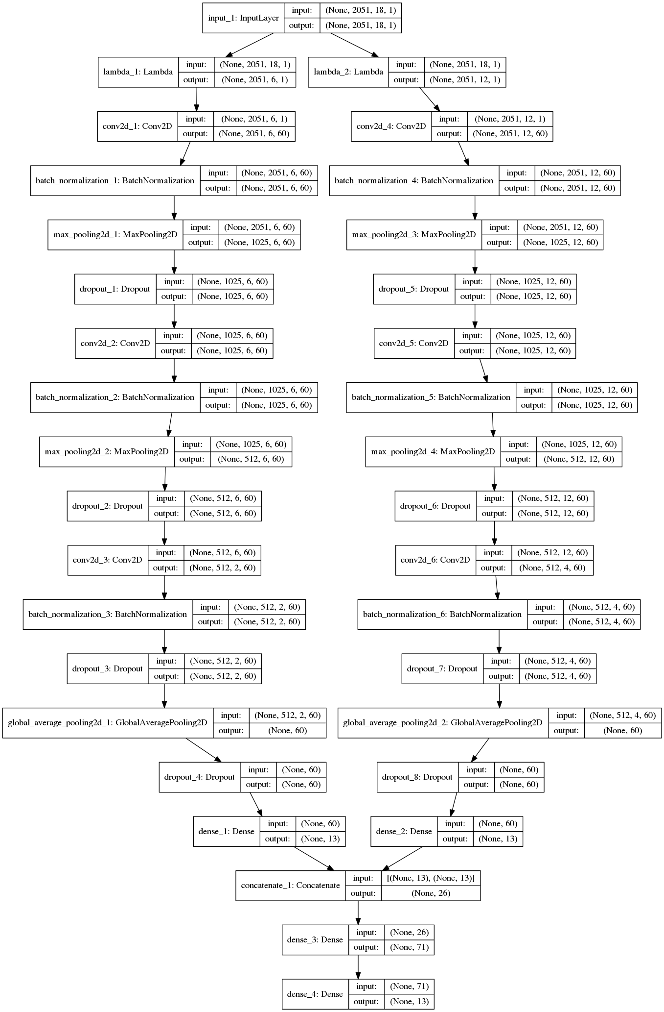
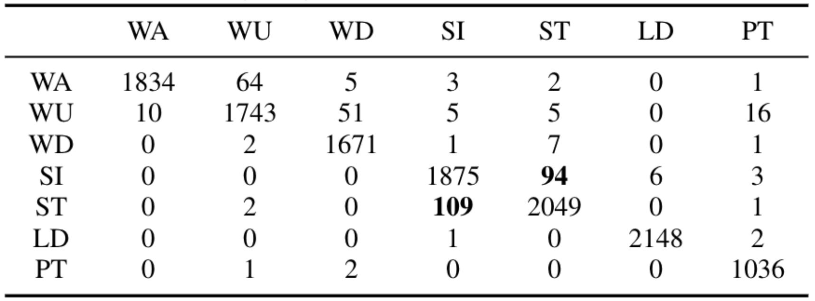
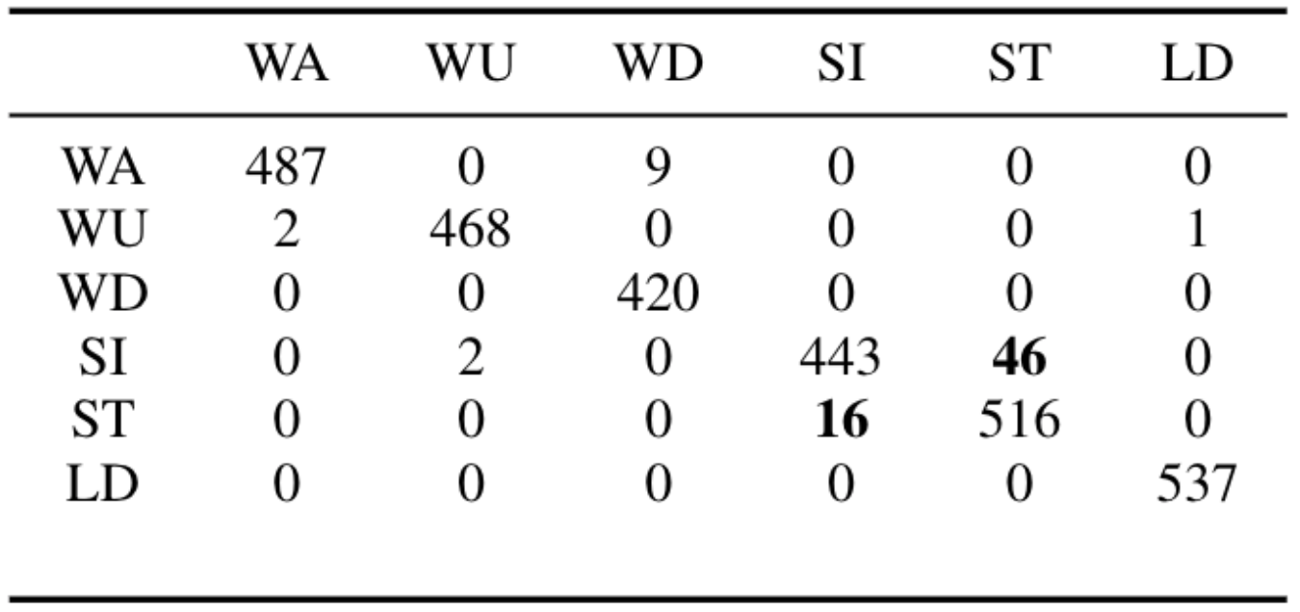
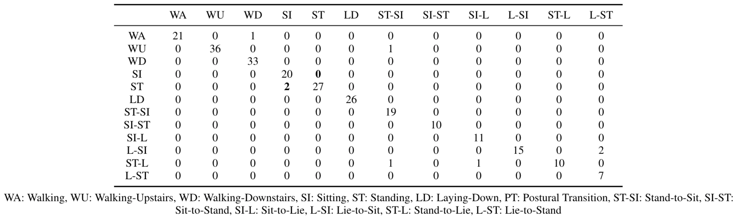
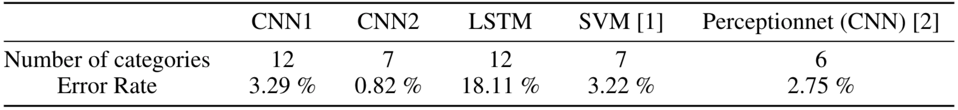
HATRNet: Human Activity/Transition Recognition using Deep Neural Networks
Nicholas Gaudio, Akash Levy, Jonas Messner, {nsgaudio, akashl, messnerj}@stanford.edu
Department of Electrical Engineering, Stanford University
BACKGROUND and MOTIVATION
2. NEURAL NETWORK ARCHITECTURE
L;sdfjasl;fkdj
;lskjf;alsdf
Al;sdkjf;dsfkj
;alskjfa;lf
Siamese (non-weight sharing) CNN
Siamese (non-weight sharing) CNN
Left subnetwork takes time traces as input (6 zero-padded channels)
Right subnetwork takes frequency and phase traces as input (12 interpolated channels)
Late sensor fusion employed for encoded, efficient feature extraction
Conv1D filter size: 1x14 Conv2D filter size: 3x42 Filter #: 60 learning rate: 0.0026
Sequence (LSTM) Model
Takes time traces as input (6 channels of variable length)
Two LSTM layers (128 to 32 output channels)
1. DATASET
SBHAR dataset of 6 activities and 6 postural transitions from the Galaxy SII
3-axial linear acceleration and 3-axial angular velocities traces at 50 Hz
Augmented to 3,640 examples with no feature selection (beyond FFT)
Random Coarse- to Fine-grain Hyperparameter Search
“Walking” time trace
“Sitting” time trace
“Standing” time trace
3. RESULTS and DISCUSSION
Literature comparison (grouped postural transitions):
SVM, 561 features extracted [1]
CNN (2.5 second traces) [2]
“Walking” frequency spectrum
“Sitting” frequency spectrum
“Standing” frequency spectrum
HATRNet Results (ungrouped postural transitions):
Siamese (non-weight sharing) CNN
REFERENCES
FUTURE WORK
[1] J.-L. Reyes-Ortiz, L. Oneto, A. Samà, X. Parra, and D. Anguita, “Transition-aware human activity recognition using smartphones,” Neurocomput., vol. 171, pp. 754–767, Jan. 2016.
[2] P. Kasnesis, C. Z. Patrikakis, and I. S. Venieris, “Perceptionnet: A deep convolutional neural network for late sensor fusion,” CoRR, vol. abs/1811.00170, 2018.
[3] C. A. J. O. D. Fuentes, L. Gonzalez-Abril, “Online motion recognition using an accelerometer in a mobile device,” Expert systems with applications, 2011.
[4] M. Kose, O. Incel, and C. Ersoy, “Online human activity recognition on smart phones,” Workshop on Mobile Sensing: From Smartphones and Wearables to Big Data, 01 2012.
[5] J. Qi, P. Yang, M. Hanneghan, and S. Tang, “Multiple density maps information fusion for effectively assessing intensity pattern of lifelogging physical activity,” Neurocomputing, vol. 220, pp. 199–209, 2017.
[6] C. Reiff, K. Marlatt, and D. Dengel, “Difference in caloric expenditure in sitting versus standing desks,” Journal of physical activity & health, vol. 9, pp. 1009–11, 09 2012.
[7] D. Anguita, A. Ghio, L. Oneto, X. Parra, and J. L Reyes-Ortiz, “A public domain dataset for human activity recognition using smartphones,” 21th European Symposium on Artificial Neural Networks, Computational Intelligence and Machine Learning, ESANN, 01 2013.
[8] A. L. Guennec, S. Malinowski, and R. Tavenard, “Data augmentation for time series classification using convolutional neural networks,” ECML/PKDD Workshop on Advanced Analytics andLearning on Temporal Data, 2016.
[9] F. Chollet et al., “Keras.” https://keras.io, 2015.
[10] M. Abadi, A. Agarwal, P. Barham, E. Brevdo, Z. Chen, C. Citro, G. S. Corrado, A. Davis, J. Dean, M. Devin, S. Ghemawat, I. Goodfellow, A. Harp, G. Irving, M. Isard, Y. Jia, R. Jozefowicz, L. Kaiser, M. Kudlur, J. Levenberg, D. Mané, R. Monga, S. Moore, D. Murray, C. Olah, M. Schuster, J. Shlens, B. Steiner, I. Sutskever, K. Talwar, P. Tucker, V. Vanhoucke, V. Vasudevan, F. Viégas, O. Vinyals, P. Warden, M. Wattenberg, M. Wicke, Y. Yu, and X. Zheng, “TensorFlow: Large-scale machine learning on heterogeneous systems,” 2015. Software available from tensorflow.org.
[11] E. Jones, T. Oliphant, P. Peterson, et al., “SciPy: Open source scientific tools for Python,” 2001.
[12] F. Pedregosa, G. Varoquaux, A. Gramfort, V. Michel, B. Thirion, O. Grisel, M. Blondel, P. Prettenhofer, R. Weiss, V. Dubourg, J. Vanderplas, A. Passos, D. Cournapeau, M. Brucher, M. Perrot, and E. Duchesnay, “Scikit-learn: Machine Learning in Python ,” Journal of Machine Learning Research, vol. 12, pp. 2825–2830, 2011.
[13] S. Chetlur, C. Woolley, P. Vandermersch, J. Cohen, J. Tran, B. Catanzaro, and E. Shelhamer, “cudnn: Efficient primitives for deep learning,” arXiv preprint arXiv:1410.0759, 2014.
Model ensembling using data representations from sequence models
Implement the model on a Galaxy SII for real-time inference
Incorporate frequency and phase traces into the sequence model
Architecture Comparison

