Slide 1

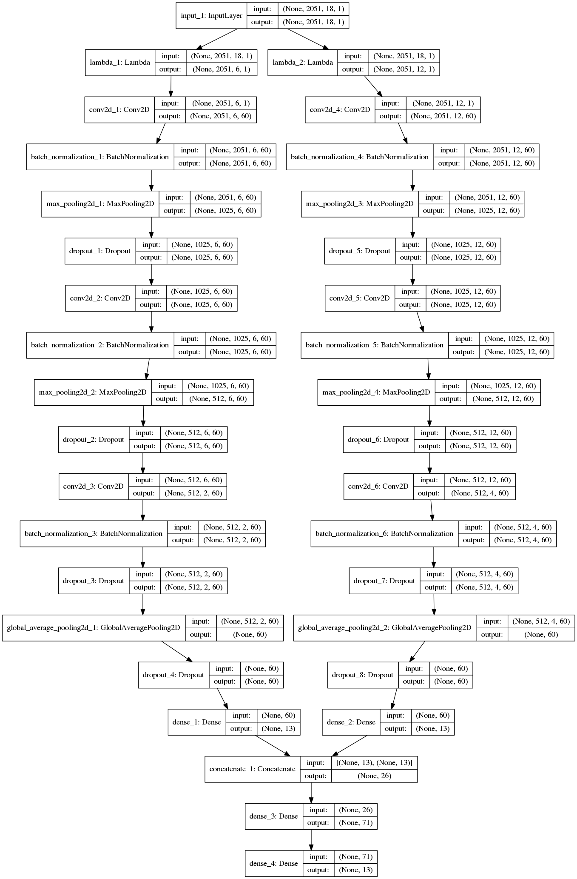
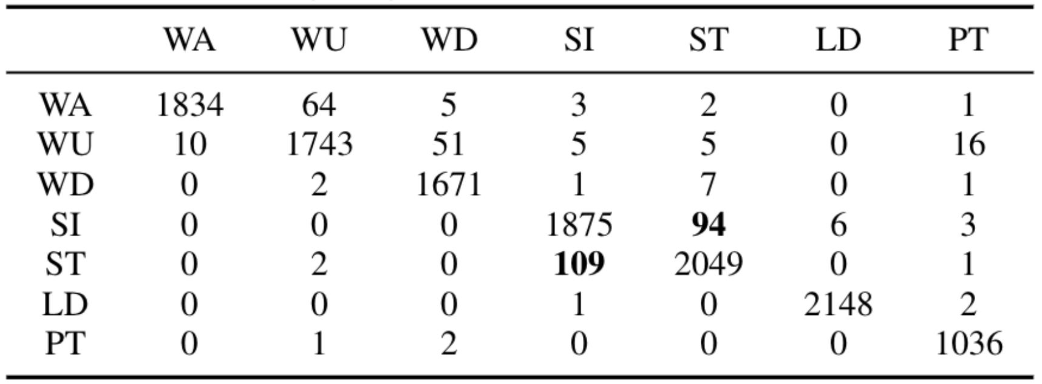
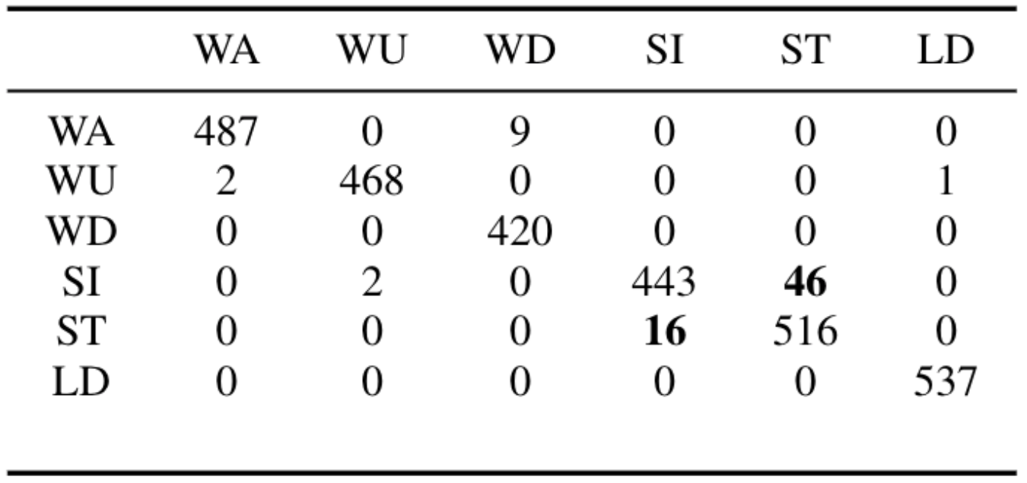
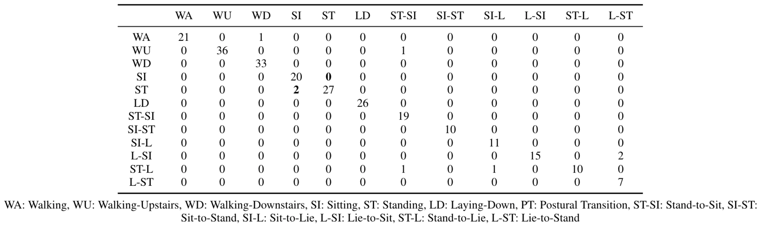
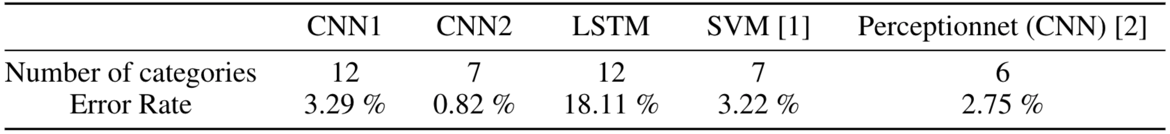
HATRNet: Human Activity/Transition Recognition using Deep Neural Networks
Nicholas Gaudio, Akash Levy, Jonas Messner, {nsgaudio, akashl, messnerj}@stanford.edu
Department of Electrical Engineering, Stanford University
BACKGROUND and MOTIVATION
2. NEURAL NETWORK ARCHITECTURE
Human Activity Recognition has great potential for customized healthcare
Smartphones incorporate sensors (accelerometer, gyroscope etc.)
Sensor data can be used to classify human activities and transitions
Improvements compared to state of the art:
Advanced preprocessing including data augmentation
End-to-end deep learning solution (no feature extraction)
Improved architecture enabling accurate classification of transitions
Siamese (non-weight sharing) CNN
Siamese (non-weight sharing) CNN
Left subnetwork takes time traces as input (6 zero-padded channels)
Right subnetwork takes frequency and phase traces as input (12 interpolated channels)
Late sensor fusion employed for encoded, efficient feature extraction
Conv1D filter size: 1x14 Conv2D filter size: 3x42 Filter #: 60 learning rate: 0.0026
Sequence (LSTM) Model
Takes time traces as input (6 channels of variable length)
Two LSTM layers (128 to 32 output channels)
1. DATASET
SBHAR dataset of 6 activities and 6 postural transitions from the Galaxy SII
3-axial linear acceleration and 3-axial angular velocities traces at 50 Hz
Augmented to 3,640 examples with no feature selection (beyond FFT)
Random Coarse- to Fine-grain Hyperparameter Search
“Walking” time trace
“Sitting” time trace
“Standing” time trace
3. RESULTS and DISCUSSION
Literature comparison (grouped postural transitions):
SVM, 561 features extracted [1]
CNN (2.5 second traces) [2]
“Walking” frequency spectrum
“Sitting” frequency spectrum
“Standing” frequency spectrum
HATRNet Results (ungrouped postural transitions):
Siamese (non-weight sharing) CNN
REFERENCES
FUTURE WORK
[1] J.-L. Reyes-Ortiz, L. Oneto, A. Samà, X. Parra, and D. Anguita, “Transition-aware human activity recognition using smartphones,” Neurocomput., vol. 171, pp. 754–767, Jan. 2016.
[2] P. Kasnesis, C. Z. Patrikakis, and I. S. Venieris, “Perceptionnet: A deep convolutional neural network for late sensor fusion,” CoRR, vol. abs/1811.00170, 2018.
[3] C. A. J. O. D. Fuentes, L. Gonzalez-Abril, “Online motion recognition using an accelerometer in a mobile device,” Expert systems with applications, 2011.
[4] M. Kose, O. Incel, and C. Ersoy, “Online human activity recognition on smart phones,” Workshop on Mobile Sensing: From Smartphones and Wearables to Big Data, 01 2012.
[5] J. Qi, P. Yang, M. Hanneghan, and S. Tang, “Multiple density maps information fusion for effectively assessing intensity pattern of lifelogging physical activity,” Neurocomputing, vol. 220, pp. 199–209, 2017.
[6] C. Reiff, K. Marlatt, and D. Dengel, “Difference in caloric expenditure in sitting versus standing desks,” Journal of physical activity & health, vol. 9, pp. 1009–11, 09 2012.
[7] D. Anguita, A. Ghio, L. Oneto, X. Parra, and J. L Reyes-Ortiz, “A public domain dataset for human activity recognition using smartphones,” 21th European Symposium on Artificial Neural Networks, Computational Intelligence and Machine Learning, ESANN, 01 2013.
[8] A. L. Guennec, S. Malinowski, and R. Tavenard, “Data augmentation for time series classification using convolutional neural networks,” ECML/PKDD Workshop on Advanced Analytics andLearning on Temporal Data, 2016.
[9] F. Chollet et al., “Keras.” https://keras.io, 2015.
[10] M. Abadi, A. Agarwal, P. Barham, E. Brevdo, Z. Chen, C. Citro, G. S. Corrado, A. Davis, J. Dean, M. Devin, S. Ghemawat, I. Goodfellow, A. Harp, G. Irving, M. Isard, Y. Jia, R. Jozefowicz, L. Kaiser, M. Kudlur, J. Levenberg, D. Mané, R. Monga, S. Moore, D. Murray, C. Olah, M. Schuster, J. Shlens, B. Steiner, I. Sutskever, K. Talwar, P. Tucker, V. Vanhoucke, V. Vasudevan, F. Viégas, O. Vinyals, P. Warden, M. Wattenberg, M. Wicke, Y. Yu, and X. Zheng, “TensorFlow: Large-scale machine learning on heterogeneous systems,” 2015. Software available from tensorflow.org.
[11] E. Jones, T. Oliphant, P. Peterson, et al., “SciPy: Open source scientific tools for Python,” 2001.
[12] F. Pedregosa, G. Varoquaux, A. Gramfort, V. Michel, B. Thirion, O. Grisel, M. Blondel, P. Prettenhofer, R. Weiss, V. Dubourg, J. Vanderplas, A. Passos, D. Cournapeau, M. Brucher, M. Perrot, and E. Duchesnay, “Scikit-learn: Machine Learning in Python ,” Journal of Machine Learning Research, vol. 12, pp. 2825–2830, 2011.
[13] S. Chetlur, C. Woolley, P. Vandermersch, J. Cohen, J. Tran, B. Catanzaro, and E. Shelhamer, “cudnn: Efficient primitives for deep learning,” arXiv preprint arXiv:1410.0759, 2014.
Model ensembling using data representations from sequence models
Implement the model on a smartphone for real-time inference
Incorporate frequency and phase traces into the sequence model
Architecture Comparison

