Slide 1
ON-state
OFF-state

Slide 2
xs
-27.5%
0.27408/0.378
-19.8%
-17.7%
0.12112/0.1510
0.07296/0.0886

Slide 4
5.76x lower
7.5x lower
27.7x lower

Slide 5
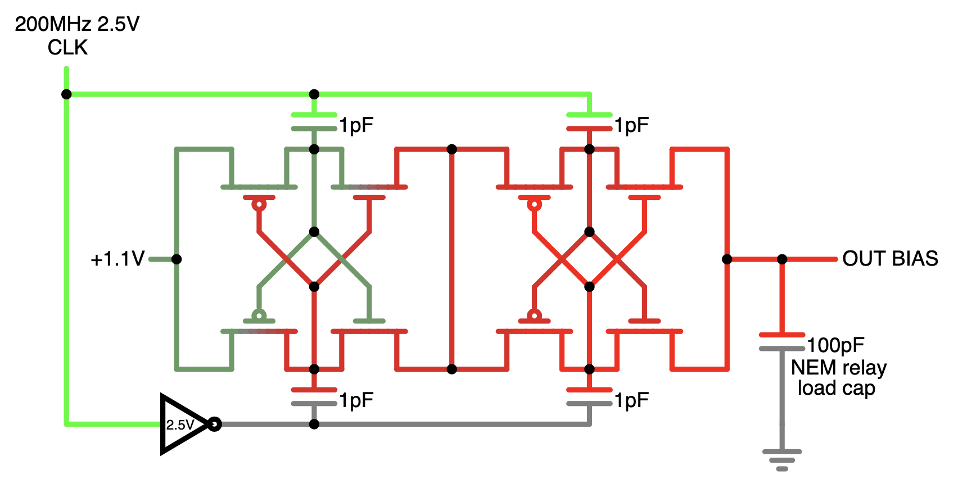
200 MHz 2.5V CLK IN
1pF
1pF
1.1V
OUT BIAS
100pF
1pF
NEM relay load cap
1pF

