Slide 1
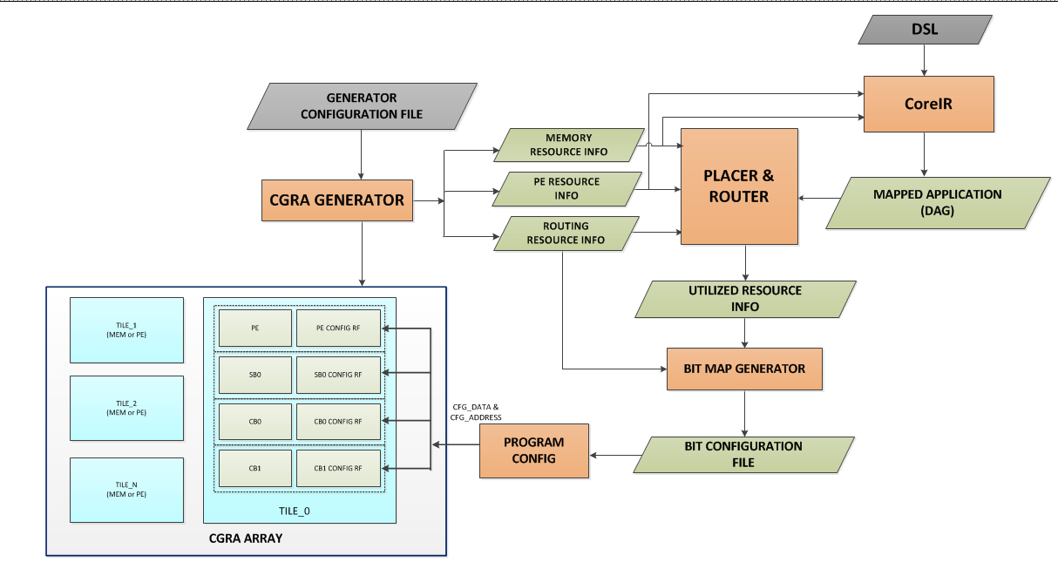
CGRA Flow and Interfaces

Slide 2
P&R interface
Artem Vasilyev

Slide 3
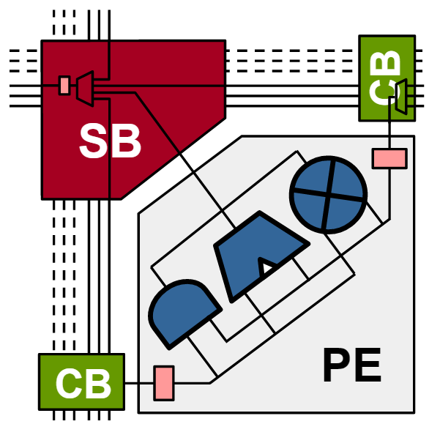
Basic PE structure
Tracks
Switch Box (SB)
Connection Box (CB)
Processing Element (PE)

Slide 4
Connectivity Matrix
Provides information to P&R
Describes all tiles
Describe all possible connection in the tile
Track -> Track (SB)
PE out -> Track (SB)
Track -> PE input (CB)

Slide 5
Assumptions
Unidirectional tracks
Repetitive pattern of tiles
Tiles connected in a mesh
Tile(x,y)_ North_out[i] -> Tile(x,y-1)_South_inp[i]
Tile(x,y)_West_out[i] -> Tile(x-1,y)_East_inp[i]
Tile(x,y)_South_out[i] -> Tile(x,y+1)_North_inp[i]
Tile(x,y)_East_out[i] -> Tile(x+1,y)_West_inp[i]
Tracks on the edge become pins

Slide 6
API format
Human readable & computer parse-able
Use tags and xml
Connectivity matrix is SPARSE and REPETATIVE
Only UNIQUE tiles
Print only possible connections
Include useful hints

Slide 7
Tag list
SB – tile connectivity
DIR – grouping of the signals
MUX – possible connection
SRC – source (input) signal
SNK – sink (output) signal

Slide 8
Sample
<sb x='0' y='0' trk_cnt='(ntracks-1)'
<dir name='N'>
<mux>
<src>'(input wirename)'</src>
<src>'(input wirename)'</src>
<src>'(input wirename)'</src>
...
<snk>'(output wirename)'</snk>
</mux>
<mux> ...
<mux> ...
<mux> ...
<dir name='S'>
...
<dir name='E'>
...
<dir name='W'>
...
</sb>

Slide 9
PE Resource Info & Bit Map Generator

Slide 10
PE Resource Information to CoreIR and P&R
# $ADD_$MULT_$LUT_$SHIFT
<TILE x='0' y='0' >
<pe>
<op> 0000_0001_00000_01 </op>
</pe>
<TILE x=‘0' y=‘1' >
<pe>
<op> 0001_0000_00100_00 </op>
</pe>
<TILE x=‘1' y='0' >
<pe>
<op> 0000_0001_10000_00 </op>
</pe>
<TILE x=‘1' y=‘1' >
<pe>
<op> 0001_0010_00000_00 </op>
</pe>
# $ADD
# $MULT
0: No Adder
1: Simple ADD
2: SAD
0: No Multiplier
1: Multiplier
2: Multiply-Add
# $LUT
# $SHIFT
# multiplier and shifter
0: No Boolean
1: Simple Gates
2-16: LUTs with that no. of inputs
0: No Shift
1: Shift
# adder and 4-input LUT
# If limited PE configurations
<TILE x='0' y='0' >
<pe>
<op> typeA </op>
</pe>
<TILE x1=‘0’ y=‘1’ >
<pe>
<op> typeB </op>
</pe>
# SAD and 4-input LUT
# multiply-add and SAD

Slide 11
Bit Map and Address Generator (1/2)
Sparse SB/CB connectivity matrix from P&R
Complete SB/CB connectivity matrix from generator
BIT MAP GENERATOR/
PROGRAM CONFIG
# $CFG_ADDR
# $CFG_DATA
<X bits>
<Y bits>
tile_addr
cfg_reg_addr
element_addr
<a bits>
<c bits>
<b bits>

Slide 12
Bit Map and Address Generator (2/2)
<sb x='0' y='0' trk_cnt='15'>
<dir name='N'>
<mux>
<snk>N_o[0]</snk>
<src>E_i[1]</src>
<src>S_i[0]</src>
<src>W_i[3]</src>
<src>PE</src>
</mux>
<mux>
<snk>N_o[1]</snk>
<src>E_i[2]</src>
<src>S_i[1]</src>
<src>W_i[2]</src>
<src>PE</src>
</mux>
<mux>
<snk>N_o[2]</snk>
<src>E_i[3]</src>
<src>S_i[2]</src>
<src>W_i[1]</src>
<src>PE</src>
</mux>
<sb x='0' y='0' trk_cnt='15'>
<dir name='N'>
<mux>
<snk>N_o[0]</snk>
<src>S_i[0]</src>
</mux>
<mux>
<snk>N_o[1]</snk>
<src>E_i[2]</src>
</mux>
<mux>
<snk>N_o[2]</snk>
<src>PE</src>
</mux>
<sb x='0' y='0' trk_cnt='15'>
<dir name='N'>
<mux>
<snk>N_o[0]</snk>
<sel>2’b01</sel>
</mux>
<mux>
<snk>N_o[1]</snk>
<sel>2’b00</sel>
</mux>
<mux>
<snk>N_o[2]</snk>
<sel>2’b11</sel>
</mux>
PARTIAL P&R CONNECTIVITY FILE
HUMAN READABLE BIT CONFIG FILE
FULL CONNECTIVITY FILE

