Slide 1
Memory Tile Design
Memory tile won’t be split into four contexts
Each memory tile now consists of one dual ported SRAM
One read port, one write port
FIFO/BRAM modes
Chain tiles for longer lines
Parallelize tiles for wider data
Current config: 16 bit 1K words i.e. 16Kb capacity

Slide 2
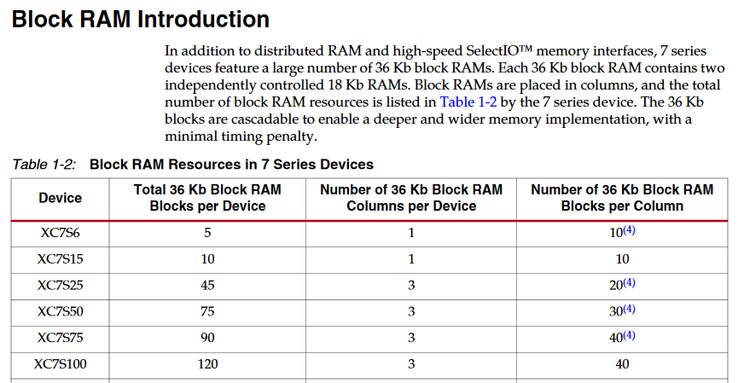
Xilinx 7-Series BRAMs

Slide 3
Column Structure PE Tile : 90u x 80u Mem Tile: 180u x 180u
PE
MEM
CB
SB
PE
SB
No vertical buses in memory column? The bottom SB becomes completely feedthrough.
Dedicated vertical link to reduce mem2mem delay during chaining
Memory output injected to the top SB only

Slide 4
Chaining
MEM
CB
MEM

Slide 5
Memory Tile Interface
DataIn 16
DataOut 16
Addr 16
WriteEn 1
Empty 1
ReadEn 1
Full 1

Slide 6
XML
<tile tile_addr='0' row='0' col='0' tracks=‘BUS1:5 BUS16:5’ type=‘mem’>
<mem feature_address=‘0‘>
<mode bitl=‘0’ bith=‘1’>00</mode>
<chain bitl=‘2’>0</chain>
</mem>
//row1
<cb feature_address='2' bus='BUS16'>…
<cb feature_address=‘3' bus='BUS16'>…
<cb feature_address=‘3’ bus='BUS1'>…
<cb feature_address=‘4' bus='BUS1'>…
<sb feature_address=‘5' bus='BUS16'>
<sb feature_address=‘6' bus='BUS1'>
//row2
<sb feature_address=‘7' bus='BUS16'>
<sb feature_address=‘8' bus='BUS1'>
//row<n>
<sb feature_address=‘x' bus='BUS16'>
<sb feature_address=‘y' bus='BUS1'>
</tile>

Slide 7
IO Groups
IO Group0
E
E
E
16
E
E
E
E
E
<tile tile_addr='0' row='0' col=‘3' tracks=‘BUS1:5 BUS16:5’ type=‘io’ width=‘16’>
<group>0</group>
<contains high=‘15’ low=‘0’></contains>
<sb …> </sb> //All tracks feedthrough except IO for 16bit bus
<sb …> </sb> //All tracks feedthrough for 1 bit bus
//All horizontal tracks feedthrough for above sbs
</tile>
<tile tile_addr='0' row='0' col=‘3' tracks=‘BUS1:5 BUS16:5’ type=‘io’ width=‘1’>
<group>0</group>
<contains high=‘3’ low=‘3’></contains>
<sb …> </sb> //All tracks feedthrough for 16bit bus
<sb …> </sb> //All tracks feedthrough except IO for 1 bit bus
//All horizontal tracks feedthrough for above sbs
</tile>
1
E
E
E
E
E
16
E
E
E
E
E
1
E
E
IO Group1

Slide 8
Debug Capabilities
Set explicit breakpoints in Halide code
Support data dependent breakpoint triggers
Download contents of line buffers / BRAMs
Observe all halide variables without reconfiguring the entire CGRA and/or rerunning the application

Slide 9
Debug Challenges
What kind of debugging interface should be provided?
Support Halide primitives
Support GDB
At what abstraction level should the user debug Halide code?
At the Halide level or the generated code level
How to align the halide code with the generated code

Slide 10
Halide Debugging Primitives
trace_stores() prints out the result of a function call each time it is evaluated
print(<expr>) prints out the value of an expression within a function when evaluated
print_when(<expr>,<expr>) prints out the value of an expression depending on the other expression
All these need the user to pre-specify the functions and variables to observe

