Slide 1
RRAM Array Testing Crash Course: TSMC 64K Cell Array (256x256)
Akash Levy
Stanford University
2/19/21
Notes:
This presentation will attempt to kill two birds with one stone
It will be structured as a 15 min crash course on how to test an RRAM array, with the TSMC RRAM array as a case study
Assumptions: direct access to the memory array (with address decoders)

Slide 2
READ
Step One

Slide 3
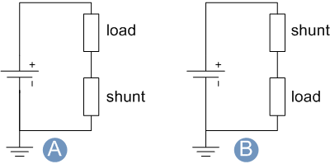
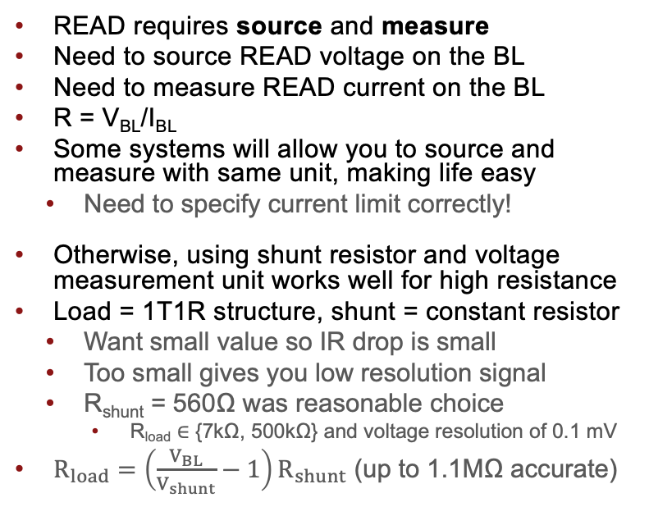
READ Operation
READ requires source and measure
Need to source READ voltage on the BL
Need to measure READ current on the BL
R = V_{BL}/I_{BL}
Some systems will allow you to source and measure with same unit, making life easy
Need to specify current limit correctly!
Otherwise, using shunt resistor and voltage measurement unit works well for high resistance
Load = 1T1R structure, shunt = constant resistor
Want small value so IR drop is small
Too small gives you low resolution signal
R_{shunt} = 560Ω was reasonable choice
R_{load} ∈ {7kΩ, 500kΩ} and voltage resolution of 0.1 mV
$R_{load}=\left(\frac{V_{BL}}{V_{shunt}}−1\right)R_{shunt}$ (up to 1.1MΩ accurate)
Shunt resistor setup
Measure voltage here
VBL
V_{shunt}
First test with constant resistor as load!

Slide 4
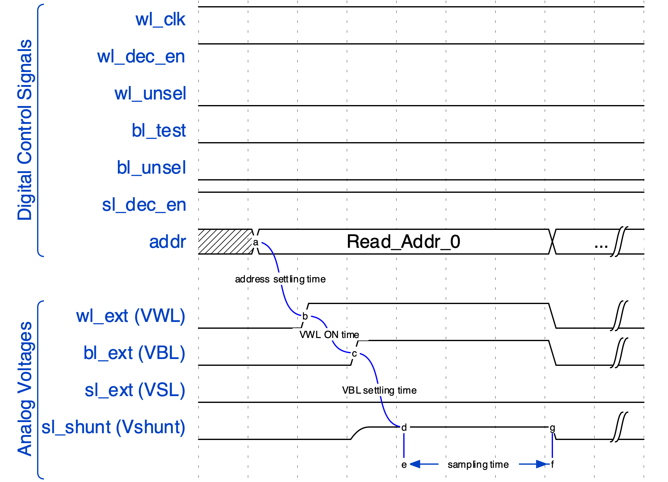
READ Waveform: Always Verify with Scope
Set VSL=0V
Set VWL=2.5V
Higher VWL means less transistor resistance included in measurement
Set VBL=200mV
Yields good signal with low read disturb
Find conservative settling times
Address settling time (500us)
VWL ON time (SW timed)
VBL settling time (2ms)
Sampling (100Sa @ 1 MSa/s)
NOTE: there are other valid waveforms that work
https://tinyurl.com/rram-read-waveform

Slide 5
Single-Bit Operation Conditions
Operation | READ | FORM | SET | RESET
BL/SL Start (V) | 0.2 (BL)
BL/SL Stop (V) | N/A
BL/SL Step (V) | N/A
WL Start (V) | 2.5
WL Stop (V) | N/A
WL Step (V) | N/A
WL Pulse Width (us) | 2000
Stop Condition | N/A
Loop Order | N/A

Slide 6
FORM
Step Two

Slide 7
FORM Waveform: Always Verify with Scope
Before FORMing, it is not possible to test your READ waveform
The first step is to just apply a long SET pulse
Example: VBL=3V, VWL=4V, VSL=0V
Then READ, and check that resistance dropped significantly
If it does, this is the first sign that your device is alive! ☺
Now try to do “dynamic FORM”:
FORM_THRESH, FORM_PW = 50E3, 1000 # 50kOhm FORMing threshold, 1ms
for VWL in range(0, 2, step=0.05): # VWL outer loop
for VBL in range(2, 4, step=1): # VBL inner loop, optional (can fix VBL val)
PULSE(VBL, VWL, VSL=0, FORM_PW) # FORMing pulse
if READ() <= FORM_THRESH:
print(‘FORM succeeded’)
break
else: # if loop completes without break
print(‘FORM failed’)

Slide 8
Full-Array FORMing Yield
Small number of FORM failures due to 1.5V VWL limit & 200us PW
Failures happen further down the BL/WL, probably due to IR drop
Important not to over-SET
Do not increase VWL limit!
Instead: increase PW or do rerun
Rerunning FORM for failed cells successfully FORMed 38/39
Rerunning a second time on the final failed cell FORMed it
Result: 100% FORM yield!
Afterwards: perhaps adjust PW
Initial:
39 Failures…

Slide 9
Full-Array FORMing Statistics
Certain BLs seem to have higher VWL (every 8 or so) and hence lower resistance
Not sure why this might be the case… any ideas?

Slide 10
Full-Array FORMing Statistics

Slide 11
Operation Conditions
Operation | READ | FORM
BL/SL Start (V) | 0.2 (BL) | 2
BL/SL Stop (V) | N/A | 4
BL/SL Step (V) | N/A | 0.5
WL Start (V) | 2.5 | 0.9
WL Stop (V) | N/A | 1.5
WL Step (V) | N/A | 0.05
WL Pulse Width (us) | 2000 | 1000
Stop Condition | N/A | < 50kΩ
Loop Order | N/A | WL outer/ BL inner

Slide 12
Single-Bit Program: SET/RESET
Step Three

Slide 13
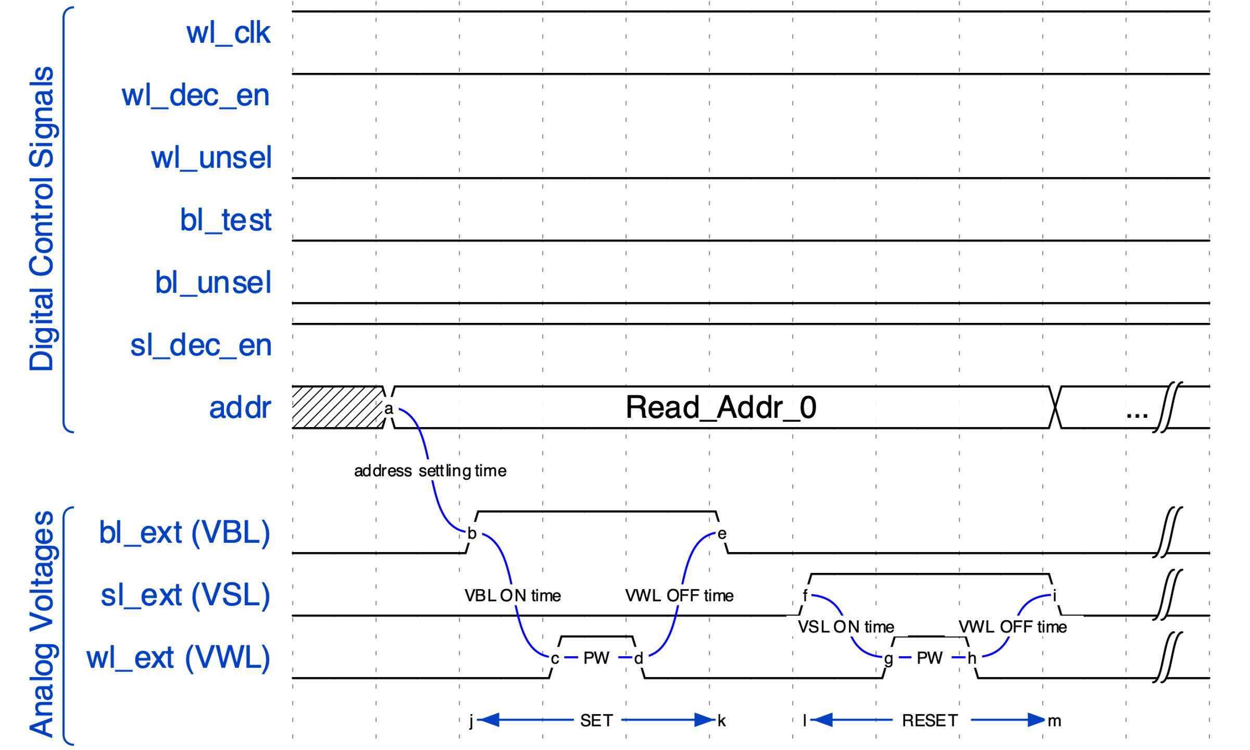
SET/RESET Waveform: Always Verify with Scope
Reuse dynamic FORM template
Pulse VWL
Find good timing
Address settling time (500us)
VBL/VSL ON time (SW timed)
PW (10us)
VWL OFF time (2ms)
NOTE: there are other valid waveforms that work
https://tinyurl.com/rram-set-reset-waveform

Slide 14
Operation conditions
Operation | READ | FORM | SET | RESET
BL/SL Start (V) | 0.2 (BL) | 2 | 2 | 3
BL/SL Stop (V) | N/A | 4 | 2 | 3
BL/SL Step (V) | N/A | 0.5 | N/A | N/A
WL Start (V) | 2.5 | 0.9 | 0.9 | 0.9
WL Stop (V) | N/A | 1.5 | 1.5 | 1.5
WL Step (V) | N/A | 0.05 | 0.1 | 0.1
WL Pulse Width (us) | 2000 | 2000 | 10 | 10
Stop Condition | N/A | < 50kΩ | Below target (9-11kΩ) | Above target (70-90kΩ)
Loop Order | N/A | WL outer/ BL inner | WL only | WL only
Total FORM Time:
3 cells/s
=
7 hrs/array
Total Prog Time:
4 cells/s
=
6 hrs/array

Slide 15
def dynamic_set():
SET_THRESH, SET_PW = 11E3, 10
for VWL in range(0, 2, step=0.05):
for VBL in range(2, 4, step=1):
PULSE(VBL, VWL, VSL=0, SET_PW)
if READ() <= SET_THRESH:
print(‘SET succeeded’)
break
else: print(‘SET failed’)

Slide 16
Checkerboard: Random Access Pattern Check
Error with single cell FORMed at VWL=1.7V
Cell cannot be fully RESET, only up to 20kOhm

Slide 17
“Anti-Checkerboard”: Random Access Pattern Check
3 errors when trying to flip
Cells cannot be fully RESET on first pulse, only up to 20-40 kOhm
Happens if cells are over-FORMed: shows importance of proper FORMing

Slide 18
Full-Array FORMing Yield
Small number of FORM failures due to 1.5V VWL limit
Failures happen further down the BL/WL, probably due to IR drop
Important not to over-SET
Cannot increase limit!
Rerunning FORM for failed cells successfully FORMed 38/39
Rerunning a second time on the final failed cell FORMed it
Result: 100% FORM yield!
Afterwards: realize longer PW will always give 100% yield
Initial:
39 Failures…

Slide 19
Full-Array FORMing Statistics
Certain BLs seem to have higher VWL and hence lower resistance

Slide 20
Full-Array FORMing Statistics

Slide 21
Status
Done with FORM, SET, RESET, Target Resistance
Done with checkerboard tests
Done with bitstream programming
Speed + yield optimizations
Done with full array FORM
Done with full array yield analysis
Done with full array programming of one array (first iteration)
In progress:
Tail distribution reprogramming
Process more arrays with different LRS/HRS
Finalize figures

Slide 22
Operation conditions
Switched to analog driver
Operation | READ | FORM | SET | RESET
BL/SL Start (V) | 0.2 (BL) | 2 | 2 | 3
BL/SL Stop (V) | N/A | 4 | 2 | 3
BL/SL Step (V) | N/A | 0.5 | N/A | N/A
WL Start (V) | 2.5 | 0.9 | 0.9 | 0.9
WL Stop (V) | N/A | 1.5 | 1.5 | 1.5
WL Step (V) | N/A | 0.05 | 0.1 | 0.1
WL Pulse Width (us) | 2000 | 2000 | 10 | 10
Stop Condition | N/A | < 50kΩ | Below target (9-11kΩ) | Above target (70-90kΩ)
Loop Order | N/A | WL outer/ BL inner | WL only | WL only
Total FORM Time:
3 cells/s
=
7 hrs/array
Total Prog Time:
4 cells/s
=
6 hrs/array

Slide 23
Multi-Bit Programming
Step Four

