Slide 1
ENGR 240: Lab 1 PCB Accelerometer Design
Akash Levy, Dylan Woodhead

Slide 2

Analysis of Designs
Using cantilever formulas discussed in class and FEM

Slide 3
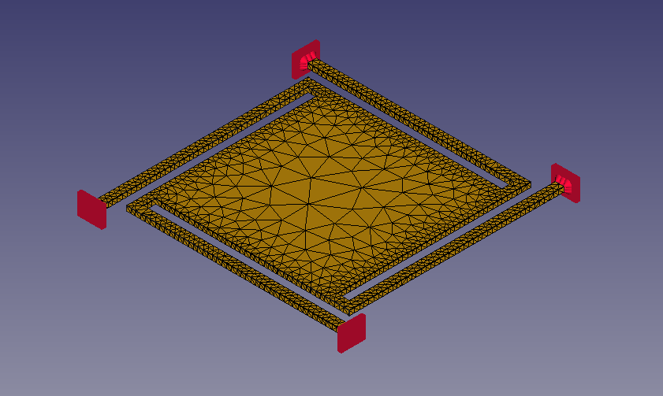

Main Design: Design 1
Parameters:
$L_{c}=26 mm$, $W_{c}=1 mm$
$A={(22 mm)}^{2}$, $H=0.5334 mm$
$ρ_{PCB}=2078 kg/m^{3}$, $E=22.5 GPa$
Hand approximations:
Plate mass
$m=ρ_{PCB}AH=0.53647 g$
Overall spring constant
Model as 4 parallel cantilevers
$k=4×\frac{EW_{c}H^{3}}{4{L_{c}}^{3}}=194.3 N/m$
Resonance frequency (unloaded)
Model springs as having negligible mass
$f_{0}=\frac{ω_{0}}{2π}=\frac{\sqrt{k/m}}{2π}=95.78 Hz$
Resonance frequency (loaded)
$f_{0}=\frac{ω_{0}}{2π}=\frac{\sqrt{k/(m+\left(2.187 g\right)) }}{2π}=42.51 Hz$
FEA results:
Resonance frequency (unloaded)
$f_{0}=\frac{ω_{0}}{2π}=169.76 Hz$

Slide 4
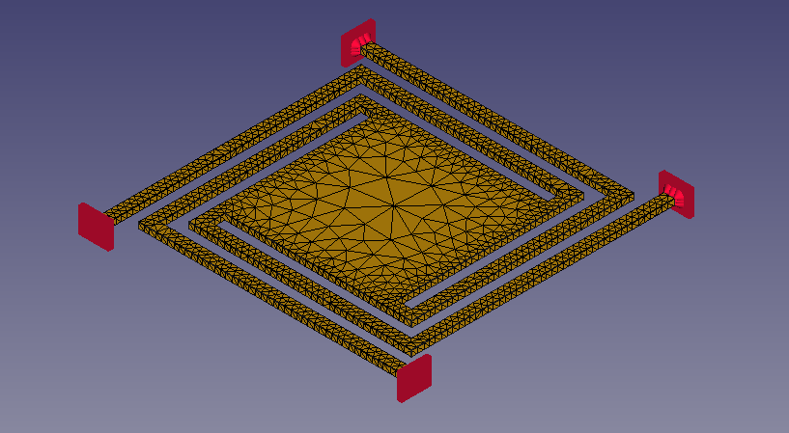

Design 2
Parameters:
$L_{c}=26 mm+22 mm=48 mm$, $W_{c}=1 mm$
$A={(17 mm)}^{2}$, $H=0.5334 mm$
$ρ_{PCB}=2078 kg/m^{3}$, $E=22.5 GPa$
Hand approximations:
Plate mass
$m=ρ_{PCB}AH=0.32033 g$
Overall spring constant
Model as 4 parallel long cantilevers
$k=4×\frac{EW_{c}H^{3}}{4{L_{c}}^{3}}=108.5 N/m$
Resonance frequency (unloaded)
Model springs as having negligible mass
$f_{0}=\frac{ω_{0}}{2π}=\frac{\sqrt{k/m}}{2π}=92.627 Hz$
Resonance frequency (loaded)
$f_{0}=\frac{ω_{0}}{2π}=\frac{\sqrt{k/(m+\left(2.187 g\right)) }}{2π}=33.108 Hz$
FEA results:
Resonance frequency (unloaded)
$f_{0}=\frac{ω_{0}}{2π}=114.238 Hz$
Might be a bad design

Slide 5
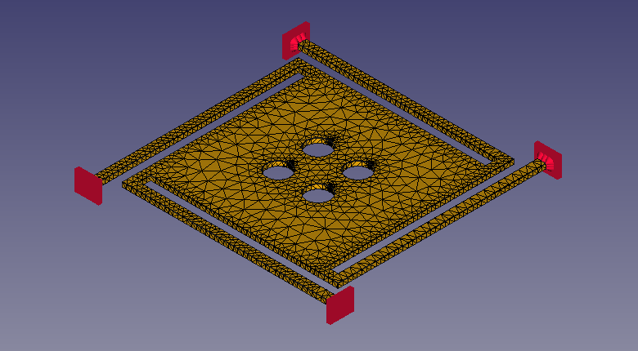

Design 3
Parameters:
$L_{c}=26 mm$, $W_{c}=1 mm$
$A={(22 mm)}^{2}$, $H=0.5334 mm$ , $R_{hole}=1.5 mm$
$ρ_{PCB}=2078 kg/m^{3}$, $E=22.5 GPa$
Hand approximations:
Plate mass (minus holes!)
$m=ρ_{PCB}H\left(A−4π{R_{hole}}^{2}\right)=0.5051 g$
Overall spring constant
Model as 4 parallel cantilevers
$k=4×\frac{EW_{c}H^{3}}{4{L_{c}}^{3}}=194.3 N/m$
Resonance frequency (unloaded)
Model springs as having negligible mass
$f_{0}=\frac{ω_{0}}{2π}=\frac{\sqrt{k/m}}{2π}=98.712 Hz$
Resonance frequency (loaded)
$f_{0}=\frac{ω_{0}}{2π}=\frac{\sqrt{k/(m+\left(2.187 g\right)) }}{2π}=42.757 Hz$
FEA results:
Resonance frequency (unloaded)
$f_{0}=\frac{ω_{0}}{2π}=174.49 Hz$

Slide 6
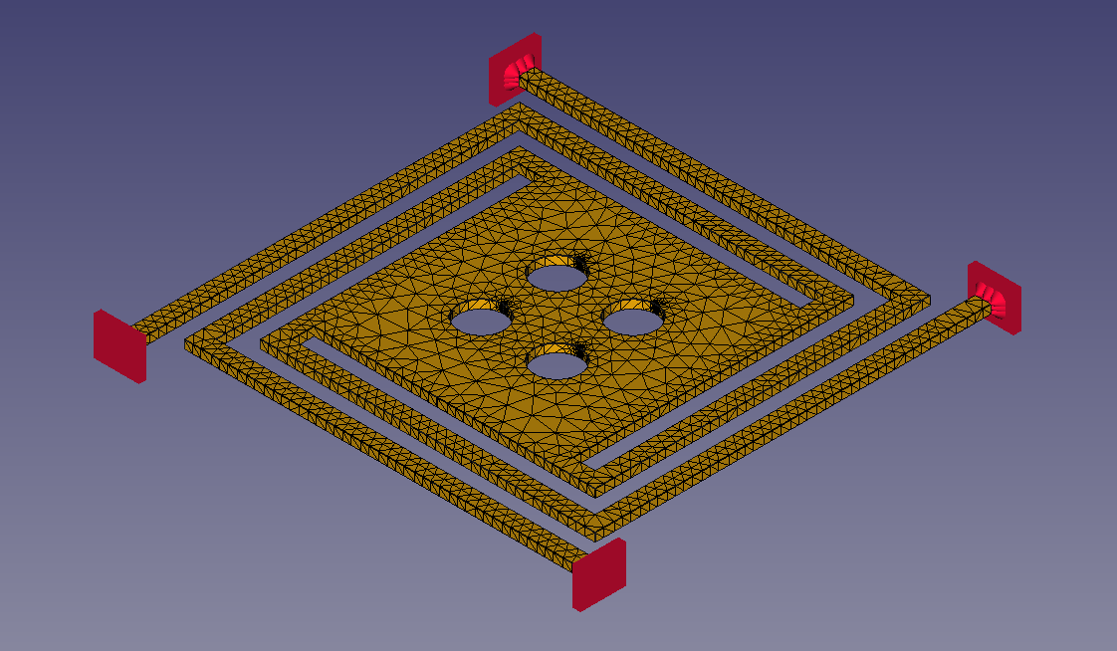

Design 4
Parameters:
$L_{c}=26 mm+22 mm=48 mm$, $W_{c}=1 mm$
$A={(17 mm)}^{2}$, $H=0.5334 mm$, $R_{hole}=1.5 mm$
$ρ_{PCB}=2078 kg/m^{3}$, $E=22.5 GPa$
Hand approximations:
Plate mass (minus holes!)
$m=ρ_{PCB}H\left(A−4π{R_{hole}}^{2}\right)=0.289 g$
Overall spring constant
Model as 4 parallel long cantilevers
$k=4×\frac{EW_{c}H^{3}}{4{L_{c}}^{3}}=108.5 N/m$
Resonance frequency (unloaded)
Model springs as having negligible mass
$f_{0}=\frac{ω_{0}}{2π}=\frac{\sqrt{k/m}}{2π}=97.52 Hz$
Resonance frequency (loaded)
$f_{0}=\frac{ω_{0}}{2π}=\frac{\sqrt{k/(m+\left(2.187 g\right)) }}{2π}=33.317 Hz$
FEA results:
Resonance frequency (unloaded)
$f_{0}=\frac{ω_{0}}{2π}=118.75 Hz$
Might be a bad design

Slide 7
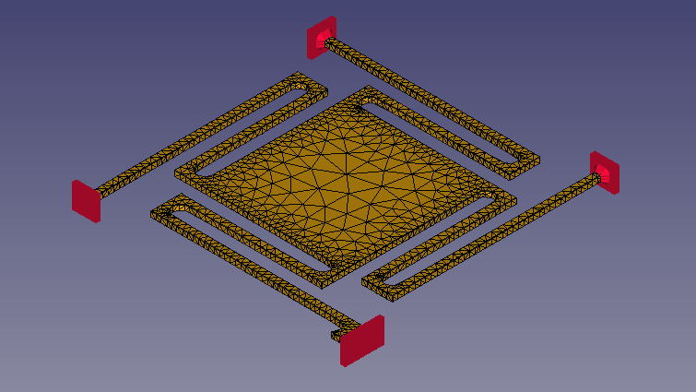

Design 5
No hand calculations done…
FEA results (unloaded):
Resonance frequency
$f_{0}=\frac{ω_{0}}{2π}=200.64 Hz$

Slide 8
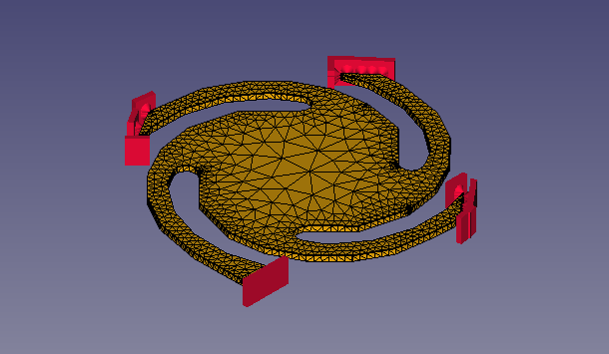

Design 6
No hand calculations done…
FEA results (unloaded):
Resonance frequency
$f_{0}=\frac{ω_{0}}{2π}=596.79 Hz$

Slide 9
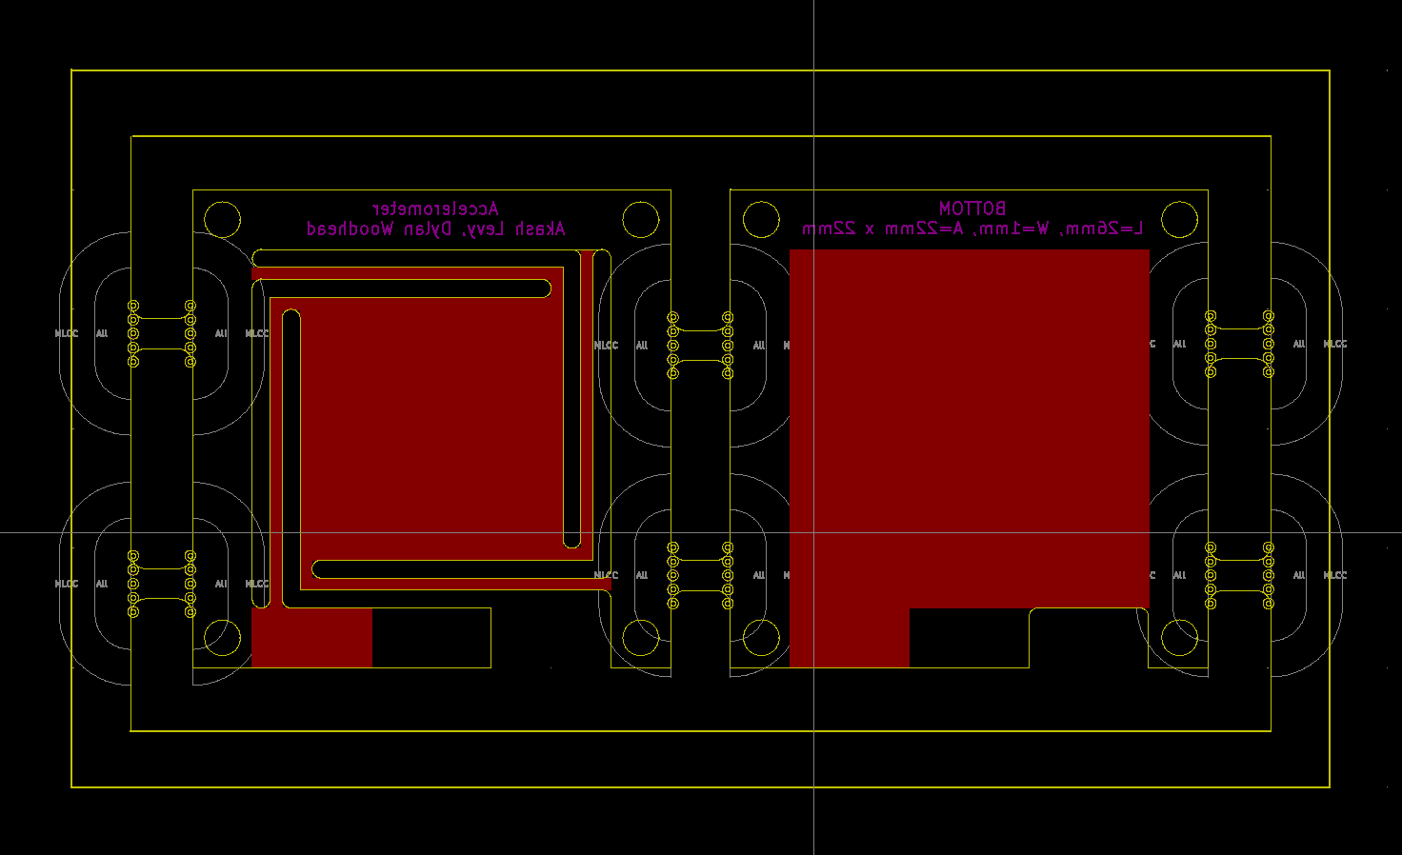
Design 1 Layout with Panelization

